Slide 1
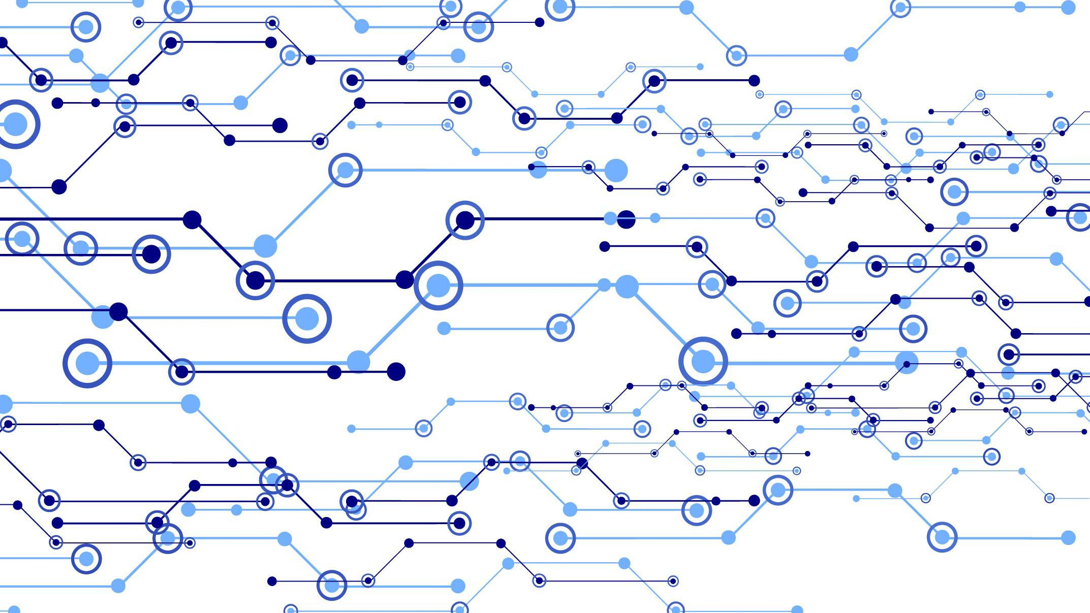
Graph Neural Networks
JONATHAN SHOBROOK, PHILIP DOHM, ROGER QIU

Slide 2
What is a Neural Network?
Consists of neurons (nodes) and synapses (edges); nodes are organized into layers, each node has an activation function, and each edge has a weight
Input layer takes in data as a vector and propagates it forward to the first hidden layer for processing; this layer passes the processed data on to the second hidden layer, and so on, until the output layer is reached
In supervised learning, the neural network is “trained” to fit a dataset of known inputs and outputs
Given an input, the network predicts the output, and error (loss) is then calculated between the predicted output and true output
Synapse weights are updated to minimize this loss, and then the process is repeated with the next input

Slide 3
What is a Neural Network?
Consists of neurons (nodes) and synapses (edges)
Nodes are organized into layers and each node has an activation function
Each edge has a weight which the network attempts to learn
Input layer takes in data as a vector and passes it through hidden layers until the output layer is reached
In supervised learning, the neural network is “trained” to fit a dataset
The network “learns” by minimizing a loss function based on the error of its predictions

Slide 4
Multi-Layer Perceptron

Slide 5
Convolutional Neural Networks (CNNs)
Deep neural network architecture typically used for image processing
The first hidden layers learn local patterns in the input image, like edges or corners
Deeper layers learn more complex patterns, such as objects or facial features
The output layer can do things such as classify the input image
CNNs differ from MLPs mainly in that they have convolutional layers

Slide 6
Convolutional Layer

Slide 7
Where do CNNs fail?
CNNs fail on graphs!
You can’t define standard convolution operators on graphs
Isomorphic graphs can have completely different-looking adjacency matrices
Minor adjacency matrix differences can change the entire structure of the graph
CNNs assume a natural order, which graphs do not have
A lot of real-world phenomena can be modeled as graphs
Molecules
Social networks
Causal networks
Word dependencies in natural language

Slide 8
Graph Neural Networks (GNNs)
Family of neural networks which generalize CNNs to graph inputs
Takes a graph where each node (and/or edge) has an associated feature vector
Outputs a predicted label (typically a vector) for each node (and/or edge)
Layers learn a vector representation for each node by aggregating information about the node’s neighborhood
This aggregation process is essentially a graph convolution
Also an iterative process
Accomplished by feeding node and neighbor information into a neural network

Slide 9
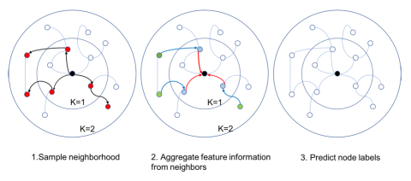
Graph Convolutions

Slide 10
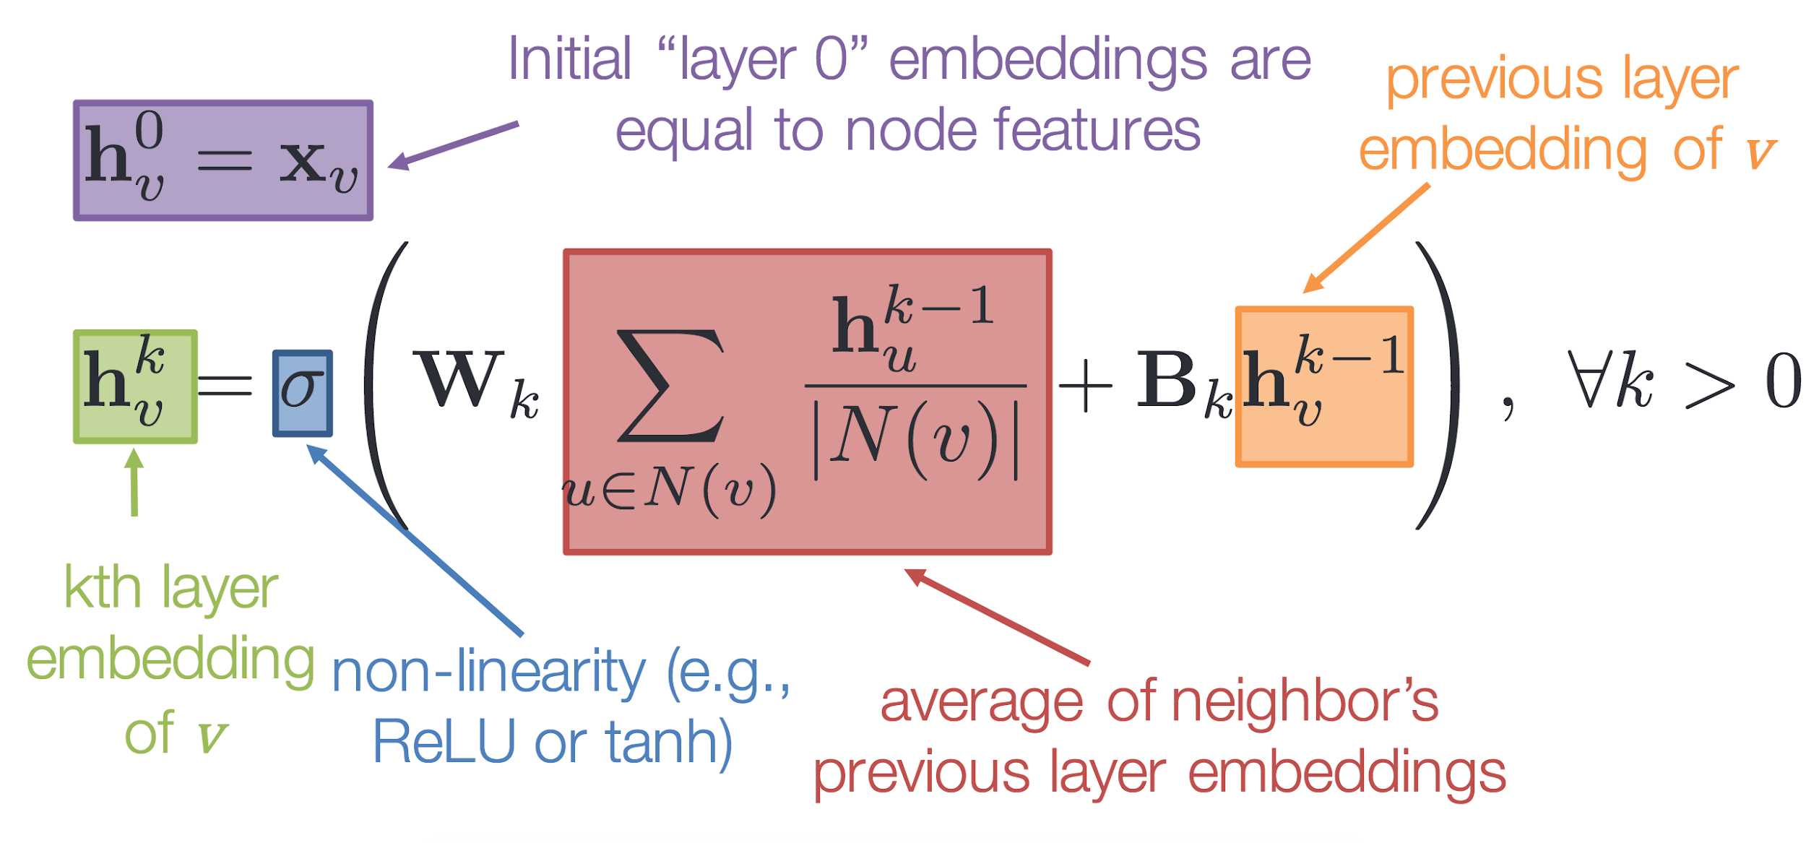
Graph Convolutional Operator (Example)

Slide 11
Case Study: Traveling Salesman Problem
Problem: Given a complete, weighted graph, find a Hamiltonian circuit with the minimum total weight
NP-hard: hard to find solutions for and hard to verify solutions
Our Solution: Train a GNN to predict the edges are in the TSP solution
Input graphs are complete graphs with 5-8 nodes and random weights
Output graphs have the same structure as the input but with the estimated TSP solution labeled
Error calculated by comparing GNN output to an algorithmic TSP solution

Slide 12
Our Results
How good is our model?
~90% accuracy of edge labels prediction
~25% accuracy of graphs are perfectly labelled
Among those graphs that are not perfectly labelled, the estimated TSP solution length they give is very close to the ground truth (relative error ~7%)
What do these numbers mean?
Our model is better estimating minimum cost than making Hamiltonian circuits

Slide 13
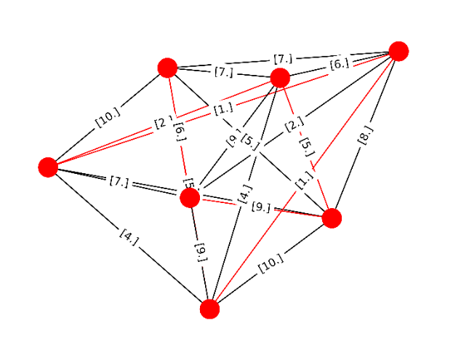
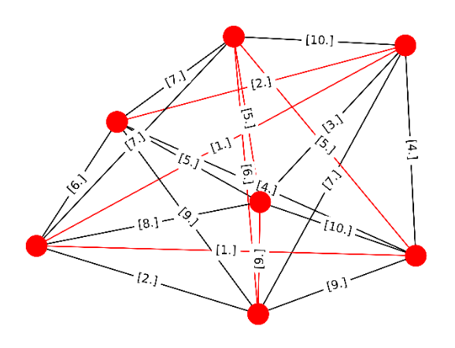
Worst Results
Our model tends to perform worse on graphs with more vertices and edges
For example, see the true solution (left) vs. the model output (right)

Slide 14
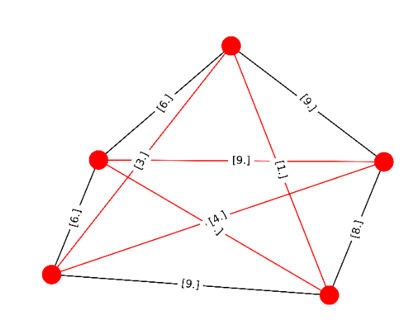
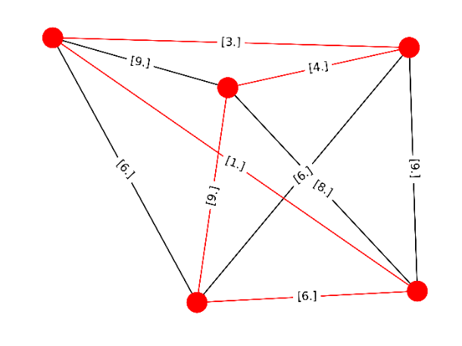
Best Results
Our model tends to perform better on graphs with less vertices and edges
For example, see the true solution (left) vs. the model output (right)--they’re the same!

Slide 15
Thanks!
Any questions?

