Slide 1
Interfacing Analog to Digital Data
Converters
The analog to digital converters is treaded as an input device by the microprocessor, that sends an initialising signal to the ADC to start the analogy to digital data conversation process. The start of conversation signal is a pulse of a specific duration.

Slide 2
The process of analog to digital conversion is a slow
process, and the microprocessor has to wait for the digital data till the conversion is over. After the conversion is over, the ADC sends end of conversion EOC signal to inform the microprocessor that the conversion is over and the result is ready at the output buffer of the ADC. These tasks of issuing an SOC pulse to ADC, reading EOC signal from the ADC and reading the digital output of the ADC are carried out by the CPU using 8255 I/O ports

Slide 3
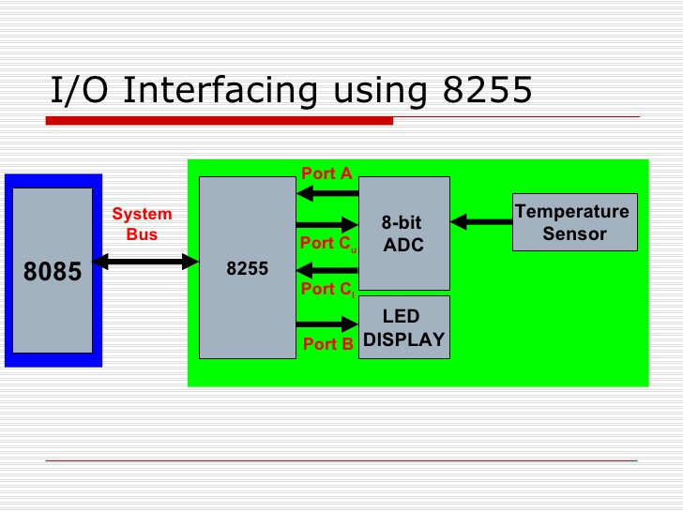

Slide 4
The time taken by the ADC from the active edge of SOC
pulse till the active edge of EOC signal is called as the
conversion delay of the ADC.
• It may range any where from a few microseconds in case
of fast ADC to even a few hundred milliseconds in case of
slow ADCs.
• The available ADC in the market use different conversion
techniques for conversion of analog signal to digitals.
Successive approximation techniques and dual slope
integration techniques are the most popular techniques
used in the integrated ADC chip.

Slide 5
NOTE :
Analog input voltage must be constant at the input of the
ADC right from the start of conversion till the end of the
conversion to get correct results. This may be ensured by a
sample and hold circuit which samples the analog signal
and holds it constant for a specific time duration. The
microprocessor may issue a hold signal to the sample and
hold circuit.
• If the applied input changes before the complete
conversion process is over, the digital equivalent of the
analog input calculated by the ADC may not be correct.

Slide 6
General algorithm for ADC interfacing contains the following steps:
1.Ensure the stability of analog input, applied to the ADC.
2. Issue start of conversion pulse to ADC
3. Read end of conversion signal to mark the end of
conversion processes.
4. Read digital data output of the ADC as equivalent digital
output.

Slide 7
ADC 0808/0809 :
• The analog to digital converter chips 0808 and 0809 are 8- bit CMOS, successive approximation converters. This technique is one of the fast techniques for analog to digital conversion. The conversion delay is 100μs at a clock frequency of 640 KHz, which is quite low as compared to other converters.
These converters internally have a 3:8 analog multiplexer so that at a time eight different analog conversion by using address lines -

Slide 8
-ADD A, ADD B, ADD C. Using these address inputs,
multichannel data acquisition system can be designed using a single ADC. The CPU may drive these lines using output port lines in case of multichannel applications. In case of single input applications, these may be hardwired to select the proper input.
• There are unipolar analog to digital converters, i.e. they are able to convert only positive analog input voltage to their digital equivalent. These chips do no contain any internal sample and hold circuit

Slide 9
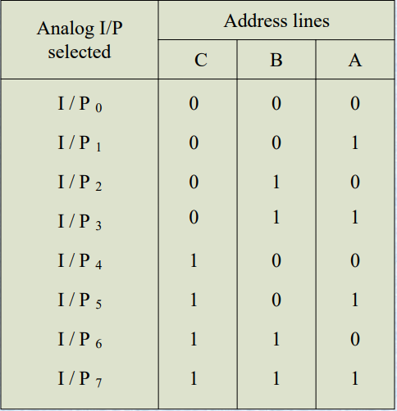

Slide 10
Pins description:
• Vcc Supply pins +5V
• GND GND
• Vref + Reference voltage positive+5 Volts maximum.
• Vref - Reference voltage negative 0Volts minimum
I/P0–I/P7 Analog inputs
• ADD A,B,C Address lines for selecting analog inputs.
• O7 – O0 Digital 8-bit output with O7 MSB and O0 LSB
• SOC Start of conversion signal pin
• EOC End of conversion signal pin
• OE Output latch enable pin, if high enables output
• CLK Clock input for ADC

Slide 11
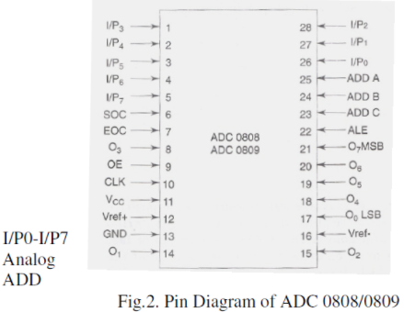

Slide 12
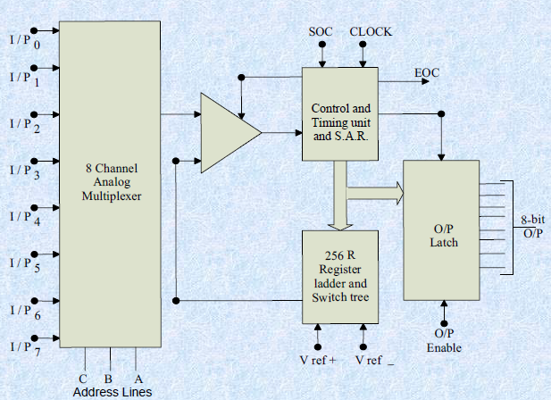
Block Diagram of ADC 0808 / 0809

Slide 13
Port A acts as a 8-bit input data port to receive the digital data output from the ADC. The 8255 control word is written as follows:
Control Word:
D7 D6 D5 D4 D3 D2 D1 D0
1 0 0 1 1 0 0 0

Slide 14
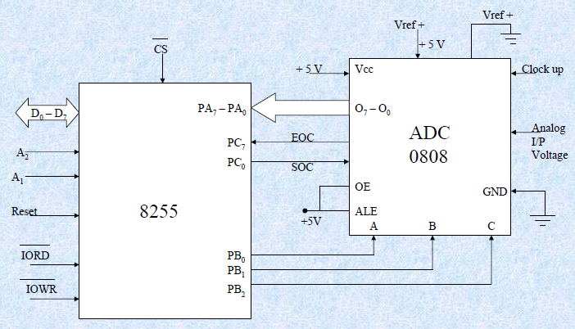
Interfacing 0808 with 8086

