Slide 1

ROYAL
(POS)

Slide 2

Problem domain
`
Wasting Transactions
Tracking inventory
Clear Reports

Slide 3

Solution
Inventory Management
Users Management
Reporting and Analytics

Slide 4

Challenges
`
Testing and validation
Compatibility
Time management

Slide 5







Tools

Slide 6









we used
Backend
Frontend

Slide 7
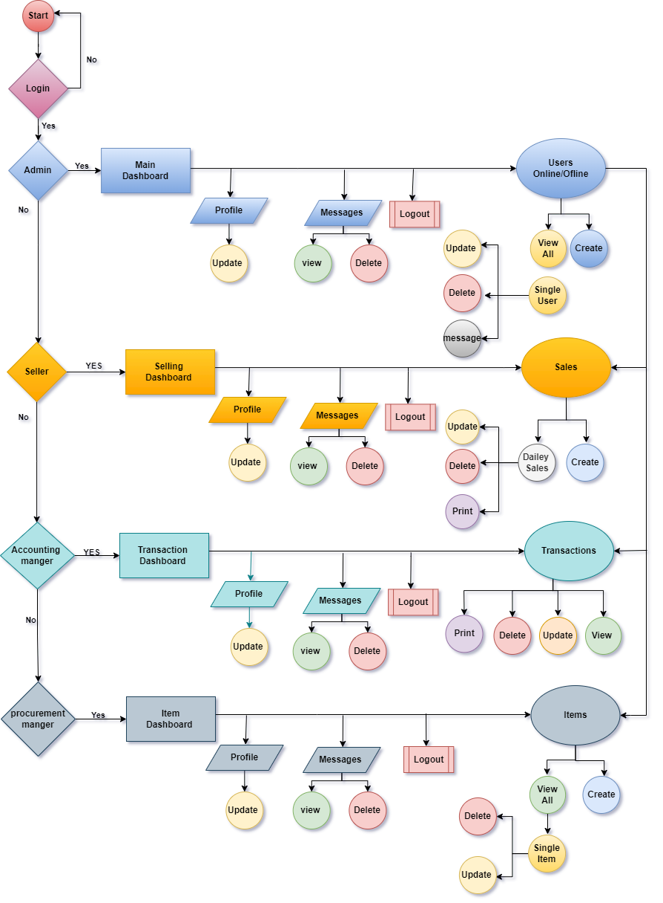

Diagram

Slide 8

Stretch goals
Categories
Payment and billing
Improved system experience

Slide 9

Thank You
Feel free to ask

