Slide 1
Discover Toledo
The City of Three Cultures

Slide 2
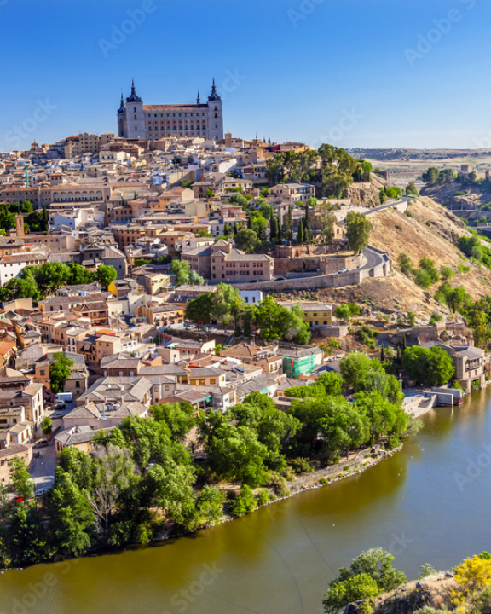
A Fortress in the Rock
Located in a 100-meter deep gorge carved by the Tagus river.
Built entirely on steep, rocky terrain, in a perfect location for the defense of the city.
It was the ancient Visigothic capital holding power before Madrid.
High-Speed Access just 33 minutes from Madrid via AVE train.

Slide 3
The Medieval Maze
Surface Level
Subterranean
It’s Labyrinthine streets and layout have remained unchanged over the years, designed to confuse invaders.
It has Roman baths formed by ancient ruins preserved right under modern shops.
It has patios concealed behind heavy wooden doors.
It has an underground water storage system that is still intact.
The covered walkways that connect buildings above the streets.
It has secret tunnels that served as escape routes used during sieges.

Slide 4


Three Cultures, One City
Christian
Muslim
Jewish
Toledo Cathedral is the masterpiece of late Gothic architecture from the 13th century, built on the site of a former mosque.
The city was the site of important ecclesiastical councils that shaped the law and religious life of the peninsula.
The Muslim presence in Toledo lasted
for almost four centuries (from 711 to 1085) and left a deep mark on its architecture, science, culture and urban layout.
Year 999 architecture survive completely intact through centuries.
The Jewish community in Toledo was one of the most important, prosperous, and culturally influential in the Iberian Peninsula.
12th-century Moorish-style architecture built for the Jewish community.
For centuries, the Christian, Jewish, and Muslim communities coexisted in relative harmony and collaboration.

Slide 5
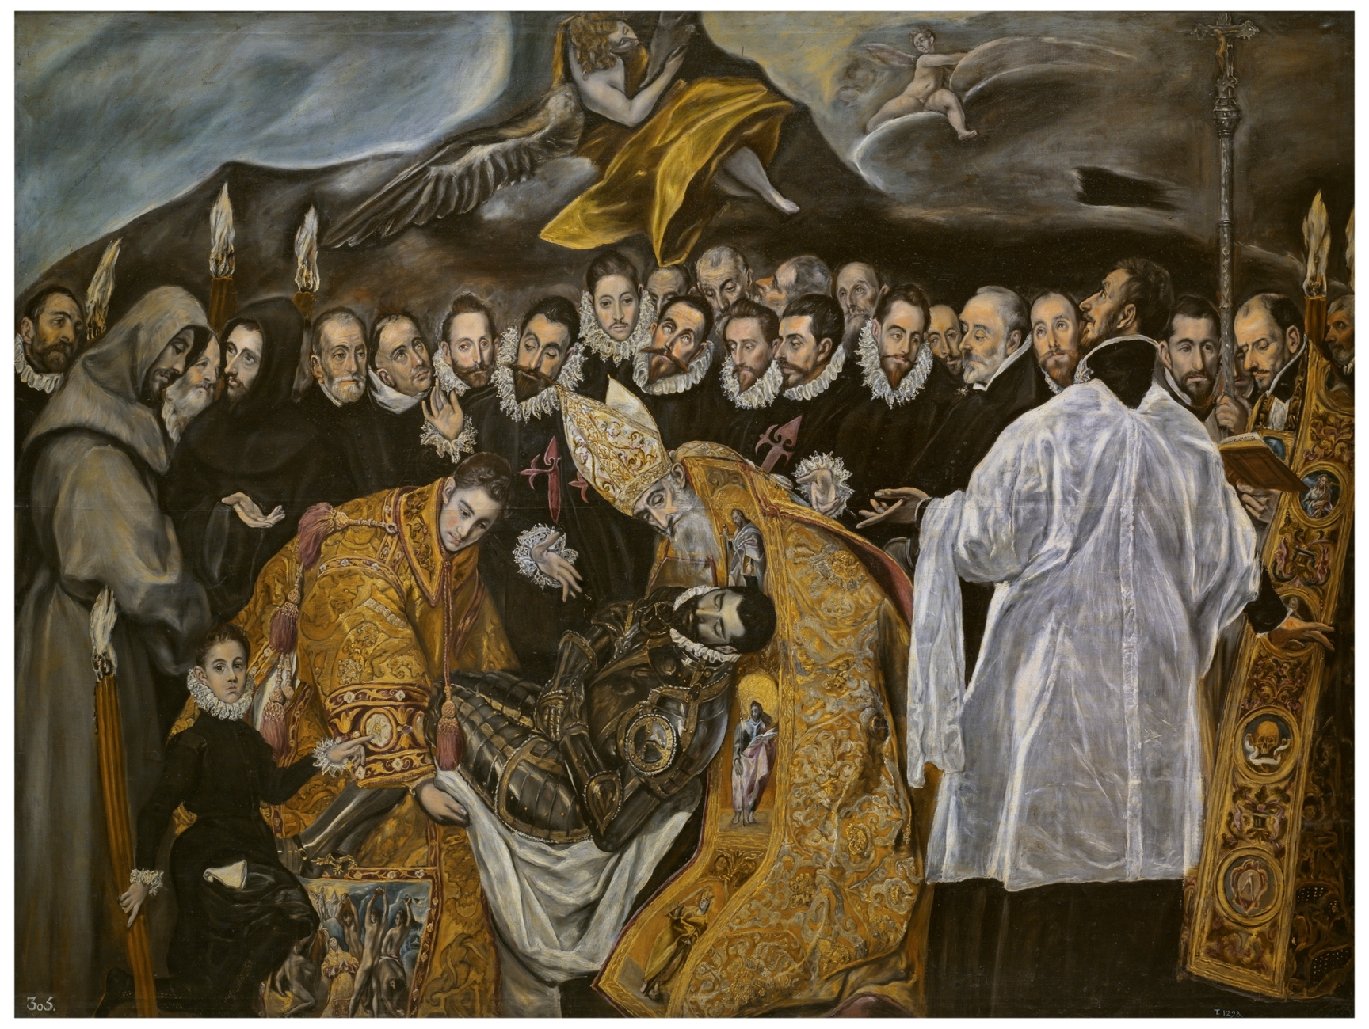
The Canvas of El Greco
The Greek painter Doménikos Theotokópoulos was an adopted son of Toledo and immortalized the city.
He had a Mannerist style famous for his elongated figures and his dramatic and unnatural colors.
His masterpiece "The Burial of the Count of Orgaz" is inside the church of Santo Tomé.
There is a House Museum that recreates a 16th-century house and exhibits his later works.
"I paint because the spirits whisper madly inside my head."

Slide 6




Unmissable Experiences
🌙
🍷
Mirador del Valle
Night & Legends
Local Gastronomy
Panoramic sunset views across the Tagus gorge, offering a breathtaking perspective of the iconic Alcázar.
Explore Toledo's subterranean passages and mystical alleys through moonlight legend tours.
Savor traditional Carcamusa, marzipan, and Manchego wines in historic medieval taverns.

Slide 7
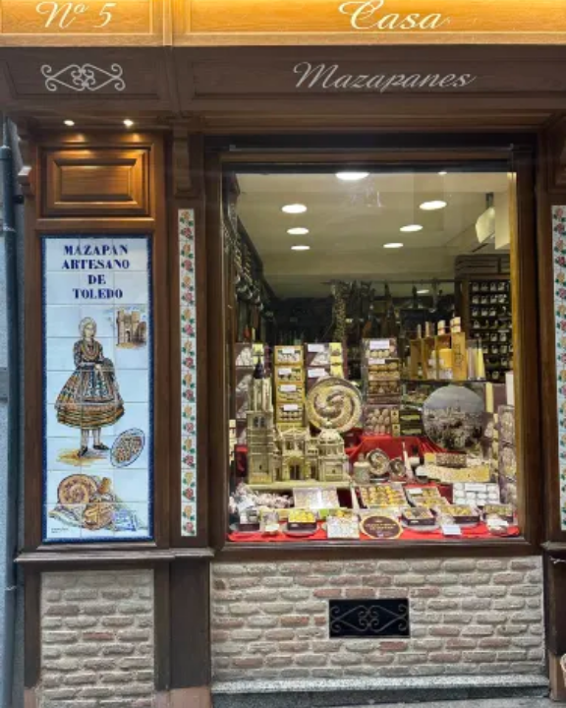
A Taste of History
8th-century Moorish recipe marzipan made of pure almonds and sugar.
Slow-cooked pork carcamusas with peas and tomato stew in clay pots
Wild partridge perdiz a la toledana slowly braised in garlic and wine
Authentic D.O.P. cured sheep's milk manchego cheese.

Slide 8
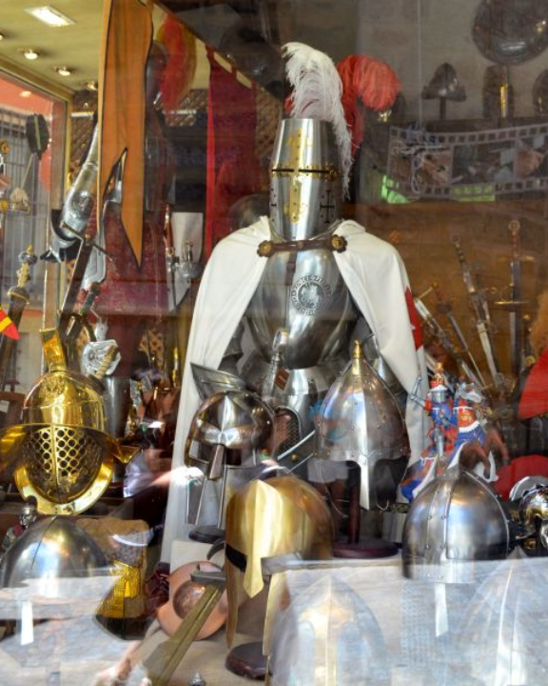
The Steel of Empires
General Hannibal's army used Toledo steel, as it was of the best quality.
The steel obtained a unique tempering process through the use of water from the Tagus River.
The swords used for The Lord of the Rings trilogy were manufactured in Toledo
Damascening is the quintessential artisanal hallmark of Toledo, used to decorate swords, armor, and shields of kings and nobles.

Slide 9

Survival Tips for Visitors
Bring Comfortable Shoes
Steep inclines and slippery thousand-year-old cobblestones.
PRO TIP:
Ride the Safont mechanical escalators hidden directly inside the rock face!

Slide 10
Ready to Explore?
Ask us anything about Toledo.

