Slide 1
DISCOVER SPAIN
Toledo
The City of Three Cultures

Slide 2
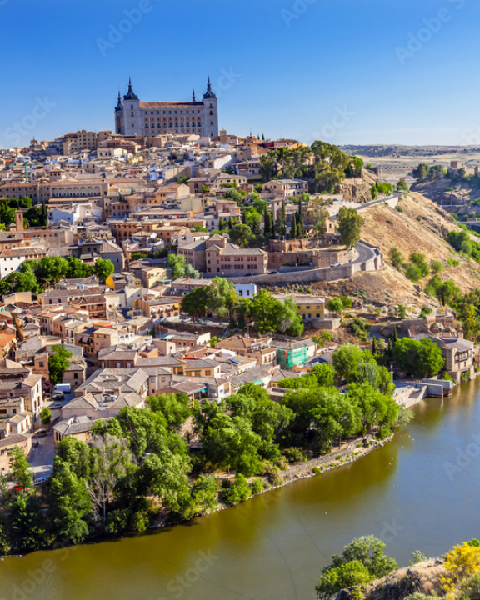
A Fortress in the Rock
Natural Moat: 100-meter deep gorge carved by the Tagus river.
Granite Foundation: Built entirely on steep, rocky terrain.
Strategic Hub: Former Visigoth capital holding power before Madrid.
High-Speed Access: 33 minutes from Madrid via AVE bullet train.

Slide 3
The Medieval Maze
Surface Level
Subterranean
Labyrinthine Streets: Unchanged layout designed to confuse invaders.
Roman Baths: Ancient ruins preserved directly under modern shops.
Hidden Courtyards: Ornate patios concealed behind heavy wooden doors.
Islamic Cisterns: Underground water storage systems still intact.
Covered Alleys: "Cobertizos" connecting buildings above the streets.
Secret Tunnels: Legendary escape routes used during sieges.

Slide 4


Three Cultures, One City
Christian
Muslim
Jewish
13th-century High Gothic masterpiece built over a former mosque.
Year 999 architecture surviving completely intact through centuries.
12th-century Moorish-style architecture built for the Jewish community.

Slide 5

The Canvas of El Greco
Adopted Son: Greek painter Doménikos Theotokópoulos immortalized the city.
Mannerist Style: Famous for elongated figures and dramatic, unnatural colors.
"I paint because the spirits whisper madly inside my head."
The Masterpiece: "The Burial of the Count of Orgaz" inside Santo Tomé church.
Museum House: 16th-century recreated home displaying his later works.

Slide 6






Unmissable Experiences
Mirador del Valle
Get Lost
Urban Zipline
Sunset panoramic views across the gorge capturing the Alcázar fortress.
Navigate the ancient Jewish quarter's narrow, map-defying alleys.
Europe's longest urban zipline traversing the historic Tagus riverbanks.

Slide 7
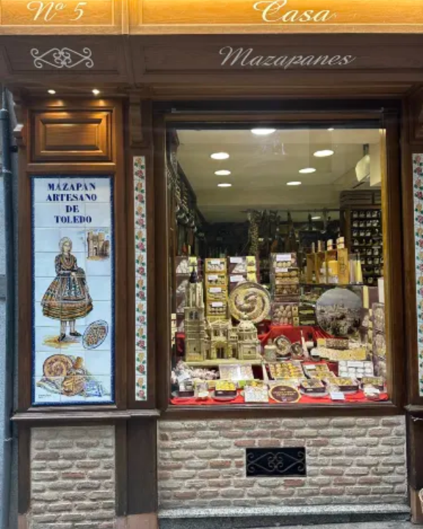
A Taste of History
Mazapán: 8th-century Moorish recipe of pure almond and sugar.
Carcamusas: Slow-cooked pork, peas, and tomato stew in clay pots.
Perdiz a la Toledana: Wild partridge braised slowly in garlic and wine.
Manchego: Authentic D.O.P. cured sheep's milk cheese.

Slide 8
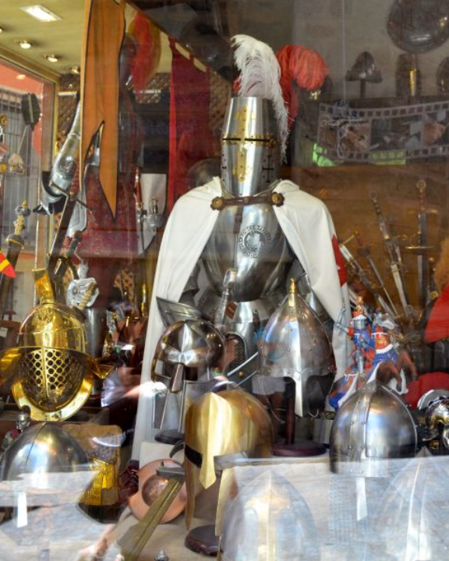
The Steel of Empires
Roman Choice: General Hannibal's army demanded Toledo steel.
Unique Tempering: Legendary strength achieved using Tagus river water.
Hollywood Armory: Official forge for Lord of the Rings weaponry.
Damasquinado: 24-karat gold threads hammered into blackened steel.

Slide 9

Survival Tips for Visitors
Bring Comfortable Shoes
Steep inclines and slippery thousand-year-old cobblestones.
PRO TIP:
Ride the Safont mechanical escalators hidden directly inside the rock face!

Slide 10
Ready to Explore?
Ask us anything about Toledo.

Slide 11



Image Sources
https://as1.ftcdn.net/v2/jpg/01/08/10/26/1000_F_108102663_XTBETL9Ay6Oxru9IqpKl9i3VuD1JdMG0.jpg
Source: www.europosters.ie
https://ak-d.tripcdn.com/images/1mi4b224x98kcsl1p1F9B.jpg?proc=resize%2Fm_z%2Cw_375%2Ch_0%3Bformat%2Ff_webp%2C9C2E
Source: sg.trip.com
http://www.martoswordstoledo.com/swordarmorblog/wp-content/uploads/2014/09/armor-toledo-spain.jpg?x94758
Source: www.martoswordstoledo.com

