Slide 1
DISCOVER SPAIN
Toledo
The City of Three Cultures

Slide 2
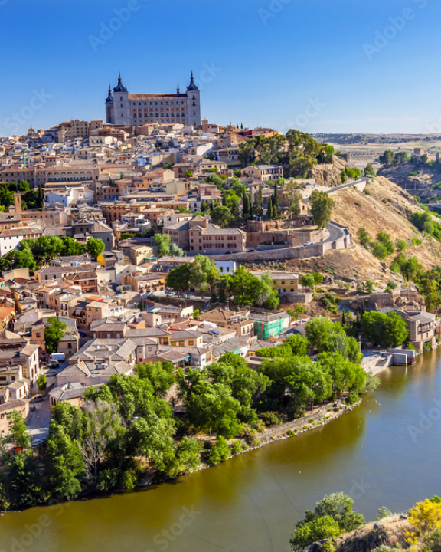
A Fortress in the Rock
Natural Moat: 100-meter deep gorge carved by the Tagus river.
Strategic Hub: Former Visigoth capital holding power before Madrid.
High-Speed Access: 33 minutes from Madrid via AVE bullet train.
Labyrinthine Streets: Unchanged medieval layout designed to confuse invaders.

Slide 3


Three Cultures, One City
Christian
Muslim
Jewish
13th-century High Gothic masterpiece built over a former mosque.
Year 999 architecture surviving completely intact through centuries.
12th-century Moorish-style architecture built for the Jewish community.

Slide 4






Unmissable Experiences
Mirador del Valle
Get Lost
Urban Zipline
Sunset panoramic views across the gorge capturing the Alcázar fortress.
Navigate the ancient Jewish quarter's narrow, map-defying alleys.
Europe's longest urban zipline traversing the historic Tagus riverbanks.

Slide 5
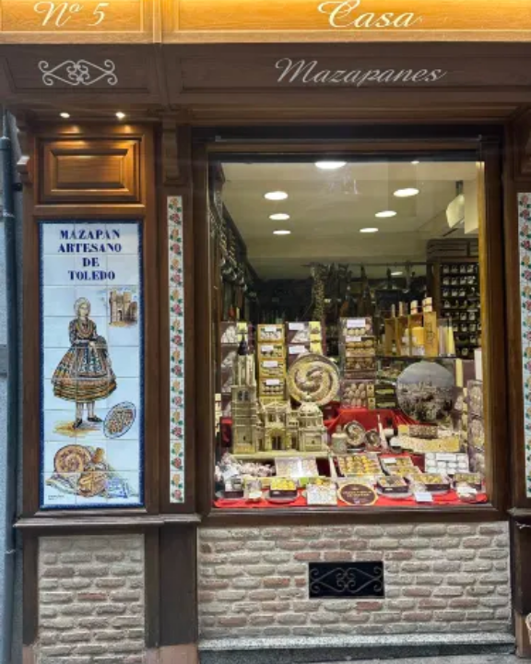
A Taste of History
Mazapán: 8th-century Moorish recipe of pure almond and sugar crafted by cloistered nuns.
Carcamusas: Slow-cooked pork, peas, and tomato stew served in traditional clay pots.
Manchego: Authentic D.O.P. cured sheep's milk cheese from the surrounding La Mancha plains.

Slide 6
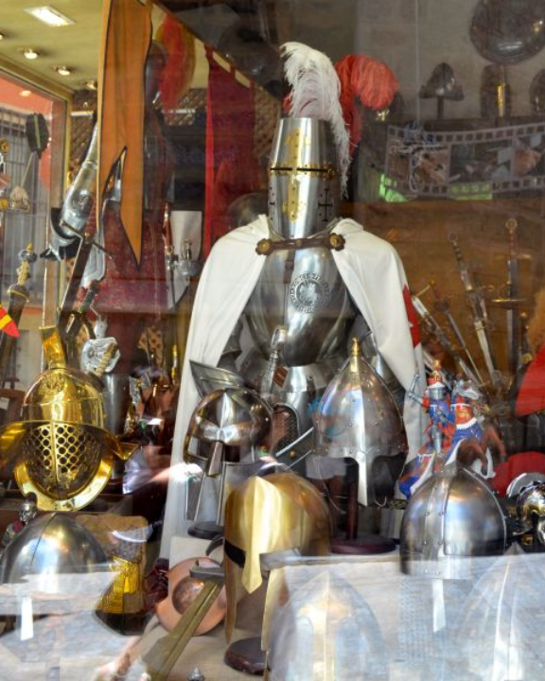
The Steel of Empires
Roman Choice: General Hannibal and Roman legions exclusively demanded Toledo steel.
Hollywood Armory: Official forge site for Lord of the Rings and Game of Thrones weaponry.
Damasquinado: 24-karat gold threads hammered directly into blackened steel surfaces.

Slide 7

Survival Tips for Visitors
Bring Comfortable Shoes
Steep inclines and slippery thousand-year-old cobblestones.
PRO TIP:
Ride the Safont mechanical escalators hidden directly inside the rock face!

Slide 8
Ready to Explore?
Ask us anything about Toledo.

Slide 9



Image Sources
https://as1.ftcdn.net/v2/jpg/01/08/10/26/1000_F_108102663_XTBETL9Ay6Oxru9IqpKl9i3VuD1JdMG0.jpg
Source: www.europosters.ie
https://ak-d.tripcdn.com/images/1mi4b224x98kcsl1p1F9B.jpg?proc=resize%2Fm_z%2Cw_375%2Ch_0%3Bformat%2Ff_webp%2C9C2E
Source: sg.trip.com
http://www.martoswordstoledo.com/swordarmorblog/wp-content/uploads/2014/09/armor-toledo-spain.jpg?x94758
Source: www.martoswordstoledo.com

