Slide 1
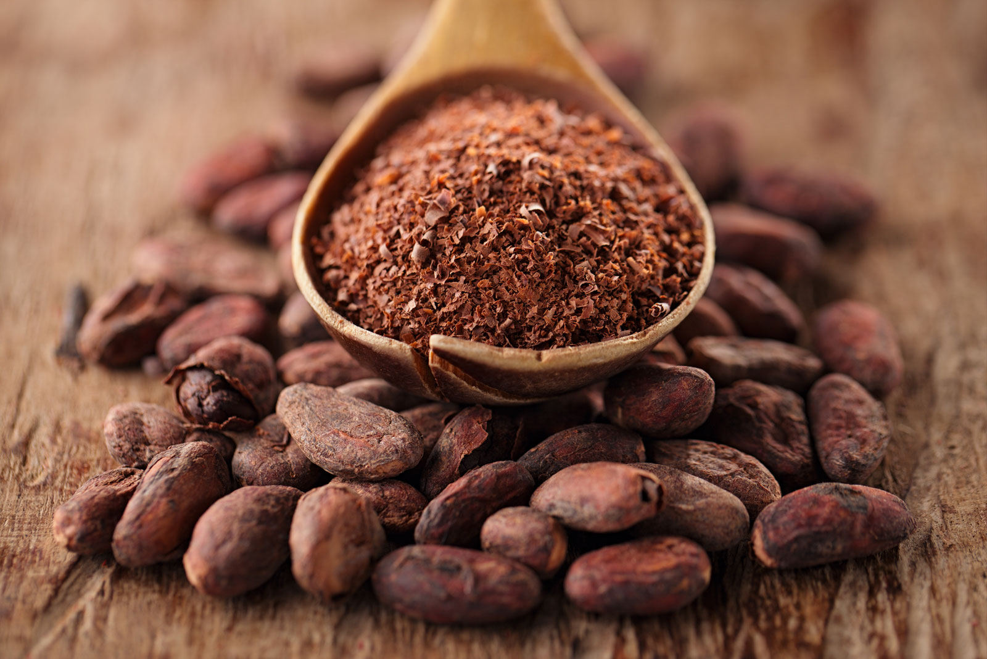
Chocolate Bar Ratings
GROUP 1 EDA ASSIGNMENT

Slide 2
Hypothesis
To determine whether there is a relationship between the rating, REF, the review and the cocoa percentage.
To know a company is the highest producer of the chocolate.
To know the location that has the greatest amount of companies that produces chocolate?
To know the greatest amount of chocolate used in terms of percentage.
To know whether 4 is the highest rating in the dataset.
To know the rating with highest frequency.
To determine the bean type which was rated the most.
To determine the biggest country contributor in rating.

Slide 3
Questions
what is the relationship between the rating, REF, the review and the cocoa percentage?
which company is the highest producer of the chocolate?
which location has the greatest amount of companies that produces chocolate?
what is the greatest amount of chocolate used in terms of percentage?
what is the highest rating in the dataset?
which of the bean type was rated the most?
which companies produces the highest rated chocolate?

