Slide 1
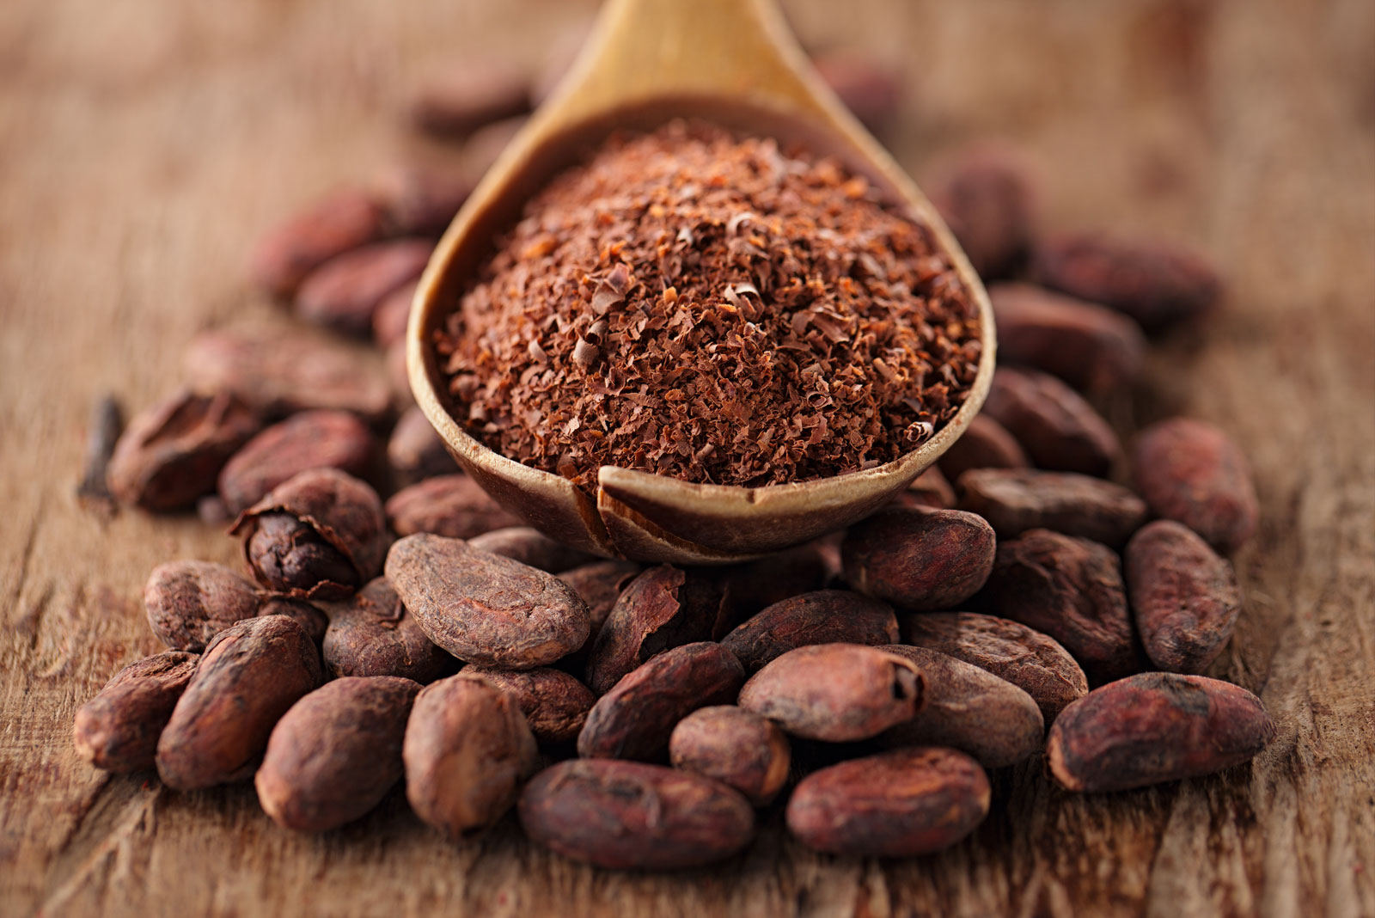
Chocolate Bar Ratings
GROUP 1 EDA ASSIGNMENT

Slide 2
Objective
To evaluate consumers attitude towards the usage of chocolates.
To evaluate consumers perception about the important factors pertaining to Chocolates purchase decision.
To analysis the consumers brand preference for Chocolates.

Slide 3
Hypothesis
To determine whether there is a relationship between the rating, REF, the review and the cocoa percentage.
To know a company is the highest producer of the chocolate.
To know the location that has the greatest amount of companies that produces chocolate?
To know the greatest amount of chocolate used in terms of percentage.
To know whether 4 is the highest rating in the dataset.
To know the rating with highest frequency.
To determine the bean type which was rated the most.
To determine the biggest country contributor in rating.

Slide 4
Questions
what is the relationship between the rating, REF, the review and the cocoa percentage?
which company is the highest producer of the chocolate?
which location has the greatest amount of companies that produces chocolate?
what is the greatest amount of chocolate used in terms of percentage?
what is the highest rating in the dataset?
which of the bean type was rated the most?
which companies produces the highest rated chocolate?

Slide 5
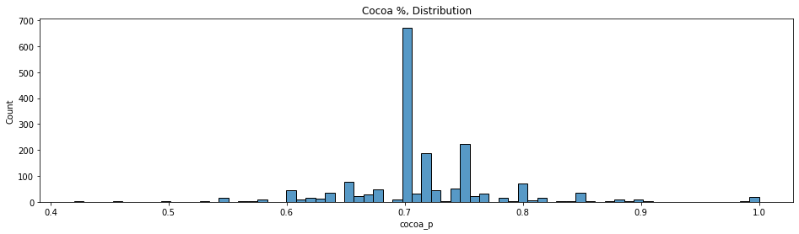
Visualization
About the greatest amount of chocolate used in terms of percentage.
For here, it can be seen that the greatest amount of chocolate used has a count of about 650.

Slide 6
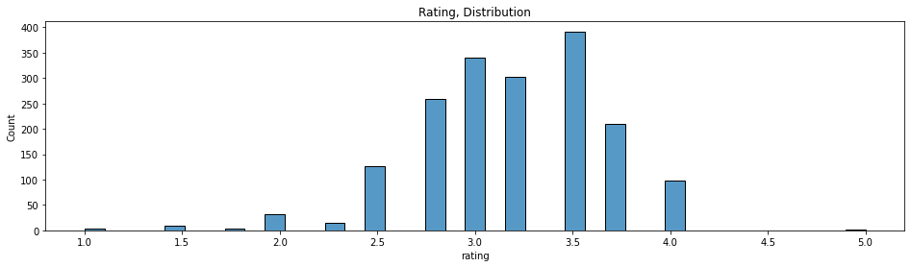
What is the highest rating of the dataset?
From the graph it can been that the 3.5 rating has the highest which is about 380 count and means that 3.5 is the in the dataset.

Slide 7
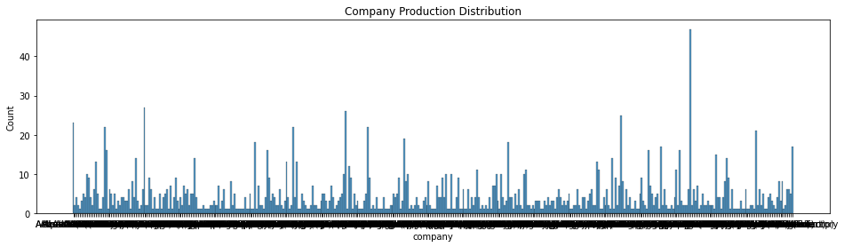
Which company is the highest producer of the chocolate?
This is a histogram showing the highest producer of the chocolate.

Slide 8
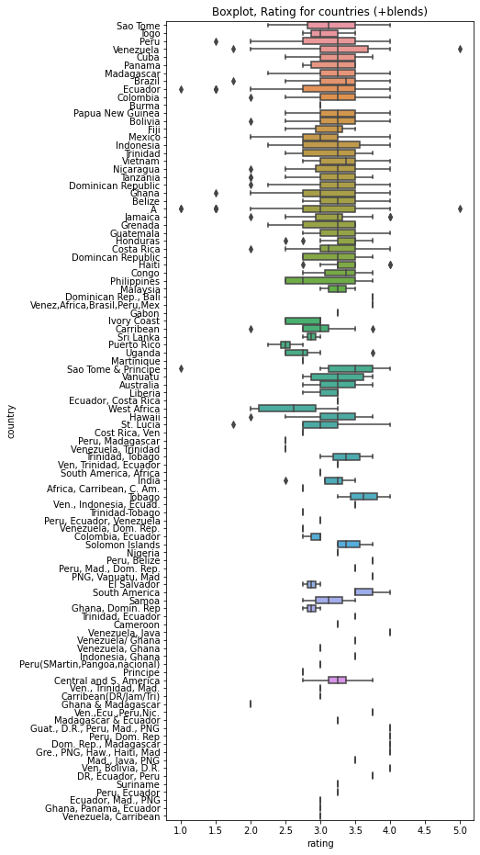
Continuation
Using a Boxplot to show the ratings by counties.

Slide 9
DATA CLEANING
Through out the project as a team, we did some data cleaning .
Here, we look out whether there is misspelling of the of countries and null dataset
Also did some data reduction in the processing.

