Slide 1
NAIROBI MINI-MARKET
Sales and Customer
Insights
An analytics project for stock and sales decisions
Nairobi CBD & Ruiru branches

Slide 2
Small shops must balance two stock risks
TOO MUCH STOCK
TOO LITTLE STOCK
Cash stays tied up in products that move slowly.
A customer may arrive and find a needed item unavailable.
Project questions
Which products and months lead sales? How do the sample branches compare? Do customer and payment groups differ? Can a trained forecast improve on simple baselines?

Slide 3
A year of sales data, with Kenyan context
2025 SAMPLE
Two branches · 10 products · 100 customer IDs · M-Pesa, cash and card
1,548 raw transaction lines → 1,511 cleaned product lines
1,134 receipts · 2,242 units · KES 375,259.50 net sales
How the files connect
Sales lines join to product, store and customer descriptions. The store county links to KNBS 2019 county population, used only as background context.

Slide 4
Maize flour and December led the sample
PRODUCT
MONTH
Maize flour 2kg
December was highest
KES 68,823 net sales for 387 units
at KES 37,034.75
February was lowest at KES 26,069.25
BRANCHES
CUSTOMERS
CBD: KES 192,003.50
Loyalty members contributed 43.7% of net sales.
Ruiru: KES 183,256.00

Slide 5
Promotion and payment tests tell different stories
PROMOTED VS NON-PROMOTED RECEIPTS
M-PESA VS CASH RECEIPTS
+KES 50.60
+KES 4.20
Average gross receipt difference
95% CI: KES 10.75 to 90.45 · p = 0.0129
Average net receipt difference
95% CI: KES -35.20 to 43.60 · p = 0.8345

Slide 6
The learned model beat both baselines
One-week-ahead validation: 42 history weeks, 11 later weeks, 220 product-branch forecasts.
METHOD
MAE · units
WAPE
BIAS · units
Last-week baseline
2.20
104.5%
0.15
Four-week average baseline
1.73
82.0%
0.12
Trained regression
1.54
72.9%
0.09
The regression learns from four past weeks, the four-week average, week of year, branch and product. It trained on 760 earlier rows; all three scores use the same 11 weeks.
MAE and WAPE are lower for the regression, but WAPE remains high at 72.9%.

Slide 7
Sharp changes still trip up the forecast
SUDDEN SPIKE
QUIETER WEEK
Ruiru maize flour 2kg
Final validation week
10 units sold; regression predicted about 3.54 units for the week of 22 December.
20 units sold across all products and branches; regression predicted about 43.5.

Slide 8
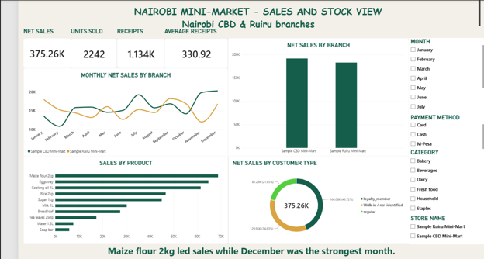
Power BI puts the sales questions in one view
The sales page summarizes performance and lets a manager filter by month, payment method, product category and branch.

Slide 9
What a real Nairobi shop should do next
1
Use the shop’s own point-of-sale records, with product, date, quantity, promotion and branch.
2
Also record stockouts and inventory. Sales alone cannot show demand when an item was unavailable.
3
Keep measuring forecast error on later weeks. Use forecasts for orders only after they perform reliably on real shop data.

