Slide 1
TITLE: Diabetes Treatment A nd Readmission Prediction
Presenter: Tim Kabira
Date:

Slide 2
Introduction
Diabetes is one of the most common chronic illnesses worldwide, often leading to serious complications if not properly managed. A major challenge is frequent hospital readmissions, which:
Increase healthcare costs
Strain hospital resources
Signal gaps in patient care
This project aims to predict diabetes treatment outcomes and hospital readmission risk using machine learning on the UCI Diabetes 130-US Hospitals dataset (1999–2008).

Slide 3
Business Problem
Hospitals need a reliable way to predict which discharged patients are at high risk of readmission so that interventions (follow-ups, education, resource allocation) can be applied before deterioration occurs.

Slide 4
Project Objectives
1. Predict High-Risk Patients
Develop a machine learning model to identify diabetic patients likely to be readmitted within 30 days of discharge.
Enable hospitals to proactively intervene before readmission occurs.
2. Reduce Healthcare Costs
Minimize avoidable readmissions, which are expensive for both hospitals and patients.
Optimize resource allocation (beds, staff, medications) to reduce waste and increase operational efficiency.
3. Improve Patient Outcomes
Enhance the quality of care by targeting patients who need closer follow-up, education, or additional support.
Reduce complications, prevent deterioration, and improve patients’ overall quality of life.

Slide 5
Project Objectives
4. Support Data-Driven Clinical Decisions
Provide clinicians and hospital administrators with interpretable insights (e.g., risk factors, SHAP feature importance).
Help hospitals implement evidence-based interventions for patients at high readmission risk.
5. Comply with Regulatory & Performance Standards
Help hospitals meet value-based care requirements and avoid financial penalties due to excessive readmissions.
Improve hospital performance metrics and patient satisfaction scores.

Slide 6
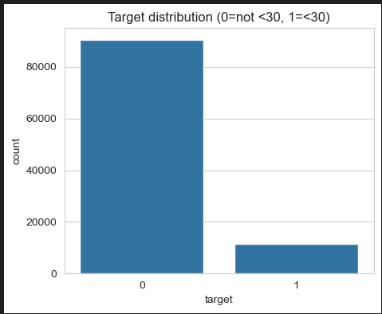
Data Understanding(Target Distribution, not less tha 30,less than 30)

Slide 7
Data Understanding (Target Distribution, not less tha 30,less than 30)
Most patients are not readmitted within 30 days, but a smaller group is. This means we have a clear imbalance: fewer readmitted patients compared to those not readmitted. This imbalance makes predicting who is at risk harder but also more important.

Slide 8
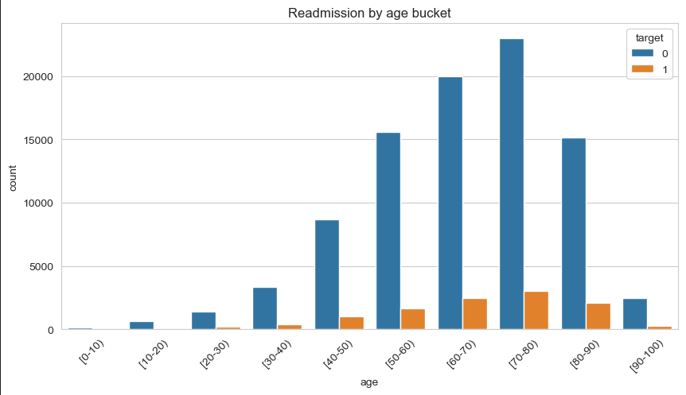
Data Understanding(Readmission By Age)

Slide 9
Data Understanding(Readmission By Age)
Readmission risk varies across age groups. Certain age brackets (often middle-aged to older patients) show a higher chance of being readmitted, suggesting that age is a significant factor in hospital return rates.

Slide 10
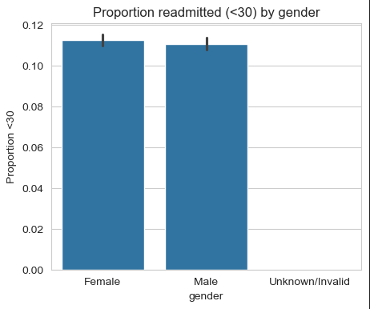
Data Understanding (Readmitted Based On Gender)

Slide 11
Data Understanding (Readmitted Based On Gender Explanation)
There is no strong difference in readmission rates between males and females. Gender alone doesn’t appear to be a major driver of readmissions, so our focus should remain on other, stronger predictors.

Slide 12
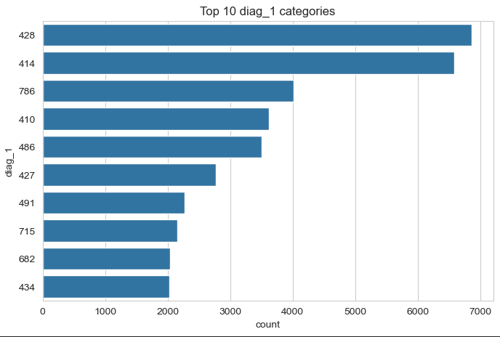
Data Understanding (Top 10 Diagnosed Categories)

Slide 13
Data Understanding (Top 10 Diagnosed Categories Explanation)
A few diagnosis categories (like diabetes complications, circulatory issues, or respiratory diseases) account for a large share of readmissions. This tells us certain conditions are riskier and may need closer follow-up care to prevent patients from returning.

Slide 14
Data Analysis-Machine Learning findings.
We used patient data (age, gender, test results, medications, prior visits) to understand factors linked to hospital readmissions.
Machine learning was applied to find patterns and predict which patients are most likely to be readmitted within 30 days.
The goal is to support hospital staff with early warnings so they can give extra care to high-risk patients.

Slide 15
What model Does
Predicts whether a patient is likely to be readmitted within 30 days.
Works like a “risk flag” system to guide doctors and nurses.
Think of it as an extra set of eyes that helps spot high-risk patients earlier.

Slide 16
Key Findings
The model achieves approximately 88% overall accuracy, meaning it predicts correctly for about 9 out of 10 patients.
However, recall for high-risk (readmitted) patients is very low (<5%), meaning most true readmissions are missed.
This shows the model is good at predicting non-readmissions, but poor at catching actual high-risk patients — a critical gap in healthcare settings.

Slide 17
Uses Of The Key Findings
Improved Care: Extra monitoring for patients flagged as high-risk.
Cost Savings: Reducing readmissions saves hospital resources and prevents financial penalties.
Patient Well-Being: Patients avoid the stress and health risks of returning soon after discharge.
Planning & Policy: Helps hospital management design better discharge and follow-up programs.

Slide 18
Recommendations
Target High-Risk Patients → Provide follow-up care for those with long hospital stays or frequent prior visits.
Medication Management → Review and optimize prescriptions linked to higher readmission risks.
Discharge Planning → Strengthen patient education and support before leaving the hospital.
Preventive Care → Encourage early outpatient visits to reduce unnecessary readmissions.
Resource Allocation → Focus hospital resources where readmission risk is highest to cut costs and improve outcomes.

