Slide 1
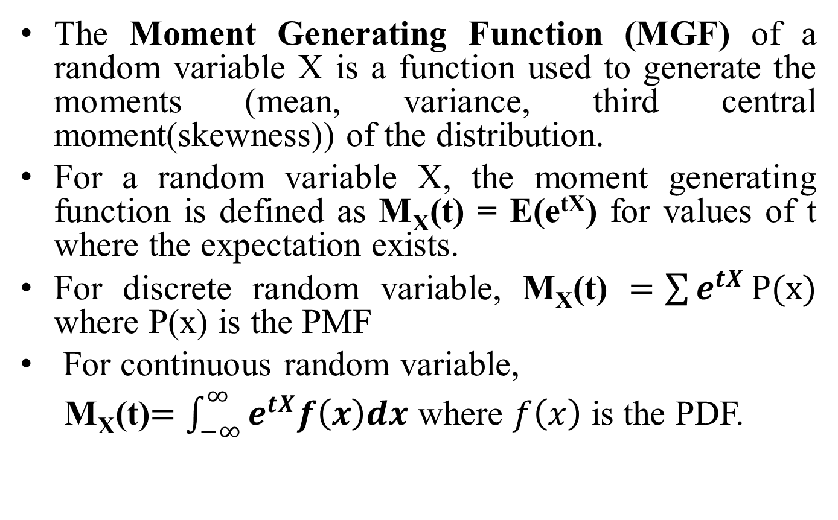
MOMENT OF A GENERATING FUNCTION
The Moment Generating Function (MGF) of a random variable X is a function used to generate the moments (mean, variance, third central moment(skewness)) of the distribution.
For a random variable X, the moment generating function is defined as M_{X}(t) = E(e^{tX}) for values of t where the expectation exists.
For discrete random variable, M_{X}(t) $=\sum{e^{tX}}P(x)$ where P(x) is the PMF
For continuous random variable,
M_{X}(t)$=\int_{−∞}^{∞}{e^{tX}f\left(x\right)dx}$ where $f\left(x\right)$ is the PDF.

Slide 2
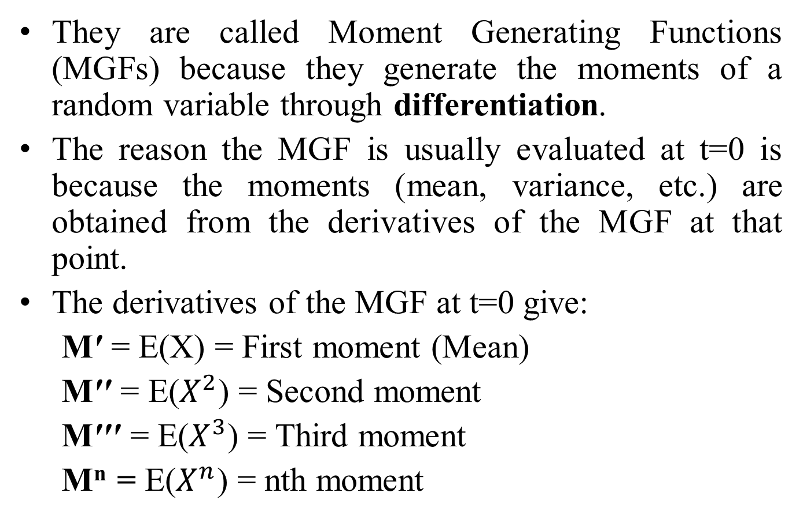
MOMENT OF A GENERATING FUNCTION
They are called Moment Generating Functions (MGFs) because they generate the moments of a random variable through differentiation.
The reason the MGF is usually evaluated at t=0 is because the moments (mean, variance, etc.) are obtained from the derivatives of the MGF at that point.
The derivatives of the MGF at t=0 give:
M′ = E(X) = First moment (Mean)
M′′ ​= E($X^{2}$) = Second moment
M′′′ = E($X^{3}$) = Third moment
M^{n} = E($X^{n}$) = nth moment

Slide 3
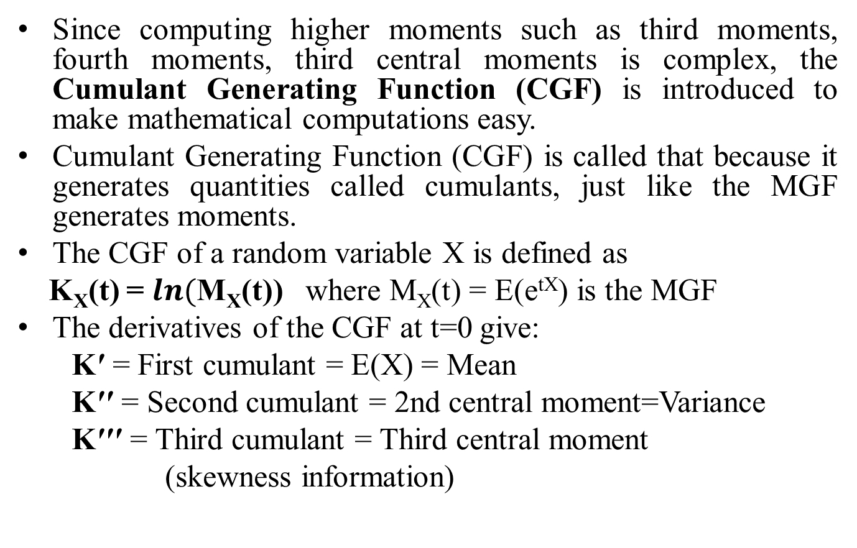
MOMENT OF A GENERATING FUNCTION
Since computing higher moments such as third moments, fourth moments, third central moments is complex, the Cumulant Generating Function (CGF) is introduced to make mathematical computations easy.
Cumulant Generating Function (CGF) is called that because it generates quantities called cumulants, just like the MGF generates moments.
The CGF of a random variable X is defined as
K_{X}(t) = $ln($M_{X}(t)) where M_{X}(t) = E(e^{tX}) is the MGF
The derivatives of the CGF at t=0 give:
K′ = First cumulant = E(X) = Mean
K′′ ​= Second cumulant = 2nd central moment=Variance
K′′′ = Third cumulant = Third central moment
(skewness information)

Slide 4
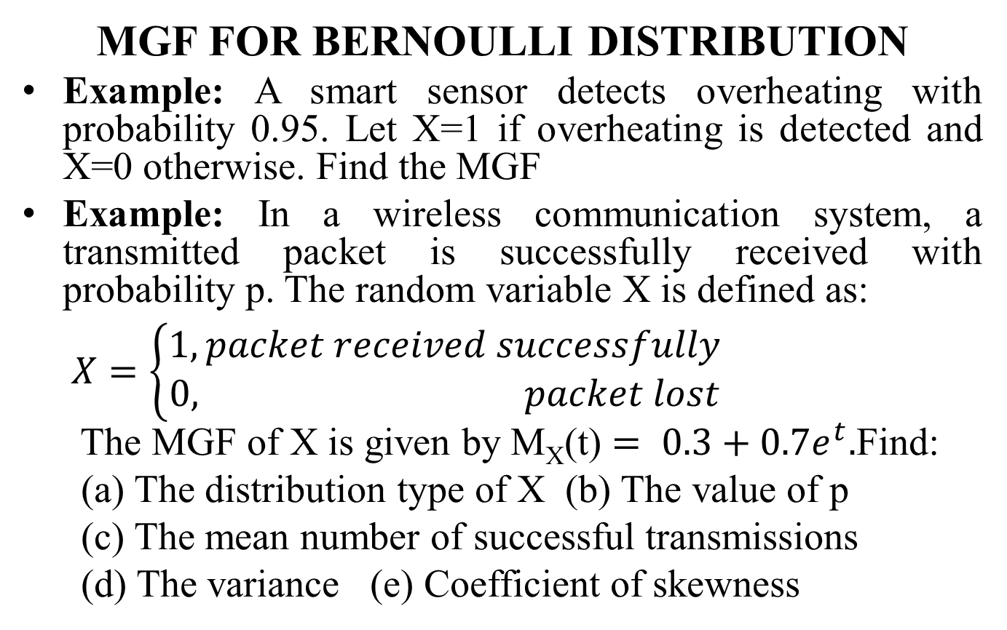
MOMENT OF A GENERATING FUNCTION
MGF FOR BERNOULLI DISTRIBUTION
Example: A smart sensor detects overheating with probability 0.95. Let X=1 if overheating is detected and X=0 otherwise. Find the MGF
Example: In a wireless communication system, a transmitted packet is successfully received with probability p. The random variable X is defined as:
$X=\left\{\begin{aligned}1, packet received successfully \\ 0, packet lost\end{aligned}\right.$​
The MGF of X is given by M_{X}(t) $= 0.3+0.7e^{t}.$Find:
(a) The distribution type of X (b) The value of p
(c) The mean number of successful transmissions
(d) The variance (e) Coefficient of skewness

Slide 5
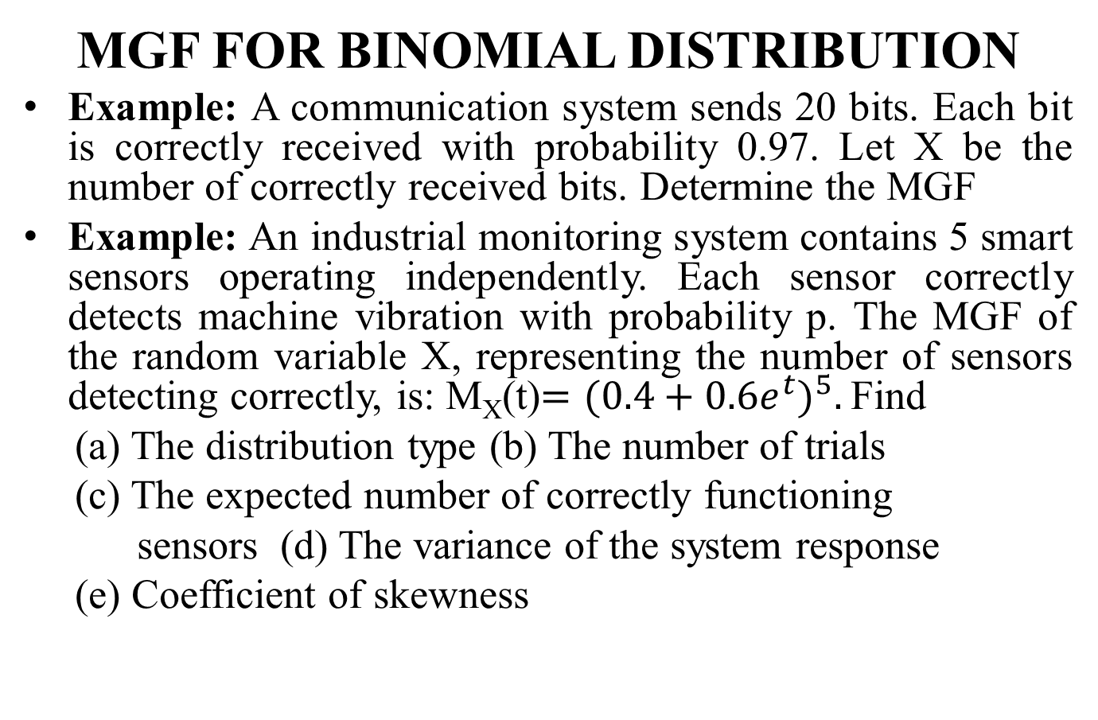
MOMENT OF A GENERATING FUNCTION
MGF FOR BINOMIAL DISTRIBUTION
Example: A communication system sends 20 bits. Each bit is correctly received with probability 0.97. Let X be the number of correctly received bits. Determine the MGF
Example: An industrial monitoring system contains 5 smart sensors operating independently. Each sensor correctly detects machine vibration with probability p. The MGF of the random variable X, representing the number of sensors detecting correctly, is: M_{X}(t)$={(0.4+0.6e^{t})}^{5}.$Find
(a) The distribution type (b) The number of trials
(c) The expected number of correctly functioning
sensors (d) The variance of the system response
(e) Coefficient of skewness

Slide 6
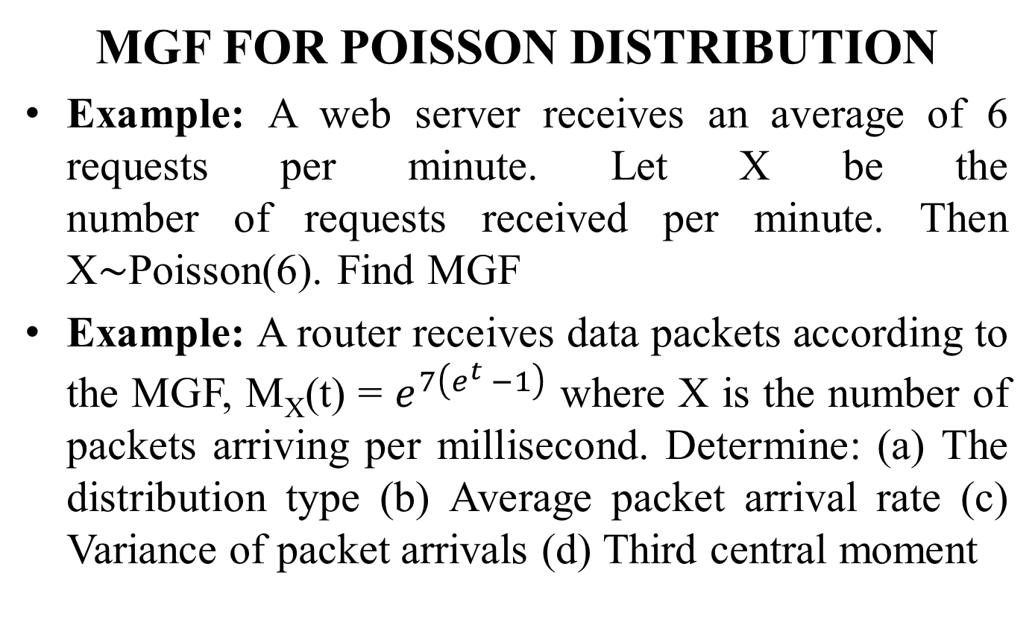
MOMENT OF A GENERATING FUNCTION
MGF FOR POISSON DISTRIBUTION
Example: A web server receives an average of 6 requests per minute. Let X be the number of requests received per minute. Then X∼Poisson(6). Find MGF
Example: A router receives data packets according to the MGF, M_{X}(t) = $e^{7\left(e^{t }−1\right)}$ where X is the number of packets arriving per millisecond. Determine: (a) The distribution type (b) Average packet arrival rate (c) Variance of packet arrivals (d) Third central moment

Slide 7
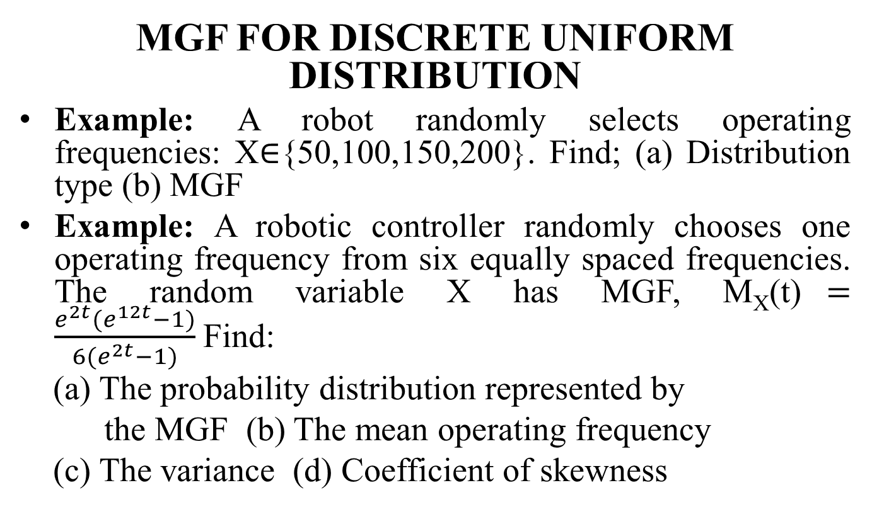
MOMENT OF A GENERATING FUNCTION
MGF FOR DISCRETE UNIFORM DISTRIBUTION
Example: A robot randomly selects operating frequencies: X∈{50,100,150,200}. Find; (a) Distribution type (b) MGF
Example: A robotic controller randomly chooses one operating frequency from six equally spaced frequencies. The random variable X has MGF, M_{X}(t)$=\frac{e^{2t}(e^{12t}−1)}{6(e^{2t}−1)}$Find:
(a) The probability distribution represented by
the MGF (b) The mean operating frequency
(c) The variance (d) Coefficient of skewness

Slide 8
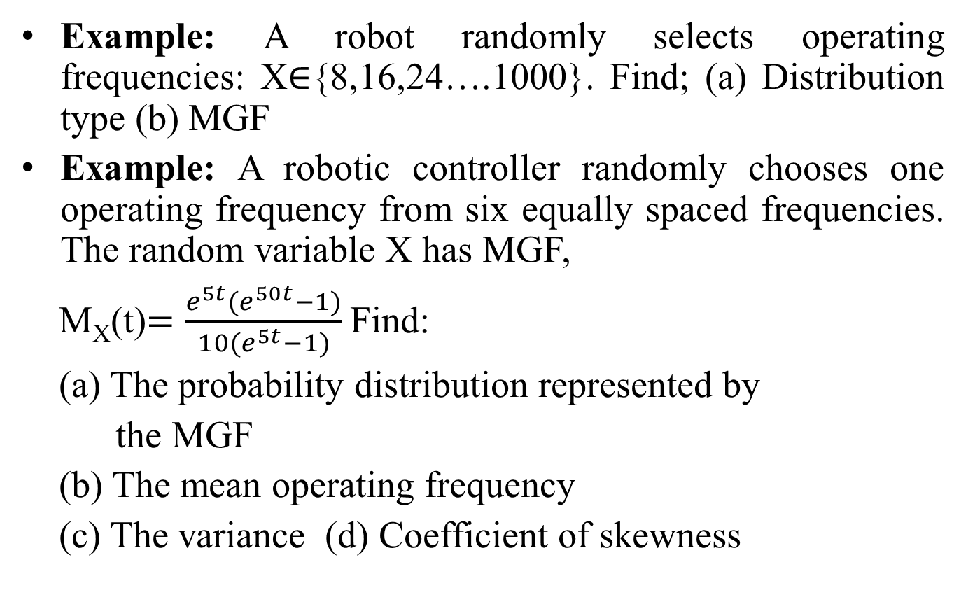
MOMENT OF A GENERATING FUNCTION
Example: A robot randomly selects operating frequencies: X∈{8,16,24….1000}. Find; (a) Distribution type (b) MGF
Example: A robotic controller randomly chooses one operating frequency from six equally spaced frequencies. The random variable X has MGF,
M_{X}(t)$=\frac{e^{5t}(e^{50t}−1)}{10(e^{5t}−1)}$Find:
(a) The probability distribution represented by
the MGF
(b) The mean operating frequency
(c) The variance (d) Coefficient of skewness

Slide 9
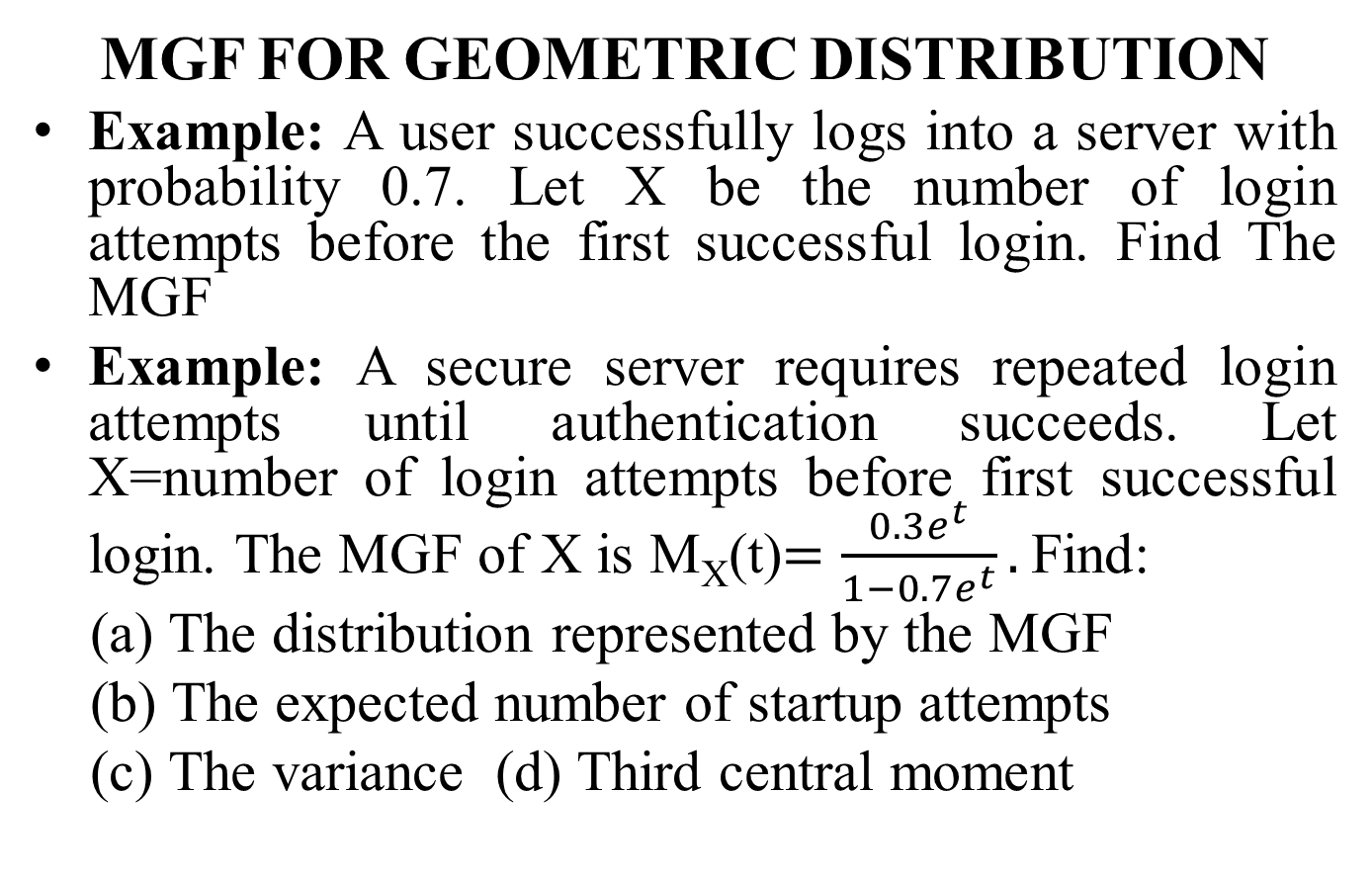
MOMENT OF A GENERATING FUNCTION
MGF FOR GEOMETRIC DISTRIBUTION
Example: A user successfully logs into a server with probability 0.7. Let X be the number of login attempts before the first successful login. Find The MGF
Example: A secure server requires repeated login attempts until authentication succeeds. Let X=number of login attempts before first successful login. The MGF of X is M_{X}(t)$=\frac{0.3e^{t}}{1−0.7e^{t}}.$Find:
(a) The distribution represented by the MGF
(b) The expected number of startup attempts
(c) The variance (d) Third central moment

Slide 10
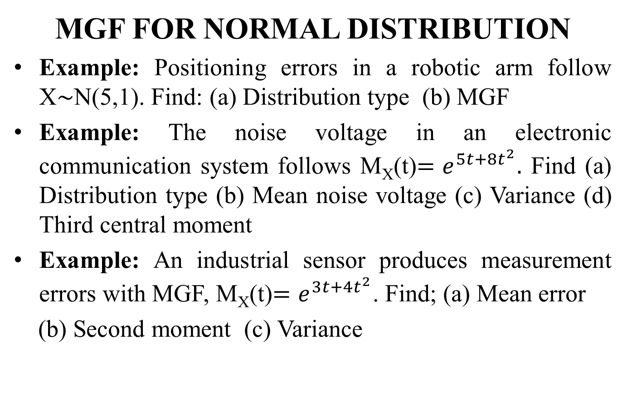
MOMENT OF A GENERATING FUNCTION
MGF FOR NORMAL DISTRIBUTION
Example: Positioning errors in a robotic arm follow X∼N(5,1). Find: (a) Distribution type (b) MGF
Example: The noise voltage in an electronic communication system follows M_{X}(t)$=e^{5t+8t^{2}}.$ Find (a) Distribution type (b) Mean noise voltage (c) Variance (d) Third central moment
Example: An industrial sensor produces measurement errors with MGF, M_{X}(t)$=e^{3t+4t^{2}}$. Find; (a) Mean error
(b) Second moment (c) Variance

Slide 11
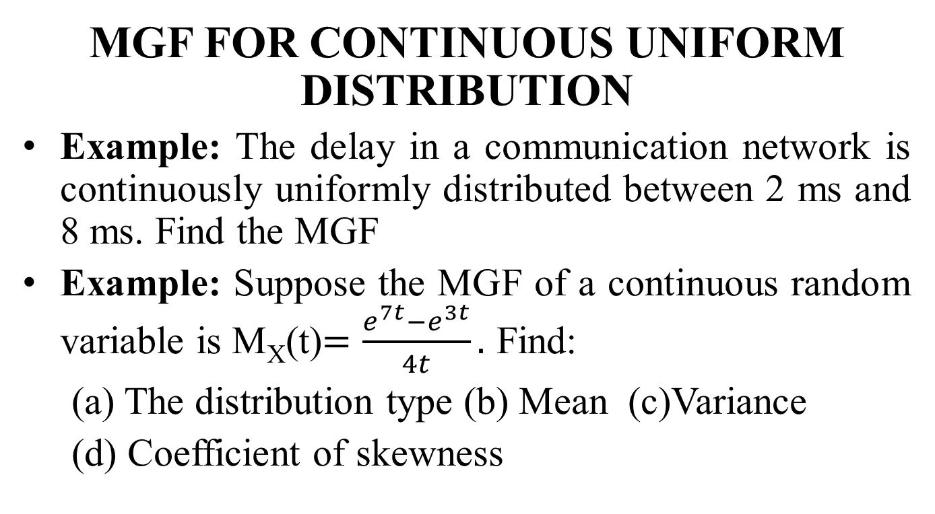
MOMENT OF A GENERATING FUNCTION
MGF FOR CONTINUOUS UNIFORM DISTRIBUTION
Example: The delay in a communication network is continuously uniformly distributed between 2 ms and 8 ms. Find the MGF
Example: Suppose the MGF of a continuous random variable is M_{X}(t)$=\frac{e^{7t}−e^{3t}}{4t}.$ Find:
(a) The distribution type (b) Mean (c)Variance
(d) Coefficient of skewness

