Slide 1
Azure Capacity Planning
Mike Barry

Slide 2

Good to know
Azure DOES have limits!! Per Azure Sub and even per Azure Region
Know the Service-specific quota limits - Limits
Some limits are a hard maximum, while others are a soft limit that can be increases upon request.
Involve your Microsoft Architects in planning…. EARLY!!!
You can increase quota!
“But I Thought Azure had Infinite Capacity?”
Limits are Good….Kinda
Limits help keep you cloud spending predictable by not allowing you to spin up the resources that could generate a huge monthly bill without you doing it on purpose. This save you and Microsoft money since they’d likely need to refund lots of cloud spending if all customers were allowed to go unchecked.
Limits help Microsoft throttle the growth of cloud usage; both within individual Azure Regions, as well as Globally across all their datacenter and regions. This allows Microsoft to ensure that individual customers aren’t able to overload any particular Azure Region or data center unexpectedly.
Be an Architect 535 Exam
January 2017

Slide 3

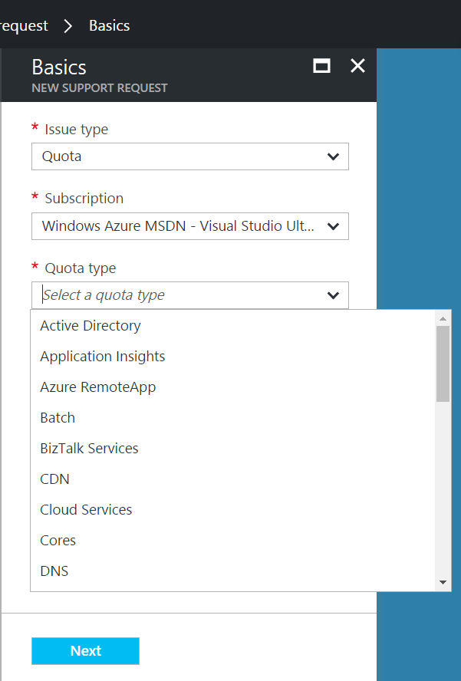
Good to know
Very large quota requests may take more than a day to be processed
Depending on how many cores are requested, a simple credit check initiated by the Support Team may be required
Recommended approach
Step 1: Visit the Azure Portal and click on ‘Help + Support’ and open a new support request.
Step 2: Click ‘Quotas’ under Issue Type and select the type of subscription for which you want to change the quota.
Step 3: Choose the resource type where you want to increase the quota.
Example 1: Increase number of cores
Example 2: Increase Storage
Step 4: Enter your preferred contact method and contact information and create the support case
“How do I increase Azure Quota?”
Support Type: Free Assisted - Billing
January 2017

