Slide 1

Design Azure Resource Manager (ARM) networking
Networking
Hybrid
Networking Services

Slide 2
Design Networking Implementation (15-20%)
From https://www.microsoft.com/en-us/learning/exam-70-535.aspx
Design Azure virtual networks
Design solutions that use Azure networking services: design for load balancing using Azure Load Balancer and Azure Traffic Manager; define DNS, DHCP, and IP strategies; determine when to use Azure Application Gateway; determine when to use virtual network (VNet) service endpoints; determine when to use multi-node application gateways, Traffic Manager and load balancers
Design external connectivity for Azure Virtual Networks
Determine when to use Azure VPN, Azure ExpressRoute and Virtual Network Peering architecture and design; determine when to use User Defined Routes (UDRs); determine when to use VPN gateway site-to-site failover for ExpressRoute; determine when to use the Container Networking Interface (CNI) plugin; design solutions that use Global VNet Peering
Design security strategies
Determine when to use network virtual appliances; design a perimeter network (DMZ); determine when to use a Web Application Firewall (WAF), Network Security Group (NSG), and virtual network service tunneling; organize resources by designing solutions that use service tags
Design connectivity for hybrid applications
Design connectivity to on-premises data from Azure applications using Azure Relay Service, Azure Data Management Gateway for Data Factory, Azure On-Premises Data Gateway, Hybrid Connections, or Azure Web App’s virtual private network (VPN) capability; identify constraints for connectivity with VPN; identify options for joining VMs to domains
Notes:
As you can see, we have A LOT to cover so please jot down your questions and hold them to the end.
https://www.microsoft.com/en-us/learning/exam-70-535.aspx

Slide 3
Azure Networking Platform
Bring Your Own Network
“Virtual Network as a Service”
Security & compliance
Routing
Scalability
High Availability
Performance
Azure Load Balancer
External and internal
Scalability & high availability
Traffic Manager
Geo-distribution & redundancy
User Defined Routes
Enable firewall, IDS/IPS, router, VPN gateways, etc.
Network Security Groups
Network segmentation
ACLs
Multi-NIC VMs
Up to 16 NICs
NSG and Routes on all NICs
Separate frontend, backend , and management

Slide 4
Network Resource Provider
NEW
New REST API surface
Loosely coupled network resource model
Fine grained access/control of networking resource
RBAC of networking resources
Support for logging and tagging
Highly performant & scalable
Regional resiliency
Imperative and declarative management style

Slide 5
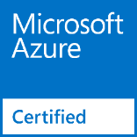
Network Virtual Appliances
Overview
VMs that perform specific network functions
Focus: Security (Firewall, IDS , IPS), Router/VPN, ADC (Application Delivery Controller), WAN Optimization
Typically Linux or FreeBSD-based platforms
Scenarios
IT Policy & Compliance – Consistency between on premises & Azure
Supplement/complement Azure capabilities
Azure Marketplace
Available through Azure Certified Program to ensure quality and simplify deployment
You can also bring your own appliance and license

Slide 6










Network Virtual Appliance Ecosystem

Slide 7

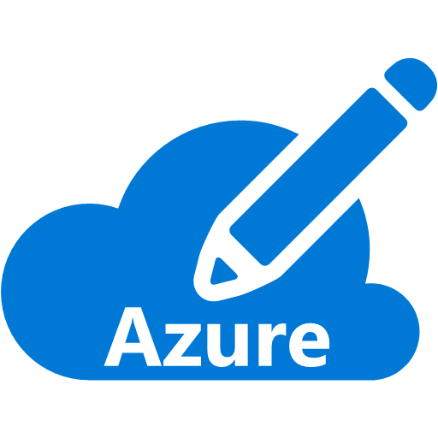



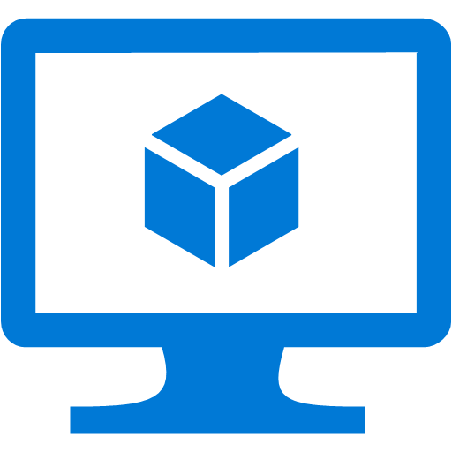



Virtual Appliances - Firewalls, IDS/IPS, VPNs
Secure your virtual networks in Azure
Azure Virtual Network
Internet
DMZ
Cross-premises connectivity
IDS
IPS

Slide 8



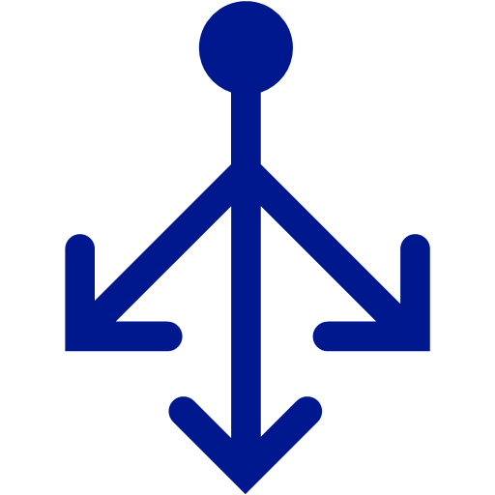
Scenario – Application Delivery Controller
Frontend load balancing and delivery control
Applications
Virtual Network
ADC & Load Balancer
Web Farms
Internet

Slide 9

Networking: Virtual Networks
Isolated
50/500 Virtual Networks per Region per Subscription
Up to 500K Concurrent TCP connections per VM
Up to 1000 Subnets. Special: GatewaySubnet
300/10,000 NICs per region per sub
Internet Connected by default
Connectivity – to each other via Peering, or to on-prem via VPN, ExpressRoute
Bound to a single region
Use Public IP address Ranges and Private IP Address ranges
Some IP address Ranges are not allowed:
224.0.0.0/4 (Multicast)
255.255.255.255/32 (Broadcast)
127.0.0.0/8 (loopback)
169.254.0.0/16 (link-local)
168.63.129.16/32 (Internal DNS)
https://docs.microsoft.com/en-us/azure/virtual-network/virtual-networks-public-ip-within-vnet
Inter-region VNET Peering now in Public Preview

Slide 10
Networking: Virtual Networks
VNet properties
Subnet Properties
Property | Description | Constraints
name | VNet name | String of up to 80 characters. May contain letters, numbers, underscore, periods, or hyphens. Must start with a letter or number. Must end with a letter, number, or underscore. Can contains upper or lower case letters.
location | Azure location (also referred to as region). | Must be one of the valid Azure locations.
addressSpace | Collection of address prefixes that make up the VNet in CIDR notation. | Must be an array of valid CIDR address blocks, including public IP address ranges.
subnets | Collection of subnets that make up the VNet | see the subnet properties table below.
dhcpOptions | Object that contains a single required property named dnsServers.
dnsServers | Array of DNS servers used by the VNet. If no server is specified, Azure internal name resolution is used. | Must be an array of up to 10 DNS servers, by IP address
Property | Description | Constraints
name | Subnet name | String of up to 80 characters. May contain letters, numbers, underscore, periods, or hyphens. Must start with a letter or number. Must end with a letter, number, or underscore. Can contains upper or lower case letters.
location | Azure location (also referred to as region). | Must be one of the valid Azure locations.
addressPrefix | Single address prefix that make up the subnet in CIDR notation | Must be a single CIDR block that is part of one of the VNet's address spaces.
networkSecurityGroup | NSG applied to the subnet
routeTable | Route table applied to the subnet
ipConfigurations | Collection of IP configuration objects used by NICs connected to the subnet

Slide 11
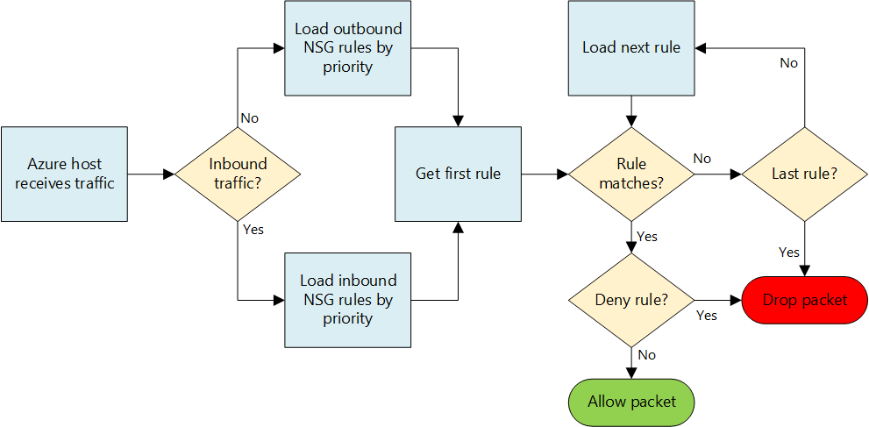
Networking: Network Security Groups
100/400 NSGs per region per sub
Rules per NSG: 200/500
Rules to allow/deny traffic
Rules for inbound/outbound
Can be associated with Subnets and/or directly to NICs attached to VMs.
Rules are based on Protocol, Source Port Range, Destination Port Range, Source Address Prefix, Destination Address Prefix
Default Tags for categories of IP addresses:
VirtualNetwork
AzureLoadbalancer
Internet
Default Rules
Inbound
Allow Vnet, Allow LoadBalancer, Deny All Inbound
Outbound
Allow Vnet, Allow Internet, Deny All Outbound
Service Tags
Application Security Groups
Augmented Rules
https://docs.microsoft.com/en-us/azure/virtual-network/virtual-networks-nsg

Slide 12
Networking: Network Security Groups
Property | Description | Constraints | Considerations
Protocol | Protocol to match for the rule. | TCP, UDP, or * | Using * as a protocol includes ICMP (East-West traffic only), as well as UDP and TCP, and may reduce the number of rules you need. At the same time, using * might be too broad an approach, so it's recommended that you use * only when necessary.
Source port range | Source port range to match for the rule. | Single port number from 1 to 65535, port range (example: 1-65635), or * (for all ports). | Source ports could be ephemeral. Unless your client program is using a specific port, use * in most cases. Try to use port ranges as much as possible to avoid the need for multiple rules. Multiple ports or port ranges cannot be grouped by a comma.
Destination port range | Destination port range to match for the rule. | Single port number from 1 to 65535, port range (example: 1-65535), or * (for all ports). | Try to use port ranges as much as possible to avoid the need for multiple rules. Multiple ports or port ranges cannot be grouped by a comma.
Source address prefix | Source address prefix or tag to match for the rule. | Single IP address (example: 10.10.10.10), IP subnet (example: 192.168.1.0/24), default tag, or * (for all addresses). | Consider using ranges, default tags, and * to reduce the number of rules.
Destination address prefix | Destination address prefix or tag to match for the rule. | Single IP address (example: 10.10.10.10), IP subnet (example: 192.168.1.0/24), default tag, or * (for all addresses). | Consider using ranges, default tags, and * to reduce the number of rules.
Direction | Direction of traffic to match for the rule. | Inbound or outbound. | Inbound and outbound rules are processed separately, based on direction.
Priority | Rules are checked in the order of priority. Once a rule applies, no more rules are tested for matching. | Number between 100 and 4096. | Consider creating rules jumping priorities by 100 for each rule to leave space for new rules you might create in the future.
Access | Type of access to apply if the rule matches. | Allow or deny. | Keep in mind that if an allow rule is not found for a packet, the packet is dropped.

Slide 13
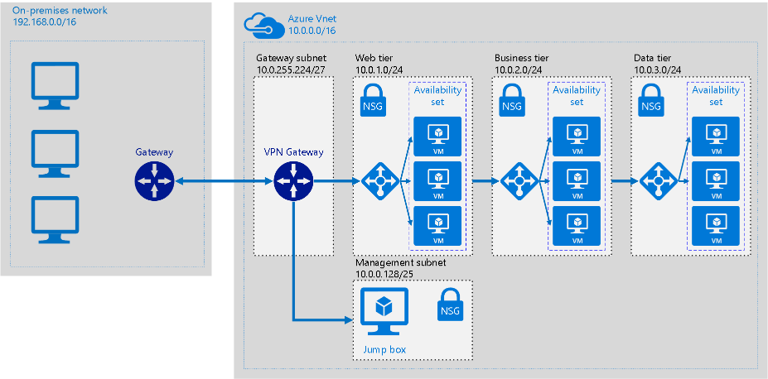
Hybrid: Extend On Premises

Slide 14
Hybrid: Extend On Premises
At a high level, most hybrid configurations require 5 resources:
VNET
Gateway Subnet
Azure VNET Gateway
“Local” Gateway
Connection
Planning a Hybrid Networking Architecture:
https://docs.microsoft.com/en-us/azure/vpn-gateway/vpn-gateway-plan-design

Slide 15
Hybrid: VPN
VPN
Types
Policy-Based (Static Routing)
Route-Based (Dynamic Routing)
Learn more: https://docs.microsoft.com/en-us/azure/architecture/reference-architectures/hybrid-networking/
SKUs
Basic (99.9% SLA)
Standard (99.95% SLA)
High Performance (99.95% SLA)
 | VPN Gateway throughput (1) | VPN Gateway max IPsec tunnels (2) | ExpressRoute Gateway throughput | VPN Gateway and ExpressRoute coexist
Basic SKU (3)(5)(6) | 100 Mbps | 10 | 500 Mbps (6) | No
Standard SKU (4)(5) | 100 Mbps | 10 | 1000 Mbps | Yes
High Performance SKU (4) | 200 Mbps | 30 | 2000 Mbps | Yes

Slide 16
Hybrid: VPN
 | PolicyBased Basic VPN Gateway | RouteBased Basic VPN Gateway | RouteBased Standard VPN Gateway | RouteBased High Performance VPN Gateway
Site-to-Site connectivity (S2S) | PolicyBased VPN configuration | RouteBased VPN configuration | RouteBased VPN configuration | RouteBased VPN configuration
Point-to-Site connectivity (P2S) | Not supported | Supported (Can coexist with S2S) | Supported (Can coexist with S2S) | Supported (Can coexist with S2S)
Authentication method | Pre-shared key | Pre-shared key for S2S connectivity, Certificates for P2S connectivity | Pre-shared key for S2S connectivity, Certificates for P2S connectivity | Pre-shared key for S2S connectivity, Certificates for P2S connectivity
Maximum number of S2S connections | 1 | 10 | 10 | 30
Maximum number of P2S connections | Not supported | 128 | 128 | 128
Active routing support (BGP) | Not supported | Not supported | Supported | Supported
https://docs.microsoft.com/en-us/azure/vpn-gateway/vpn-gateway-plan-design

Slide 17
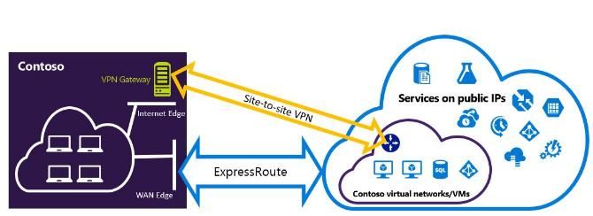
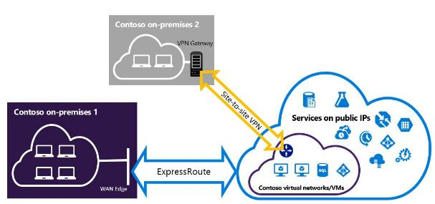
Hybrid: VPN
On-Premises VPN appliances
https://docs.microsoft.com/en-us/azure/vpn-gateway/vpn-gateway-about-vpn-device
Point-to-Site, Site-to-Site, ExpressRoute
https://docs.microsoft.com/en-us/azure/vpn-gateway/vpn-gateway-about-vpn-devices
ExpressRoute & Site-to-Site Co-Exist
https://docs.microsoft.com/en-us/azure/expressroute/expressroute-howto-coexist-resource-manager
Point-to-Site supports Mac clients

Slide 18
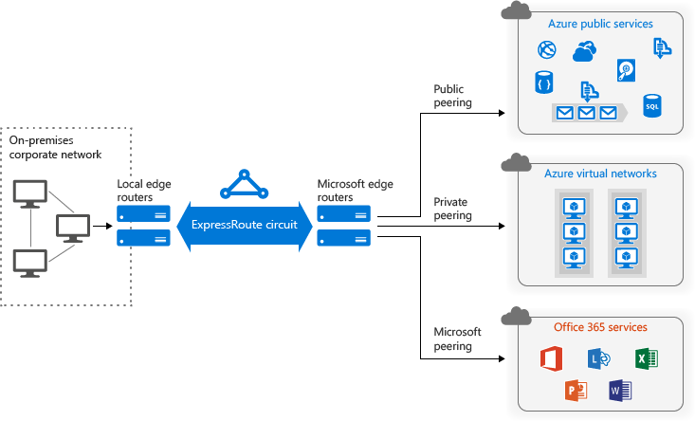
Hybrid: Express Route
Express Route
Merged Public & Microsoft Peering

Slide 19
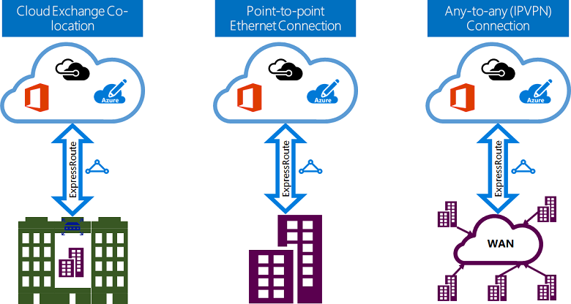
Hybrid: ExpressRoute
ExpressRoute
Layer 2 / Layer 3
https://docs.microsoft.com/en-us/azure/expressroute/expressroute-connectivity-models

Slide 20
Hybrid: ExpressRoute (99.95% SLA)
10 ER circuits per region per sub (ARM)
Min/Max Circuit Size = 50 Mbps / 10 Gbps
10 VNet Links per circuit
2 Plans (Metered, Unlimited), Multiple Port Speeds
https://azure.microsoft.com/en-us/pricing/details/expressroute/
ExpressRoute Premium Add-on
Increased route limits for public and private peering from 4,000 routes to 10,000 routes.
Global connectivity for services. An ExpressRoute circuit created in any region (excluding Azure China, Azure Germany, and Azure Government cloud) will have access to resources across any other region in the world.
Without Premium Add-On, ER circuit limited to geo-political area
Increased number of VNet links per ExpressRoute circuit from 10 to a larger limit (depending on the bandwidth of the circuit). 20 - 100
ExpressRoute videos
https://channel9.msdn.com/Shows/Azure-Friday/Azure-Hybrid-Networking-101
https://channel9.msdn.com/Shows/Azure-Friday/Azure-Hybrid-Networking-201

Slide 21


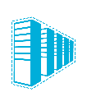
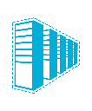

Hybrid Network Design Considerations
Cloud
Customer
Segment and workloads
Consumers
Access over public IP
DNS resolution
Connect from anywhere
Internet Connectivity
Developers
POC Efforts
Small scale deployments
Connect from anywhere
Secure point-to-site connectivity
SMB, Enterprises
Connect to Azure compute
Secure site-to-site
VPN connectivity
SMB & Enterprises
Mission critical workloads
Backup/DR, media, HPC
Connect to Microsoft services
ExpressRoute private connectivity

Slide 22
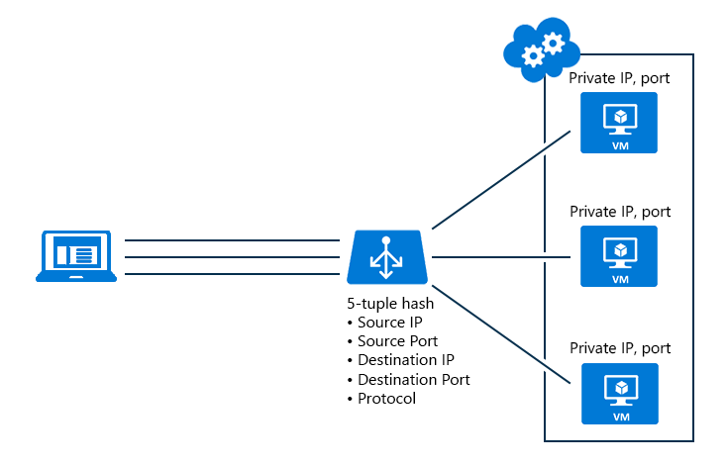

Network Services: Load Balancer
Hash-based distribution
5 tuple and 2 or 3 tuple
Port forwarding (e.g. Port 80 to Port 81)
Automatic Reconfiguration
Service Monitoring
Guest probe
HTTP custom probe
TCP custom probe
NAT Capability
Source NAT (share same VIP)
100 per subscription
150 rules per Load Balancer
https://docs.microsoft.com/en-us/azure/load-balancer/load-balancer-overview
Supports 1000 VMs
Availability Zones
HA Ports
Notes:
Availability Zones is a high-availability offering that protects your applications and data from datacenter failures. Availability Zones are unique physical locations within an Azure region. Each zone is made up of one or more datacenters equipped with independent power, cooling, and networking. To ensure resiliency, there’s a minimum of three separate zones in all enabled regions. The physical separation of Availability Zones within a region protects applications and data from datacenter failures. Zone-redundant services replicate your applications and data across Availability Zones to protect from single-points-of-failure. With Availability Zones, Azure offers industry best 99.99% VM uptime SLA. The full Azure SLA explains the guaranteed availability of Azure as a whole.

Slide 23
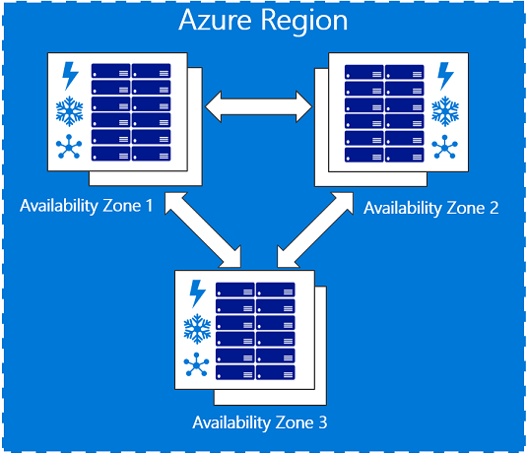
 | Regions that support Availability Zones Central US France Central East US 2 (Preview) West Europe (Preview) Southeast Asia (Preview) Services that support Availability Zones The Azure services that support Availability Zones are: Linux Virtual Machines Windows Virtual Machines Virtual Machine Scale Sets Managed Disks Load Balancer Public IP address Zone-redundant storage SQL Database

Slide 24
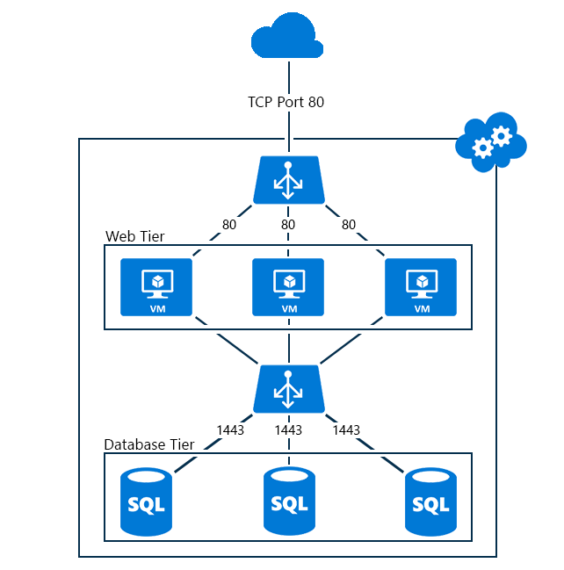
Network Services: Load Balancer
Public / Internet Facing Load Balancer
Internal Load Balancer
Outbound traffic & Source NAT
Scenario | Method | Note
Standalone VM (no load balancer, no Instance Level Public IP address) | Default SNAT | Azure associates a public IP address for SNAT
Load-balanced VM (no Instance Level Public IP address on VM) | SNAT using the load balancer | Azure uses a public IP address of the Load Balancer for SNAT
VM with Instance Level Public IP address (with or without load balancer) | SNAT is not used | Azure uses the public IP assigned to the VM
https://docs.microsoft.com/en-us/azure/load-balancer/load-balancer-outbound-connections

Slide 25
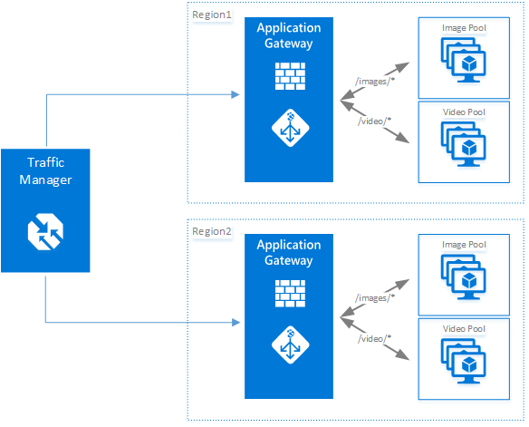
Network Services: Application Gateway
Layer 7 Load balancer, 99.95% SLA
HTTP(S) Load balancing
Cookie based session affinity
Web Application Firewall built-in
SSL Offload
End-to-End SSL
URL based content routing
Multi-site routing
Websockets
3 sizes: Small, Medium, Large
Up to 10 instances per gateway.
50 App Gateways per Subscription
20 Backend Pools per App Gateway
https://docs.microsoft.com/en-us/azure/application-gateway/application-gateway-introduction

Slide 26
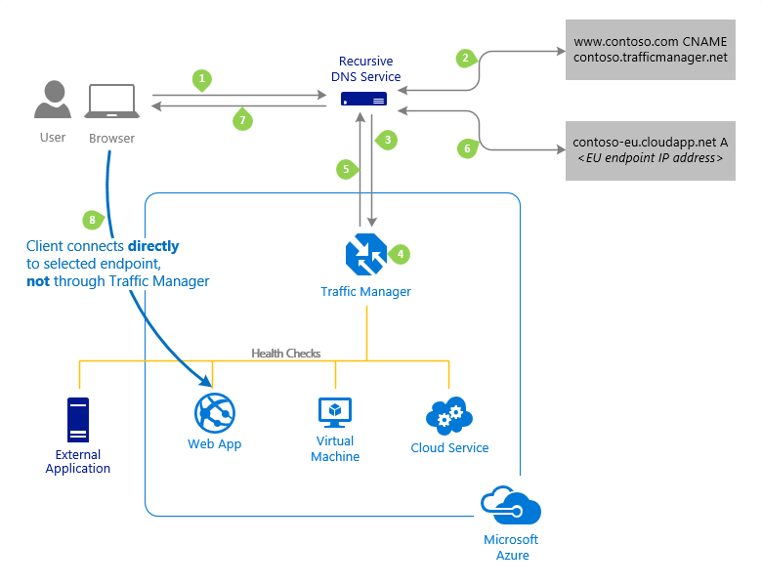
Network Services: Traffic Manager
Global High Availability (99.99% SLA)
Routing
Priority
Weighted
Performance
Geographic
Load Balance between Cloud and On-Premises
Can be Nested
100 profiles per subscription
200 Endpoint per profile

Slide 27
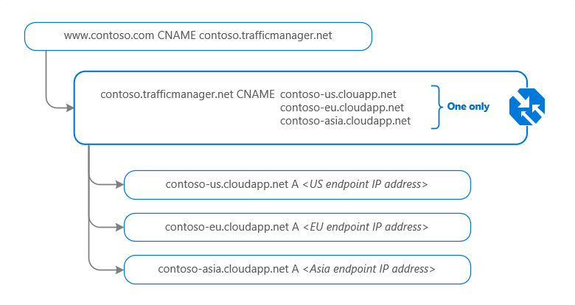
Network Services: Traffic Manager
Endpoint Types
Azure
External
Nested
Web Apps
https://docs.microsoft.com/en-us/azure/traffic-manager/traffic-manager-endpoint-types

Slide 28
Network Services
Load Balancer vs Application Gateway vs Traffic Manager
Service | Azure Load Balancer | Application Gateway | Traffic Manager
Technology | Transport level (Layer 4) | Application level (Layer 7) | DNS level
Application protocols supported | Any | HTTP, HTTPS, and WebSockets | Any (An HTTP endpoint is required for endpoint monitoring)
Endpoints | Azure VMs and Cloud Services role instances | Any Azure internal IP address, public internet IP address, Azure VM, or Azure Cloud Service | Azure VMs, Cloud Services, Azure Web Apps, and external endpoints
Vnet support | Can be used for both Internet facing and internal (Vnet) applications | Can be used for both Internet facing and internal (Vnet) applications | Only supports Internet-facing applications
Endpoint Monitoring | Supported via probes | Supported via probes | Supported via HTTP/HTTPS GET

Slide 29
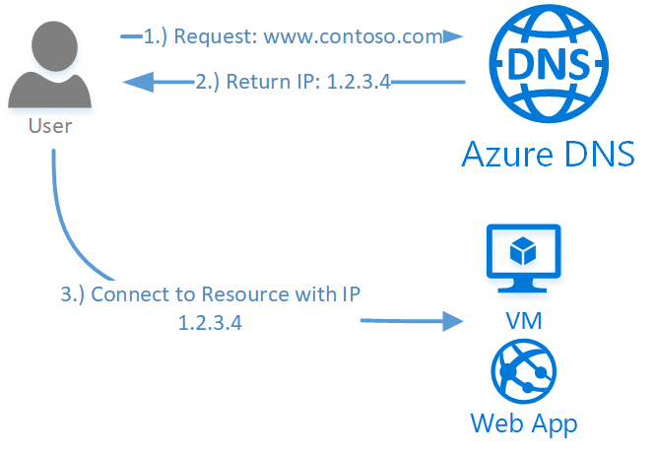
Network Services: Azure DNS
Azure Service for managing Public DNS (99.99% SLA)
Integrates with Azure Management Services
Controlled with Role Based Access Control
100 DNS Zones per subscription
5000 Record sets per zone
20 Records per record set
https://docs.microsoft.com/en-us/azure/dns/dns-overview

Slide 30
Networking Services: Private DNS
Scenario | Solution | Suffix
Name resolution between role instances or VMs located in the same cloud service or virtual network | Azure-provided name resolution | hostname or FQDN
Name resolution between role instances or VMs located in different virtual networks | Customer-managed DNS servers forwarding queries between vnets for resolution by Azure (DNS proxy). see Name resolution using your own DNS server | FQDN only
Resolution of on-premises computer and service names from role instances or VMs in Azure | Customer-managed DNS servers (e.g. on-premises domain controller, local read-only domain controller or a DNS secondary synced using zone transfers). See Name resolution using your own DNS server | FQDN only
Resolution of Azure hostnames from on-premises computers | Forward queries to a customer-managed DNS proxy server in the corresponding vnet, the proxy server forwards queries to Azure for resolution. See Name resolution using your own DNS server | FQDN only
Reverse DNS for internal IPs | Name resolution using your own DNS server | n/a
Name resolution between VMs or role instances located in different cloud services, not in a virtual network | Not applicable. Connectivity between VMs and role instances in different cloud services is not supported outside a virtual network. | n/a
Use Azure Provided, OR
Bring Your Own?
Azure DNS Private Zones for cross VNET name resolution
https://docs.microsoft.com/en-us/azure/virtual-network/virtual-networks-name-resolution-for-vms-and-role-instances

Slide 31
Networking Services: Private DNS
Azure Provided
No configuration, Highly Available
Intra VNET name resolution doesn’t require FQDN
DNS suffix can now be modified
WINS and NetBIOS not supported
DNS queries are throttled
Your Own DNS Server
Forwarded DNS Requests are sent to reserved IP 168.63.129.16
Specify DNS Server per Virtual Network or NIC
20/100 DNS Servers per Virtual Network

Slide 32
Networking Services: DHCP
Private IP address allocations:
Dynamic (default)
Static – survives stop/start
Use Static for
VMs that act as domain controllers or DNS servers.
Resources that require firewall rules using IP addresses.
Resources accessed by other apps/resources through an IP address.
Can be associated with
VM, Load Balancer, App Gateway
https://docs.microsoft.com/en-us/azure/virtual-network/virtual-network-ip-addresses-overview-arm

Slide 33
Networking Services: IP Addresses
Public and Private
4096 Private IP addresses per vnet
60 Dynamic Public IPs
20 Static Public IPs
Public IP addresses can be dynamic or static.
Dynamic IP address is not allocated until associated resource is created/started.
Dynamic IP Released when stop/delete resource.
Static IP address allocated immediately. Released only when it is deleted.
Use with
Virtual machines (VM)
Internet-facing load balancers
VPN gateways
Application gateway
Azure Datacenter IP Ranges: https://www.microsoft.com/en-us/download/details.aspx?id=41653
https://docs.microsoft.com/en-us/azure/virtual-network/virtual-network-ip-addresses-overview-arm#public-ip-addresses

Slide 34
Networking Services: User Defined Routes
System Routes allow VMs to communicate with each other inside a VNET
Out of the box, 3 rules:
Local Vnet Rule: Intra and Inter Subnet communication
Internet Rule: VMs to Internet
On-Prem Rule: VNET to on-prem via VPN
VNET to VNET via a Gateway or Peering also supported
User Defined Routes (UDR) to control the routing of packets
Force Tunneling to the Internet via on-prem network
Use Virtual Appliances
Route selection order: User Defined Route, BGP Route (with ER), System Route
IP forwarding allows a VM like a Virtual Appliance to receive traffic addressed to other destinations
100/200 User defined Routes per region per subscription

Slide 35
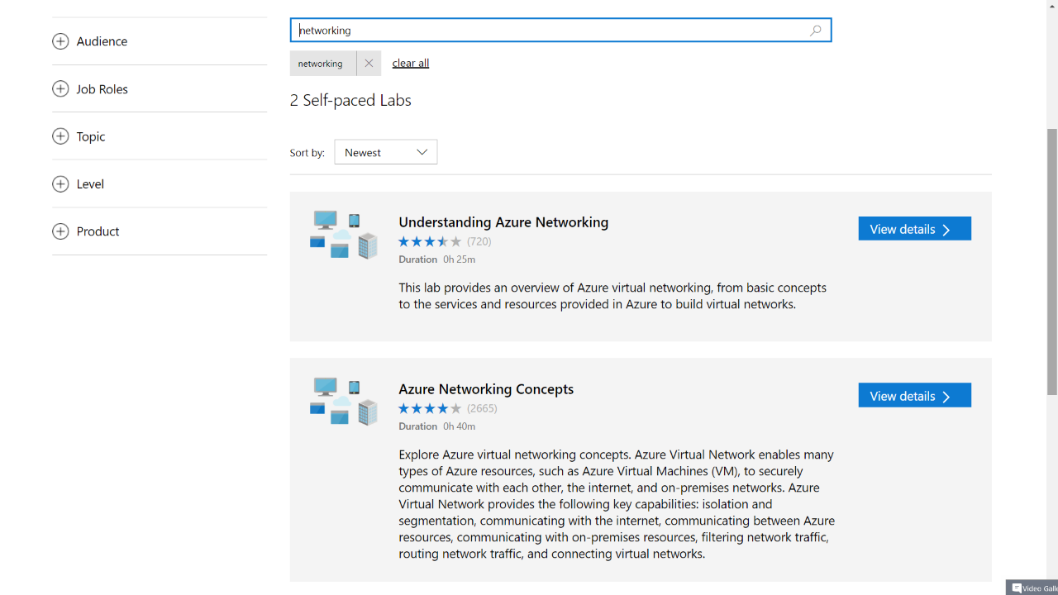

Slide 36
You want to let your mobile workers connect to a Network in Azure so they can access an internal only system. What VPN solution should you deploy?
Vnet to Vnet
Point to Site
Site to Site
ExpressRoute

Slide 37
You want to let your mobile workers connect to a Network in Azure so they can access an internal only system. What VPN solution should you deploy?
Vnet to Vnet
Point to Site
Site to Site
ExpressRoute

Slide 38
You want to create a JumpBox in Azure, and only allow users to SSH into it from their home or office. The JumpBox IP address is 10.0.0.100. How should you configure the Network Security Group rule?
"protocol": "Tcp", "sourcePortRange": "*", "destinationPortRange": "22", "sourceAddressPrefix": "*", "destinationAddressPrefix": "*", "access": "Allow", "priority": 1000, "direction": "Outbound"
"protocol": "Tcp", "sourcePortRange": "22", "destinationPortRange": "*", "sourceAddressPrefix": "*", "destinationAddressPrefix": "*", "access": "Allow", "priority": 1000, "direction": "Outbound“
"protocol": "Tcp", "sourcePortRange": "*", "destinationPortRange": "22", "sourceAddressPrefix": "10.0.0.0/24", "destinationAddressPrefix": "*", "access": "Allow", "priority": 100, "direction": "Inbound“
"protocol": "Tcp", "sourcePortRange": "*", "destinationPortRange": "22", "sourceAddressPrefix": "*", "destinationAddressPrefix": "*", "access": "Allow", "priority": 1000, "direction": "Inbound"

Slide 39
You want to create a JumpBox in Azure, and only allow users to SSH into it from their home or office. The JumpBox IP address is 10.0.0.100. How should you configure the Network Security Group rule?
"protocol": "Tcp", "sourcePortRange": "*", "destinationPortRange": "22", "sourceAddressPrefix": "*", "destinationAddressPrefix": "*", "access": "Allow", "priority": 1000, "direction": "Outbound"
"protocol": "Tcp", "sourcePortRange": "22", "destinationPortRange": "*", "sourceAddressPrefix": "*", "destinationAddressPrefix": "*", "access": "Allow", "priority": 1000, "direction": "Outbound“
"protocol": "Tcp", "sourcePortRange": "*", "destinationPortRange": "22", "sourceAddressPrefix": "10.0.0.0/24", "destinationAddressPrefix": "*", "access": "Allow", "priority": 100, "direction": "Inbound“
"protocol": "Tcp", "sourcePortRange": "*", "destinationPortRange": "22", "sourceAddressPrefix": "*", "destinationAddressPrefix": "*", "access": "Allow", "priority": 1000, "direction": "Inbound"

Slide 40
I am updating an app to a new release. I want to minimize downtime as much as possible and slowly introduce the release into production. Which Traffic Manager routing method should I use?
Weighted
Priority
Performance
Geographic

Slide 41
I am updating an app to a new release. I want to minimize downtime as much as possible and slowly introduce the release into production. Which Traffic Manager routing method should I use?
Weighted
Priority
Performance
Geographic

Slide 42
You've got an Azure Vnet in Europe and one in North America. What is the most cost effective way to connect these vnets so they can communicate securely?
Vnet Peering
Vnet-to-Vnet Connection
ExpressRoute
Connect through on-prem with VPNs

Slide 43
You've got an Azure Vnet in Europe and one in North America. What is the most cost effective way to connect these vnets so they can communicate securely?
Vnet Peering
Vnet-to-Vnet Connection
ExpressRoute
Connect through on-prem with VPNs
Global peering is available as of Mar 30, 2018

Slide 44
When adding a new VM to a load balancer, what must I do?
Update the Load Balancer's backend pool.
Update the Load Balancer's distribution mode.
Restart the Load Balancer
Add a new Load Balancer Probe.

Slide 45
When adding a new VM to a load balancer, what must I do?
Update the Load Balancer's backend pool.
Update the Load Balancer's distribution mode.
Restart the Load Balancer
Add a new Load Balancer Probe.

Slide 46
I have 25 IIS websites that I want to host in Azure. Each has a separate domain. Some require https and some require cookie based session affinity. At a minimum, what will I need?
2 Public IP Addresses
25 Application Gateways
25 Application Gateway Instances
2 Application Gateways
25 Public IP Addresses
Notes:
90 DAYS FROM GENERAL AVAILABILITY, NEW AZURE FUNCTIONALITY IS FAIR GAME!

Slide 47
I have 25 IIS websites that I want to host in Azure. Each has a separate domain. Some require https and some require cookie based session affinity. At a minimum, what will I need?
2 Public IP Addresses
25 Application Gateways
25 Application Gateway Instances
2 Application Gateways
25 Public IP Addresses

Slide 48
I have VMs in 2 Azure Vnets that need to communicate via name resolution. What can I use?
Azure’s Built In Private DNS
The Azure DNS Service
My own Azure based DNS servers
My on-premises Domain Controllers

Slide 49
I have VMs in 2 Azure Vnets that need to communicate via name resolution. What can I use?
Azure’s Built In Private DNS
The Azure DNS Service
My own Azure based DNS servers
My on-premises Domain Controllers
Azure Private DNS Zones Preview

Slide 50
Clients outside of Azure access my VM by IP address. I’ve maxed out my static Public IP addresses for the subscription and I occasionally need to turn the VM off. What is the most cost effective alternative?
Private Static IP address and a Dynamic Public IP address
Application Gateway with Dynamic Public IP address
VPN with a Dynamic Public IP address
Load Balancer with Dynamic Public IP address
Never turn off the VM

Slide 51
Clients outside of Azure access my VM by IP address. I’ve maxed out my static Public IP addresses for the subscription and I occasionally need to turn the VM off. What is the most cost effective alternative?
Private Static IP address and a Dynamic Public IP address
Application Gateway with Dynamic Public IP address
VPN with a Dynamic Public IP address
Load Balancer with Dynamic Public IP address
Never turn off the VM

Slide 52
Labs

