Slide 1
Exam 70-533 Implementing Microsoft Azure Infrastructure Solutions Exam 70-535 Architecting Azure Solutions
https://www.microsoft.com/en-ie/learning/exam-70-533.aspx
https://www.microsoft.com/en-ie/learning/exam-70-535.aspx
Speaker Information:
Notes:
Presentation: 105 minutes
Lab: 50 minutes
After completing this module, students will be able to:
Identify suitable workloads for the cloud.
Identify services and capabilities that Microsoft Azure provides.
Use Azure portals to manage Azure services and subscriptions.
Use Windows PowerShell to manage Azure services and subscriptions.
Use Azure Command-Line Interface (CLI) to manage Azure services and subscriptions.
Describe the primary characteristics of Azure Resource Manager.
Use Azure services to enhance management and monitoring of Azure.
Required materials
To teach this module, you need the Microsoft PowerPoint file 20533D_01.pptx.
Preparation tasks
To prepare for this module, you should:
Read all this module’s materials.
Practice performing the demonstrations and labs.
Work through the Module Review and Takeaways section to determine how you will use the information to reinforce student learning and promote knowledge transfer to on-the-job performance.
As you prepare for this class, it is imperative that you complete the labs yourself. This gives you an understanding of how the labs work, as well as the concepts that each lab covers. This enables you to provide meaningful hints to students who might have issues while working in the labs. Furthermore, it will help guide your lecture to ensure that you discuss the concepts that the labs cover.
20533D
1: Introduction to Microsoft Azure

Slide 2
Getting Started Labs https://docs.microsoft.com/en-us/azure/#get-started
Deploy infrastructure
Linux virtual machines
Windows virtual machines
Secure and manage resources
Azure Security Center
Azure Monitor
Azure Application Insights
Azure Cost Management
Azure Backup
Azure Site Recovery
Azure Migrate
Azure Policy
Develop apps
Manage data and AI
Relational Databases
SQL database as a service
SQL Data Warehouse as a service
PostgreSQL database as a service
MySQL database as a service
NoSQL
Azure Cosmos DB
Storage
Blob Storage
AI and Cognitive Services
Machine Learning
Cognitive Services
.NET Python Java | PHP Node.js Go
App Models
Web Apps
Serverless Functions
Containers
Microservices with Service Fabric
https://docs.microsoft.com/en-us/azure/#get-started

Slide 3
Attendee Challenge – What Azure challenges should we tackle? What Challenges Are You Facing?
Examples:
Contoso Purchases Fabrikam and needs to Migrate Fabrikam to Contoso or Azure
How to Architect Networks Using Isolation Security Zones to Enhance Security Posture When Moving to Azure
What challenges are YOU facing?
http://github.com/guruskill/70-535 Labs/

Slide 4
Linux Labs Using Cloud Shell
Linux 1. Create and Manage Linux VMs with the Azure CLI 2.0 in Azure Cloud Shell
Linux 2a. Install a LAMP web server on a Linux virtual machine in Azure
Linux 2b. Install a LEMP web server on a Linux virtual machine in Azure
Linux 2c. Create a MongoDB, Express, AngularJS, and Node.js (MEAN) stack on a Linux virtual machine in Azure
Linux 3. Monitor and update a Linux virtual machine in Azure using Cloud Shell
Linux 4. Use Azure Security Center to monitor Linux virtual machines
Linux Bonus. Prepare a Debian VHD for Azure – Prereq’s Hyper-V and Debian .ISO
Linux Labs if you do not have access to SSH or you want to use Azure Cloud Shell
https://docs.microsoft.com/en-us/azure/virtual-machines/linux

Slide 5
Linux 1. Create and Manage Linux VMs with the Azure CLI 2.0 in Azure Cloud Shell
You learn how to:
Create and connect to a VM
Select and use VM images
View and use specific VM sizes
Resize a VM
View and understand VM state
[Optional] Manage Disks: https://docs.microsoft.com/en-us/azure/virtual-machines/linux/tutorial-manage-disks
Important Notes
Use your Initials1514 or other unique code for variables to prevent any duplicate public urls e.g. (lowercase):
dan1514vm for “myVM”
Stop and Deallocate or Delete resources when done with ALL labs (you can reuse these machines for the next few labs but do not forget to go back after done with labs)
https://docs.microsoft.com/en-us/azure/virtual-machines/linux/tutorial-manage-vm
Notes:
High level demonstration steps
From the classroom VM, start Internet Explorer and browse to https://github.com/Azure /azure-quickstart-templates/tree/master/101-vm-simple-windows.
On the Very simple deployment of a Windows VM page, click Deploy to Azure.
On the Custom deployment blade, specify the following:
Subscription: Your subscription
Resource group: Create new
New resource group name: 10979D03-DemoRG03
Location: Azure region closest to the classroom location
Admin Username: Student
Admin Password: Pa55w.rd1234
Dns Label Prefix: Unique string consisting of lower-case letters and digits
Windows OS Version: 2016-Datacenter
Click I agree to the terms and conditions stated above.
Select the Pin to dashboard check box.
Click Purchase.
Note the Deployment started message in the notification area at the top of the page.
Do not wait for the deployment to complete. Continue with the next topic.

Slide 6
Linux 2a. Install a LAMP web server on a Linux virtual machine in Azure
You learn how to:
Create an Ubuntu VM
Open port 80 for web traffic
Install Apache, MySQL, and PHP
Verify installation and configuration
Install WordPress on the LAMP server
Important Notes
Use your Initials1514 or other unique code for variables to prevent any duplicate public urls e.g. (lowercase):
dan1514vm for “myVM”
Stop and Deallocate or Delete resources when done with ALL labs (you can reuse these machines for the next few labs but do not forget to go back after done with labs)
https://docs.microsoft.com/en-us/azure/virtual-machines/linux/tutorial-lamp-stack
Notes:
High level demonstration steps
From the classroom VM, start Internet Explorer and browse to https://github.com/Azure /azure-quickstart-templates/tree/master/101-vm-simple-windows.
On the Very simple deployment of a Windows VM page, click Deploy to Azure.
On the Custom deployment blade, specify the following:
Subscription: Your subscription
Resource group: Create new
New resource group name: 10979D03-DemoRG03
Location: Azure region closest to the classroom location
Admin Username: Student
Admin Password: Pa55w.rd1234
Dns Label Prefix: Unique string consisting of lower-case letters and digits
Windows OS Version: 2016-Datacenter
Click I agree to the terms and conditions stated above.
Select the Pin to dashboard check box.
Click Purchase.
Note the Deployment started message in the notification area at the top of the page.
Do not wait for the deployment to complete. Continue with the next topic.

Slide 7
Linux 2b. Install a LEMP web server on a Linux virtual machine in Azure
You learn how to:
Create an Ubuntu VM (the 'L' in the LEMP stack)
Open port 80 for web traffic
Install NGINX, MySQL, and PHP
Verify installation and configuration
Install WordPress on the LEMP server
Important Notes
Use your Initials1514 or other unique code for variables to prevent any duplicate public urls e.g. (lowercase):
dan1514vm for “myVM”
Stop and Deallocate or Delete resources when done with ALL labs (you can reuse these machines for the next few labs but do not forget to go back after done with labs)
https://docs.microsoft.com/en-us/azure/virtual-machines/linux/tutorial-lemp-stack
Notes:
High level demonstration steps
From the classroom VM, start Internet Explorer and browse to https://github.com/Azure /azure-quickstart-templates/tree/master/101-vm-simple-windows.
On the Very simple deployment of a Windows VM page, click Deploy to Azure.
On the Custom deployment blade, specify the following:
Subscription: Your subscription
Resource group: Create new
New resource group name: 10979D03-DemoRG03
Location: Azure region closest to the classroom location
Admin Username: Student
Admin Password: Pa55w.rd1234
Dns Label Prefix: Unique string consisting of lower-case letters and digits
Windows OS Version: 2016-Datacenter
Click I agree to the terms and conditions stated above.
Select the Pin to dashboard check box.
Click Purchase.
Note the Deployment started message in the notification area at the top of the page.
Do not wait for the deployment to complete. Continue with the next topic.

Slide 8
Linux 2c. Create a MongoDB, Express, AngularJS, and Node.js (MEAN) stack on a Linux virtual machine in Azure
You learn how to:
Create a Linux VM
Install Node.js
Install MongoDB and set up the server
Install Express and set up routes to the server
Access the routes with AngularJS
Run the application
Important Notes
Use your Initials1514 or other unique code for variables to prevent any duplicate public urls e.g. (lowercase):
dan1514vm for “myVM”
Stop and Deallocate or Delete resources when done with ALL labs (you can reuse these machines for the next few labs but do not forget to go back after done with labs)
https://docs.microsoft.com/en-us/azure/virtual-machines/linux/tutorial-mean-stack
Notes:
High level demonstration steps
From the classroom VM, start Internet Explorer and browse to https://github.com/Azure /azure-quickstart-templates/tree/master/101-vm-simple-windows.
On the Very simple deployment of a Windows VM page, click Deploy to Azure.
On the Custom deployment blade, specify the following:
Subscription: Your subscription
Resource group: Create new
New resource group name: 10979D03-DemoRG03
Location: Azure region closest to the classroom location
Admin Username: Student
Admin Password: Pa55w.rd1234
Dns Label Prefix: Unique string consisting of lower-case letters and digits
Windows OS Version: 2016-Datacenter
Click I agree to the terms and conditions stated above.
Select the Pin to dashboard check box.
Click Purchase.
Note the Deployment started message in the notification area at the top of the page.
Do not wait for the deployment to complete. Continue with the next topic.

Slide 9
Linux 3. Monitor and update a Linux virtual machine in Azure using Cloud Shell
You learn how to:
Enable boot diagnostics on the VM
View boot diagnostics
View host metrics
Enable diagnostics extension on the VM
View VM metrics
Create alerts based on diagnostic metrics
Manage package updates
Monitor changes and inventory
Set up advanced monitoring
Important Notes
Use your Initials0514 or other unique code for variables to prevent any duplicate public urls e.g. (lowercase):
dan1514vm for “myVM”
If you did not delete your VMs from another lab, you can use that VM instead of creating one
Deallocate or Delete the resources when done with the labs
Do not create the VM Scale Set – we do not have enough Azure Credits ☹
https://docs.microsoft.com/en-us/azure/virtual-machines/linux/tutorial-monitoring
Notes:
High level demonstration steps
From the classroom VM, start Internet Explorer and browse to https://github.com/Azure /azure-quickstart-templates/tree/master/101-vm-simple-windows.
On the Very simple deployment of a Windows VM page, click Deploy to Azure.
On the Custom deployment blade, specify the following:
Subscription: Your subscription
Resource group: Create new
New resource group name: 10979D03-DemoRG03
Location: Azure region closest to the classroom location
Admin Username: Student
Admin Password: Pa55w.rd1234
Dns Label Prefix: Unique string consisting of lower-case letters and digits
Windows OS Version: 2016-Datacenter
Click I agree to the terms and conditions stated above.
Select the Pin to dashboard check box.
Click Purchase.
Note the Deployment started message in the notification area at the top of the page.
Do not wait for the deployment to complete. Continue with the next topic.

Slide 10
Linux 4. Use Azure Security Center to monitor Linux virtual machines
You learn how to:
Set up data collection
Set up security policies
View and fix configuration health issues
Review detected threats
Important Notes
Use VMs from prior labs
Stop and Deallocate or Delete resources when done with ALL labs
https://docs.microsoft.com/en-us/azure/virtual-machines/linux/tutorial-azure-security
Notes:
High level demonstration steps
From the classroom VM, start Internet Explorer and browse to https://github.com/Azure /azure-quickstart-templates/tree/master/101-vm-simple-windows.
On the Very simple deployment of a Windows VM page, click Deploy to Azure.
On the Custom deployment blade, specify the following:
Subscription: Your subscription
Resource group: Create new
New resource group name: 10979D03-DemoRG03
Location: Azure region closest to the classroom location
Admin Username: Student
Admin Password: Pa55w.rd1234
Dns Label Prefix: Unique string consisting of lower-case letters and digits
Windows OS Version: 2016-Datacenter
Click I agree to the terms and conditions stated above.
Select the Pin to dashboard check box.
Click Purchase.
Note the Deployment started message in the notification area at the top of the page.
Do not wait for the deployment to complete. Continue with the next topic.

Slide 11
Linux Bonus. Prepare a Debian VHD for Azure – Prereq’s Hyper-V and Debian .ISO
You learn how to:
Use Azure-Manage to create Debian VHDs
Manually prepare a Debian VHD
Important Notes
This section assumes that you have already installed a Debian Linux operating system from an .iso file downloaded from the Debian website to a virtual hard disk. Multiple tools exist to create .vhd files; Hyper-V is only one example. For instructions using Hyper-V, see Install the Hyper-V Role and Configure a Virtual Machine.
Please see also General Linux Installation Notes for more tips on preparing Linux for Azure.
SEE ALSO:
Information for Non-Endorsed Distributions
https://docs.microsoft.com/en-us/azure/virtual-machines/linux/create-upload-generic
https://docs.microsoft.com/en-us/azure/virtual-machines/linux/debian-create-upload-vhd
Notes:
High level demonstration steps
From the classroom VM, start Internet Explorer and browse to https://github.com/Azure /azure-quickstart-templates/tree/master/101-vm-simple-windows.
On the Very simple deployment of a Windows VM page, click Deploy to Azure.
On the Custom deployment blade, specify the following:
Subscription: Your subscription
Resource group: Create new
New resource group name: 10979D03-DemoRG03
Location: Azure region closest to the classroom location
Admin Username: Student
Admin Password: Pa55w.rd1234
Dns Label Prefix: Unique string consisting of lower-case letters and digits
Windows OS Version: 2016-Datacenter
Click I agree to the terms and conditions stated above.
Select the Pin to dashboard check box.
Click Purchase.
Note the Deployment started message in the notification area at the top of the page.
Do not wait for the deployment to complete. Continue with the next topic.

Slide 12
Windows Labs Using Cloud Shell
Win 1. Creating a VM from an Azure Resource Manager template using Cloud Shell – PowerShell
Win 2a. Create a Windows virtual machine install IIS with the Azure CLI 2.0
Win 2b. Install the SQL\IIS\.NET stack in a Windows VM with Azure Cloud Shell
Win 3. Monitor and update a Windows virtual machine in Azure using Cloud Shell
4. Use Azure Security Center to monitor Windows virtual machines
Windows Labs if you do not have access to RDP or you want to use Azure Cloud Shell
https://docs.microsoft.com/en-us/azure/virtual-machines/windows

Slide 13
Win 1. Creating a VM from an Azure Resource Manager template using Cloud Shell - PowerShell
You learn how to:
Use Azure Cloud Shell
Create an availability set
Create a VM in an availability set
Check available VM sizes
Check Azure Advisor
Important Notes
Use your Initials1514 or other unique code for variables to prevent any duplicate public urls e.g. (lowercase):
dan1514IP for “myPublicIpAddress”
dan1514vm for “myVM”
Stop and Deallocate or Delete resources when done with ALL labs (you can reuse these machines for the next few labs but do not forget to go back after done with labs)
Do not create the VM Scale Set – we do not have enough Azure Credits ☹
https://docs.microsoft.com/en-us/azure/virtual-machines/linux/tutorial-manage-vm
Notes:
High level demonstration steps
From the classroom VM, start Internet Explorer and browse to https://github.com/Azure /azure-quickstart-templates/tree/master/101-vm-simple-windows.
On the Very simple deployment of a Windows VM page, click Deploy to Azure.
On the Custom deployment blade, specify the following:
Subscription: Your subscription
Resource group: Create new
New resource group name: 10979D03-DemoRG03
Location: Azure region closest to the classroom location
Admin Username: Student
Admin Password: Pa55w.rd1234
Dns Label Prefix: Unique string consisting of lower-case letters and digits
Windows OS Version: 2016-Datacenter
Click I agree to the terms and conditions stated above.
Select the Pin to dashboard check box.
Click Purchase.
Note the Deployment started message in the notification area at the top of the page.
Do not wait for the deployment to complete. Continue with the next topic.

Slide 14
Win 2a. Create a Windows virtual machine install IIS with the Azure CLI 2.0
You learn how to:
Use Azure Cloud Shell
Create a Resource Group
Create a VM
Install IIS
Open Port 80
Connect via RDP and HTTP
Delete Resource Group
Important Notes
Use your Initials1514 or other unique code for variables to prevent any duplicate public urls e.g. (lowercase):
dan1514vm for “myVM”
Stop and Deallocate or Delete resources when done with ALL labs (you can reuse these machines for the next few labs but do not forget to go back after done with labs)
https://docs.microsoft.com/en-us/azure/virtual-machines/windows/quick-create-cli
Notes:
High level demonstration steps
From the classroom VM, start Internet Explorer and browse to https://github.com/Azure /azure-quickstart-templates/tree/master/101-vm-simple-windows.
On the Very simple deployment of a Windows VM page, click Deploy to Azure.
On the Custom deployment blade, specify the following:
Subscription: Your subscription
Resource group: Create new
New resource group name: 10979D03-DemoRG03
Location: Azure region closest to the classroom location
Admin Username: Student
Admin Password: Pa55w.rd1234
Dns Label Prefix: Unique string consisting of lower-case letters and digits
Windows OS Version: 2016-Datacenter
Click I agree to the terms and conditions stated above.
Select the Pin to dashboard check box.
Click Purchase.
Note the Deployment started message in the notification area at the top of the page.
Do not wait for the deployment to complete. Continue with the next topic.

Slide 15
Win 2b. Install the SQL\IIS\.NET stack in a Windows VM with Azure Cloud Shell
Azure Security Center can help you gain visibility into your Azure resource security practices. Security Center offers integrated security monitoring. It can detect threats that otherwise might go unnoticed. In this tutorial, you learn about Azure Security Center, and how to:
Create a VM
Install IIS and the .NET Core SDK on the VM
Create a VM running SQL Server
Install the SQL Server extension
Important Notes
Use your Initials0514 or other unique code for variables to prevent any duplicate public urls e.g. (lowercase):
dan0514iisip for “myIISPublicIpAddress”
dan1514vmiis for “IISVM”
Stop and Deallocate or Delete resources when done with ALL labs (After Security Lab 4)
https://docs.microsoft.com/en-us/azure/virtual-machines/windows/tutorial-iis-sql
Notes:
High level demonstration steps
From the classroom VM, start Internet Explorer and browse to https://github.com/Azure /azure-quickstart-templates/tree/master/101-vm-simple-windows.
On the Very simple deployment of a Windows VM page, click Deploy to Azure.
On the Custom deployment blade, specify the following:
Subscription: Your subscription
Resource group: Create new
New resource group name: 10979D03-DemoRG03
Location: Azure region closest to the classroom location
Admin Username: Student
Admin Password: Pa55w.rd1234
Dns Label Prefix: Unique string consisting of lower-case letters and digits
Windows OS Version: 2016-Datacenter
Click I agree to the terms and conditions stated above.
Select the Pin to dashboard check box.
Click Purchase.
Note the Deployment started message in the notification area at the top of the page.
Do not wait for the deployment to complete. Continue with the next topic.

Slide 16
Win 3. Monitor and update a Windows virtual machine in Azure using Cloud Shell
You learn how to:
Use PowerShell or Azure Cloud Shell
Enable boot diagnostics on a VM
View boot diagnostics
View VM host metrics
Install the diagnostics extension
View VM metrics
Create an alert
Manage Windows updates
Monitor changes and inventory
Set up advanced monitoring
Important Notes
Use your Initials0514 or other unique code for variables to prevent any duplicate public urls e.g. (lowercase):
dan0514ip for “myIISPublicIpAddress”
dan1514vm for “myVM”
If you did not delete your VMs from another lab, you can use that VM instead of creating one
Deallocate or Delete the resources when done with the labs
Do not create the VM Scale Set – we do not have enough Azure Credits ☹
https://docs.microsoft.com/en-us/azure/virtual-machines/windows/tutorial-monitoring
Notes:
High level demonstration steps
From the classroom VM, start Internet Explorer and browse to https://github.com/Azure /azure-quickstart-templates/tree/master/101-vm-simple-windows.
On the Very simple deployment of a Windows VM page, click Deploy to Azure.
On the Custom deployment blade, specify the following:
Subscription: Your subscription
Resource group: Create new
New resource group name: 10979D03-DemoRG03
Location: Azure region closest to the classroom location
Admin Username: Student
Admin Password: Pa55w.rd1234
Dns Label Prefix: Unique string consisting of lower-case letters and digits
Windows OS Version: 2016-Datacenter
Click I agree to the terms and conditions stated above.
Select the Pin to dashboard check box.
Click Purchase.
Note the Deployment started message in the notification area at the top of the page.
Do not wait for the deployment to complete. Continue with the next topic.

Slide 17
4. Use Azure Security Center to monitor Windows virtual machines
Azure Security Center can help you gain visibility into your Azure resource security practices. Security Center offers integrated security monitoring. It can detect threats that otherwise might go unnoticed. In this tutorial, you learn about Azure Security Center, and how to:
Set up data collection
Set up security policies
View and fix configuration health issues
Review detected threats
Important Notes
Use VMs from prior labs
Stop and Deallocate or Delete resources when done with ALL labs
https://docs.microsoft.com/en-us/azure/virtual-machines/windows/tutorial-iis-sql
Notes:
High level demonstration steps
From the classroom VM, start Internet Explorer and browse to https://github.com/Azure /azure-quickstart-templates/tree/master/101-vm-simple-windows.
On the Very simple deployment of a Windows VM page, click Deploy to Azure.
On the Custom deployment blade, specify the following:
Subscription: Your subscription
Resource group: Create new
New resource group name: 10979D03-DemoRG03
Location: Azure region closest to the classroom location
Admin Username: Student
Admin Password: Pa55w.rd1234
Dns Label Prefix: Unique string consisting of lower-case letters and digits
Windows OS Version: 2016-Datacenter
Click I agree to the terms and conditions stated above.
Select the Pin to dashboard check box.
Click Purchase.
Note the Deployment started message in the notification area at the top of the page.
Do not wait for the deployment to complete. Continue with the next topic.

Slide 18
Containers
Create your first container https://blogs.technet.microsoft.com/canitpro/2017/08/02/step-by-step-first-steps-with-azure-container-services/
More ways to create containers https://docs.microsoft.com/en-us/azure/container-instances/

Slide 19
Compute & Networking
Multi-NIC Virtual Machine Creation using Two Subnets https://github.com/Azure/azure-quickstart-templates/blob/master/101-1vm-2nics-2subnets-1vnet/
Create a virtual network using PowerShell https://docs.microsoft.com/en-us/azure/virtual-network/virtual-networks-create-vnet-arm-ps
Create a virtual network using the Azure CLI https://docs.microsoft.com/en-us/azure/virtual-network/virtual-networks-create-vnet-arm-cli
http://github.com/guruskill/70-535

Slide 20
Storage and Operational Readiness
Getting Started with Storage - Manage Storage Account - in .Net https://azure.microsoft.com/en-us/resources/samples/storage-dotnet-manage-storage-accounts/
Desired State Configuration (DSC) https://docs.microsoft.com/en-us/azure/automation/automation-dsc-getting-started
How Azure Backup Works in 10 mins https://docs.microsoft.com/en-us/azure/backup/backup-try-azure-backup-in-10-mins
More Storage: https://azure.microsoft.com/en-us/resources/samples/?service=storage

Slide 21
Labs
Multi-NIC Virtual Machine Creation using Two Subnets https://github.com/Azure/azure-quickstart-templates/blob/master/101-1vm-2nics-2subnets-1vnet
Create a virtual network using PowerShell https://docs.microsoft.com/en-us/azure/virtual-network/virtual-networks-create-vnet-arm-ps
Create a virtual network using the Azure CLI https://docs.microsoft.com/en-us/azure/virtual-network/virtual-networks-create-vnet-arm-cli
Create your first container https://blogs.technet.microsoft.com/canitpro/2017/08/02/step-by-step-first-steps-with-azure-container-services/
More ways to create containers https://docs.microsoft.com/en-us/azure/container-instances/
Getting Started with Storage - Manage Storage Account - in .Net https://azure.microsoft.com/en-us/resources/samples/storage-dotnet-manage-storage-accounts/
Authentication: Broken Link in lab Use: https://docs.microsoft.com/en-us/dotnet/azure/dotnet-sdk-azure-authenticate?view=azure-dotnet
Desired State Configuration (DSC) https://docs.microsoft.com/en-us/azure/automation/automation-dsc-getting-started
How Azure Backup Works in 10 mins https://docs.microsoft.com/en-us/azure/backup/backup-try-azure-backup-in-10-mins
More… http://github.com/guruskill/70-535
Azure Quick Start Templates https://github.com/Azure/azure-quickstart-templates

Slide 22
Thought Experiment / Case Study Labs Architecting Solutions on the Whiteboard
Case 1: Web App – Solution Design / Architectural Design Contoso Vacation Application Migration to Azure
Case 2: Contoso Acquisition and Migration of Fabrikam
Case 3a: Operational Design - INDIVIDUAL
Case 3b: Operational Design - TEAM
Case 4: Using Isolation Security Zones to Enhance Security Posture
Team or Individual Exercises
Answers are NOT in the slides. There are no wrong answers (unless answer does not solve the problem). Is there a better answer? Keep digging to find the best solutions.

Slide 23
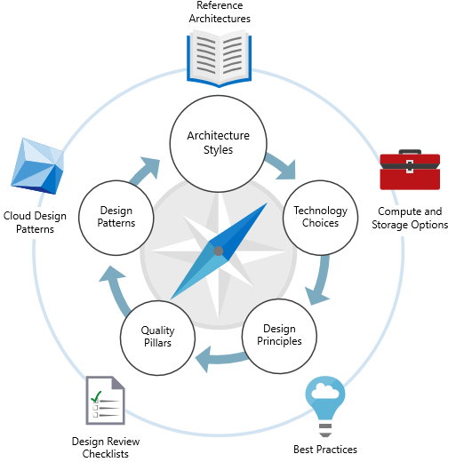
Solution Architecture: Overview
Session Goals
Understand Azure architectural approach, and recognize different Architecture Styles
Know when to choose a particular style, based on benefits, challenges, and best practices
Understand Technology Choices for implementing architecture styles.
Recognize Azure services that can be used for compute and data services
Reference: https://docs.microsoft.com/en-us/azure/architecture/

Slide 24
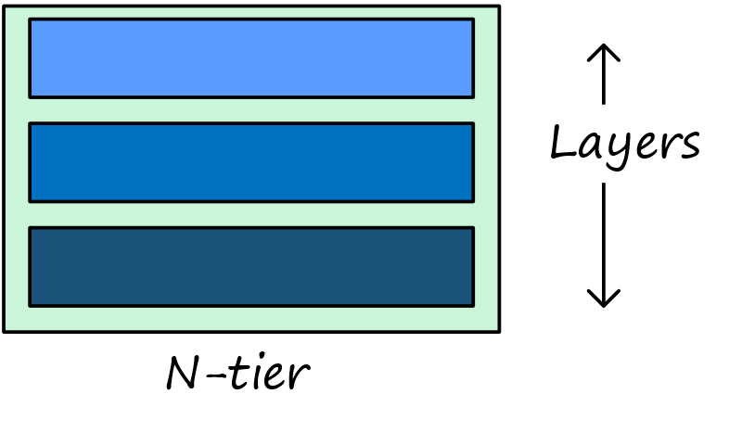
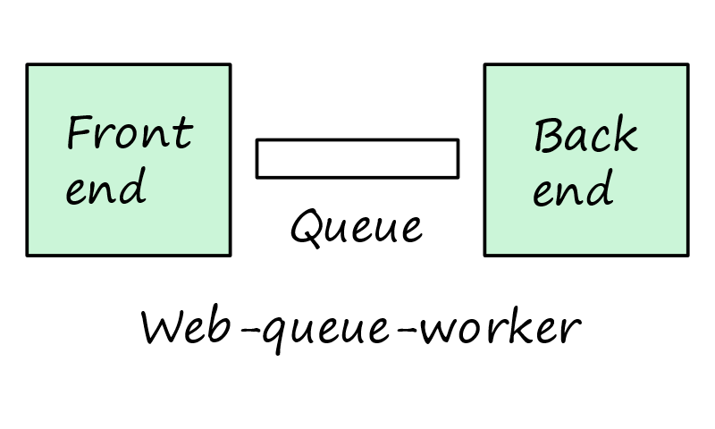
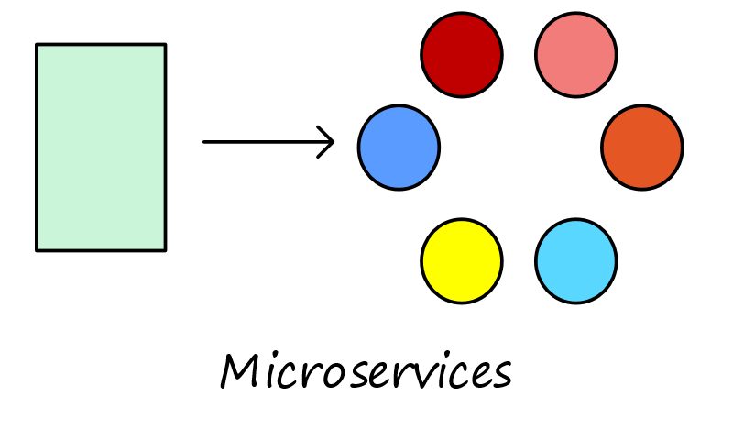
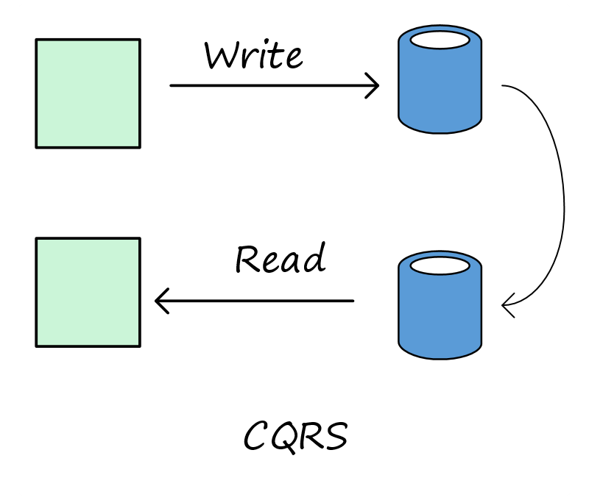
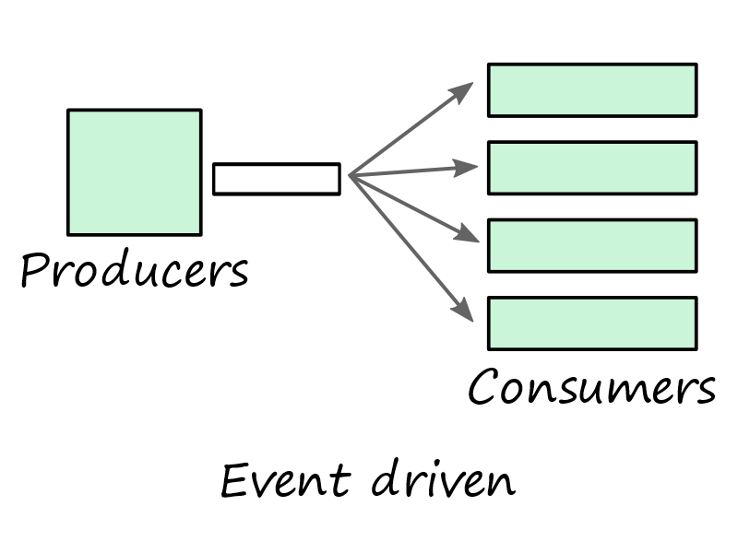
Lab Setup: Architecture Styles
N-tier
Traditional enterprise architecture
Ideal for lift-and-shift
Web-Queue-Worker
PaaS solutions
Relies on asynchronous messaging
Microservices
Many small, independent services
Requires mature DevOps processes
CQRS (Command and Query Responsibility Segregation)
Scale the read and write workloads independently; Large Scale
For collaborative domains where many users access the same data
Event-driven
Producers publish, consumers subscribe
Common with large data volumes (e.g. IoT)
Big Data & Big Compute
Parallel processing of chunks across large dataset
Parallel computations across large number of cores
Design Considerations
Scale
Complexity
Cost
Manageability
Service-Level Agreement
Architecture Styles
Know when to choose a particular style, based on benefits, challenges, and best practices
Technology Choices
Recognize Azure services that can be used for compute and data services
Reference: https://docs.microsoft.com/en-us/azure/architecture/guide/

Slide 25
Thought Experiment / Case Study 1 Web App - SOLUTION DESIGN
Break Into Teams of 5-8
Prepare report to be delivered to CA during your next meeting
Include any clarifying questions or additional observations in report
Background: Contoso Vacations is a full-service travel agency with operations across North America and Europe. As part of a campaign to gain market share in emerging tourism trends, Contoso recently acquired Fabrikam Adventures, a small agritourism company that helps vacationers find and book working vacations on farms and ranches. As part of the acquisition, Contoso has decided to sunset all but three of Fabrikam’s existing applications.
You are a team of Cloud Architects at Contoso Vacations. The Chief Architect (CA) has just sent an email that was forwarded to you for collaboration, asking for your help on a special project.
Subject: Need plan to migrate 3 Fabrikam apps to Azure
I wanted to give you a status update on the datacenter consolidation project. I got word from the Steering Committee that the target data for decommissioning the Fabrikam datacenter will be the end of Q3, when their cage lease expires. The plan is for all their legacy LOB apps to be sunset and folded into our corresponding Contoso LOB apps. That leaves them with three customer-facing apps to continue supporting after the DC closes.
These three applications will be migrated to Azure, so that Fabrikam’s existing datacenter can be decommissioned. The applications that will be migrated to Azure include:
GoFabrikam.com – Fabrikam’s customer-facing website lets vacationers browse, search, and book trips. The current website is an asp.net application that runs on IIS and SQL Server 2014 SP2. Traffic volume to this website is low, but performance needs to be reliable in order to capture every potential booking.
Agri-Hub – Fabrikam’s partner-facing website is used by farm operators to enter and update inventory, manage reservations and customer charges, and coordinate revenue payments from Fabrikam. The partner website is a section of the main website, but uses a SQL server 2008 (SP4) backend for reservations. It also has several custom APIs and scheduled batch process jobs that were written in Java, PHP, and C#, which allow the reservation system to integrate with several 3rd party service providers, including airlines, credit card processors, and banks.
Farm Viewer –Fabrikam provides real-time data about each farm on their website. Visitors can research information about crops, livestock, weather, and harvest activities as they book their trips. This information is collected by IoT sensors at each farm. The sensor data are sent to a web service, where they are collected and stored in a MongoDB database. The information is then accessed and displayed on the main website.
Desired Outcome:
For each of the three workflows identified as candidates to move to Azure, identify an architecture style for the target-state solution, and create a high-level solution design that indicates the Azure services that you plan on using. You do not need to specify service configurations or other details at this point; however, please be prepared to justify your decision in terms of features, cost, and quality.
Resources:
Azure Architecture Styles
Azure Reference Architectures
https://github.com/guruskill/70-535 Labs folder 70-534-00-Labs.pptx (or .PDF)

Slide 26
Case Study #1: Contoso Vacations
Contoso Vacations is a full-service travel agency with operations across North America and Europe. As part of a campaign to gain market share in emerging tourism trends, Contoso recently acquired Fabrikam Adventures, a small agritourism company that helps vacationers find and book working vacations on farms and ranches. As part of the acquisition, Contoso has decided to sunset all but three of Fabrikam’s existing applications.
The three applications that remain will be migrated to Azure, so that Fabrikam’s existing datacenter can be decommissioned. The three applications that will be migrated to Azure include:
GoFabrikam.com – Fabrikam’s customer-facing website lets vacationers browse, search, and book trips. The current website is an asp.net application that runs on IIS and SQL Server 2014 SP2. Traffic volume to this website is low, but performance needs to be reliable in order to capture every potential booking.
Agri-Hub – Fabrikam’s partner-facing website is used by farm operators to enter and update inventory, manage reservations and customer charges, and coordinate revenue payments from Fabrikam. The partner website is a section of the main website, but uses a SQL server 2008 (SP4) backend for reservations. It also has several custom APIs and scheduled batch process jobs that were written in Java, PHP, and C#, which allow the reservation system to integrate with several 3rd party service providers, including airlines, credit card processors, and banks.
Farm Viewer (“View”) –Fabrikam provides real-time data about each farm on their website. Visitors can research information about crops, livestock, weather, and harvest activities as they book their trips. This information is collected by IoT sensors at each farm. The sensor data are sent to a web service, where they are collected and stored in a MongoDB database. The information is then accessed and displayed on the main website.
Resources:
Azure Architecture Styles
Azure Reference Architectures
https://github.com/guruskill/70-535 Labs folder 70-534-00-Labs.pptx (or .PDF)

Slide 27
Thought Experiment / Case Study 1 Web App - SOLUTION DESIGN
Break Into Teams of 5-8
Prepare report to to be delivered to CTO during your next meeting
Include any clarifying questions or additional observations in report
Application
Architecture: N-tier, Web-queue-worker, Microservices, CQRS, Event-driven
Design Considerations / Why?: Scale, Complexity, Cost, Manageability, Service-Level Agreement
GoFabrikam.com –
Agri-Hub –
Farm Viewer -

Slide 28
Thought Experiment / Case Study #2 Acquisition and Migration of Fabrikam Team Collaboration Exercise
Break Into Teams of 5-8
Prepare report to be delivered to CTO during your next meeting
Include any clarifying questions or additional observations in report
You are the administrator for Contoso. You have more than 100 hosts in your on-premises datacenter. You are replicating and using Site Recovery as part of your BC/DR plan. Contoso just acquired another company, Fabrikam, Inc. The development teams at both Contoso and Fabrikam use Visual Studio and Visual Studio Team Services.
Letter from the CTO:
As you know, we have finalized the acquisition of Fabrikam. I would like for you to come up with a plan of execution for migrating the workloads running in the Fabrikam datacenter. Here are some key points you should understand as you plan for consuming Fabrikam services:
The lease of the space will be expiring in 9 months at that time we must have everything out. I would prefer that we get everything moved quickly, in the next 4-6 months. Then we can do some cleanup later if needed. We MUST make sure we maintain a high degree of confidence in securing all data as we go through this transition.
All applications will continue to be used for the foreseeable future.
It is important to minimize system downtime of Fabrikam services.
The physical machines at Fabrikam are beyond or nearing their expected usable life.
We have a directive from leadership to minimize capital expenditures where possible, so we should look at viability of putting services in Azure.
I would also like you to be conscious of the costs of ongoing maintenance of these services until such a time that they can be evaluated for longer term upkeep projections.
Where possible, leverage our DevOps practices and switch applications to native cloud apps and serverless compute.
Some of the Fabrikam apps are already running in containers. Plan on adding these to our existing container infrastructure running on Azure Service Fabric.
Fabrikam has 5 VMware hosts, 10 Hyper-V hosts and more than 60 VMs. They are running a mix of operating systems, some running Linux but most running Windows Server. The following is a quick list of servers and apps.
46-web applications running on Windows Server and IIS; 4 are only providing API services to applications. Those that use data, use SQL server. All but three are running stateless.
3-websites running on Linux, Apache, PHP, WordPress
3-containerized applications running .NET core on Linux
8-containerized applications running Node.js
1-Oracle database server
3-SQL servers running more than 20 databases
2-Domain Controllers
2-External DNS servers
2-Monitoring and reporting servers
1-file server
1-3 node cluster for batch processing and analysis running R scripts; usually on a monthly cadence to do analysis of customer purchasing patterns
Email continued on next slide….
Lab Slide Location: http://github.com/guruskill/70-535 Labs/70-535-00-Labs.pptx or .pdf

Slide 29
Thought Experiment / Case Study #2 Answer the following questions in a report back to the CTO…
Break Into Teams of 5-8
Prepare report to to be delivered to CTO during your next meeting
Include any clarifying questions or additional observations in report
Email from CTO Continued:
With this in mind, please help me answer the following questions :
What site should be used to receive Fabrikam VM services and why?
What tool(s) could we use to securely migrate the VM workloads while minimizing downtime?
How can we minimize downtime of Fabrikam web services?
Can the Linux websites be migrated to serverless compute on Azure? If so, how?
What are the best destination services for migration of the IIS websites?
What is the best way to move the containers to Azure Container Instances?
What are the next steps after an application has been moved to Azure?
Is the batch cluster a good candidate for migration to native cloud apps or serverless compute? Why or Why not?
Are there any tools to help us understand what is running at Fabrikam and what would be needed for the migration?
Is there a tool or service to switch the existing web workloads to the new production location (Azure or Contoso) with little or no downtime?
What challenges do you think you need to prepare for?

Slide 30
Thought Experiment / Case Study 3a Operational Design - Individual
Individual Assignment 15 mins
Prepare report to be delivered to Dan during your next meeting
Include any clarifying questions or additional observations in report
Background: You are the architect for Contoso. Your Innovation team would like to deploy new services on Azure to support a new application Contoso is building. You get an email from the head of Innovation with the following request.
Letter from the Director of Innovation:
As part of our new DevOps initiatives, we would like to deploy a new application project into the Azure cloud. We have one such application nearing completion, which is a multi-tier application with a .NET application front end and a SQL Server backend database. There are a number of different components, including a number of API applications that make up the system. The application will need to send and receive data from Contoso’s network for various tasks both scheduled and on-demand. As we plan to deploy this application to Azure, can you help us understand how to design for high-availability, monitoring and alerting? This new application is critically important to the business. It is actually creating a new revenue stream for Contoso. I would not be surprised if 3 years from now it became our top flagship product. For some period of time, we will be giving away the high-end services for free to help us get all of our existing customers on the platform and to bring in a massive new pipeline of prospective customers. Let’s have a meeting next week to discuss the architecture we should be using to monitor and manage the applications. I will check our calendars and send you an invite.
Thanks so much for your help.
Dan
Desired Outcome: Prepare for your meeting with Dan and report to the class how you will address the following questions:
What services would you use to monitor and scale the application front end?
What services would you use to monitor and scale the SQL Database?
What alerts will need to be configured?
What automation should be put in place to make sure there is not configuration drift?
What foreseeable challenges do you think you need to discuss in your first meeting with Dan?
Resources:
Lab Slide Location: http://github.com/guruskill/70-535 Labs/70-535-00-Labs.pptx or .pdf

Slide 31
Thought Experiment / Case Study 3a Operational Design - Individual
Team Assignment Break into Teams of 5-8
Prepare report to be delivered to Dan during your next meeting
Include any clarifying questions or additional observations in report
Background: You are the architect for Contoso. Your Innovation team would like to deploy new services on Azure to support a new application Contoso is building. You get an email from the head of Innovation with the following request.
Letter from the Director of Innovation:
As part of our new DevOps initiatives, we would like to deploy a new application project into the Azure cloud. We have one such application nearing completion, which is a multi-tier application with a .NET application front end and a SQL Server backend database. There are a number of different components, including a number of API applications that make up the system. The application will need to send and receive data from Contoso’s network for various tasks both scheduled and on-demand. As we plan to deploy this application to Azure, can you help us understand how to design for high-availability, monitoring and alerting? This new application is critically important to the business. It is actually creating a new revenue stream for Contoso. I would not be surprised if 3 years from now it became our top flagship product. For some period of time, we will be giving away the high-end services for free to help us get all of our existing customers on the platform and to bring in a massive new pipeline of prospective customers. Let’s have a meeting next week to discuss the architecture we should be using to monitor and manage the applications. I will check our calendars and send you an invite.
Thanks so much for your help.
Dan
Desired Outcome: Prepare for your meeting with Dan and report to the class how you will address the following questions:
What services would you use to monitor and scale the application front end?
What services would you use to monitor and scale the SQL Database?
What alerts will need to be configured?
What automation should be put in place to make sure there is not configuration drift?
What foreseeable challenges do you think you need to discuss in your first meeting with Dan?
Resources:
Lab Slide Location: http://github.com/guruskill/70-535 Labs/70-535-00-Labs.pptx or .pdf
Notes:
Desired Outcome: Prepare for your meeting with Dan and report to the class how you will address the following questions:
What services would you use to monitor and scale the application front end?
What services would you use to monitor and scale the SQL Database?
What alerts will need to be configured?
What automation should be put in place to make sure there is not configuration drift?
What foreseeable challenges do you think you need to discuss in your first meeting with Dan?
Cost
Cloud compatibility
data volume
data growth
how application was built
sla RTO, RPO
State of devops pipeline
code coverage in testing
golive?
performance requirements
availability
current/startup capacity
Securty REquiremetns
Endpoint, authentication, type of connections, federation
Data movement
Where are the customers?
What are teh teams (QA, UAT, Pre-prod, etc)
Backup and recovery

Slide 32
Thought Experiment / Case Study 4 Using Isolation Security Zones to Enhance Security Posture
Team Assignment
Break into Teams of 5-8
Answer Questions and Draw Network Diagram
Using isolated security zones is an effective way to reduce many types of risks and increase security posture.
For example, many enterprises use a perimeter network to isolate their Internet-facing resources from other parts of their internal network. You can implement the same level of protection in Azure Virtual Network as well. In this case, you have a number of VMs that will be exposed to the Internet. And you have a number of application servers and database servers on the same virtual network.
You decide what servers you have in this network
Minimum:
1 RDP Server
1 File Server
1 DC
4 application servers
1 DB server
With this in mind, answer the following questions:
What technologies would you use to implement a perimeter network in Azure Virtual Network?
How would you design your network topology?

