Slide 1
Don’t put all your eggs in the same basket: Omnivory as a Dynamic Response to Changing Conditions
The Lab

Slide 2
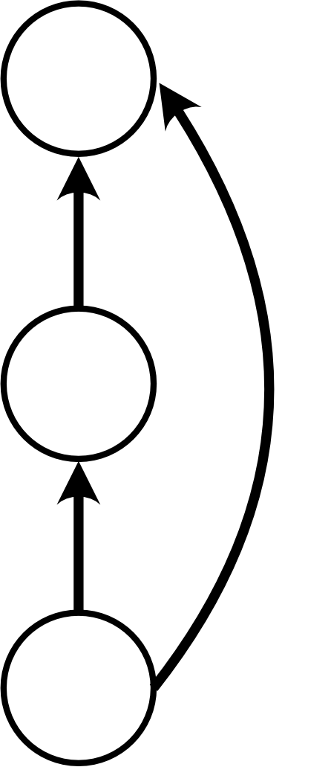
Model: Core
Pros:
Clearly the simplest
Extensive literature on outcomes and relation to empirical data
Cons:
Only a single channel – Can not directly deal with habitat coupling
Is this enough to deal with both the “bottom up” and “top down” approaches?

Slide 3
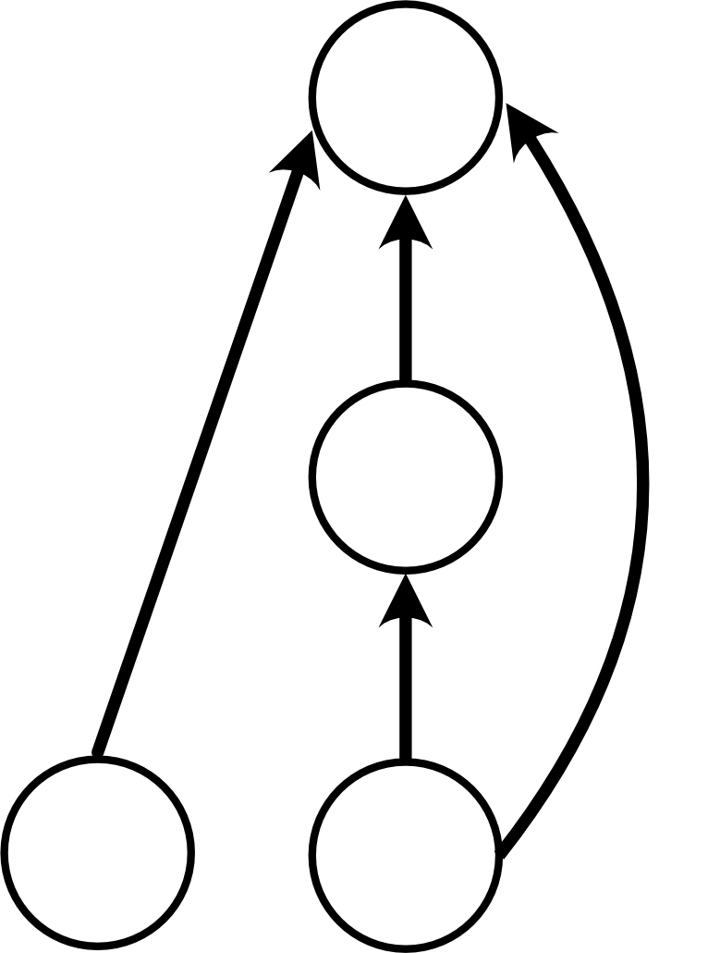
Model: Subsidy
Pros:
Not much more complex than the basic model
Has a clear separation between the parameters of interest (the main chain, ad the two omnivory links)
Cons:
Adds a second “kind” of omnivory, “across chain” versus “same chain”. This might have unintended consequences
Goes this capture habitat selection? If not, might not be a good choice

Slide 4
Model: Subsidy (Consumer)
Fix figure, add quick description and then send to onedrive carling setup

Slide 5
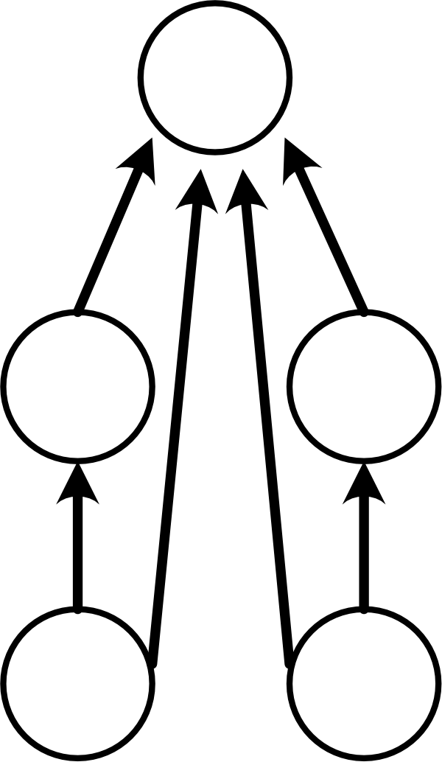
Model: Multichannel
Pros:
The most all inclusive
Clearly can be used to look at the interplay between habitat selection and omnivory
Cons:
Complex
Need to think about how to isolate the symmetry between the two chains

