Slide 1
Eric McClelland
Data Analytics Portfolio

Slide 2





Projects
GameCo
Analyze global video game sales to recommend market strategy.
Medical Staffing Company
Analyze influenza trends to recommend staffing assignments.
Rockbuster Stealth, LLC
Analyze movie rentals to recommend market strategy.
Instacart
Analyze grocery orders and customer profiles to recommend sales and promotions.
Texas Rain
Analyze dataset of weather events to identify relationships.

Slide 3

GameCo
Objective: Perform a descriptive analysis of a video game data set to foster a better understanding of how GameCo’s new games might fare in the market.
Project Brief
Skills Used: Data Integrity checks and Cleaning; Grouping, Summarizing, and Visualizing data; Descriptive Analysis; Presentation of findings.
Dataset: ​Video Game Sales from VGChartz.
Tools Used:

Slide 4
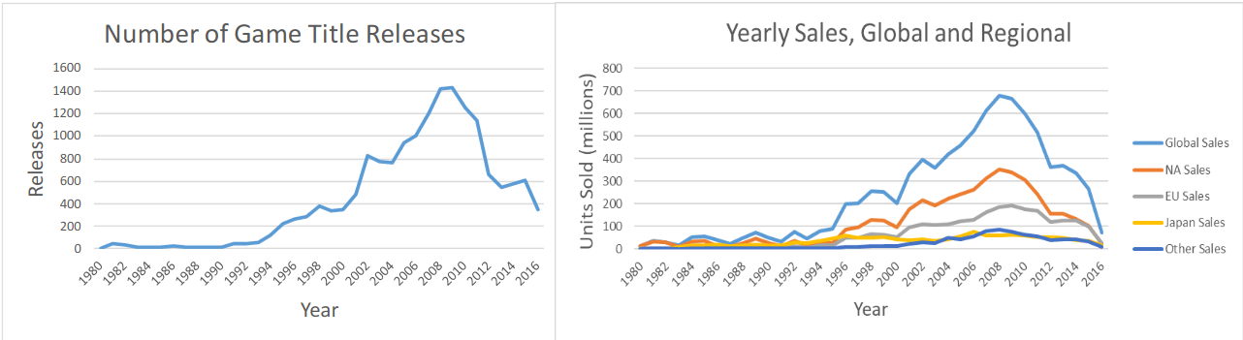
Analysis for 1980 – 2016: Plummeting Physical Market
Both the number of new game title releases - and their sales - have plummeted since their peak in 2009, at least for physical retail. Our data do not cover online purchases or digital delivery channels.

Slide 5
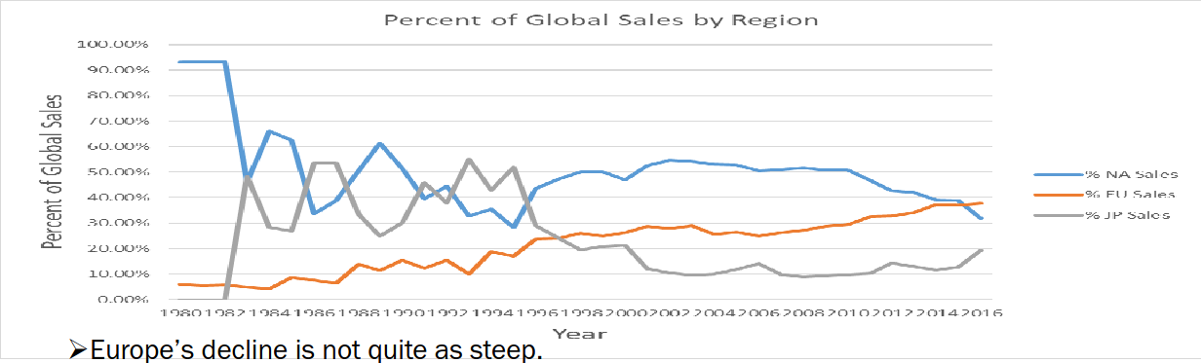
Analysis for 1980 – 2016: Regional Dominance Shifts Over Time
North America and Japan alternately dominated until the mid-1990s in terms of units sold, after which Japan fell to third place. However, among the worldwide declines since 2009, Europe’s has been the most gradual, such that Europe now appears to have the largest slice of this dwindling pie.

Slide 6
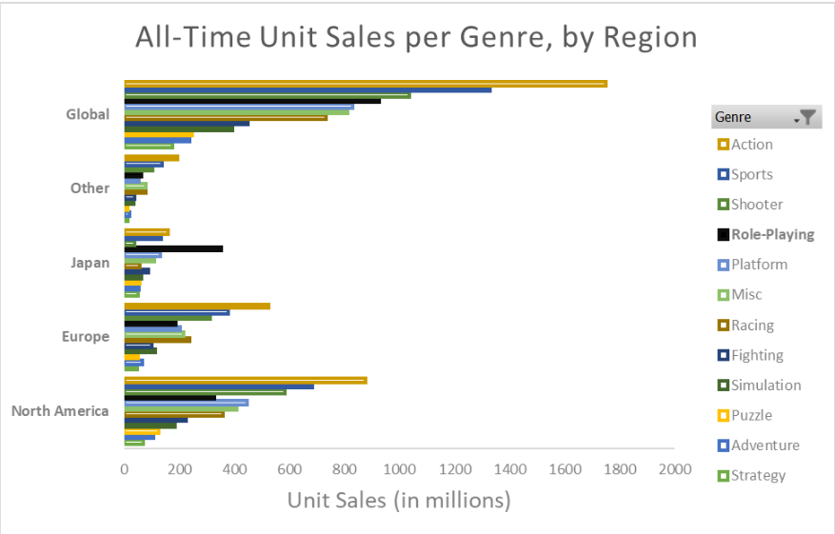
Analysis for 1980 – 2016: Genre Dominance
Action, Sports, and Shooter genres are the top three globally, and everywhere except Japan.
In Japan, Role-Playing games (highlighted in black) \dominate.

Slide 7
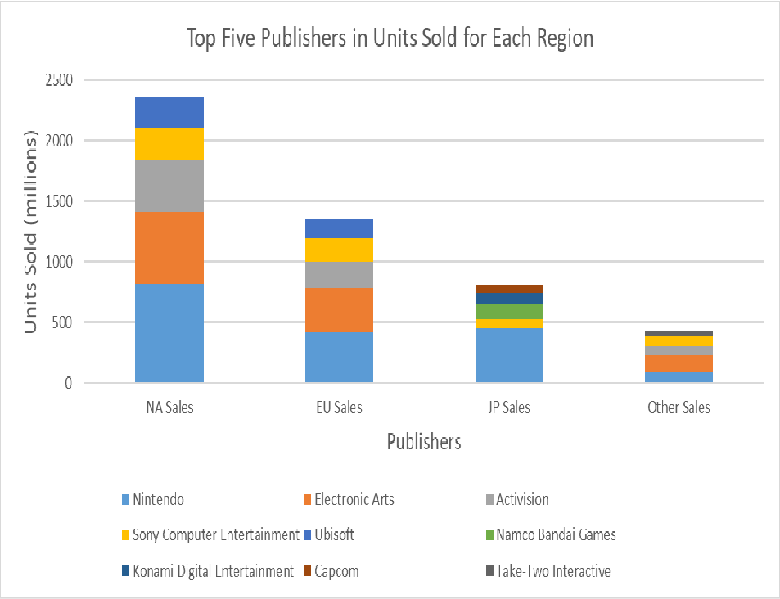
Analysis for 1980 – 2016: Regional Competition: Top Five Publishers
Nintendo has dominated all three main regions.
Electronic Arts a strong second in North America and Europe, but not top five in Japan.

Slide 8
Recommendations
The physical retail market for games appears to be in serious decline!
To the extent that we remain invested in the physical retail markets:
Since its peak in 2008 and 2009, physical retail game sales have plummeted, and the likely cause is that purchasing - and to some extent delivery - has shifted online.
Urgently investigate online markets.
We lack data about online markets, so we should acquire and analyze such data immediately.
Europe appears to be the best region for investment right now, with North America a falling second and Japan a rising third.
Europe is declining alongside the rest of the world, but its decline is not quite as steep.
Action, Sports, and Shooter genres are generally most popular, except for Japan, where Role-Playing dominates.
Nintendo is the publisher to beat.

Slide 9

Medical Staffing Agency
Objective: Determine when to send staff, and how many, to each state, in preparation for the upcoming influenza season.
Project Brief
Skills Used: Data Integrity checks and Cleaning; Data Integration; Data Transformation; Statistical Hypothesis Testing; Visualization; Forecasting; Storytelling.
Dataset: ​Influenza Death Statistics from the CDC.
Dataset: ​Population Statistics from the U.S. Census Bureau.
Tools Used:

Slide 10
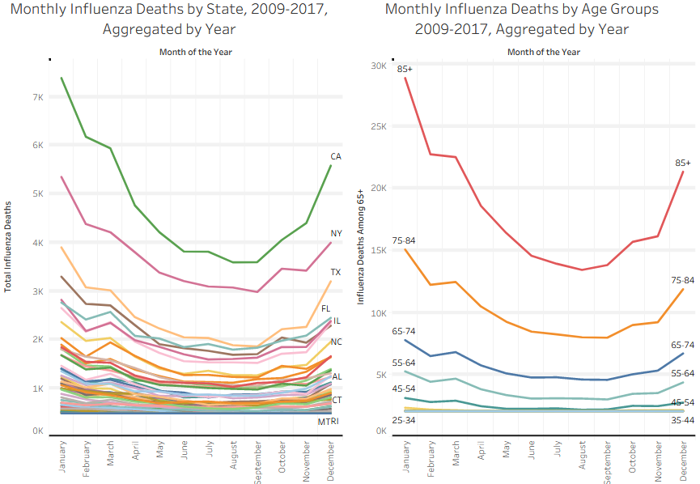
Analysis for 2009 – 2017: Seasonality, Ages of Influenza Deaths
Flu deaths generally rise across all states in October, peaking in January and tapering off in May.
Adults aged 65 years and over make up the majority of fatalities.

Slide 11
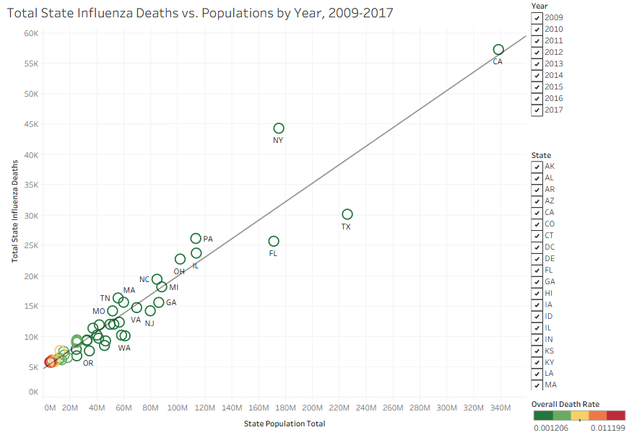
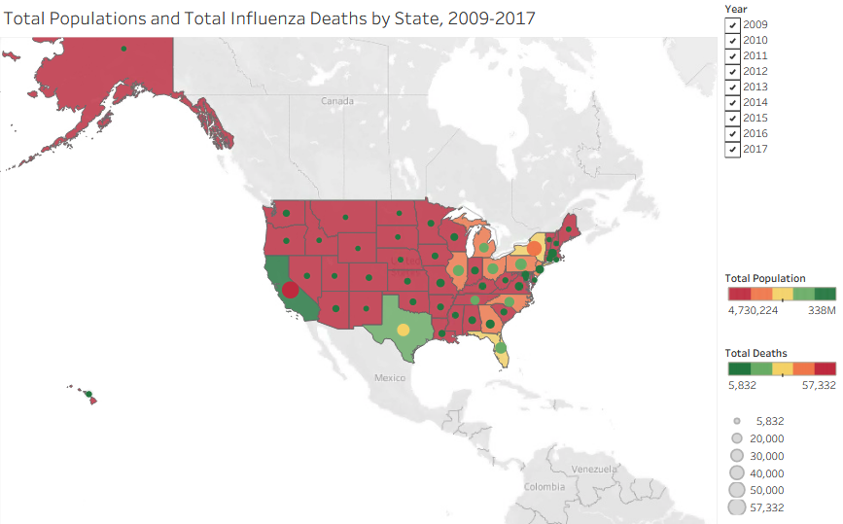
Analysis for 2009 – 2017: Geographic Distribution of Flu Deaths
Absolute counts of influenza deaths are highest in states with largest populations.
However, the death rates are higher among less-populated states.

Slide 12
Recommendations
Times & Locations for Staff Placement
Obtain More Data:
More staff should be sent to states with higher mortality counts, particularly California, New York, Texas, Pennsylvania, and Florida. Urgently investigate online markets.
Staff should be in place by October.
Link to Tableau Presentation: Here
Missing Data:
Agency staff numbers.
Required staff-to-patient ratios.
Past years’ staffing performance (over- vs. under-staffing).
Past years’ hospitalization rates.
Research possible causes for inverse relationship between Total Population and Overall Death Rate.
Conduct surveys, both during and after this season, to evaluate patient outcomes, as well as staff and patient satisfaction.

Slide 13

Rockbuster Stealth, LLC
Objective: Provide data-driven answers to a series of questions from executives; the answers will be used for their 2020 company strategy.
Project Brief
Skills Used: SQL Database Usage with PostgreSQL: Data Integrity checks and Cleaning; Data Filtering and Summarization; Joining Tables; Subqueries; Common Table Expressions; Views
Dataset: ​Rockbuster dataset
Tools Used:

Slide 14
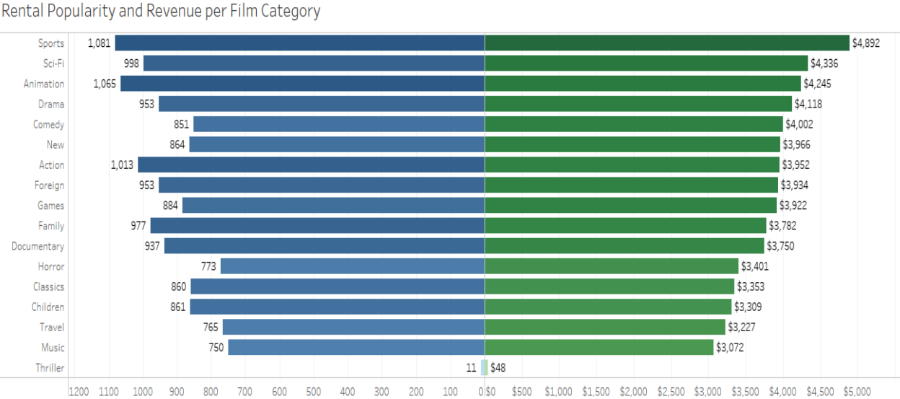
Analysis
Sports, SciFi, and Animation are the Top Three Categories for both revenue and rental popularity.
The Thriller genre is strikingly unpopular.

Slide 15
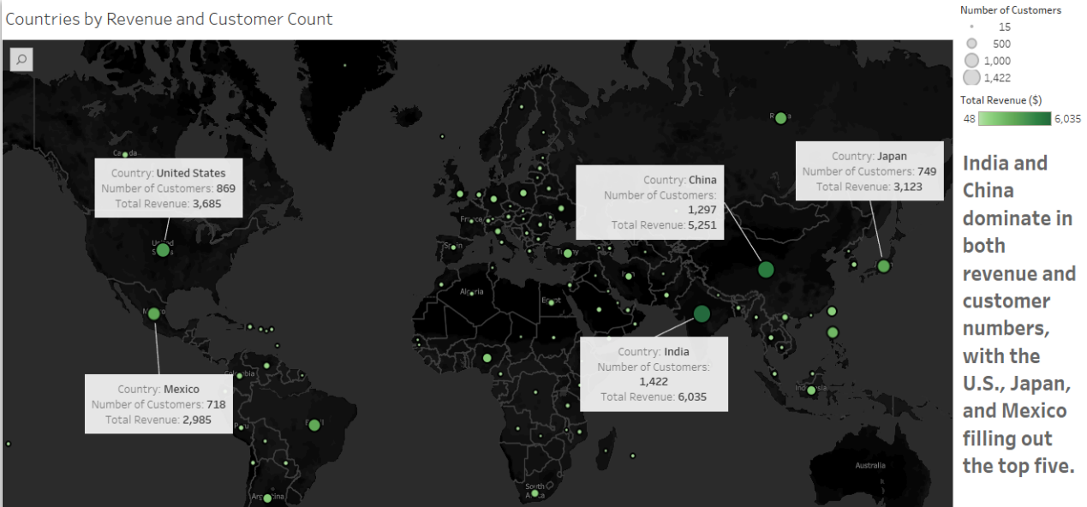
Analysis

Slide 16
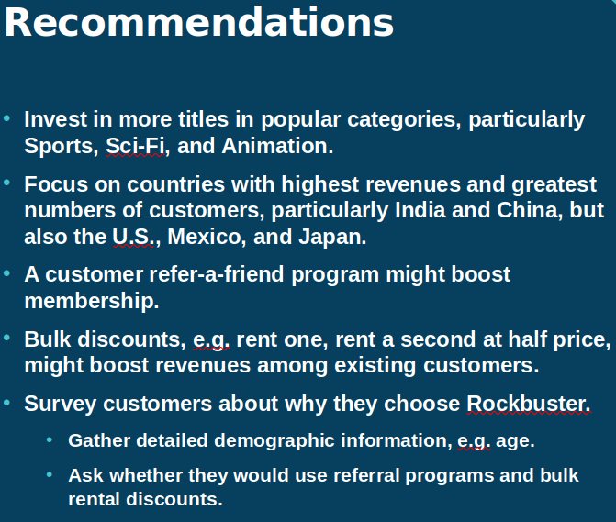
Link to GitHub Repository: Here

Slide 17

Instacart
Objective: Perform an initial exploratory analysis of some of Instacart’s data, in order to derive insights and suggest strategies for better segmentation based on the provided criteria.
Project Brief
Skills Used: Data Analysis with Python (particularly pandas, numpy, matplotlib, seaborn, and scipy) and Jupyter: Data Integrity checks and Cleaning; Data Merging and Wrangling; Deriving variables; Grouping and Aggregating data; Visualizations; FOR loops; Iteration with itertools.
Dataset: ​Customer Dataset
Dataset: Data Dictionary
Tools Used:

Slide 18
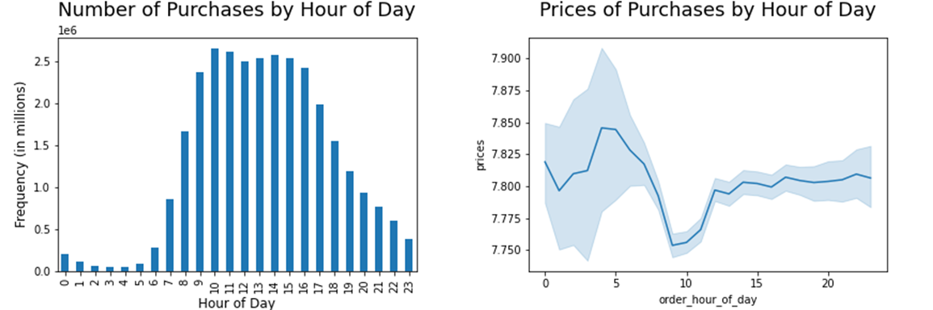
Analysis
The busiest hours are generally 9am to 4pm. However, purchases made between 4am and 6am have significantly higher prices, albeit with a much broader price range.

Slide 19
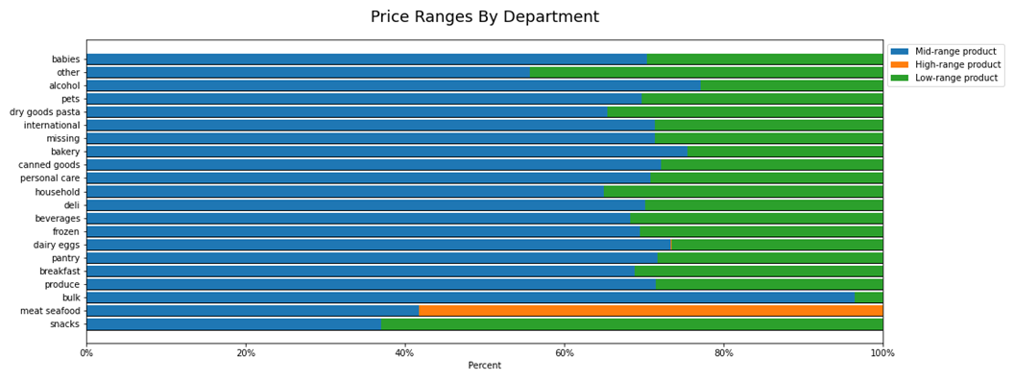
Analysis
Prices have been divided into three ranges:
Low-range products: <=$ 5 Mid-range products: > $5 & <= $15
High-range products: > $15

Slide 20
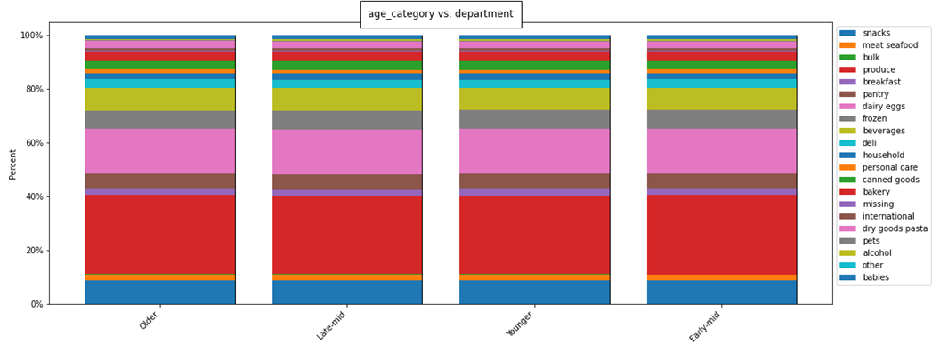
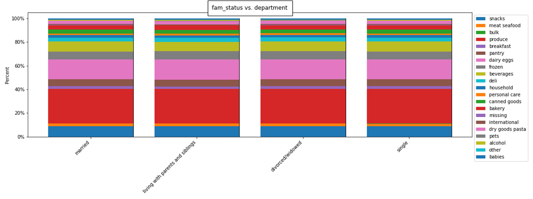
Analysis
There is essentially no group classification of appreciable size suggested by purchasing behavior; comparing the different options for a given demographic against each other shows nearly identical patterns to those seen in the previous two questions.

Slide 21
Recommendations
Pricing & Promotions
Obtain Real Data:
The expensive early-morning purchases may be driven by urgency or impulse. People may be more willing to pay more for products at those hours out of desperation, e.g. if other stores are not open.
Scheduling ads on Tuesday (Day 3) or Wednesday (Day 4) would target the least busy days, and scheduling ads between 2am and 4am would target the least busy hours. However, it may be better to target Thursdays and Fridays, and 6am to 7am hours, to catch people just before the busier days and times, when they are most likely to be on the verge of making purchases already: they may be more receptive to the ads.
The data is nearly uniform across all demographics: its artificial nature makes true insights nearly impossible.
Data should be gathered on cost (and therefore profit margins) of products.
Gain better context.
Understand whether less-popular categories may be worth popularizing due to higher margins.
Link to GitHub Repository: Here
Link to Client Report: Here

Slide 22


Rain in Texas
Objective: Perform an initial exploratory analysis of chosen dataset from Kaggle, in order to derive insights and on trends and relationships in weather in the U.S. State of Texas.
Project Brief
Skills Used: Data Analysis with Python (particularly pandas, numpy, matplotlib, seaborn, scipy, scikit-learn, quandl, and folium) and Jupyter: Data Integrity checks and Cleaning; Data Merging and Wrangling; Deriving variables; Grouping and Aggregating data; Visualizations; Geospatial Analysis; Linear Regression; k-means Clustering; Time Series Analysis.
Dataset: ​Primary Weather Dataset from Moosavi, et al. (2019)
Dataset: Average Temperature in Texas by Year
Tools Used:

Slide 23
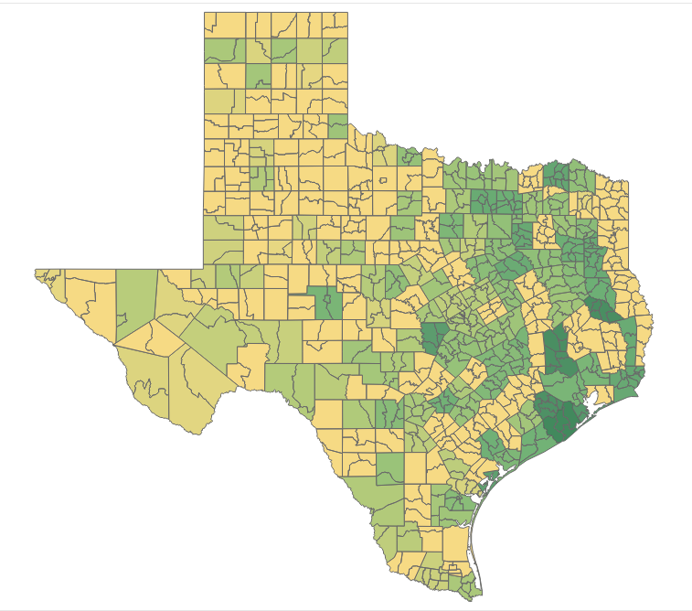
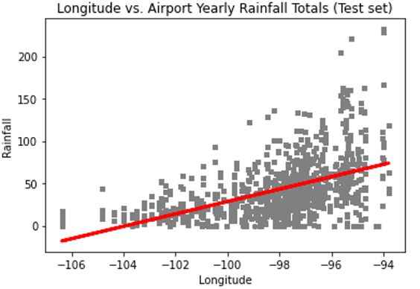

Analysis
Total rainfall amounts generally increase towards the eastern part of the state and the Gulf of Mexico, and away from the Chihuahuan Desert. However, the relationship is not linear.

Slide 24
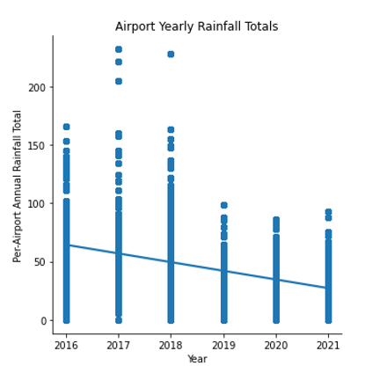
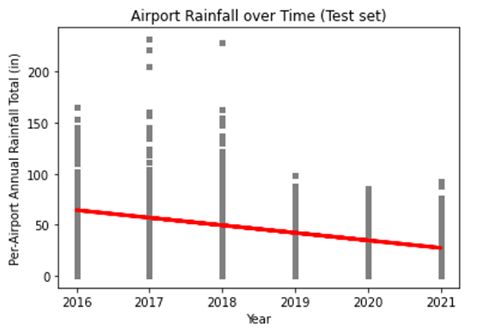
Analysis
Rainfall totals reported at airports appear to be decreasing over the 2016-2021 time period. However, this relationship is not linear, either.

Slide 25
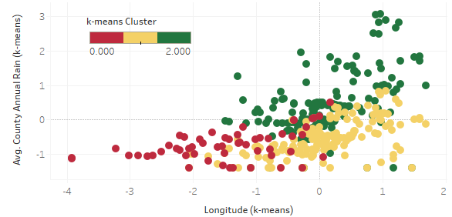
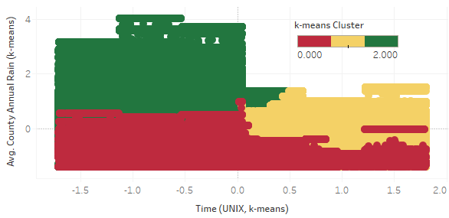
Analysis
We found three clusters of data points. The two larger clusters, colored Green and Yellow here, overlap greatly in longitude, but show near-total separation in the times data were collected, as well as some separation in precipitation amounts.

Slide 26
Findings & Next Steps
Findings & Discussion
Next Steps
While relationships between longitude, rainfall amounts, and time appear to exist, they are non-linear.
The primary dataset contains continuous measurements solely for precipitation; data for other climatic dimensions such as wind speed and temperature are categorical and extremely limited in scope.
Unexpected chronological separation of clusters with strong longitudinal overlap raises questions of data integrity.
Additional data sources should be analyzed with the following goals:
Gain better context.
Perform multivariate analysis to explain non-linear relationships.
Corroborate or discount the data from the original data source.
Link to GitHub Repository: Here
Link to Tableau Presentation: Here

Slide 27
Thank You

