Slide 1
Rockbuster Stealth
Data Analysis

Slide 2
About Us
Rockbuster Stealth LLC is a movie rental company that used to have stores around the world.
We face stiff competition from streaming services such as Netflix and Amazon Prime.
We aim to use our existing movie licenses to launch an online video rental service in order to stay competitive.

Slide 3
Key Questions and Objectives
Which movies contributed the most/least to revenue gain?
What was the average rental duration for all videos?
Which countries are Rockbuster customers based in?
Where are customers with a high lifetime value based?
Do sales figures vary between geographic regions?

Slide 4
Business Overview
Number of films in our catalog: 1,000
Average Rental Duration: 5 days
Lowest Rental Rate: $0.99
Highest Rental Rate: $4.99
Average Rental Rate: $2.98
Total Number of Customers: 599
Number of Active Customers: 584

Slide 5
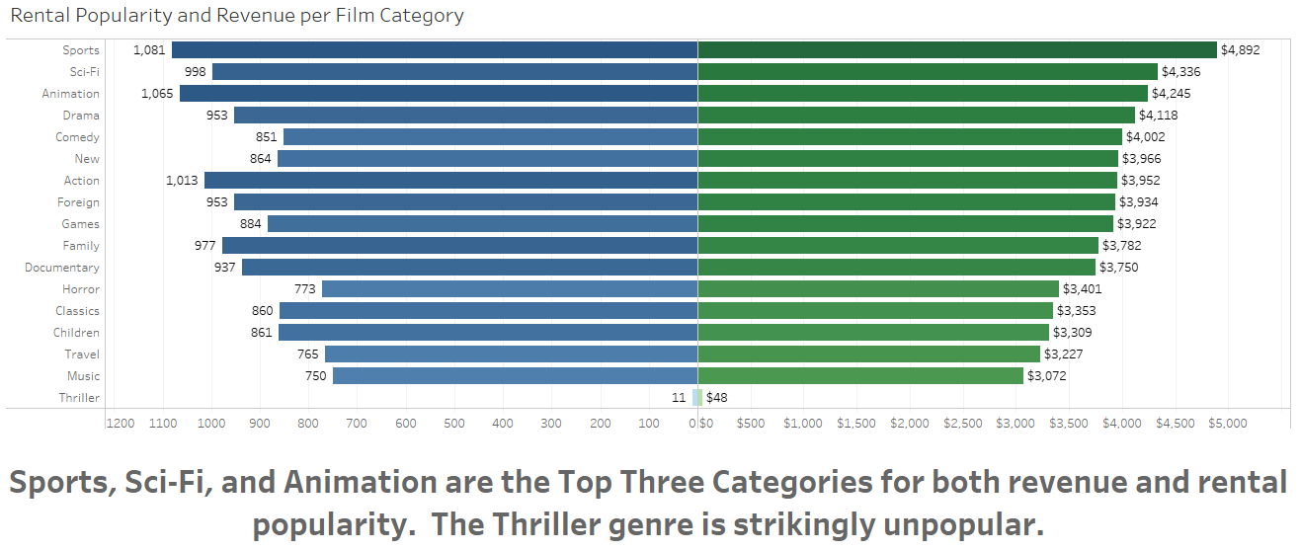
Rental Popularity and Revenue per Film Category

Slide 6
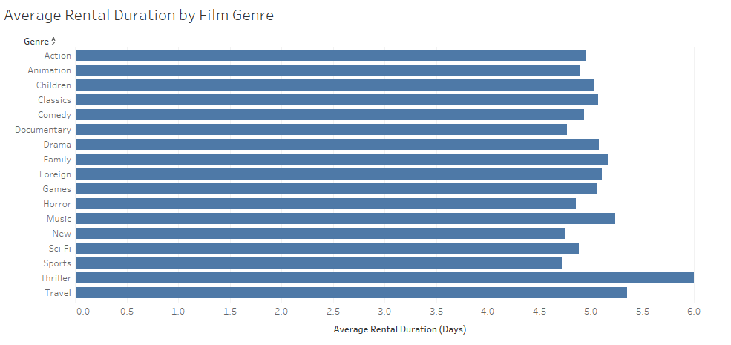
What was the average rental duration for all videos?

Slide 7
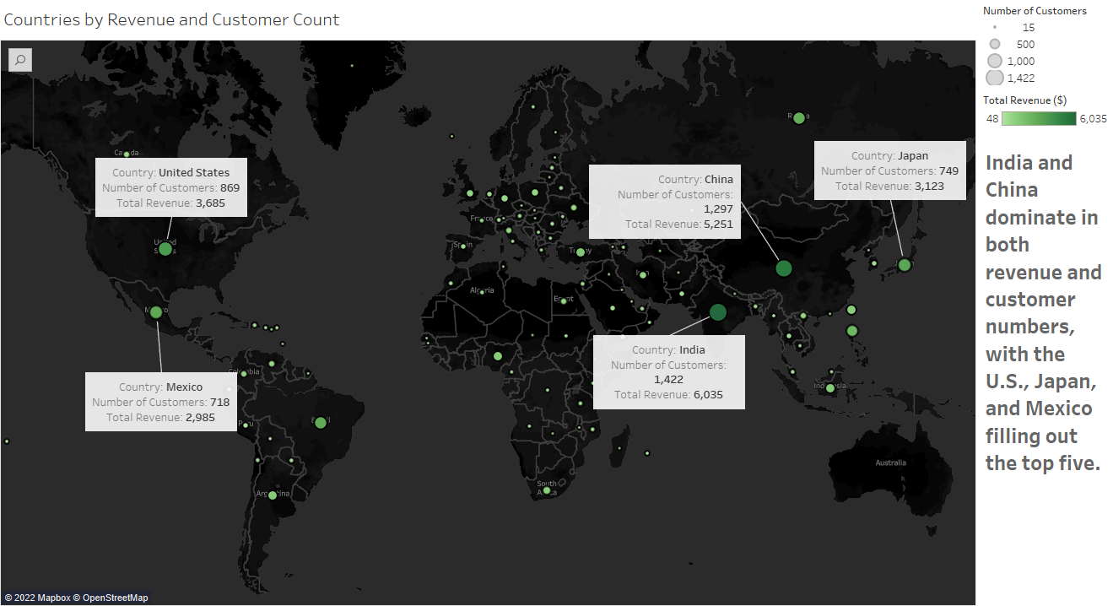
Countries by Revenue and Customer Count

Slide 8
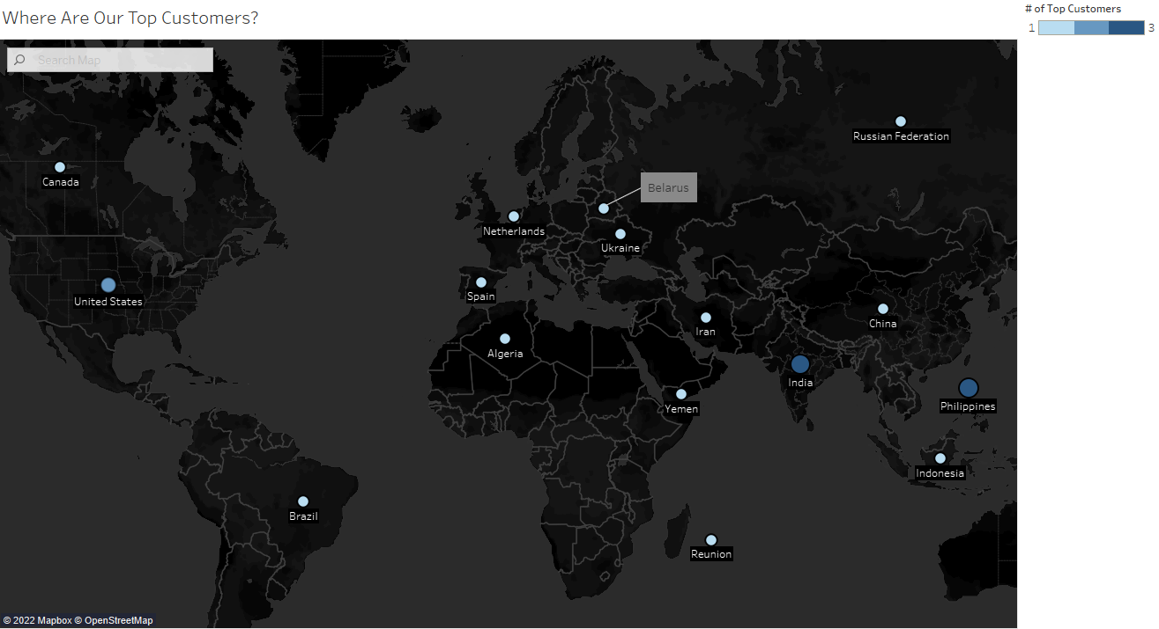
Where are customers with a high lifetime value based?

Slide 9
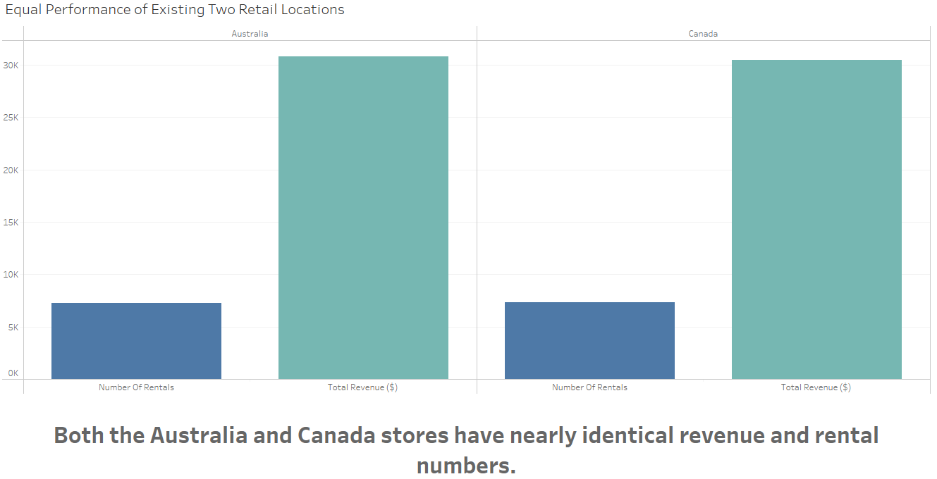
Equal Performance of Existing Two Retail Locations

Slide 10
Recommendations
Invest in more titles in popular categories, particularly Sports, Sci-Fi, and Animation.
Focus on countries with highest revenues and greatest numbers of customers, particularly India and China, but also the U.S., Mexico, and Japan.
A customer refer-a-friend program might boost membership.
Bulk discounts, e.g. rent one, rent a second at half price, might boost revenues among existing customers.
Survey customers about why they choose Rockbuster.
Gather detailed demographic information, e.g. age.
Ask whether they would use referral programs and bulk rental discounts.

Slide 11
QUESTIONS?
Thank you!
Tableau Visualizations

