Slide 1
NSAAL Bot
An open-source crypto trading bot concept being developed by Jonathan McCormick
Never Sell At A Loss

Slide 2
The Problems
Everyday investors often have limited options.
  Prioritizing “safety” often means sacrificing high returns.
E-traded assets (esp. cryptos) tend to be extremely volatile.
  This is not healthy for the crypto ecosystem. Merchants and customers who use crypto to transact value should not be at the mercy of speculators.
Many fintech platforms are limited to only certain nationalities.
  This means that there are underserved markets which need more access to borderless financial/investment platforms.

Slide 3
The Solution
Create an asset trading strategy which can get a high degree of BOTH safety and high returns. To increase trustworthiness, make it open source.
Make sure that this strategy has a positive externality of helping to stabilize crypto prices.
Make a censorship-resistant and/or decentralized platform to allow anyone with Internet access to be able to invest.

Slide 4
Market
According to CoinMarketCap as of 21 Sep., 2021 at 13:01 Central Time, the trading volume for BTC in the last 24 hours has been roughly $43.5 billion*. There are also many other cryptos.
While NSAAL Bot will NOT be dependent on user growth in order to make money, the potential users will probably be at least in the millions, especially given the rise of fintech firms like Robinhood, WeBull, etc. where everyday investors are already experiencing innovation and will likely be open to new options.
*https://coinmarketcap.com/currencies/bitcoin/

Slide 5
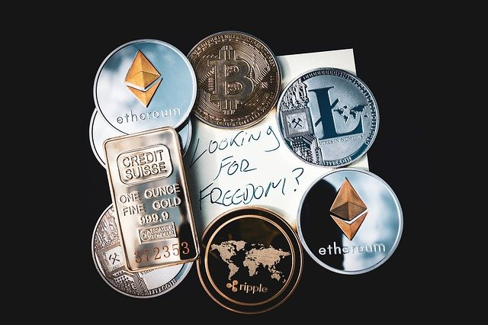
Product
An open-source algorithmic trading bot to allow anyone on earth with Internet access and a little bit of cryptocurrency to find financial freedom.
Image by WorldSpectrum from Pixabay.

Slide 6
Product: trading algorithm
The main idea of my algorithm is the simple principle of “Never selling at a loss.” If my bot buys 1 DOGE at price “x”, then it would never sell that unit until it is able to sell it for “x + y”, where “y” is my intended margin per buy/sell cycle.
The same goes for the reverse actions. If my bot sells 1 DOGE at price “z”, then it would never buy using that specific “z” amount of USD until it is able to buy DOGE at a unit price of “z - y”, where “y” is my intended margin per buy/sell cycle.
For clarity, “z - y = x”.

Slide 7
Product: trading algorithm
Because my algorithm does not allow for the possibility of selling at a loss, it greatly limits the potential for loss that might be experienced with other trading strategies. With my algorithm, I do not need to know whether the price of an asset will go up or down. All I need to know is that it will be volatile, and my bot can make a profit without me needing to become emotionally involved.
By having the “y” be small, I can also make it so that my bot can make lots of small trades every day which accumulate and compound to an annual return that is hopefully orders of magnitude above the other options everyday investors have available.
Once fully developed, I am personally convinced that this platform will be able to achieve an average of more than 1% ROI per day. Multiplying that rate by 365.25 days in a year gives an annual interest rate of 365.25%, which is already far beyond the returns expected from mutual funds, for example. But that number is not even accounting for the frequency of compounding, which would be almost continuous for my platform. But even if we were to assume a mere daily compounding of interest, that would mean an APY of over 3,600%! That means that even if another huge crypto price bubble happens, my rate of reliable exponential growth will be simply too strong to justify worrying about the price crash.

Slide 8
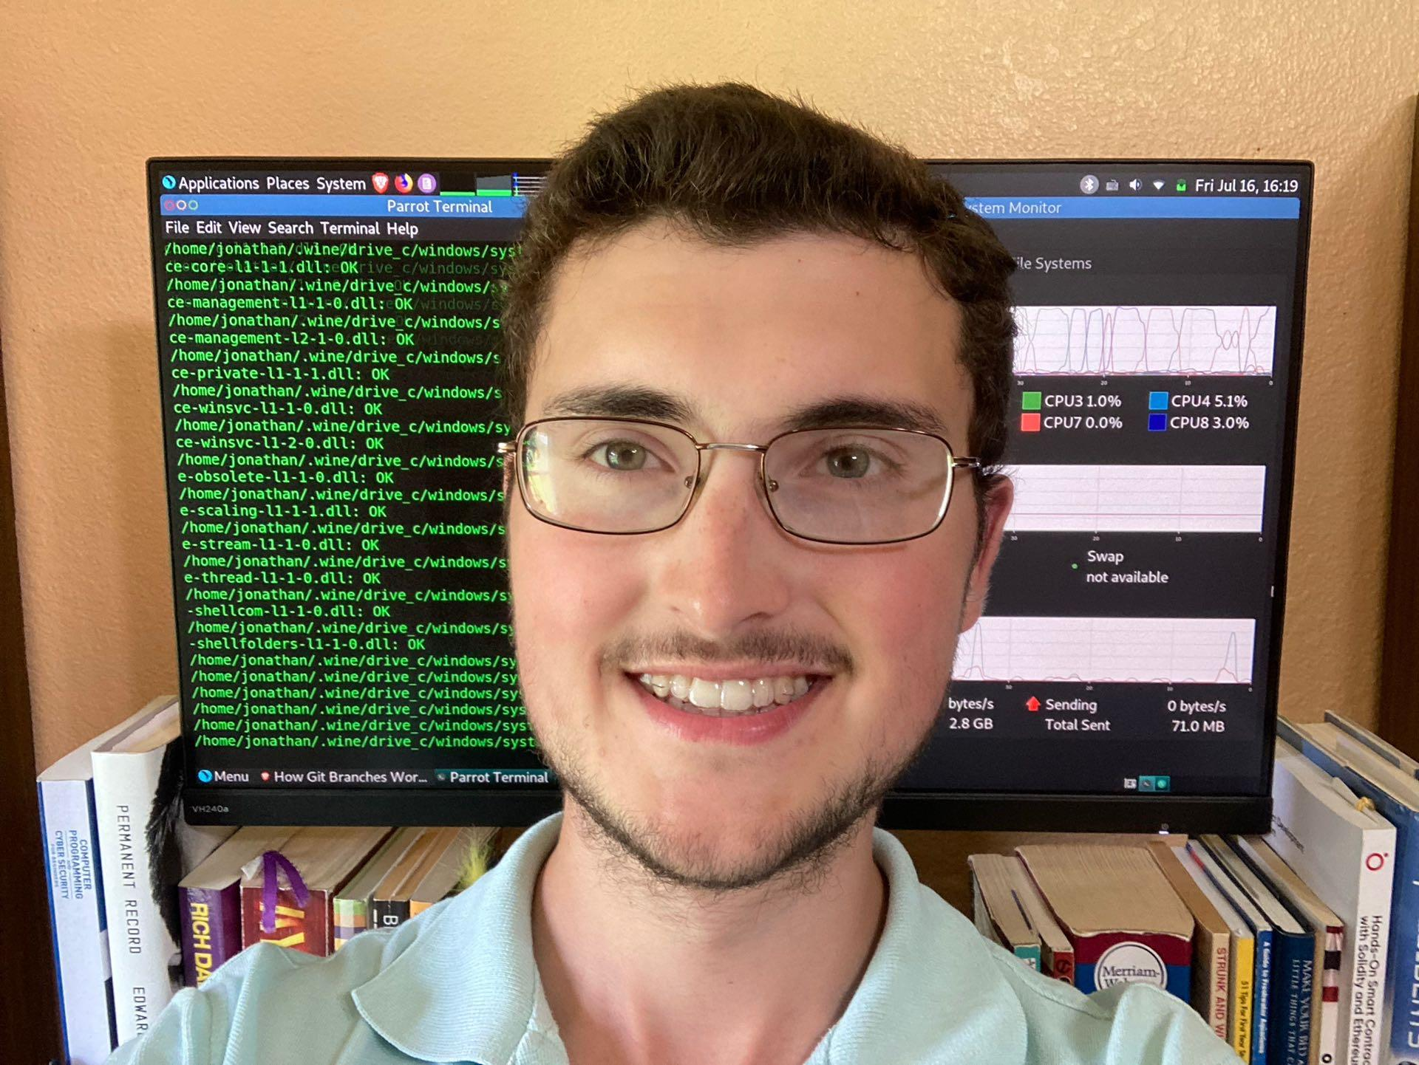
Team of one
Jonathan A. McCormick, Jr., CEO, CTO
  Former political “science” major at Andrews U.
  Started teaching himself to code during the COVID-19 lockdowns in Michigan.
  Realized that technology and entrepreneurship have more power to liberate humanity then mere political arguing.
  Seeks to help build a freer and more prosperous world.

Slide 9
Competition (or lack thereof)
While there are many day trading projects out there, I am not aware of any of them taking the same approach to trading as my own algorithm.
In essence, the only competition is price stability itself.
The more stable crypto prices become, the better it is for the crypto ecosystem.
However, there will always be fluctuations in the supply and demand, so there will (probably) always be opportunity for this bot to profit. However, once general price stability is achieved, it will be harder to maintain the same rate of return.
There will also probably always be speculators, but they (generally) will be the losers, since they will be the ones contributing to price instability, which makes them buy high and sell low.
On the other hand, it might turn out that fiat currencies in general will eventually become the volatile assets. In such a case, my algorithm would help stabilize the fiat price as well. However, I might want to turn the bot off during periods with lots of money-printing.

Slide 10
Current finances
Broke (for the moment).
~$490 in sales (from trading DOGE manually on my personal Robinhood Account).
Average price of DOGE bought*: $0.055148735746158
Average price of DOGE sold*: $0.064456564082587
Average gross profit per DOGE buy/sell cycle*: $0.0093078283364
*Between Dec 22, 2020 and April 13, 2021

Slide 11
Two Financial Projections for 2022
1.
2.
Income with grant |  | Income without grant
Thiel Fellowship grant (1st year) | $50,000 | Investment from founder’s personal bank account | ~$300
This scenario will allow me to focus almost exclusively on making this project happen ASAP. As with all compound interest, the sooner that I can get this thing running, the better. |  | This scenario will require me to split my attention between this project and several side hustles and/or part-time jobs in order to pay the bills in the short term.
Expenses would be made on an as-needed basis. Among those expenses would be costs associated with legal/accounting/cybersecurity services, branding, and basic living expenses of the founder.

Slide 12
Thank you!

