Slide 1
HW_04
For this assignment, we were adding the ability to write to the file using MPI and not relying on writing to the file using the sequential method as before. We did this by modifying the code for the read and the print methods and creating new methods called write_row_striped_matrix and write_submatrix. This allowed us to modify some code and that we already had and gain the additional functionality.
NOTE: use run_example.sh for a demo of the project.
By: Ryan McCormick

Slide 2
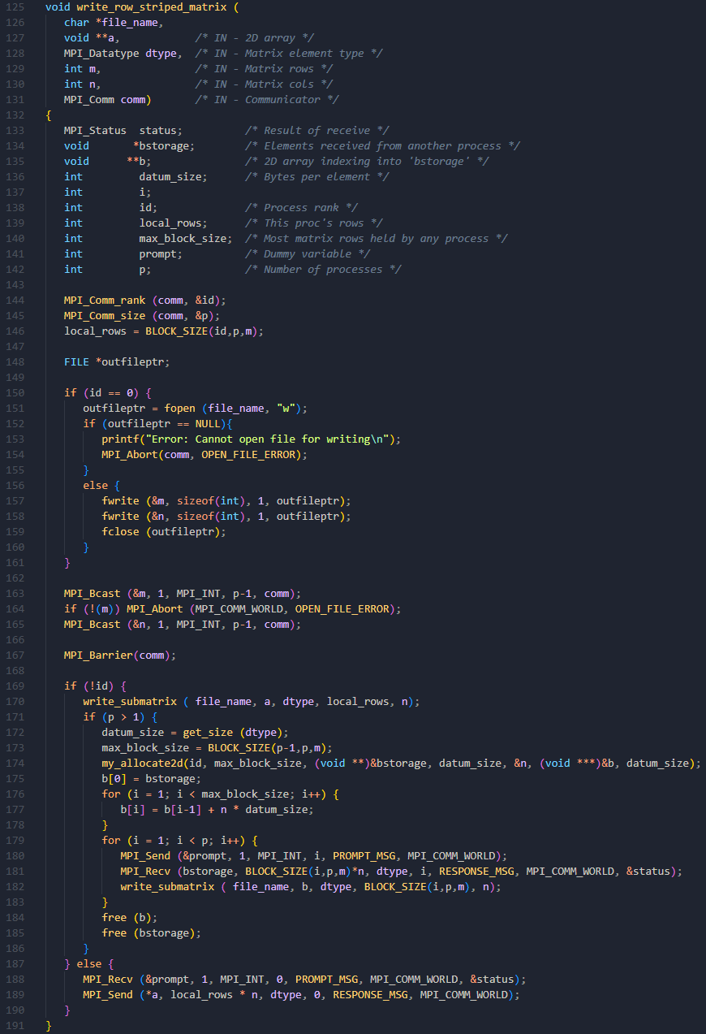
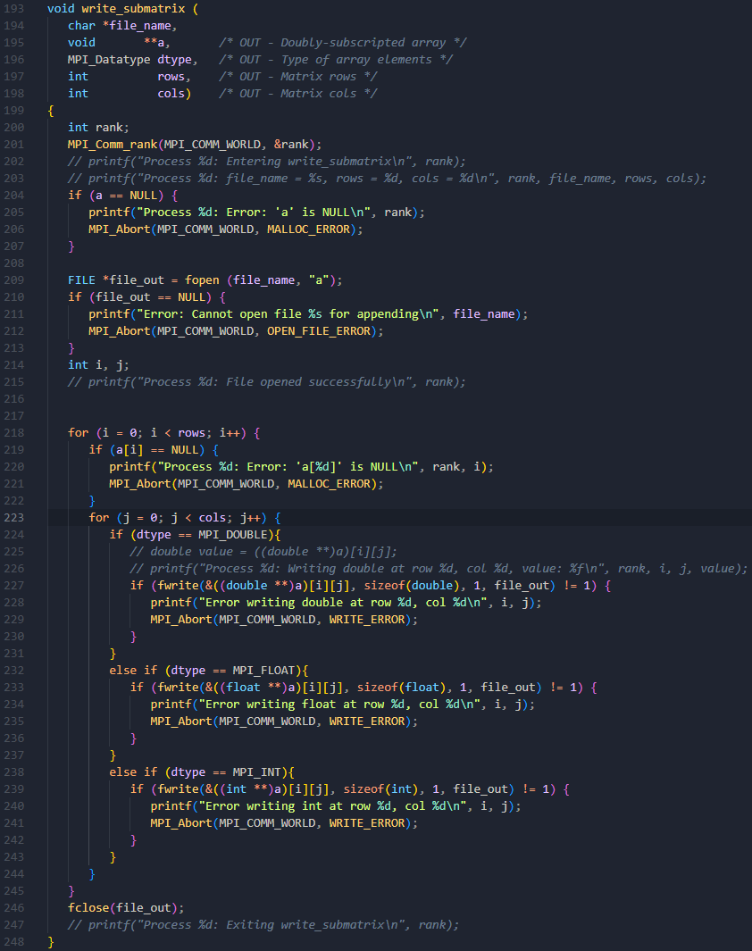

Slide 3
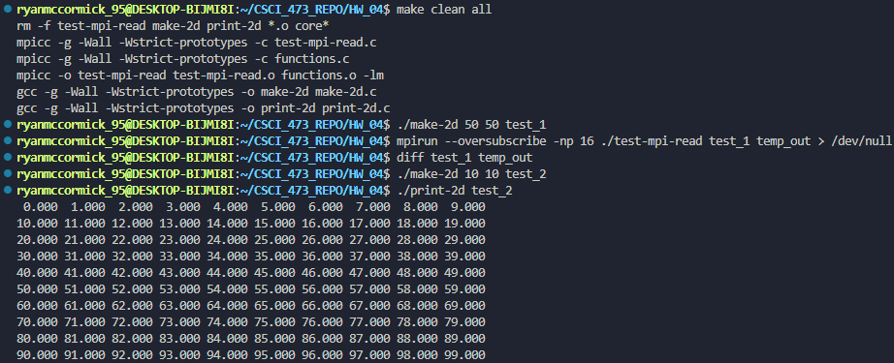
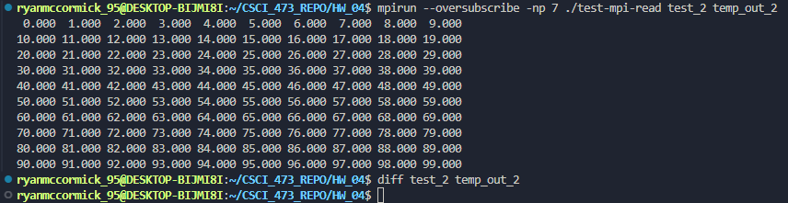

Slide 4
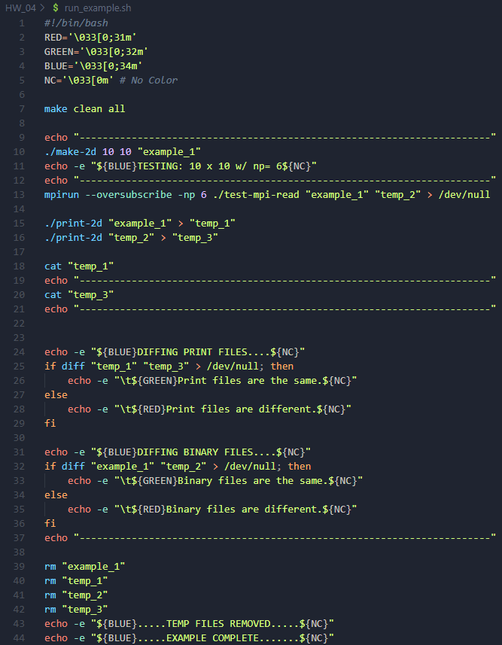
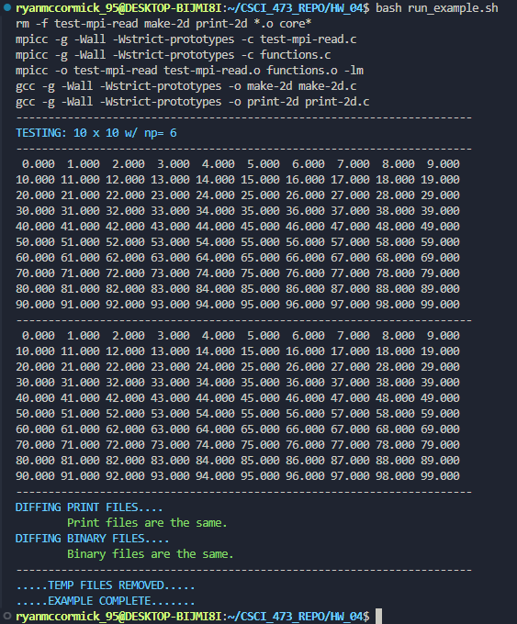

Slide 5
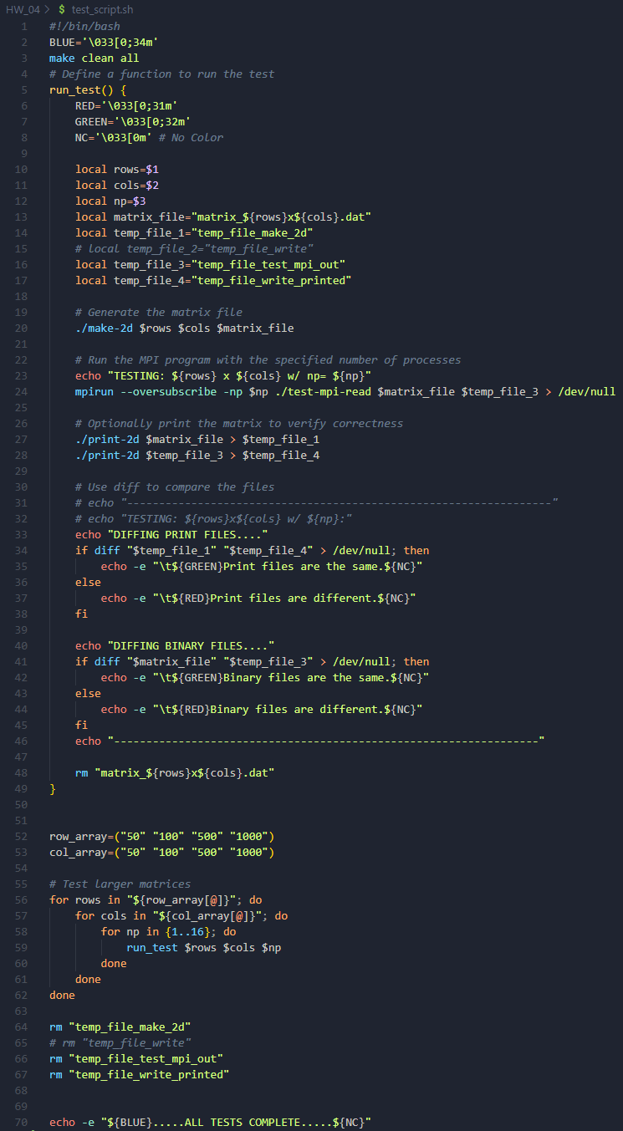
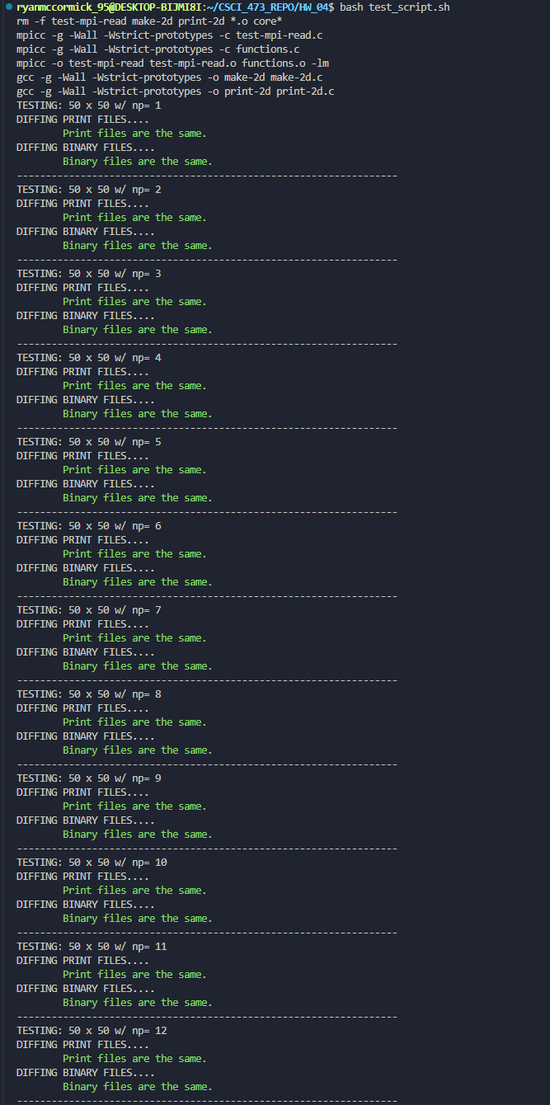
Example output from test script.

