Slide 1
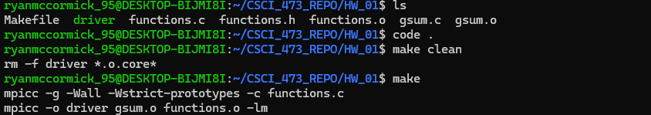
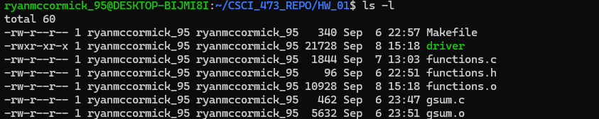
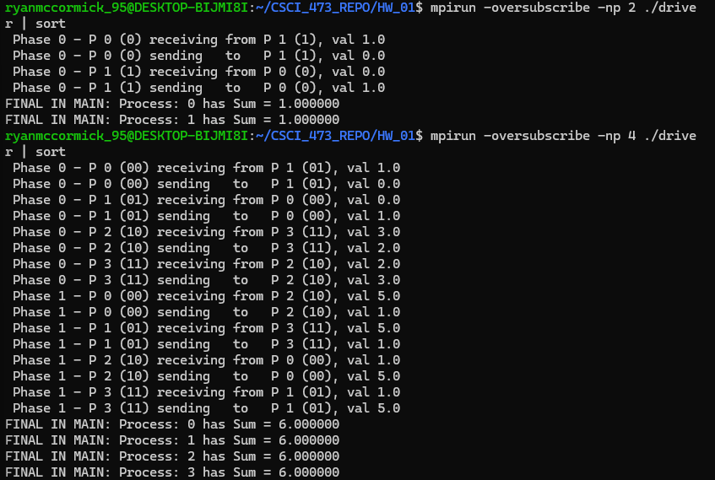
HW_01 Ryan McCormick
GLOBAL SUM:
For this assignment we were tasked with computing a global sum using the MPI_Ssend() & MPI_Recv().The number of processors needed to be a power of two and error handling in place to verify this. This program needed to compute the global sum and all processors needed to have the total at the end of execution. The print statements needed to match the ones in the provided assignment documentation including the binary representation of the processor numbers. I accomplished this assignment through the following steps:
I started with researching MPI_Ssend() & MPI_Recv(), how they work and what parameters are required to use them.
I then proceeded to get the code provided in the assignment documentation copied over and ready to go.
I started to write out the code for the global_sum() function, using the pseudocode that we worked on last week as a template.
Once I had this working with some temporary print statements, I added the correctly formatted print statements and started working on the function to generate the binary strings for the processors.
I added the error handling for the number of processors and began to test all the code that I had written.
Once the code was tested and commented, I took the output screenshots for this report.
The screenshot on the left contains the following:
Shows the files in the directory
make clean
make
The list of files in the directory
Execution with np= 2
Execution with np= 4

Slide 2
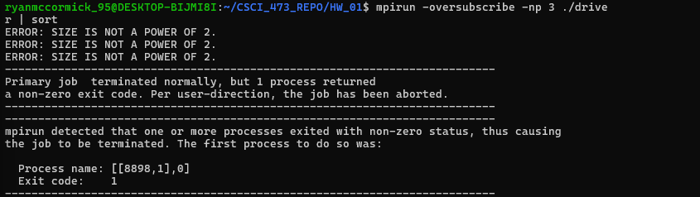
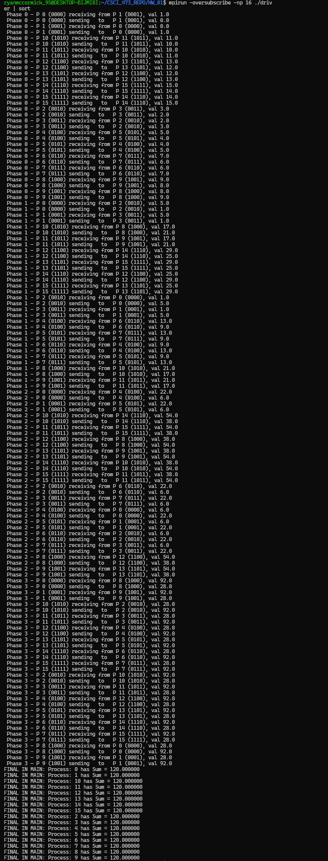
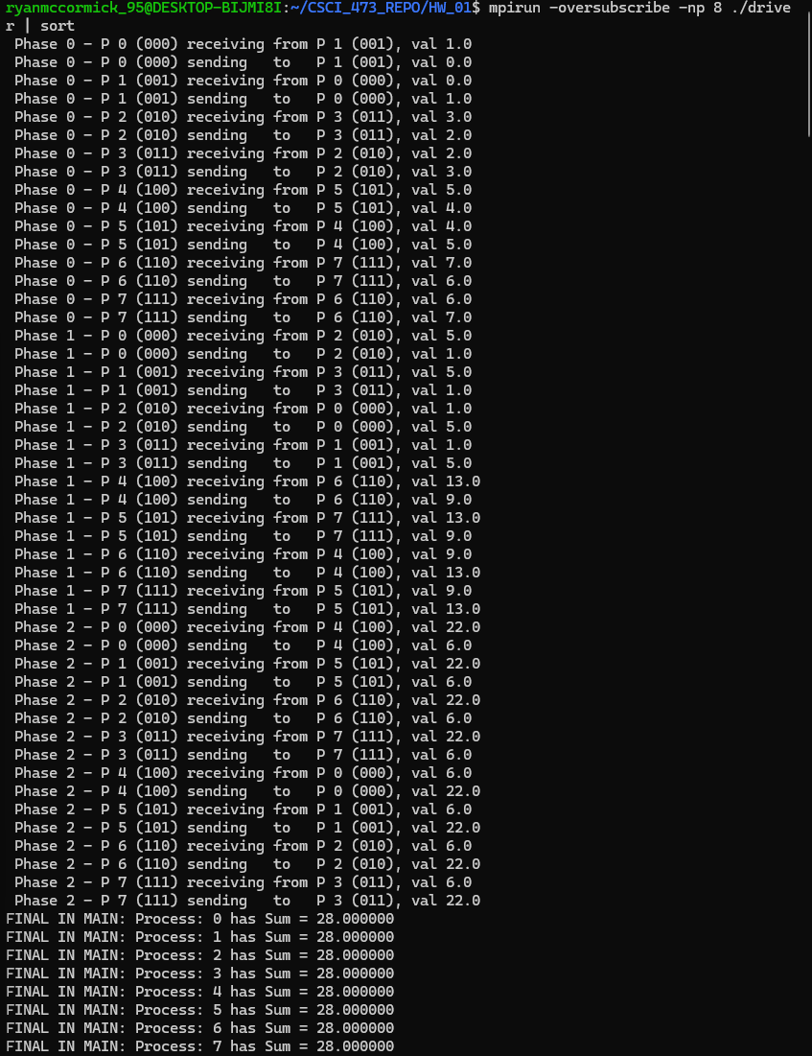
The left screenshot shows the program being run with np=3, along with the returned error messages, and the program being run with np=8.
The one on the right is the program being run with np=16 and the associated output.

Slide 3
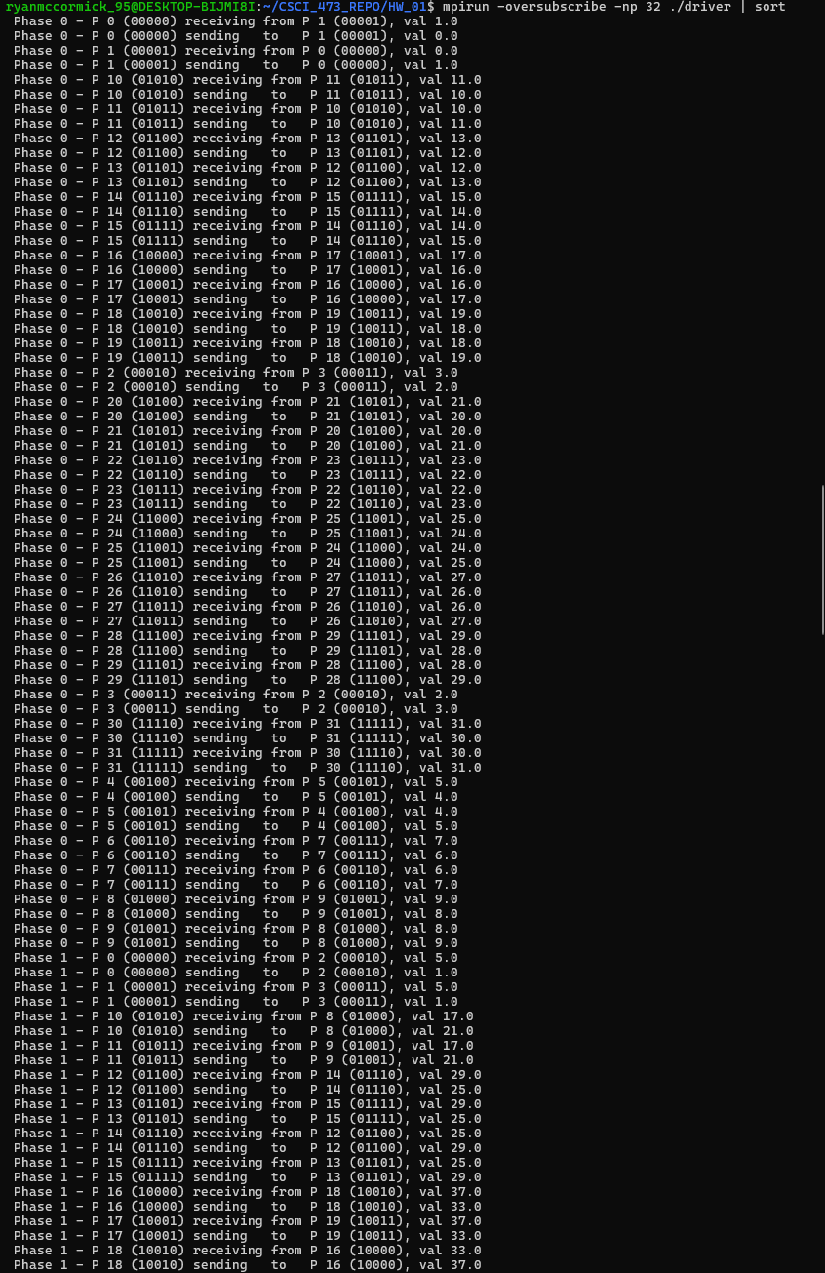
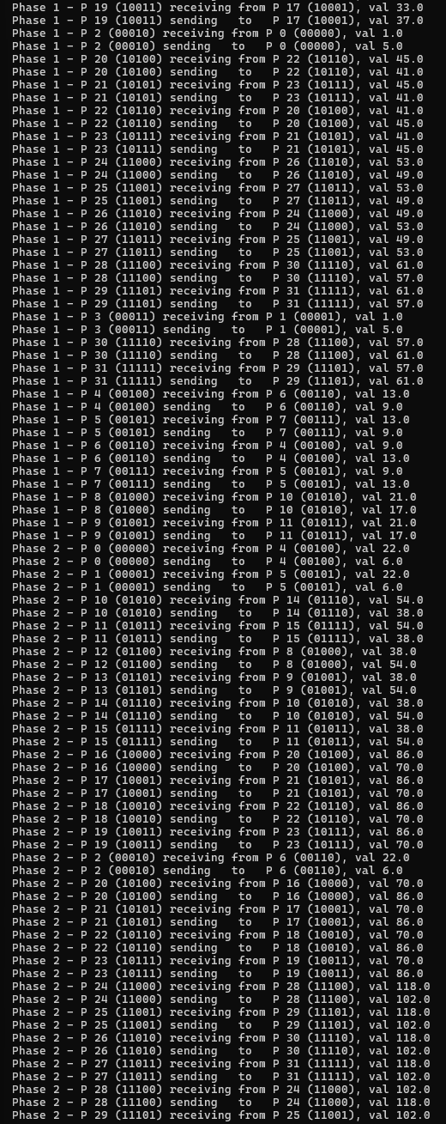
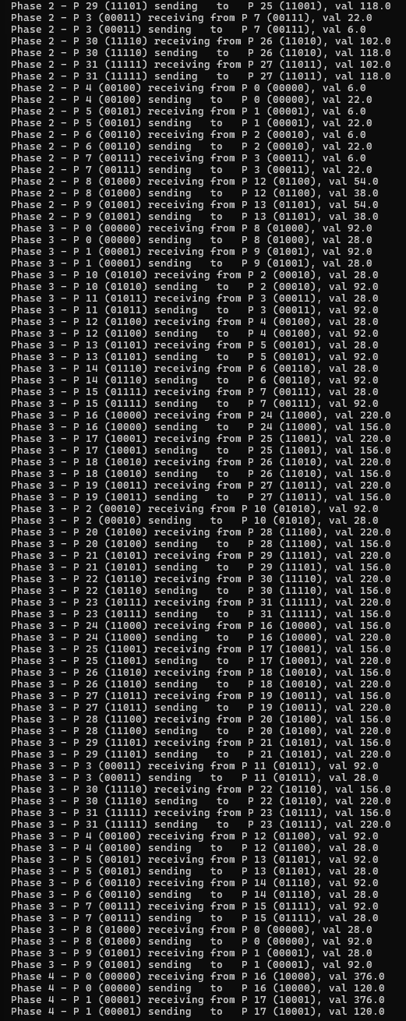
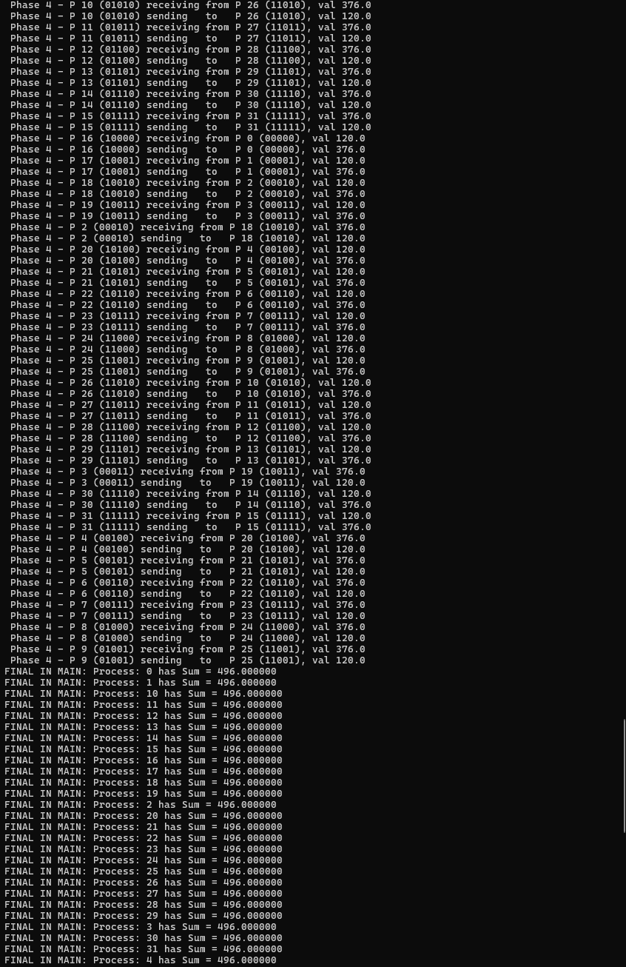
EXAMPLE: np = 32

