Slide 1

Data Science Mini-Project: HSBC Global Markets
Amy Gardiner, Brooke Grantham, Michael McCoubrey, Aditya Singh

Slide 2
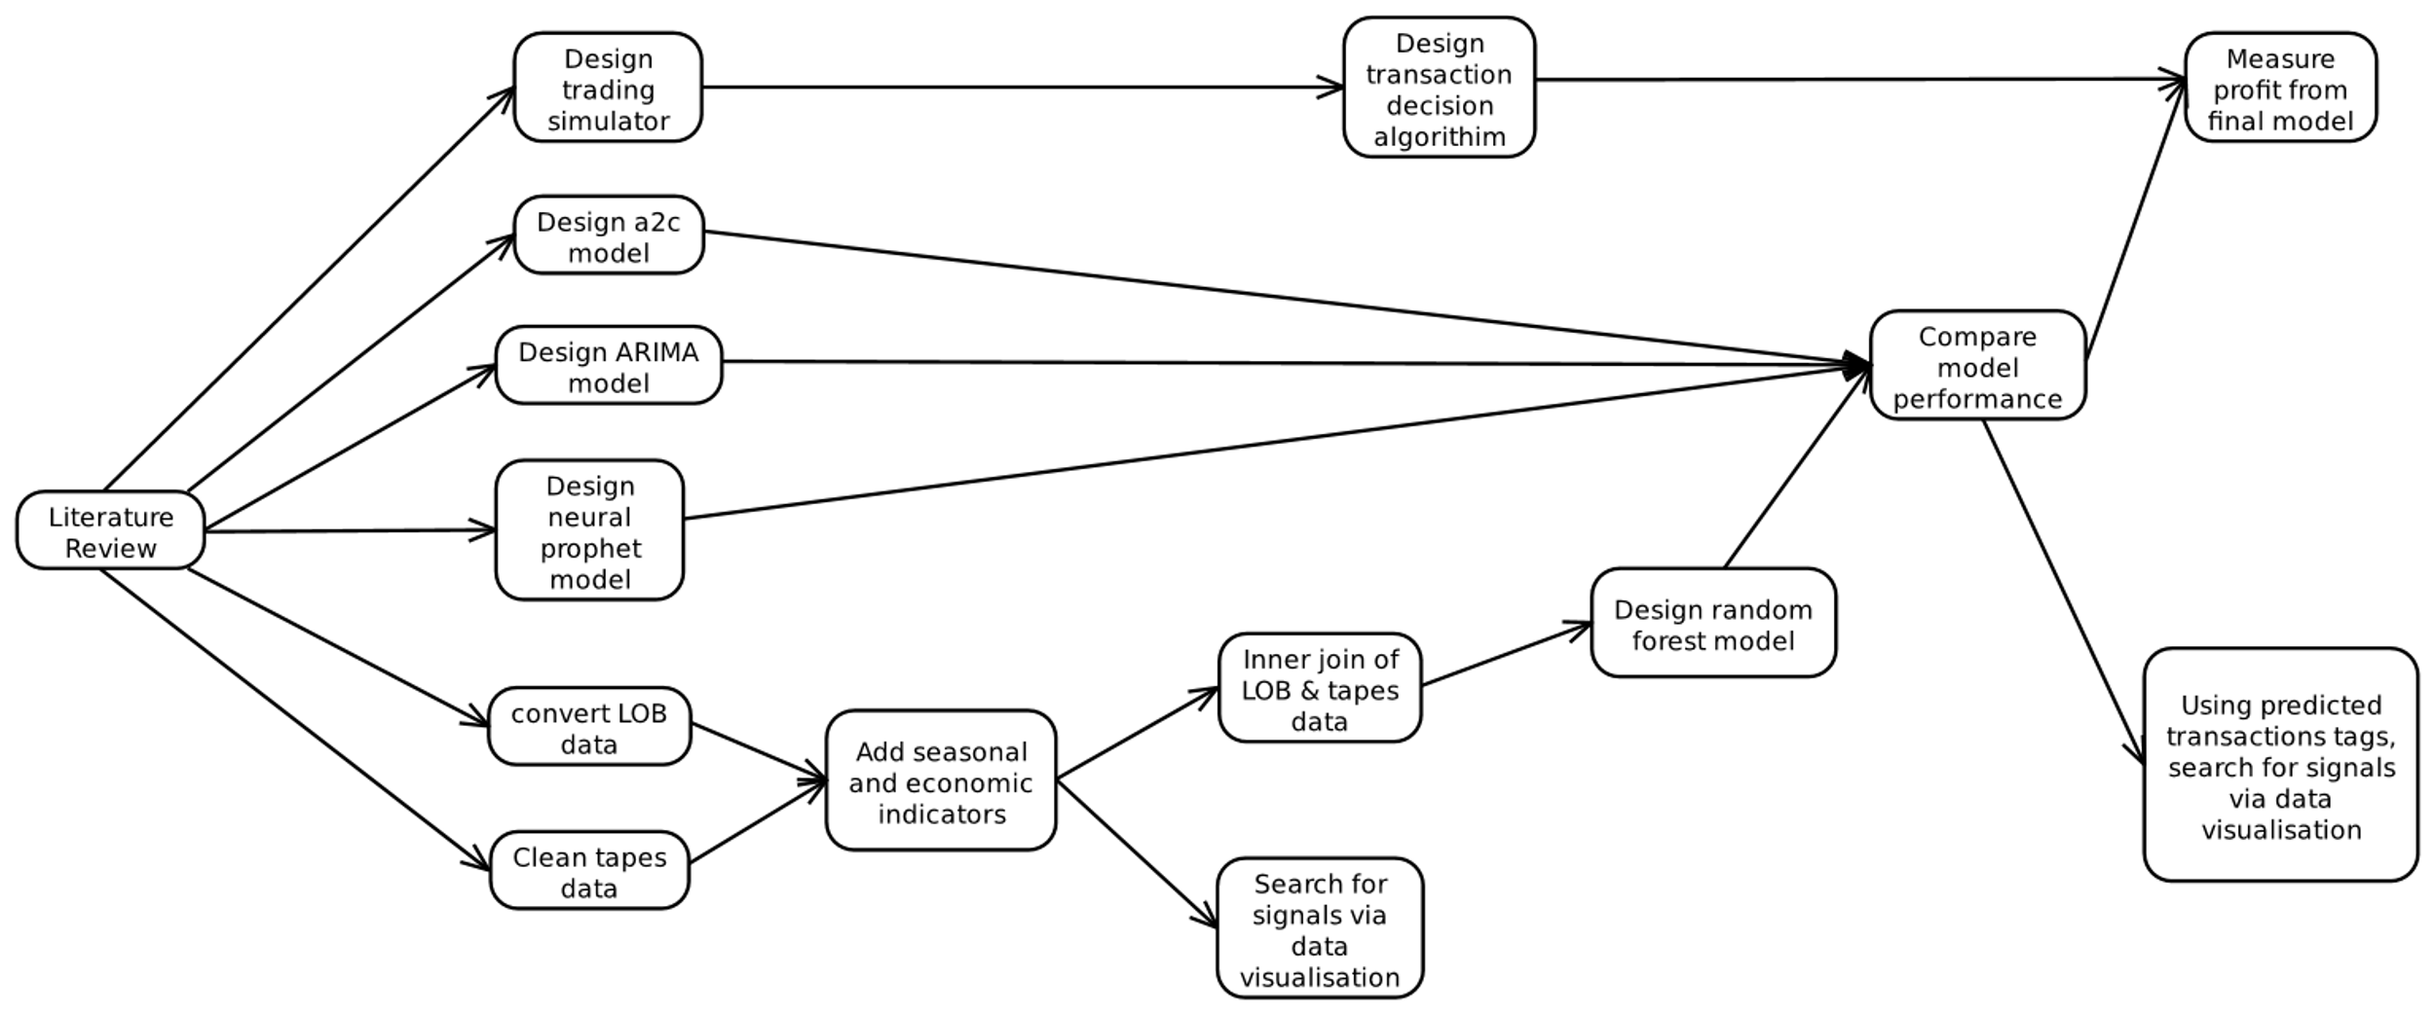
Presentation structure
Data preparation
Model descriptions and result discussions
Further work considerations

Slide 3
Data Preparation – tape data
Followed a distributive approach using PySpark.
Cleaned the data to retain only the required columns.
Applied multiple transformations on cleaned data to derive important features required for training the model.

Slide 4
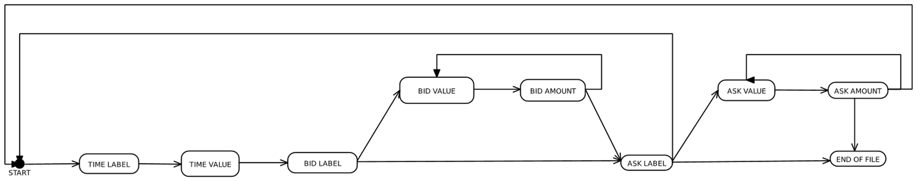
Data preparation – lob data
[ "time", 1.936, [ "bid", [ [ 183, 4 ], [ 27, 3 ] ] ], [ "ask", [ [ 739, 5 ] ] ] ]
The data needed to be converted into a tabular format.
The original format didn't follow any standard format and needed a custom solution.
The data files were extremely large and so the solution had to be memory efficient, otherwise a regular desktop would run out of memory.
The additional dataset used a different format so couldn't use this.

Slide 5


Deriving Features – lob data
Spread Features:
Micro price
Mid price
Quoted Spread
Liquidity Features:
Median transaction price
Interquartile range of transaction prices
Best transaction price
Least expensive bid price
Most expensive ask price
Transaction quantity at best price
Median transaction quantity
Interquartile range of transaction quantities
Number of Transactions
[ "time", 1.936, [ "bid", [ [ 183, 4 ], [ 27, 3 ] ] ], [ "ask", [ [ 739, 5 ] ] ] ]

Slide 6
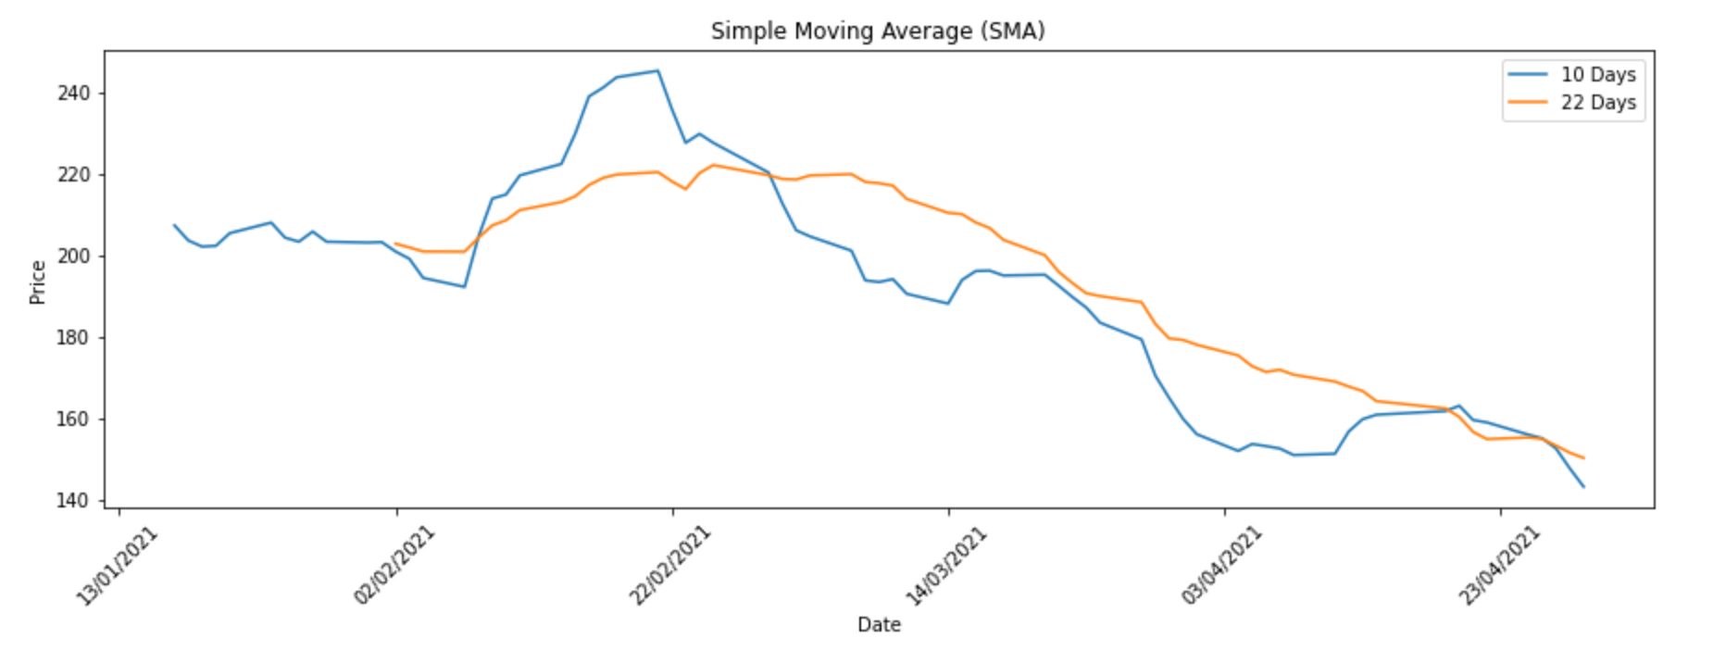
Data EXPLORATION
EMA and SMA moving averages
Short term average dropping below long term average

Slide 7
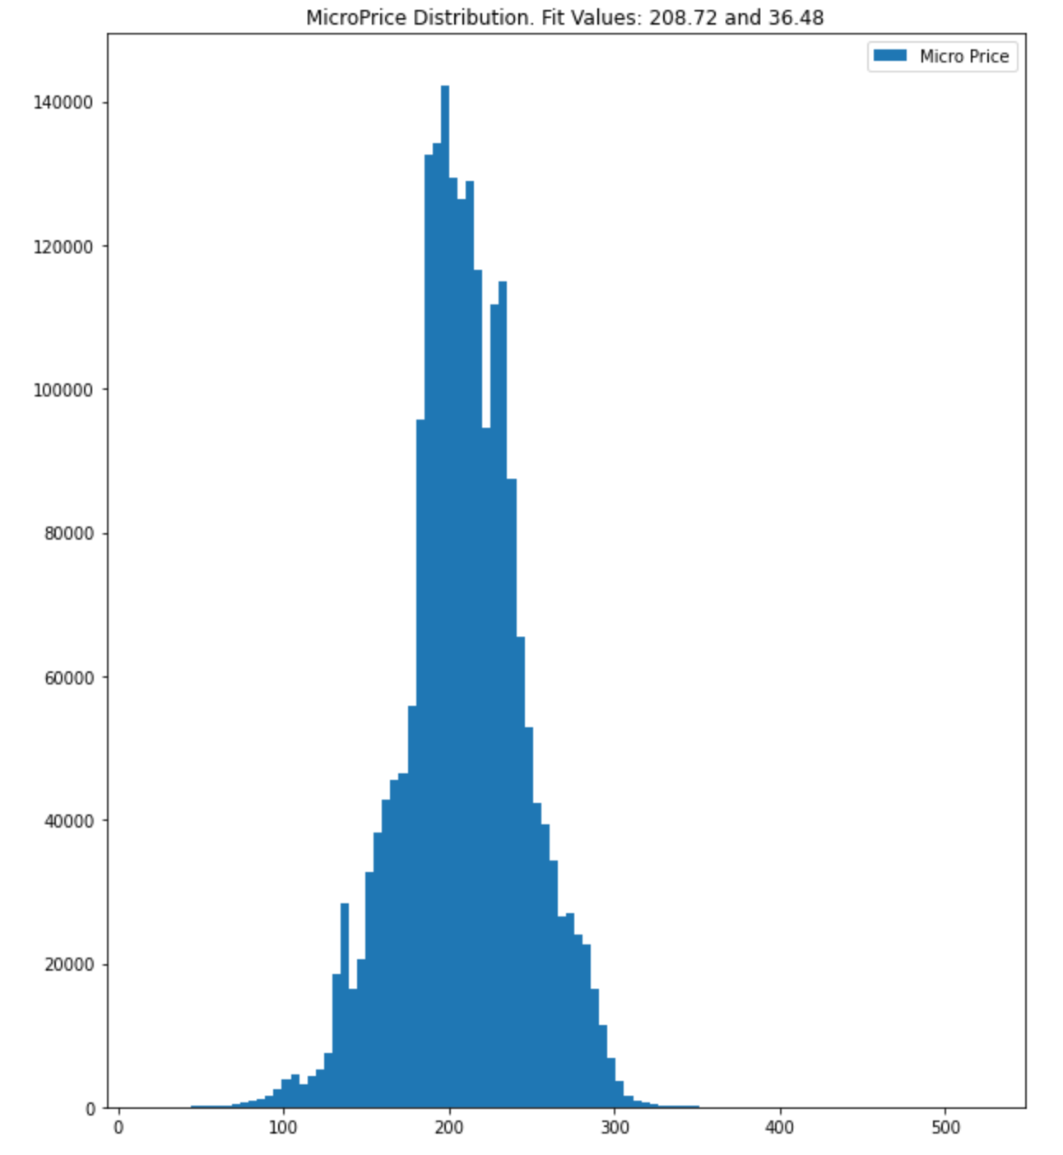
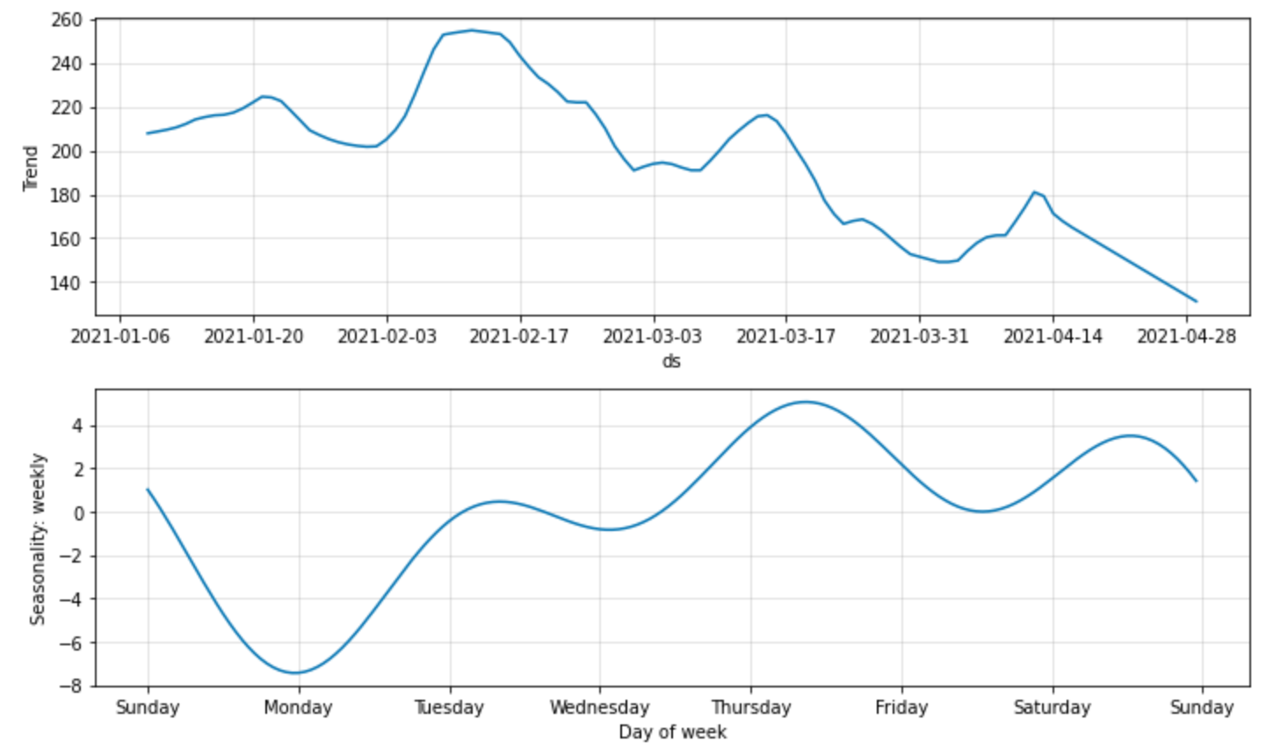
Data EXPLORATION
Micro price showing multimodal Gaussian distribution
Weekly seasonality trends derived from NeuralProphet

Slide 8
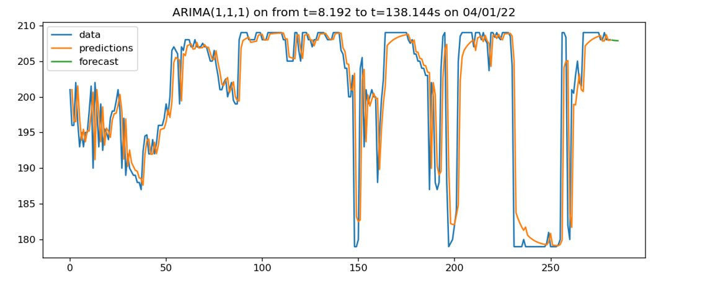
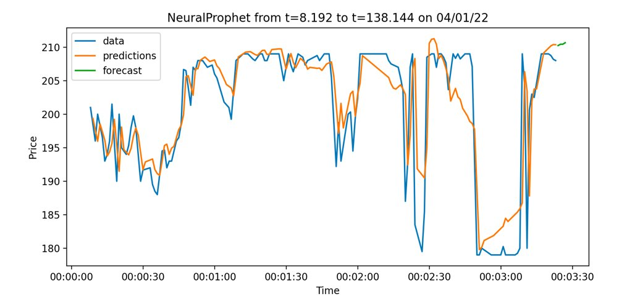
Univariate Models: aRIMA & Neural prophet
Provided exploration into short-term price modelling
Forecasting methods extremely limited within time-series algorithms
ARIMA: ACF/PACF breaks down with N>250 datapoints

Slide 9
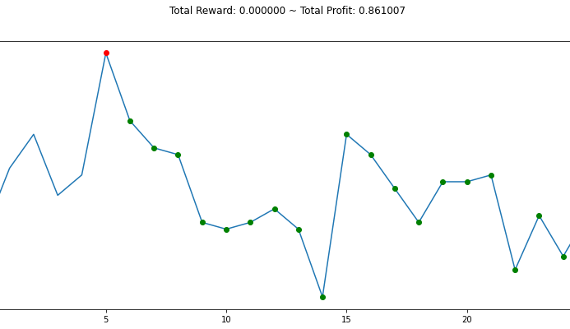
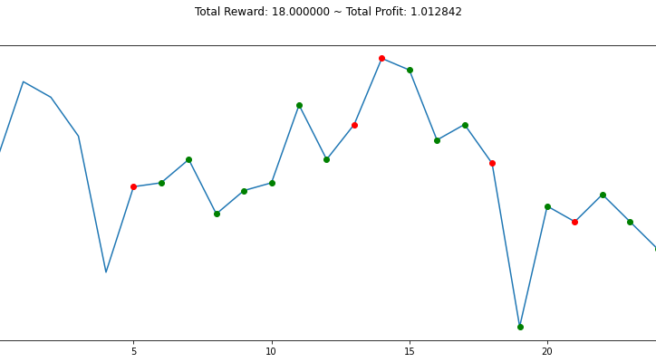
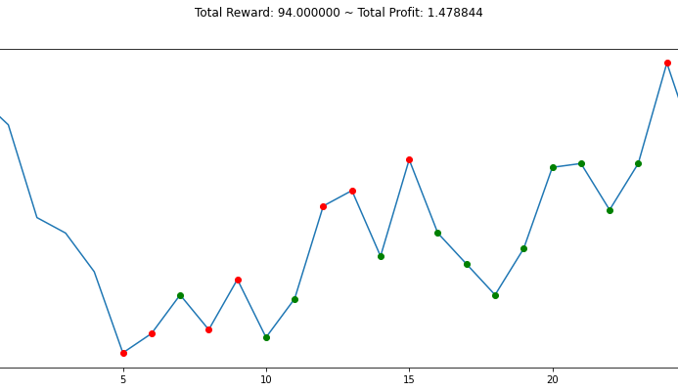
A2C
Provides profitable strategies across the datasets
Only considers tape data
Trading Actions: Sell=0, Buy=1
Trading Positions: Short=0, Long=1
M. A. Haghpanah, “The most simple, flexible, and Comprehensive Openai Gym Trading Environment (approved by Openai Gym),” GitHub, 2022. [Online]. Available: https://github.com/AminHP/gym-anytrading.

Slide 10
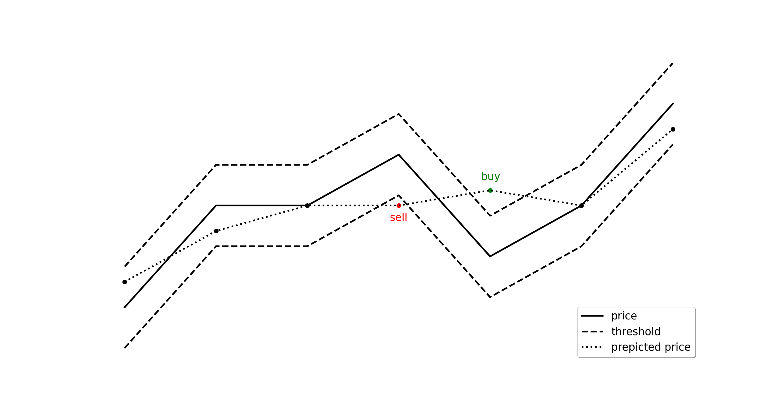

Transaction decision algorithm
Price predictions from random forest regressor:
MAE: 1.138 MSE: 8.337
Our custom uses a random forest to predict price
We mapped these predicted prices to transaction decisions
The thresholds are based on the absolute error of the model

Slide 11
Trading simulator
Buy method computes the outstanding balance of money and number of shares after each buy transaction.
Sell method computes the outstanding balance of money and number of shares after each buy transaction.
Result is a significant profit ratio of 2.238 considering all transactions over 4 months.

Slide 12
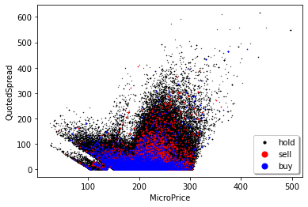
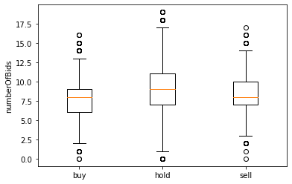
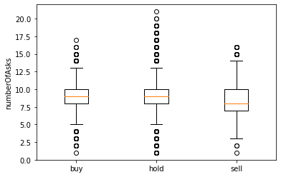
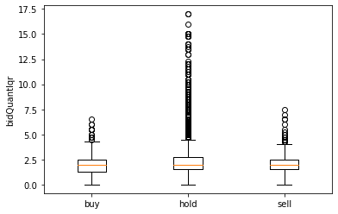
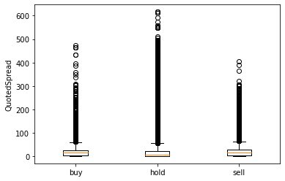
Transaction type patterns

Slide 13
Further Work Considerations
Adding more features to tape data for model training.
Implement heterogeneous ensemble methods.
Automating the end-to-end process for more than one asset.
The transaction decision algorithm could be improved by purchasing a quantity of asset proportionally to numerous risk thresholds.

Slide 14
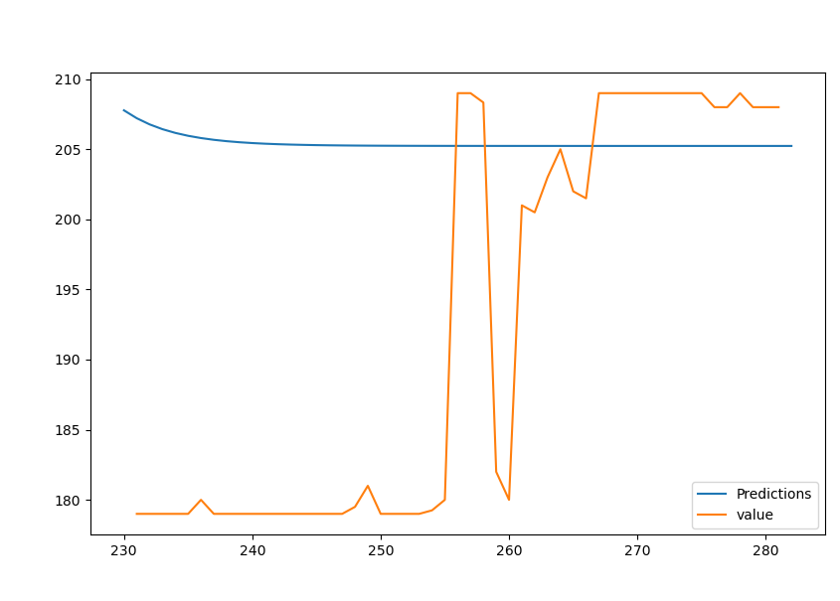
ARIMA with train-test splits
In agreement with previous method regarding convergence
MSE = 373.39

Slide 15
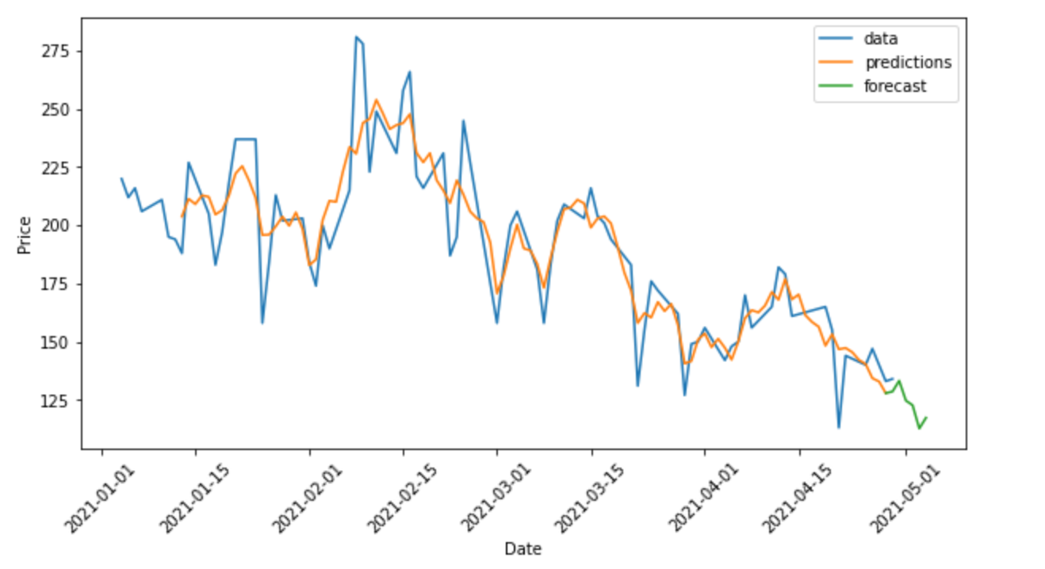
Neural Prophet weekly forecast
Forecasts including weekly seasonality
Predicts daily trend well

Slide 16
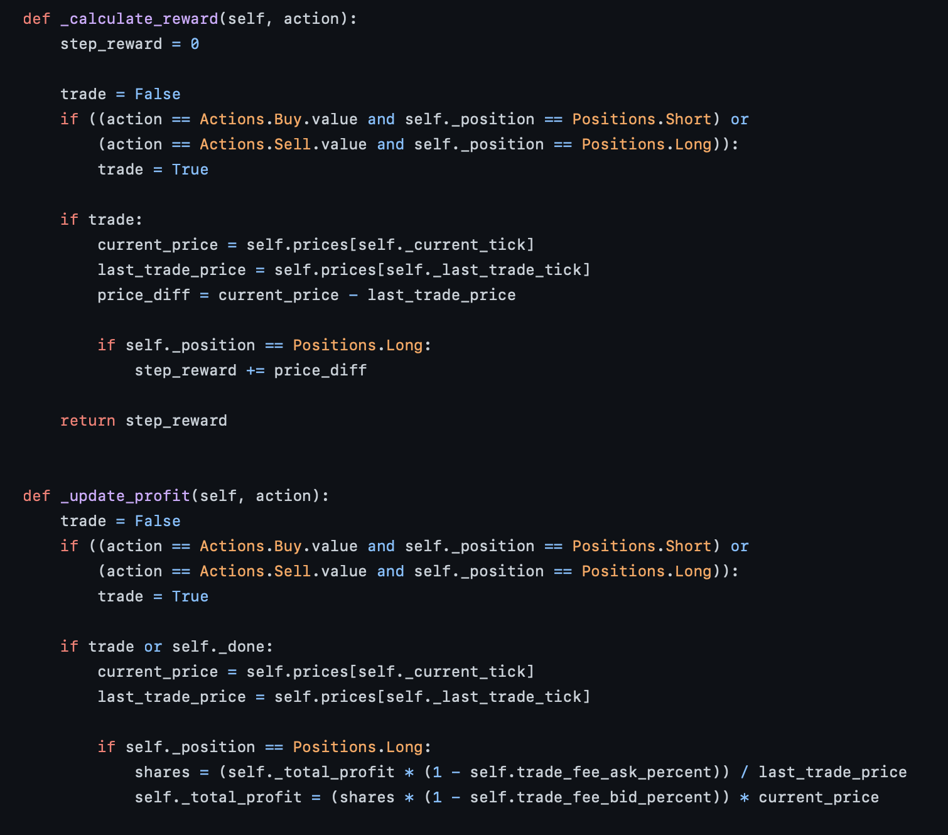
A2C stocks_env source code fragments
M. A. Haghpanah, “The most simple, flexible, and Comprehensive Openai Gym Trading Environment (approved by Openai Gym),” GitHub, 2022. [Online]. Available: https://github.com/AminHP/gym-anytrading.

