Slide 1
A Novel Search and Rescue Model Based on a Stochastic Gradient Descent Solution to a Travelling Salesman Problem
Search and Rescue
National Weather Service Alert
IBM Watson and cellphone location data
Machine Learning and Gradient Descent

Slide 2
Search and Rescue
National Weather Service Alert
IBM Watson and cellphone location data
Machine Learning and Gradient Descent

Slide 3
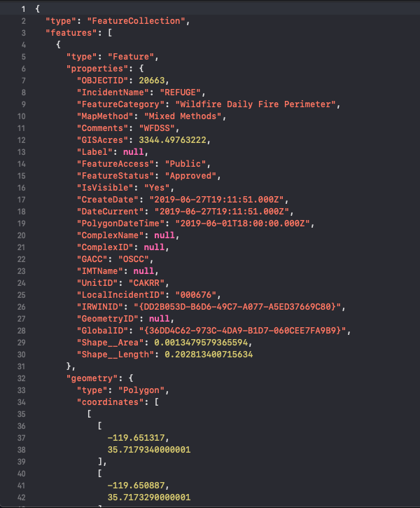
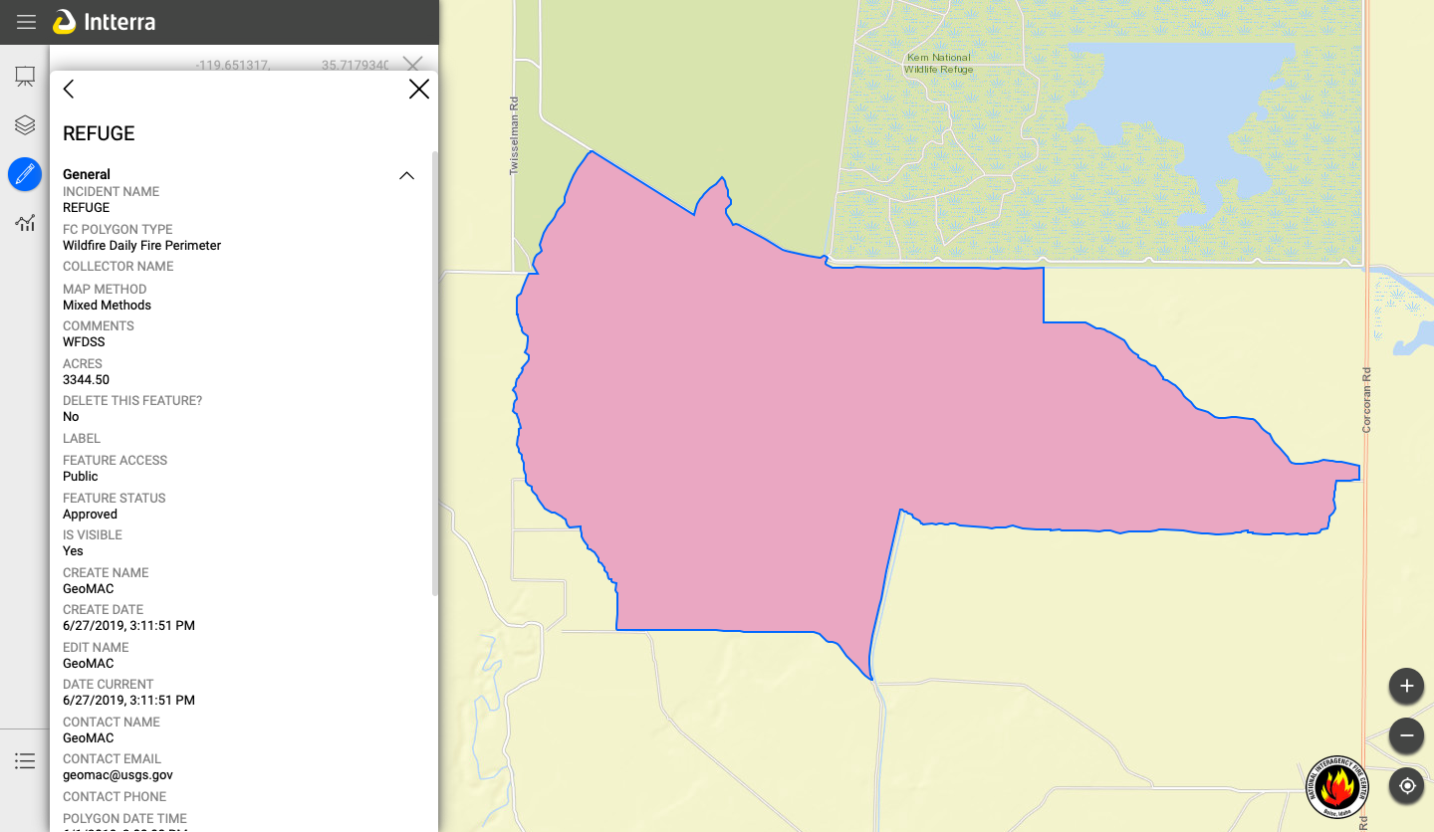
API Data from National Interagency Fire Center’s Wildfire Perimeter API

Slide 4
There’s a Wildfire Near You!
Immediate Danger
Evacuate Soon
Possible Threat
Cell phone location data
Nearest Emergency Vehicle Base

Slide 5
Search and Rescue
National Weather Service Alert
IBM Watson and cellphone location data
Machine Learning and Gradient Descent

Slide 6
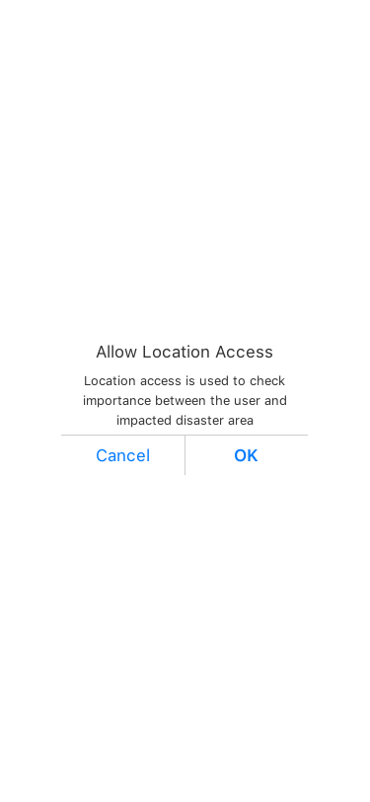
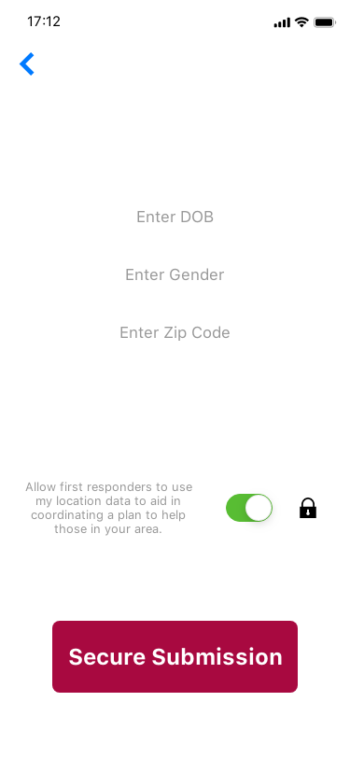
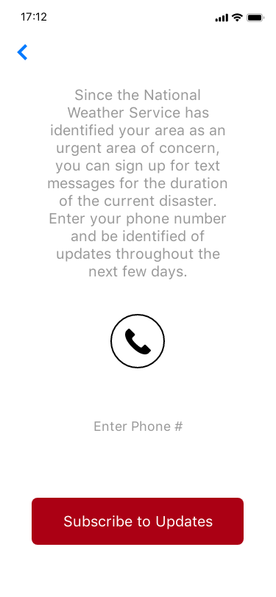
Cell Phone Data Authorization

Slide 7
Latitude, Longitude, Radial Position, and IBM Watson
Safe Factor
Latitude
Longitude
Distance from Source
Not-so-safe Factor

Slide 8
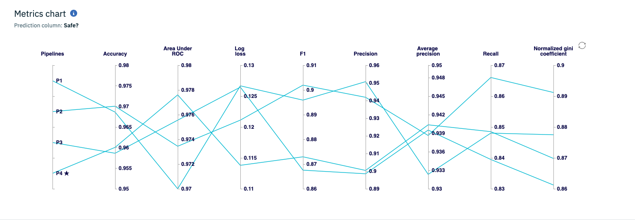
IBM AutoAI Pipeline Comparison

Slide 9
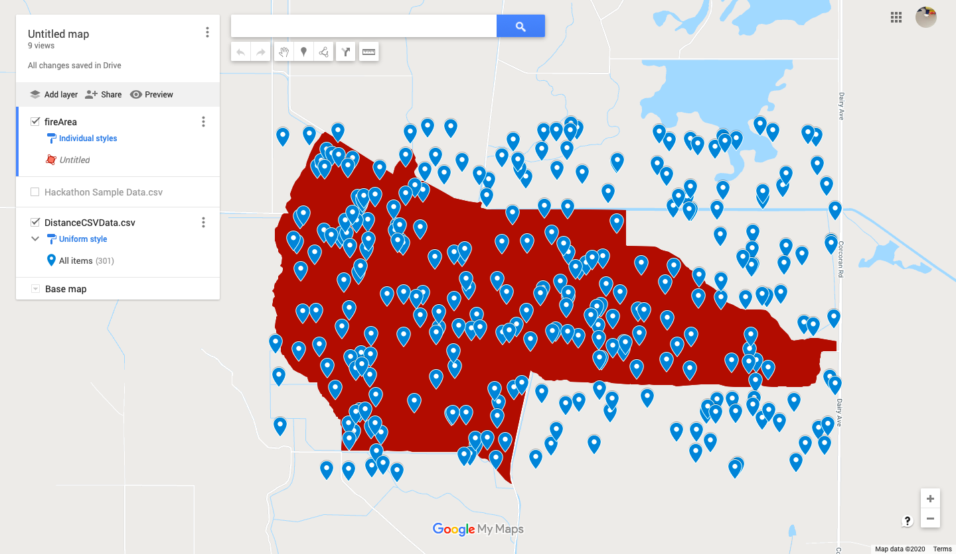
Representation of Map Training Data over Wildfire Region

Slide 10
Search and Rescue
National Weather Service Alert
IBM Watson and cellphone location data
Machine Learning and Gradient Descent

Slide 11
A Travelling Salesman

Slide 12
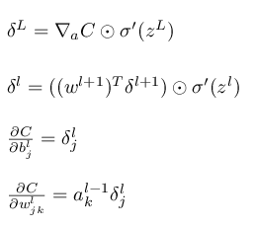
An Error Function and Gradient Descent

Slide 13
A Plan of Action

Slide 14
Checkout Our Github

