Slide 1
A Novel Search and Rescue Model Based on a Stochastic Gradient Descent Solution to a Travelling Salesman Problem
Search and Rescue
National Weather Service Alert
IBM Watson and cellphone location data
Machine Learning and Gradient Descent

Slide 2
Search and Rescue
National Weather Service Alert
IBM Watson and cellphone location data
Machine Learning and Gradient Descent

Slide 3
There’s a Wild Fire Near You!
Immediate Danger
Evacuate Soon
Possible Threat
Cell phone location data
Nearest Emergency Vehicle Base

Slide 4
Search and Rescue
National Weather Service Alert
IBM Watson and cellphone location data
Machine Learning and Gradient Descent

Slide 5
Latitude, Longitude, Radial Position, and IBM Watson
Safe Factor
Latitude
Longitude
Distance from Source
Not-so-safe Factor

Slide 6
Search and Rescue
National Weather Service Alert
IBM Watson and cellphone location data
Machine Learning and Gradient Descent

Slide 7
A Travelling Salesman

Slide 8
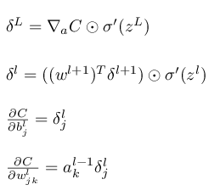
An Error Function and Gradient Descent

Slide 9
A Plan of Action

Slide 10
Checkout Our Github

