Slide 1

∫
APPM 4360 — Complex Variables and Applications, Spring 2026
Department of Applied Mathematics, University of Colorado Boulder
Ideal Fluid Flow in a Polygonal Domain
via the Schwarz–Christoffel Transformation
Congyuan Zheng · Sophia Arany
Department of Applied Mathematics, University of Colorado Boulder
April 27, 2026
Notes:
Good afternoon. Today we're presenting our project on ideal fluid flow in a polygonal domain using the Schwarz–Christoffel transformation. The core idea is that conformal maps let us transplant a hard PDE problem on an irregular shape into a canonical domain where it's already solved. Sophia will walk through the mathematical framework, and I'll take over to explain how we actually compute everything numerically for Boulder County.

Slide 2


From Polygon to Flow: The SC Approach
Sophia Arany
2 / 12
The Problem
① Irregular Polygon Ω
Laplace's equation ∇²φ = 0 governs ideal
∇²φ = 0 intractable in physical domain
fluid flow — but has no elementary closed-form
solution on an arbitrary polygon Ω.
The Key Idea: Conformal Mapping
② SC Map f : ℍ → Ω
A conformal map f : ℍ → Ω preserves
harmonicity. Any analytic W(ζ) in ℍ gives
valid flow in Ω via W̃(z) = W(f⁻¹(z)).
③ Analytic W(ζ) in ℍ
Application: Boulder County Polygon
Streamlines ψ = const satisfy boundary
12-vertex simplification of the Boulder County,
conditions automatically on ∂ℍ
CO boundary - a non-trivial test domain.
④ Pull Back to Ω
— valid flow in polygon
APPM 4360 — Schwarz–Christoffel Flow
Sophia Arany · Congyuan Zheng
Notes:
Speaker: Sophia Arany
The starting point is deceptively simple: we want to model ideal fluid flow — think wind or groundwater — inside a region shaped like Boulder County. The problem is that Laplace's equation has no closed-form solution on an irregular polygon. The Schwarz–Christoffel map is the key: it gives us an explicit conformal map from the upper half-plane ℍ to our polygon Ω. Once we have that map, any analytic complex potential W(ζ) in ℍ — which we can write down immediately — pulls back to give a valid flow in Ω. No approximation, no finite elements. The four-step pipeline on the right summarises the whole project.

Slide 3










Ideal Flow and the Complex Potential
Sophia Arany
3 / 12
Flow Conditions
Complex Potential
Boundary Condition
Irrotational:
Since φ, ψ satisfy Cauchy–Riemann,
No-penetration condition:
the function
Fluid cannot cross solid wall ∂Ω:
Incompressible:
is analytic on the flow domain.
→ stream function ψ
Velocity from W'(z):
The SC strategy:
In ℍ, the real axis ∂ℍ = ℝ is the boundary.
Both conditions → Cauchy–Riemann:
Complex derivative gives velocity directly.
Choose W(ζ) so Im W = 0 on ℝ.
Pulling back via f : ℍ → Ω gives
Geometric meaning:
ψ = 0 on ∂Ω automatically.
φ = const → equipotential lines
ψ = const → streamlines
Riemann Mapping Theorem:
Both families are orthogonal (∇φ · ∇ψ = 0)
Such f exists for any simply
connected Ω ⊊ ℂ (Riemann, 1851).
SC gives the explicit formula.
APPM 4360 — Schwarz–Christoffel Flow
Sophia Arany · Congyuan Zheng
Notes:
Speaker: Sophia Arany
Let me set up the flow theory. Ideal flow is irrotational and incompressible: the velocity field is a gradient, which satisfies Laplace's equation, and the divergence is zero. This means we can encode both the velocity potential φ and the stream function ψ into a single analytic function W(z) = φ + iψ. The beauty is that streamlines are exactly the level curves of ψ — and the no-penetration condition at the boundary reduces to ψ = const on ∂Ω. The Cauchy–Riemann equations guarantee that streamlines and equipotentials meet at right angles everywhere the derivative is non-zero.

Slide 4
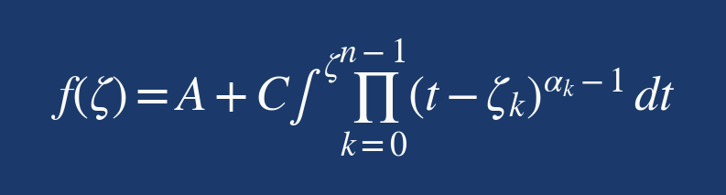


The Schwarz–Christoffel Formula
Sophia Arany
4 / 12
A ∈ ℂ
C ∈ ℂ
ζk ∈ ℝ
αk ∈ (0, 2)
Translation constant
Scale & rotation
Pre-vertices
Interior angle / π
positions the polygon
|C| = scale factor
Real-axis pre-images
Interior angle at wk = αkπ
in the complex plane
arg(C) = rotation angle
of polygon vertices wk
Angle sum: Σαk = n − 2
Why does this formula work?
① Direction of f '(t) on ℝ
② Vertex angle reproduction
③ Möbius freedom
④ Boulder County: n = 12
3 real degrees of freedom
n − 3 = 9 free pre-vertices
→ image is a straight segment
at each ζk → interior angle
→ fix ζ₀=−1, ζ₁=0,
ζ₂, …, ζ₁₀ ∈ (0, 1) to recover
(the k-th polygon edge)
is exactly αkπ at wk
ζn−1=1; n−3 free params
via Gauss–Legendre + LM
Key insight: all geometry of the target polygon is encoded in the exponents (αk − 1).
Segments of ℝ between pre-vertices map to straight edges; vertices to corners with prescribed angles.
APPM 4360 — Schwarz–Christoffel Flow
Sophia Arany · Congyuan Zheng
Notes:
Speaker: Sophia Arany
The Schwarz–Christoffel formula tells us explicitly how to build the conformal map. The integrand is a product of factors (t − ζk)^(αk − 1), where each ζk is a pre-vertex on the real axis mapping to a polygon vertex, and αk is the interior angle at that vertex measured in units of π. Three degrees of freedom are fixed by Möbius invariance — we pin ζ₀ = −1, ζ₁ = 0, ζn−1 = 1 — leaving n − 3 free pre-vertices to be determined. The constants A and C control the position and scale of the polygon. This is the formula everything else depends on.

Slide 5
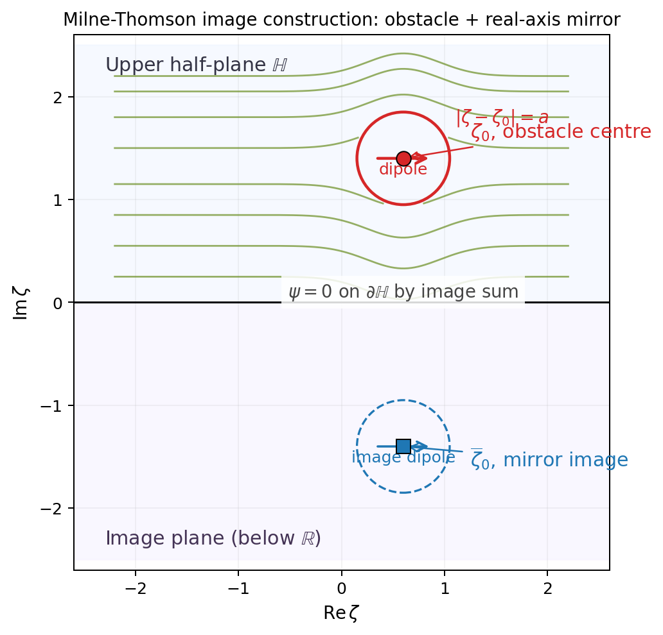
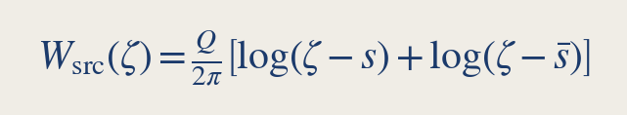
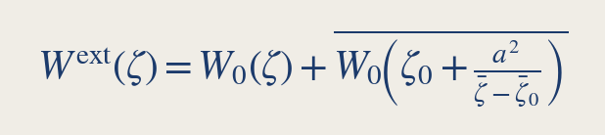
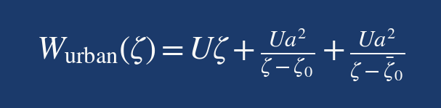
Adding an Obstacle: Method of Images + Milne-Thomson
Sophia Arany
5 / 12
Method of Images
Image construction in ℍ (schematic):
To enforce Im W = 0 on ∂ℍ = ℝ, pair any
singularity at s ∈ ℍ with its mirror at s̄ ∈ ℍ⁻:
Result: Im W = 0 on ℝ for all x ∈ ℝ (conjugate arguments cancel)
Milne-Thomson Circle Theorem (1940)
Given W₀(ζ) analytic outside disk D of radius a:
→ Im W^ext = 0 on ∂D (circle is a streamline)
→ Same singularities outside D as W₀
Combined: Urban Flow Potential
For W₀ = Uζ (uniform flow in ℍ), combining
MT theorem with method of images gives:
Red: obstacle ζ₀ and circle |ζ−ζ₀| = a.
Blue: mirror ζ̄₀ in lower half-plane.
Green: streamlines bend around obstacle
while satisfying both boundary conditions.
APPM 4360 — Schwarz–Christoffel Flow
Sophia Arany · Congyuan Zheng
Notes:
Speaker: Sophia Arany
Now suppose we want to add an obstacle — say, a circular region modelling downtown Boulder — inside Ω. We need the streamfunction to be constant both on ∂Ω and on the circle boundary ∂D. We handle this in two steps. First, the method of images: to enforce Im W = 0 on the real axis ∂ℍ, we pair each singularity at s ∈ ℍ with its complex conjugate mirror. Second, the Milne-Thomson circle theorem from 1940 says that given any analytic potential W₀ outside a disk, the modified potential W^ext automatically makes the circle a streamline. Combining these for uniform flow gives the urban potential shown at the bottom — a clean closed-form expression.

Slide 6
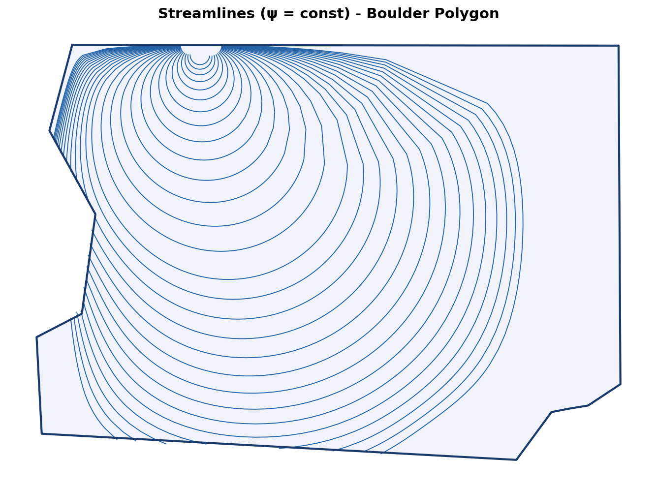
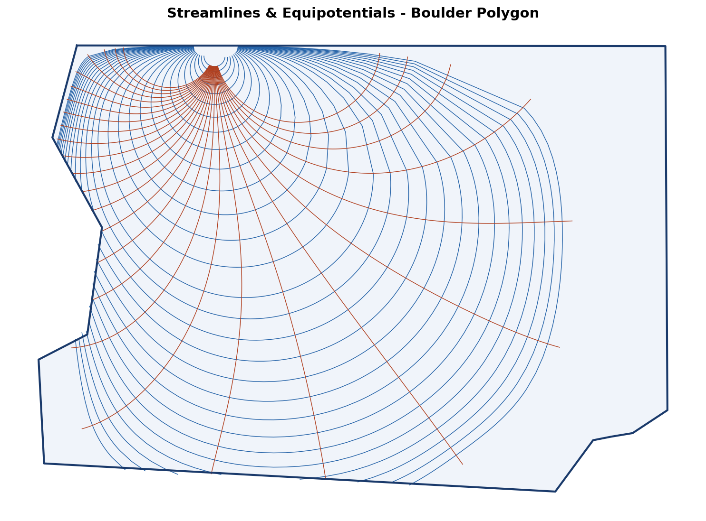
Uniform Flow W = Uζ in the Boulder County Polygon
Sophia Arany
6 / 12
(a) Streamlines ψ = const
(b) Conformal grid (streamlines + equipotentials)
Stay inside ∂Ω — no-penetration exact by construction.
Orthogonality throughout interior: definitive visual proof of conformality.
Closed appearance: topological consequence of f : ℍ → bounded Ω.
Consequence of Cauchy–Riemann equations wherever f '(ζ) ≠ 0.
The SC map converts an intractable PDE on Ω into a solved problem in ℍ —
boundary conditions are satisfied automatically, with no per-pixel Newton iteration.
APPM 4360 — Schwarz–Christoffel Flow
Sophia Arany · Congyuan Zheng
Notes:
Speaker: Sophia Arany
Here are the results for uniform flow W = Uζ pulled back through the SC map into the Boulder County polygon. On the left, streamlines ψ = const stay strictly inside ∂Ω — this is not an approximation, it's exact by construction, because the SC map sends the real axis to the polygon boundary. The closed appearance of the streamlines is a topological consequence of mapping ℍ to a bounded region. On the right, the conformal grid of streamlines and equipotentials confirms orthogonality throughout the interior — a definitive visual proof that the map is conformal wherever f′(ζ) ≠ 0. I'll now hand over to Congyuan, who will explain how we actually compute the SC map numerically.

Slide 7
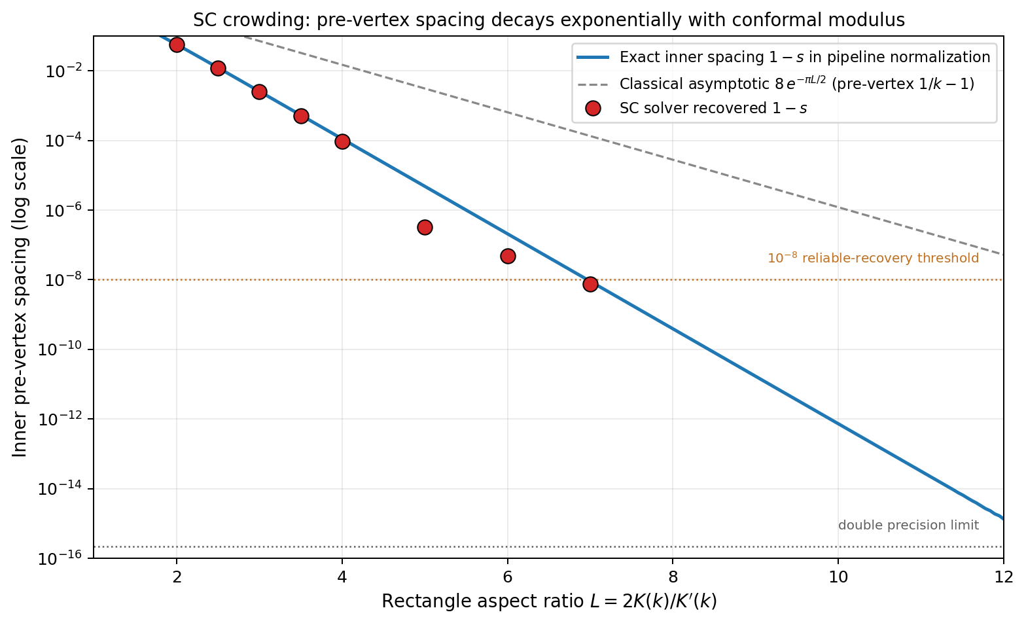
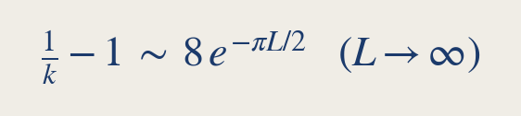
Why Numerical? The SC Crowding Problem
Congyuan Zheng
7 / 12
Pre-vertex spacing vs. aspect ratio:
What is SC Crowding?
Pre-vertices {ζk} cluster exponentially on ℝ
when the polygon has unequal edge lengths.
pre-vertex spacing for a rectangle of aspect ratio L
Why it limits the solver:
Spacing < 10⁻⁴ at L ≈ 4; below 10⁻⁸ at L ≈ 7
Beyond L ≳ 10 → double-precision limit → ill-posed parameter problem
Limits SC solvers to n ≲ 20 vertices with mild aspect ratios
Not an artifact — rigid complex-analytic invariant (conformal modulus)
→ Boulder County: 2752 vertices must simplify
to n = 12 polygon (angles confined to [0.35π, 1.75π])
keeping conformal modulus within the stable regime
Blue: exact spacing; grey dashed: asymptotic 8e^(−πL/2);
Conformal Modulus (invariant):
red circles: recovered by our SC solver.
Orange line: 10⁻⁸ threshold — below this, LM cannot resolve.
Rectangle R: modulus m(R) = 2K/K' is conformally invariant.
Pre-vertices related to m(R) via complete elliptic integrals K(k), K'(k).
APPM 4360 — Schwarz–Christoffel Flow
Sophia Arany · Congyuan Zheng
Notes:
Speaker: Congyuan Zheng
Thanks Sophia. Before I describe the algorithm, I need to explain why a numerical approach is necessary at all. If you try to apply the SC formula to a polygon with very unequal edge lengths, you run into what's called the crowding phenomenon: the pre-vertices {ζk} cluster exponentially on the real axis. The spacing decays like 8 e^(−πL/2) where L is the aspect ratio. By L ≈ 7, you're already below double-precision — the parameter problem becomes numerically ill-posed. This isn't a numerical artifact; it's a rigid complex-analytic invariant called the conformal modulus. The practical consequence is that Boulder County's 2752-vertex boundary absolutely must be simplified to a small polygon with controlled angles.

Slide 8
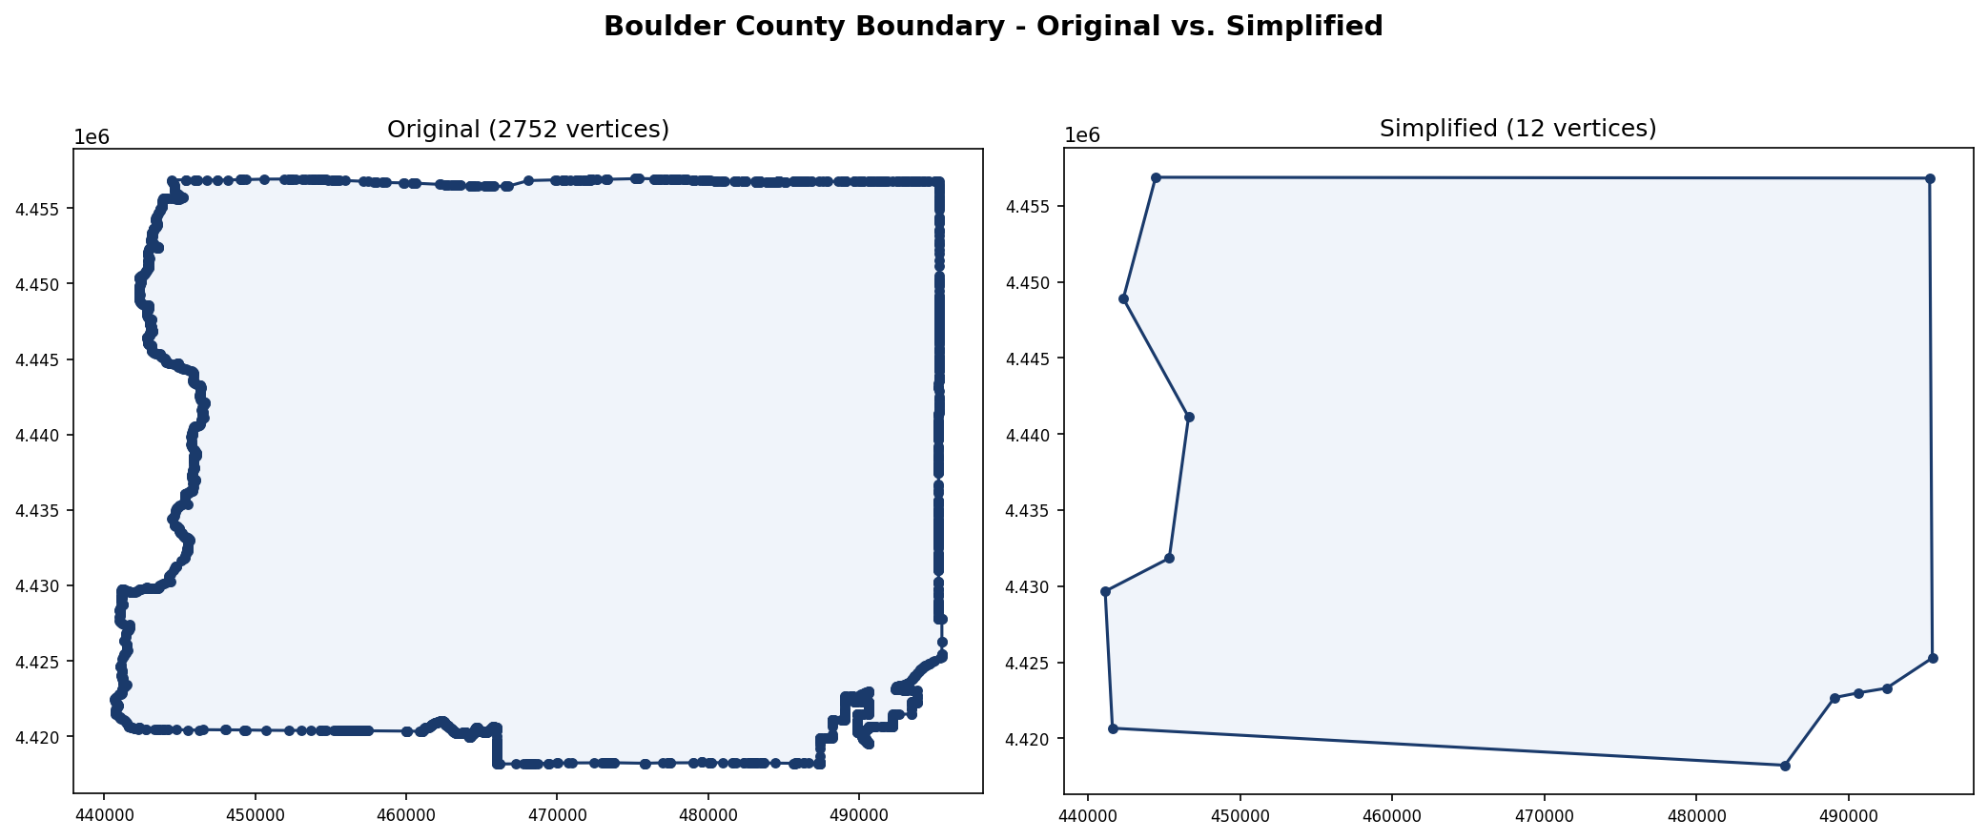
Boulder County: 2752 → 12 Vertices
Congyuan Zheng
8 / 12
Raw Boundary
Douglas–Peucker
Angle Filtering
SC-Ready
2752
D–P
14
filter
12
n = 12 Polygon
TIGER/Line vertices
vertices remaining
final vertices
normalised to O(1) scale
raw county boundary
adaptive tolerance
αk ∈ [0.35π, 1.75π]
centred at origin
Boulder County boundary: before and after SC preprocessing
Left: 2752-vertex TIGER/Line boundary
Right: 12-vertex SC polygon — dominant geometric features preserved
APPM 4360 — Schwarz–Christoffel Flow
Sophia Arany · Congyuan Zheng
Notes:
Speaker: Congyuan Zheng
The preprocessing pipeline has two stages. First, Douglas–Peucker simplification with an adaptive tolerance reduces the 2752-vertex TIGER/Line boundary down to 14 vertices. Second, we apply an interior angle filter: any vertex whose angle falls outside [0.35π, 1.75π] is removed, leaving n = 12. The lower bound 0.35π avoids very sharp corners that would cause severe crowding; the upper bound 1.75π excludes near-reflex angles. The polygon is then normalised to O(1) scale and centred at the origin. The figure compares the raw and simplified boundaries — the dominant geometric features are preserved.

Slide 9
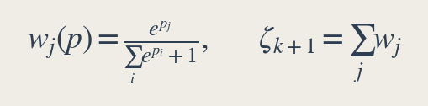
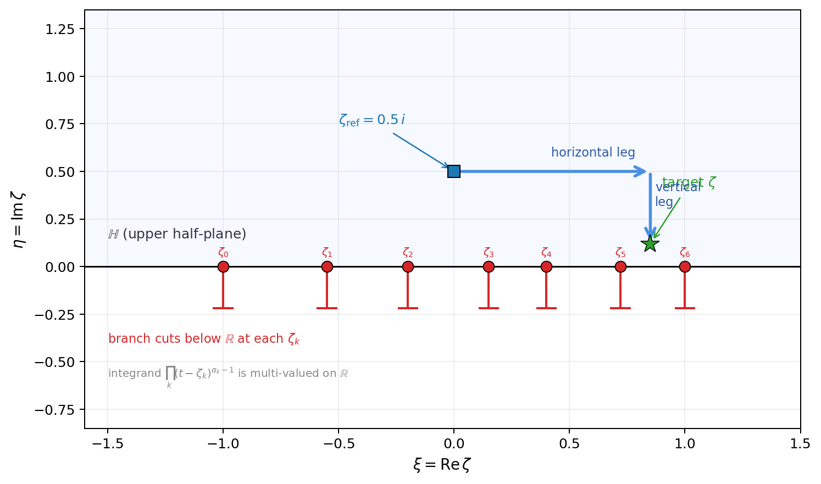
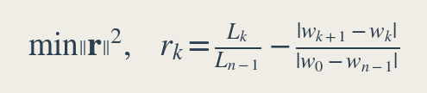
Solving the Parameter Problem
Congyuan Zheng
9 / 12
Goal: Find 9 free pre-vertices ζ₂,…,ζ₁₀ ∈ (0,1)
L-shaped path avoiding branch cuts:
1
Softmax Reparameterisation
→ Ordering + box constraints automatic; unconstrained optimisation over p ∈ ℝ⁹
2
Gauss–Legendre Quadrature
N = 500 nodes, affine-rescaled to [ζk, ζk+1]
Each side-length Lk = single vectorised dot product
Accuracy O(N⁻¹) ≈ 2×10⁻³ per sub-integral (plain GL, no endpoint sub.)
3
Levenberg–Marquardt Least Squares
SciPy least_squares; nodes + weights pre-computed, reused across iterations
L-shaped integration path (see figure →)
Each SC integral uses an L-path: horizontal leg at Im ζ = 0.5
(above all pre-vertices), then vertical to target.
Red markers on ℝ: pre-vertices ζk (branch cut sources).
Both legs stay strictly above ℝ → never cross branch cuts.
Blue square: reference point ζref = 0.5i.
Green star: target ζ in ℍ.
Recovering A, C ∈ ℂ:
Horizontal then vertical — no branch cut crossing.
Overdetermined system A + C·Ik = wk; least-squares via numpy.linalg.lstsq.
Vectorised GL + LM: <1s convergence for n = 12
APPM 4360 — Schwarz–Christoffel Flow
Sophia Arany · Congyuan Zheng
Notes:
Speaker: Congyuan Zheng
With a 12-vertex polygon we need to find 9 free pre-vertices. The three-step algorithm works as follows. First, softmax reparameterisation maps unconstrained parameters p ∈ ℝ⁹ to pre-vertices automatically satisfying ordering and box constraints — no projection or clamping needed during optimisation. Second, Gauss–Legendre quadrature with N = 500 nodes evaluates each SC side-length integral as a single vectorised dot product; nodes and weights are precomputed once and reused across iterations. Third, the Levenberg–Marquardt solver from SciPy minimises the side-length ratio residuals. The L-shaped integration path shown on the right keeps both legs strictly above the real axis, so neither leg ever crosses a branch cut from any pre-vertex.

Slide 10
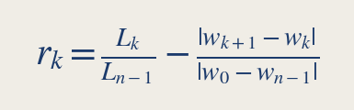
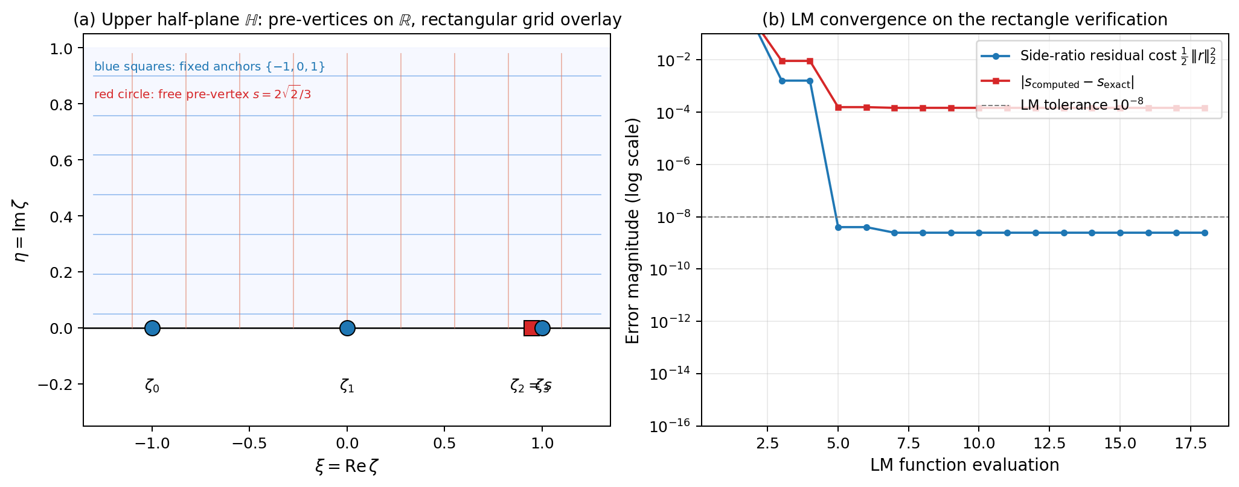
Levenberg–Marquardt Solver & Rectangle Verification
Congyuan Zheng
10 / 12
LM Objective:
Exact pre-vertex s
Recovered s (LM)
Absolute Error |Δs|
Final Residual ‖r‖
0.94281
0.94296
1.5×10⁻⁴
7×10⁻⁵
softmax + GL + LM
0.016% relative error
floor: O(N⁻¹) GL near endpoints
Residual floor arises from O(N⁻¹) GL quadrature accuracy near branch-point endpoints — Duffy substitution would push this to machine precision.
Rectangle test (aspect ratio m = 2): SC-recovered pre-vertices vs. analytic values
APPM 4360 — Schwarz–Christoffel Flow
Sophia Arany · Congyuan Zheng
Notes:
Speaker: Congyuan Zheng
How do we know the solver is correct? We test it on a rectangle with aspect ratio m = 2, where the exact pre-vertex position is s = 2√2/3 ≈ 0.94281, derivable analytically from elliptic integrals. Our solver recovers s ≈ 0.94296, an absolute error of 1.5 × 10⁻⁴ and a final residual ‖r‖ ≈ 7 × 10⁻⁵. The residual floor is set by the O(N⁻¹) accuracy of Gauss–Legendre quadrature near the branch-point endpoints. Applying Duffy's substitution or endpoint subtraction would push this to near-machine precision, but for our 12-vertex polygon the current accuracy is more than sufficient.

Slide 11
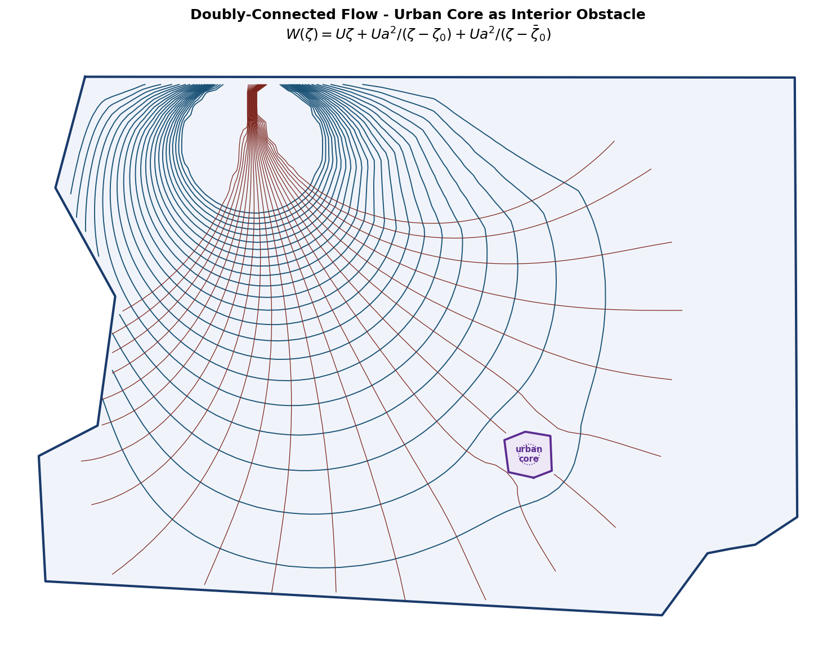
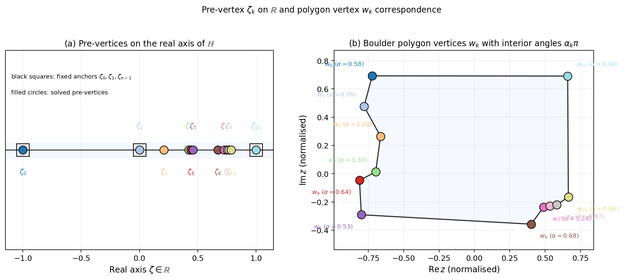
Urban Obstacle Flow: Milne-Thomson in the Boulder Polygon
Congyuan Zheng
11 / 12
Pre-vertex clustering (ℍ → Ω)
· Pre-vertices cluster on western flank
· Reflects long western edge of Boulder County
· Conformal modulus constraint — not numerical artifact
· Error O((a/Im ζ₀)²) — small obstacle approximation
· Future: exact doubly-connected SC map
(a) Streamlines around downtown Boulder obstacle
Obstacle = min-enclosing circle of downtown Boulder in ℍ
Streamlines deflect around obstacle; ψ = 0 on ∂Ω and ∂D enforced exactly.
Milne-Thomson + method of images: two boundary conditions satisfied simultaneously, zero per-point Newton iterations.
APPM 4360 — Schwarz–Christoffel Flow
Sophia Arany · Congyuan Zheng
Notes:
Speaker: Congyuan Zheng
With the SC map in hand, we apply the urban flow potential. Downtown Boulder is modelled as the minimum-enclosing circle in ℍ. The streamlines on the left deflect around the obstacle and remain inside ∂Ω — both boundary conditions are enforced exactly by the method of images and Milne-Thomson theorem, with zero per-point Newton iterations. The right panel shows the pre-vertex positions overlaid on the polygon: the clustering on the western flank reflects the long western edge of Boulder County, exactly as the crowding analysis predicted. The approximation error is O((a/Im ζ₀)²), small for our obstacle size.

Slide 12
Conclusions
Congyuan Zheng
12 / 12
Conformal Reduction
The SC map converts Laplace's equation on an arbitrary polygon into an analytic problem in ℍ —
boundary conditions satisfied automatically, with no per-pixel Newton iteration.
Robust Numerical Pipeline
Softmax reparameterisation + Gauss–Legendre quadrature (N=500) + Levenberg–Marquardt
recovers n=12 pre-vertices in <1 s; residual ‖r‖ ≈ 7×10⁻⁵.
Flow Results
Uniform flow: conformal grid confirms orthogonality throughout Ω. Milne-Thomson + method
of images adds a circular urban obstacle with ψ = const on ∂D and ψ = 0 on ∂Ω.
Boulder County Application
TIGER/Line 2752-vertex boundary reduced to n=12 by Douglas–Peucker + angle filtering;
dominant geometric features preserved; conformal modulus kept within stable regime.
Future Directions:
Duffy substitution → near-machine-precision GL at branch-point endpoints;
exact doubly-connected SC map (Schottky–Klein prime function) for obstacle flow without the small-obstacle approximation.
APPM 4360 — Complex Variables and Applications, Spring 2026
Sophia Arany · Congyuan Zheng
Advisor: Prof. James Meiss — Department of Applied Mathematics, University of Colorado Boulder
APPM 4360 — Schwarz–Christoffel Flow
Sophia Arany · Congyuan Zheng
Notes:
Speaker: Congyuan Zheng
To summarise: the SC map converts Laplace's equation on the Boulder County polygon into an analytically solved problem in ℍ. Our numerical pipeline — softmax + Gauss–Legendre + Levenberg–Marquardt — recovers all 12 pre-vertices in under a second with residual 7 × 10⁻⁵. Uniform flow confirms conformality via orthogonal gridlines. Milne-Thomson adds an urban obstacle with two boundary conditions satisfied simultaneously. Two directions for future work: Duffy substitution for near-machine-precision quadrature, and the Schottky–Klein prime function approach for an exact doubly-connected SC map that removes the small-obstacle approximation entirely. Thank you.

