Slide 1
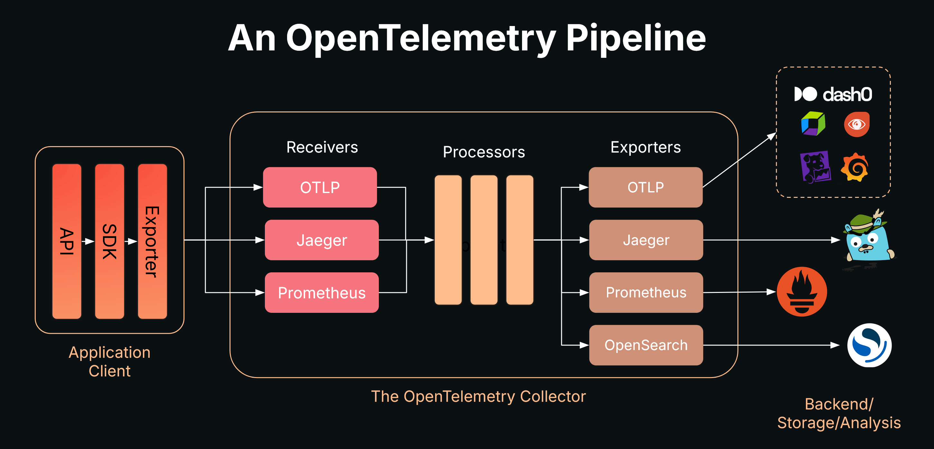
OpenTelemetry
Universal standard and sets of tools allowing applications to report telemetry data
API / SDK
OpenTelemetry Collector separete proces ( written in GO ), that received all data
OTLP – OpenTelemetry Protocol Schema / Serialization -> Protobuff itf / JSON schema Transport -> gRPC / HTTP/1.1
Trace / Span
Metrics
Logs

Slide 2
OpenTelemetry
C++
C#
Erlang/Elixir
Go
Java — Record Telemetry with API
JavaScript
PHP
Python
Ruby
Rust
C#
Go
Java
Python
Rust
https://opentelemetry.io/docs/languages/

Slide 3
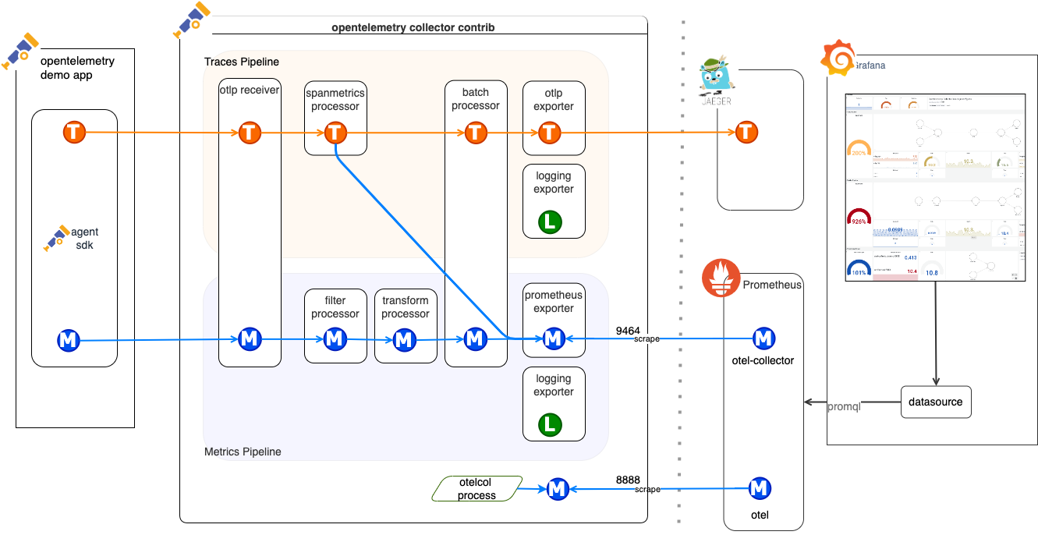
Logging exporter -> logs from Otel Collector itself
the observer must also be observable

Slide 4
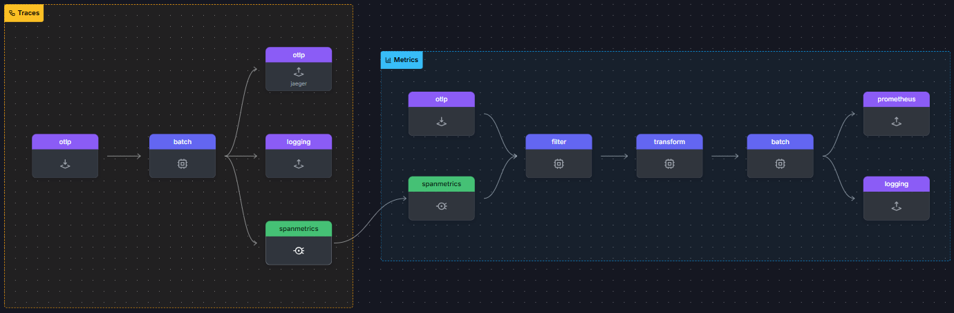
Spanmetrics - Rate / Error count / Duration
We automatically create metric for passing traces / spans

Slide 5
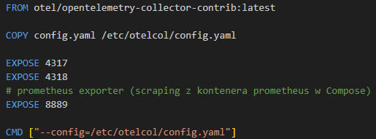
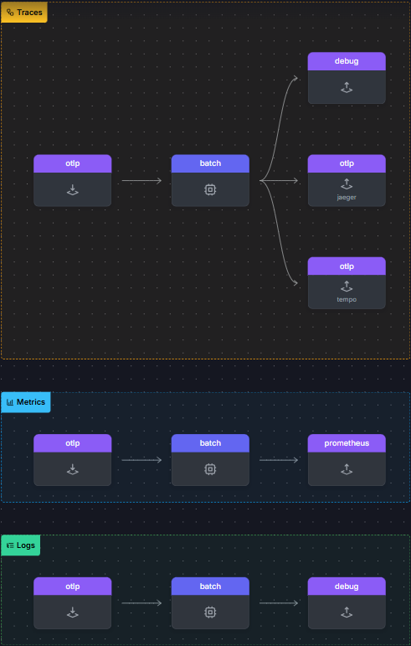
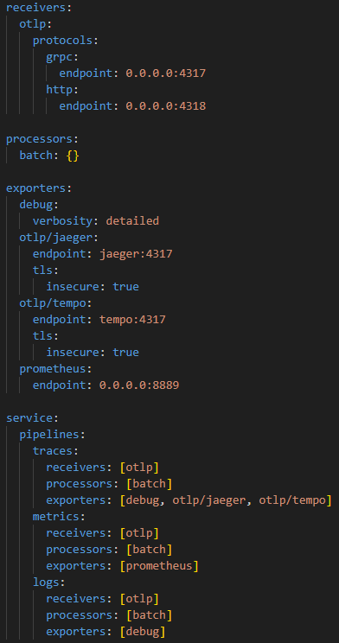
https://www.otelbin.io

Slide 6
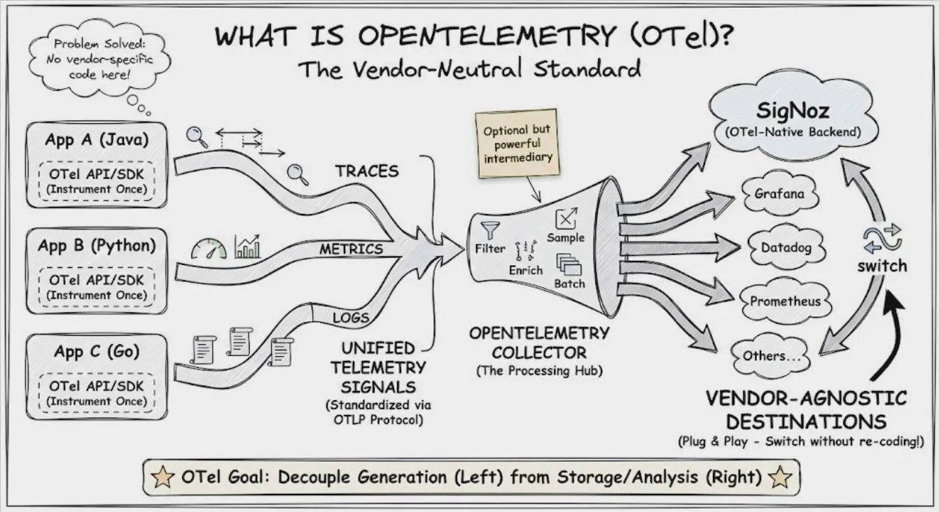
Filters discarding annoying logs / sensitive data before it leaves your system (ping, healthchecks, passwords, creadit card ids, passing only certain log levels)
Enrich adding tags about application deplyment (instance numer, cloud region, test / production)
Sample lets store 1% of normal requests (to get the baseline) and store all Error http responses and all responses longer then 200ms
Batch sending data in batches - send when buffer filles & drain after fixed period

Slide 7
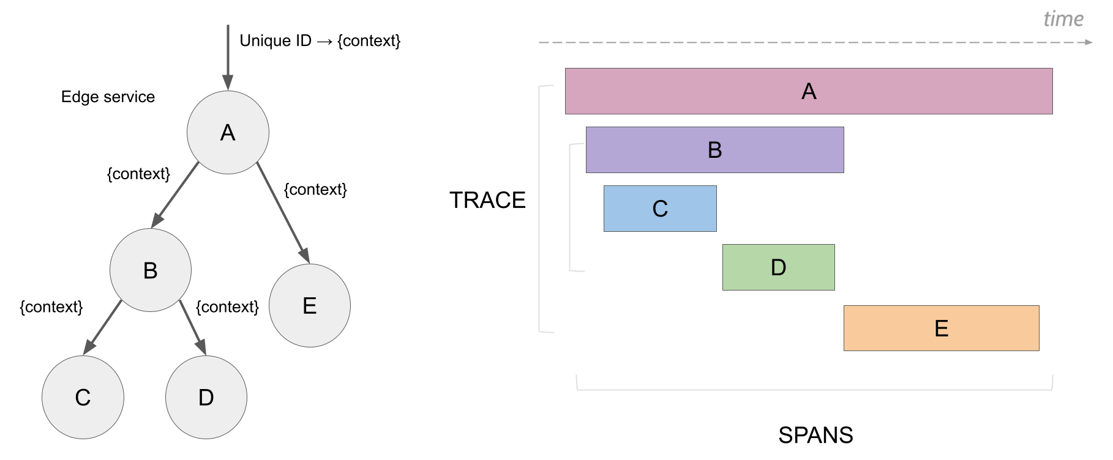
Traces / Spans
Span -> smallest set of tasks, you decide to track
this opens possibility to observing gaps in span hierarchy
when some processing is untracked parent span is just growing wider and wider, while childern spans remain their normal sizes
this could be a consequence of coarse-grained spans (not enought processing gets its own span, we missed spots of our code)

Slide 8
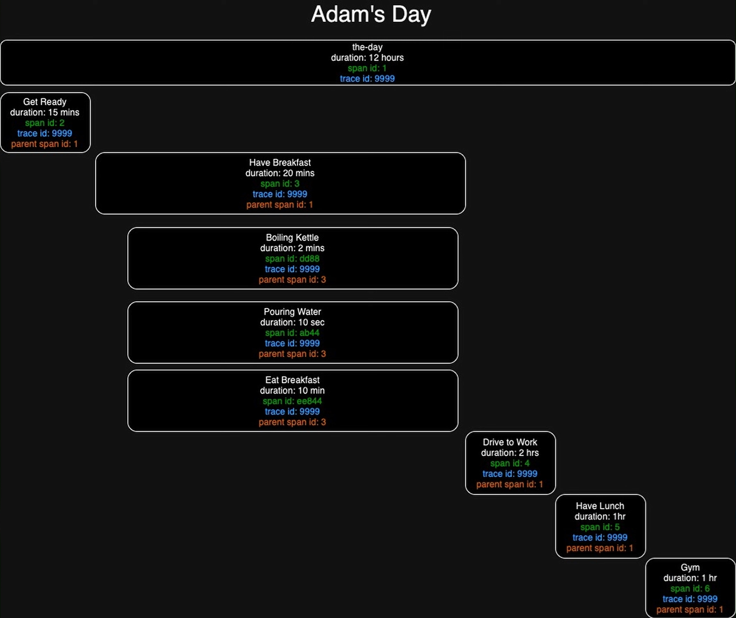
HTTP Header / Protobuff Metadata
trace id
span id
parent span id
Context
Rest of the data such as:
span timestamps
metrics
logs
is sent via background thread straight to Otel Datacollector (OTLP -> gRPC)

Slide 9

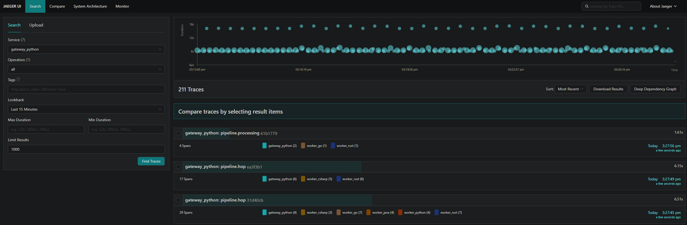
Traces / Spans

Slide 10
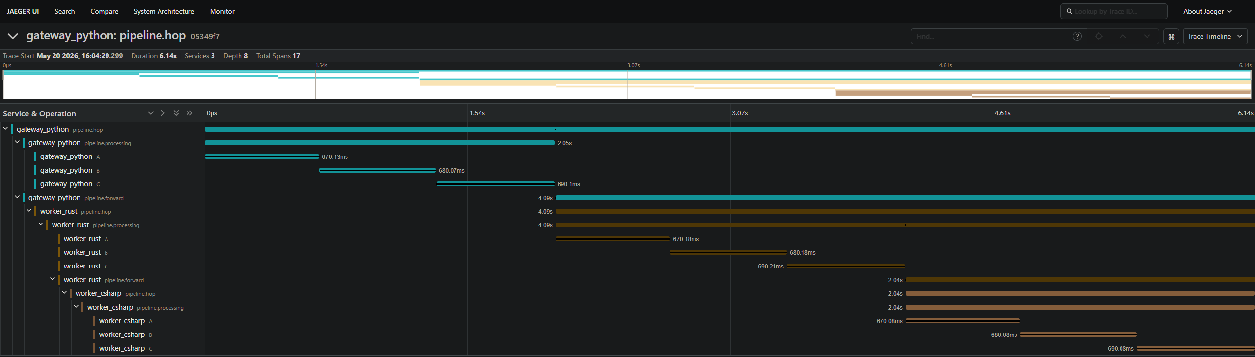
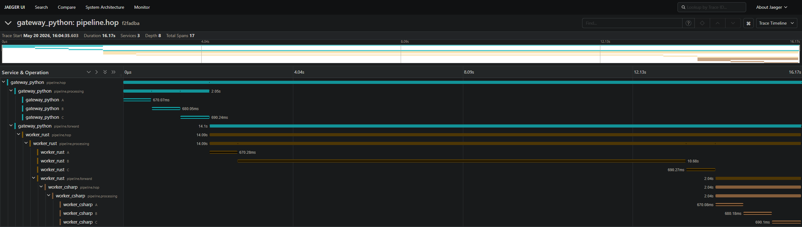
Traces Timeline
( same paths - different processing time )

Slide 11
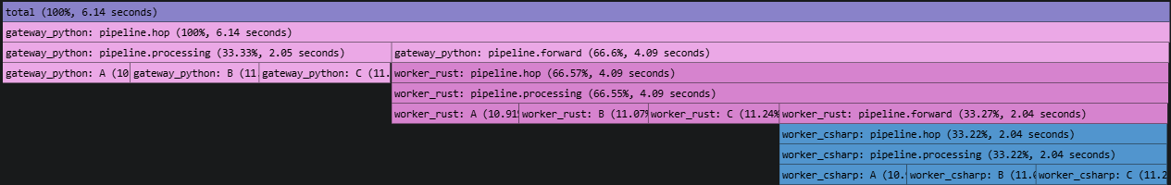
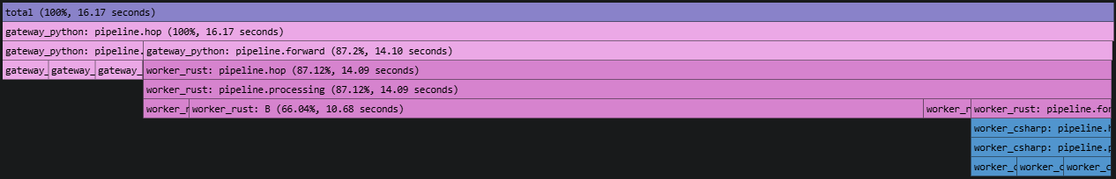
Traces Flamegraph
( same paths - different processing time )
as we can see, the difference in trace duration is caused by incresed amout of time spent in span worker_rust: B
unfortunatelly free analisys tools (Jeager / Grafana) are unable to compare this case effectively - so we are forced to look at them side by side and spot the difference with our own eyes

Slide 12
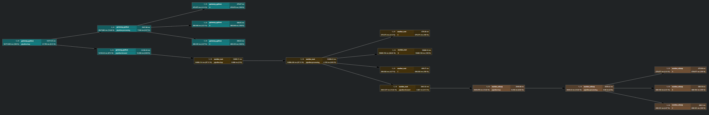
Traces Graph
( same paths - different processing time )

Slide 13
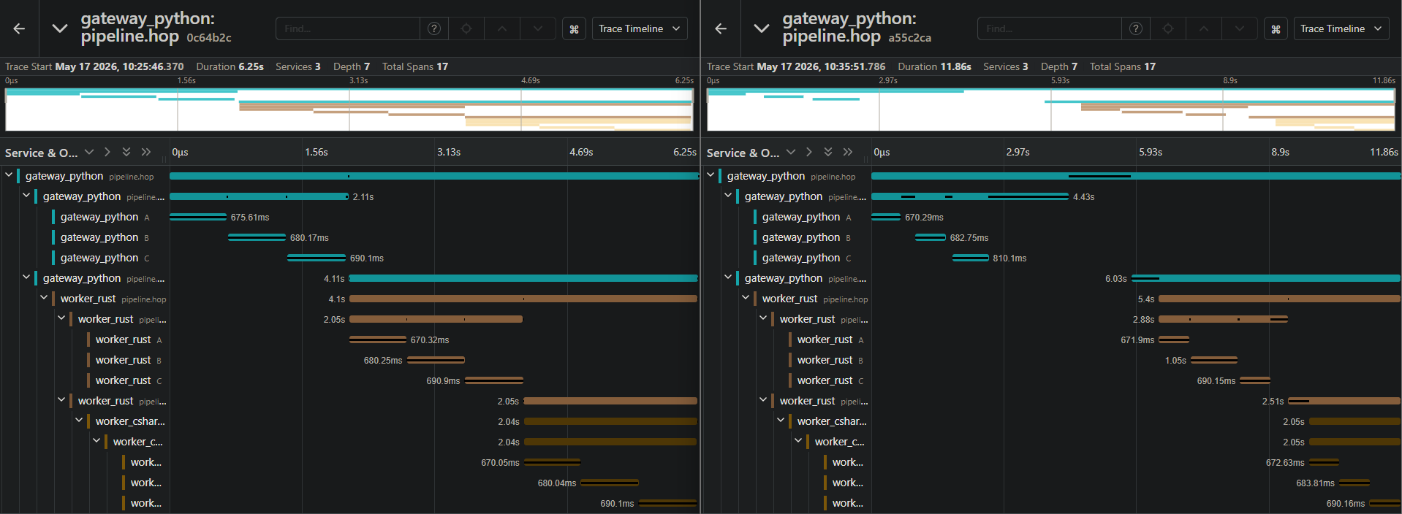
Traces Timeline
( same paths - different processing time )
latency increase
outside of constructed spans

Slide 14
Traces Timeline
( same paths - different processing time )
latency increase
outside of constructed spans
our spans didn’t grow wider -> empty space was added between out spans

Slide 15
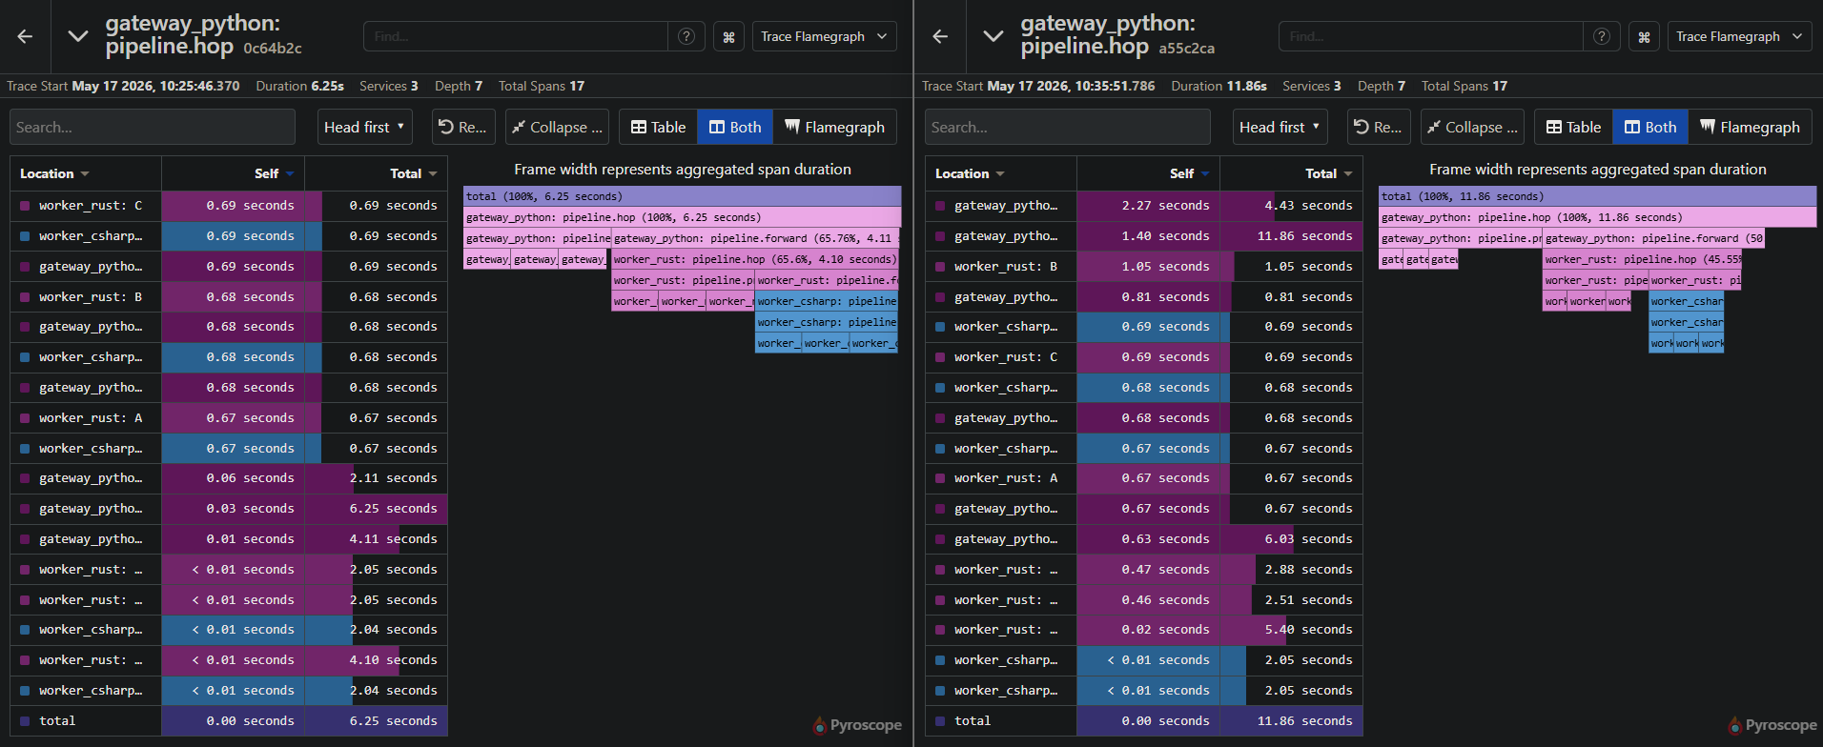
Traces Flamegraph
( same paths - different processing time )
latency increase
outside of constructed spans

Slide 16
Traces Flamegraph
( same paths - different processing time )
latency increase
outside of constructed spans

Slide 17
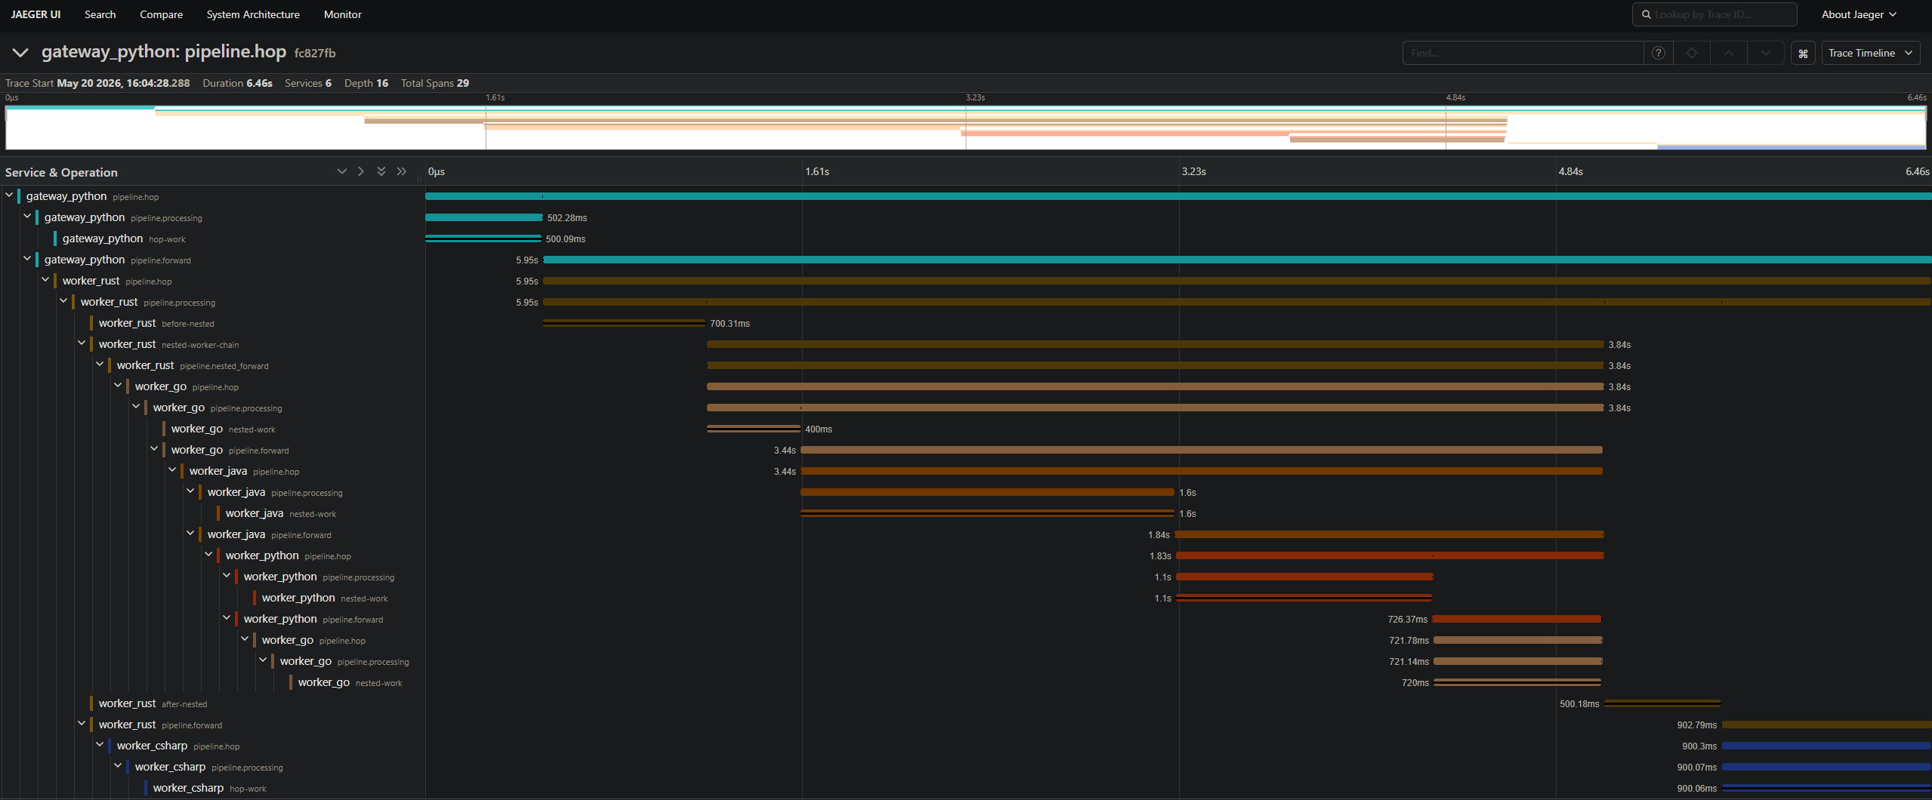
Traces Timeline
( different paths )

Slide 18
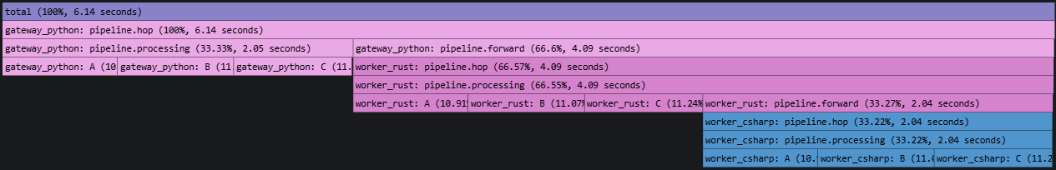
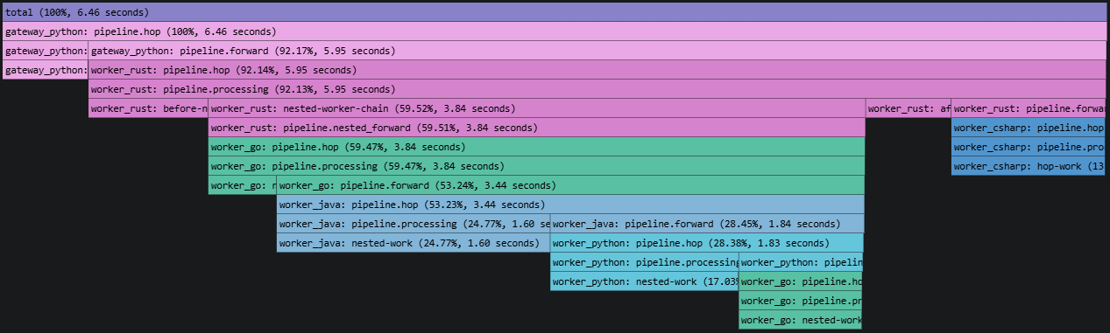
Traces Flamegraph
( different paths )

Slide 19
Traces Graph
( different paths )

Slide 20
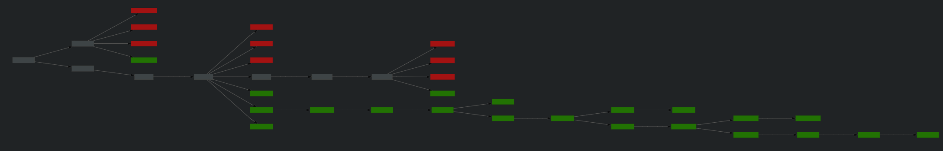
Traces Compare
( different paths )
common
deleted
added

Slide 21
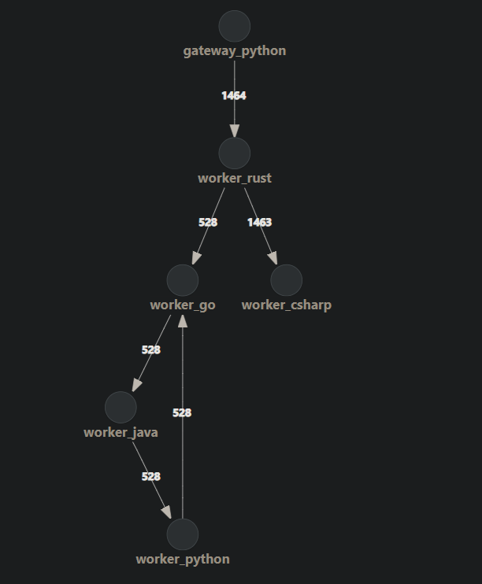
System Architecture

Slide 22
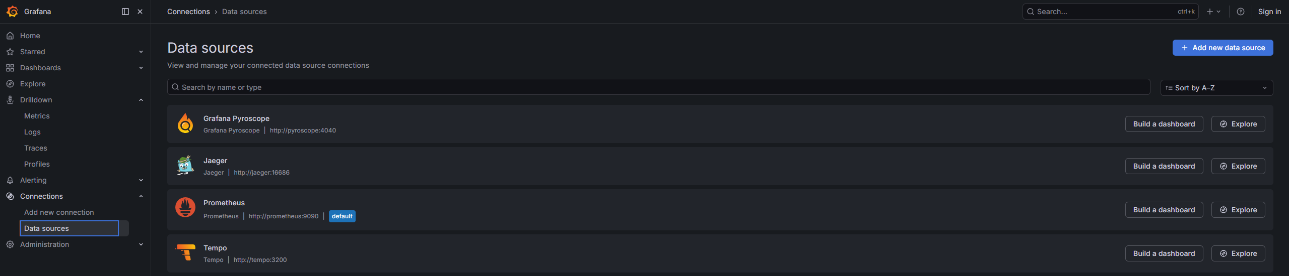
Grafana

Slide 23
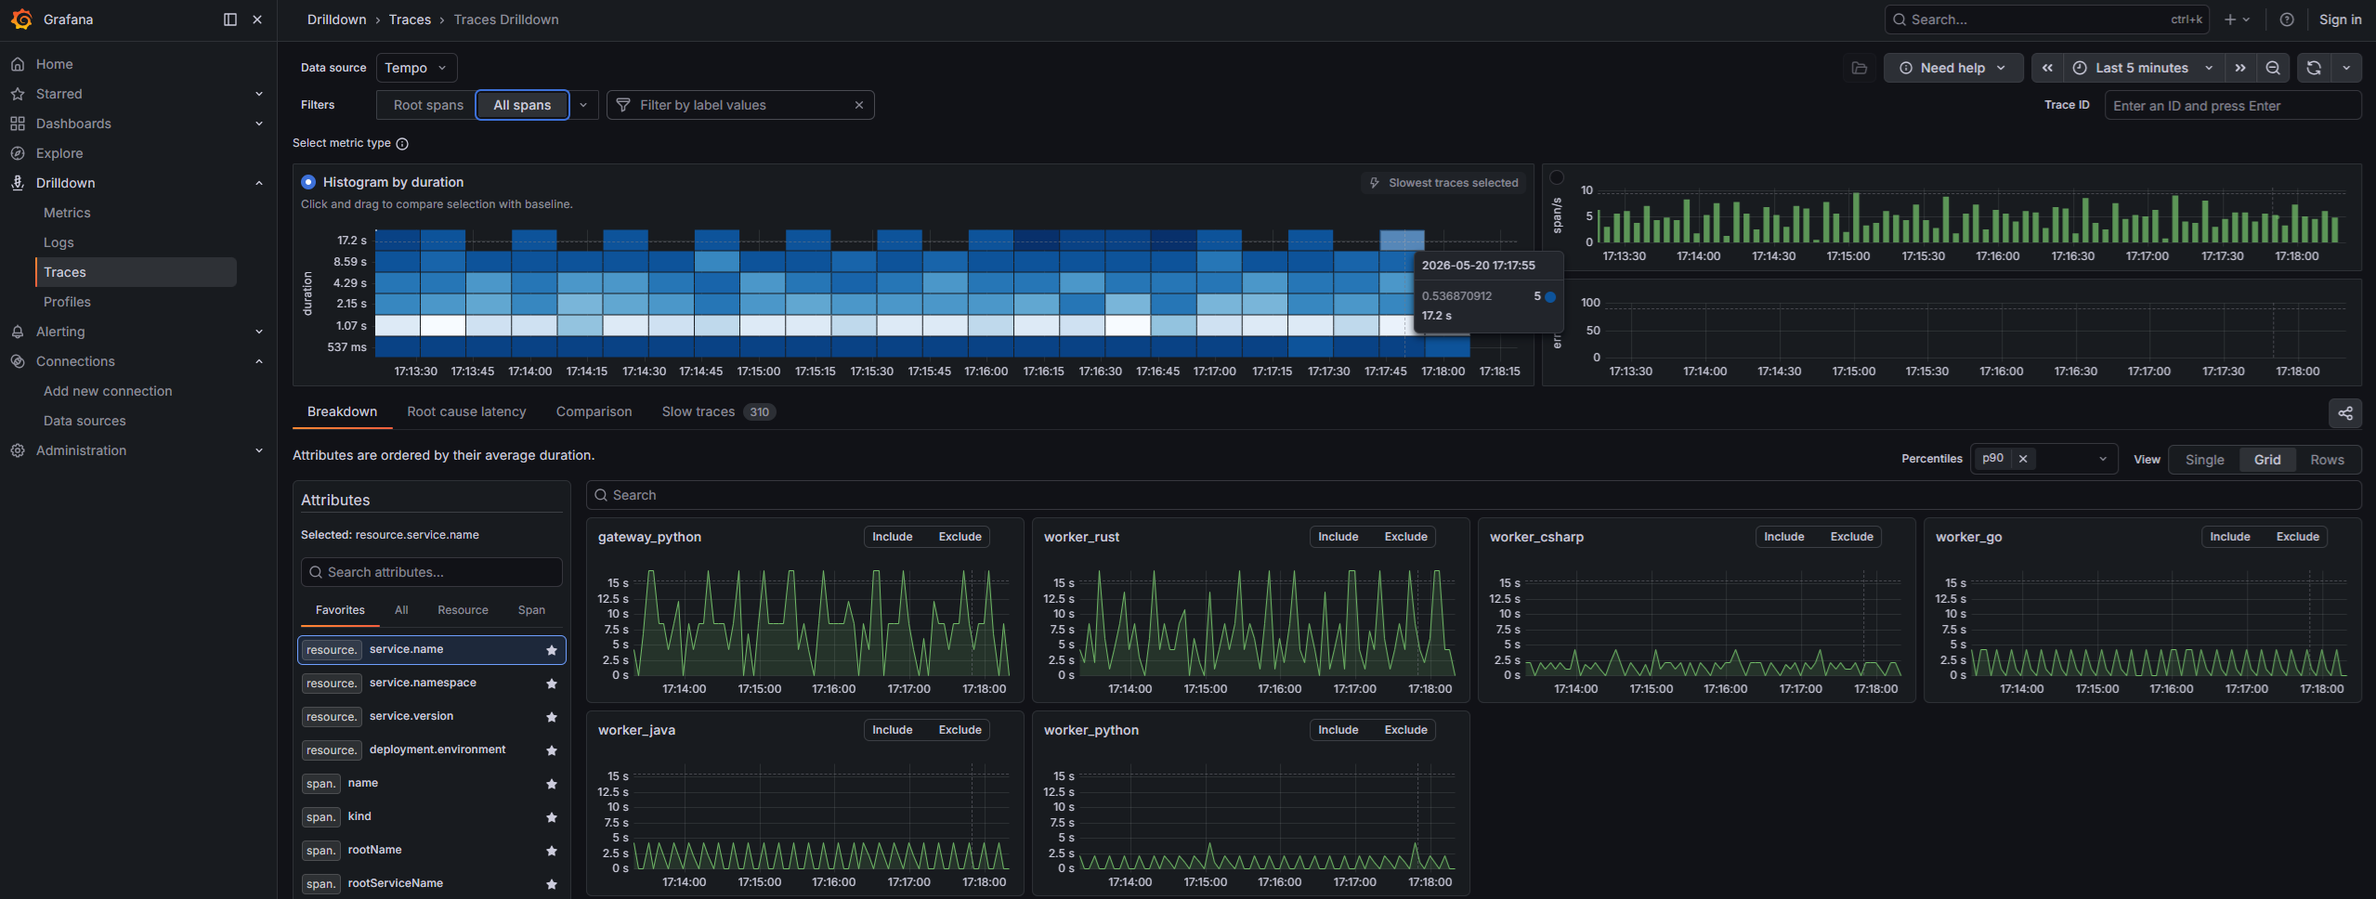
Grafana - Traces

Slide 24
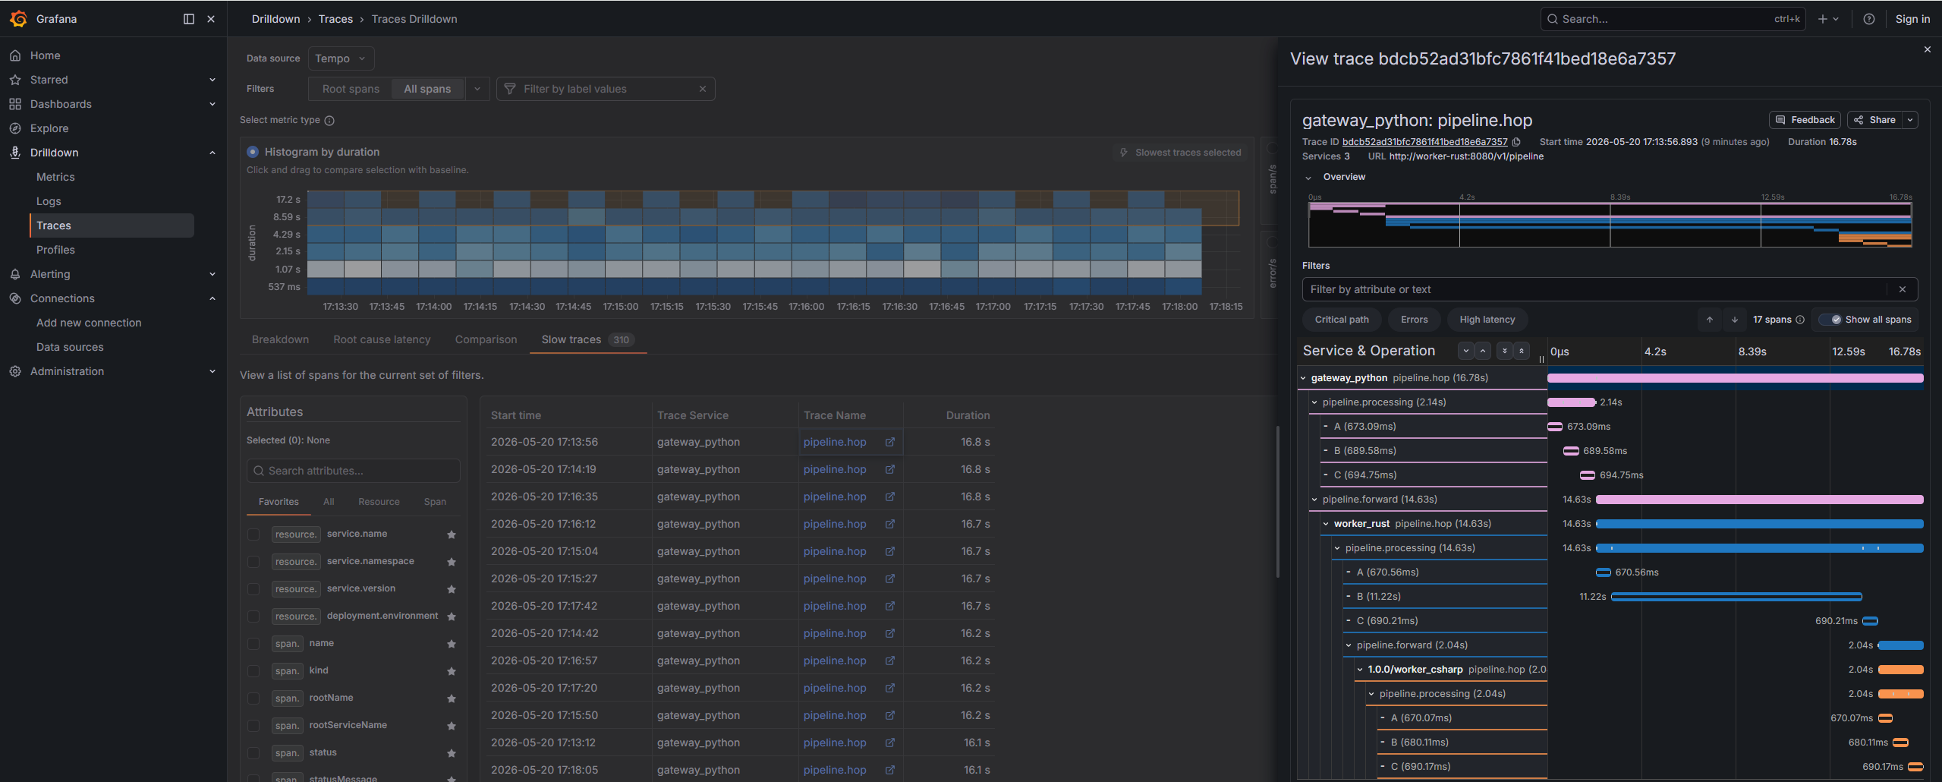
Grafana - Traces

Slide 25
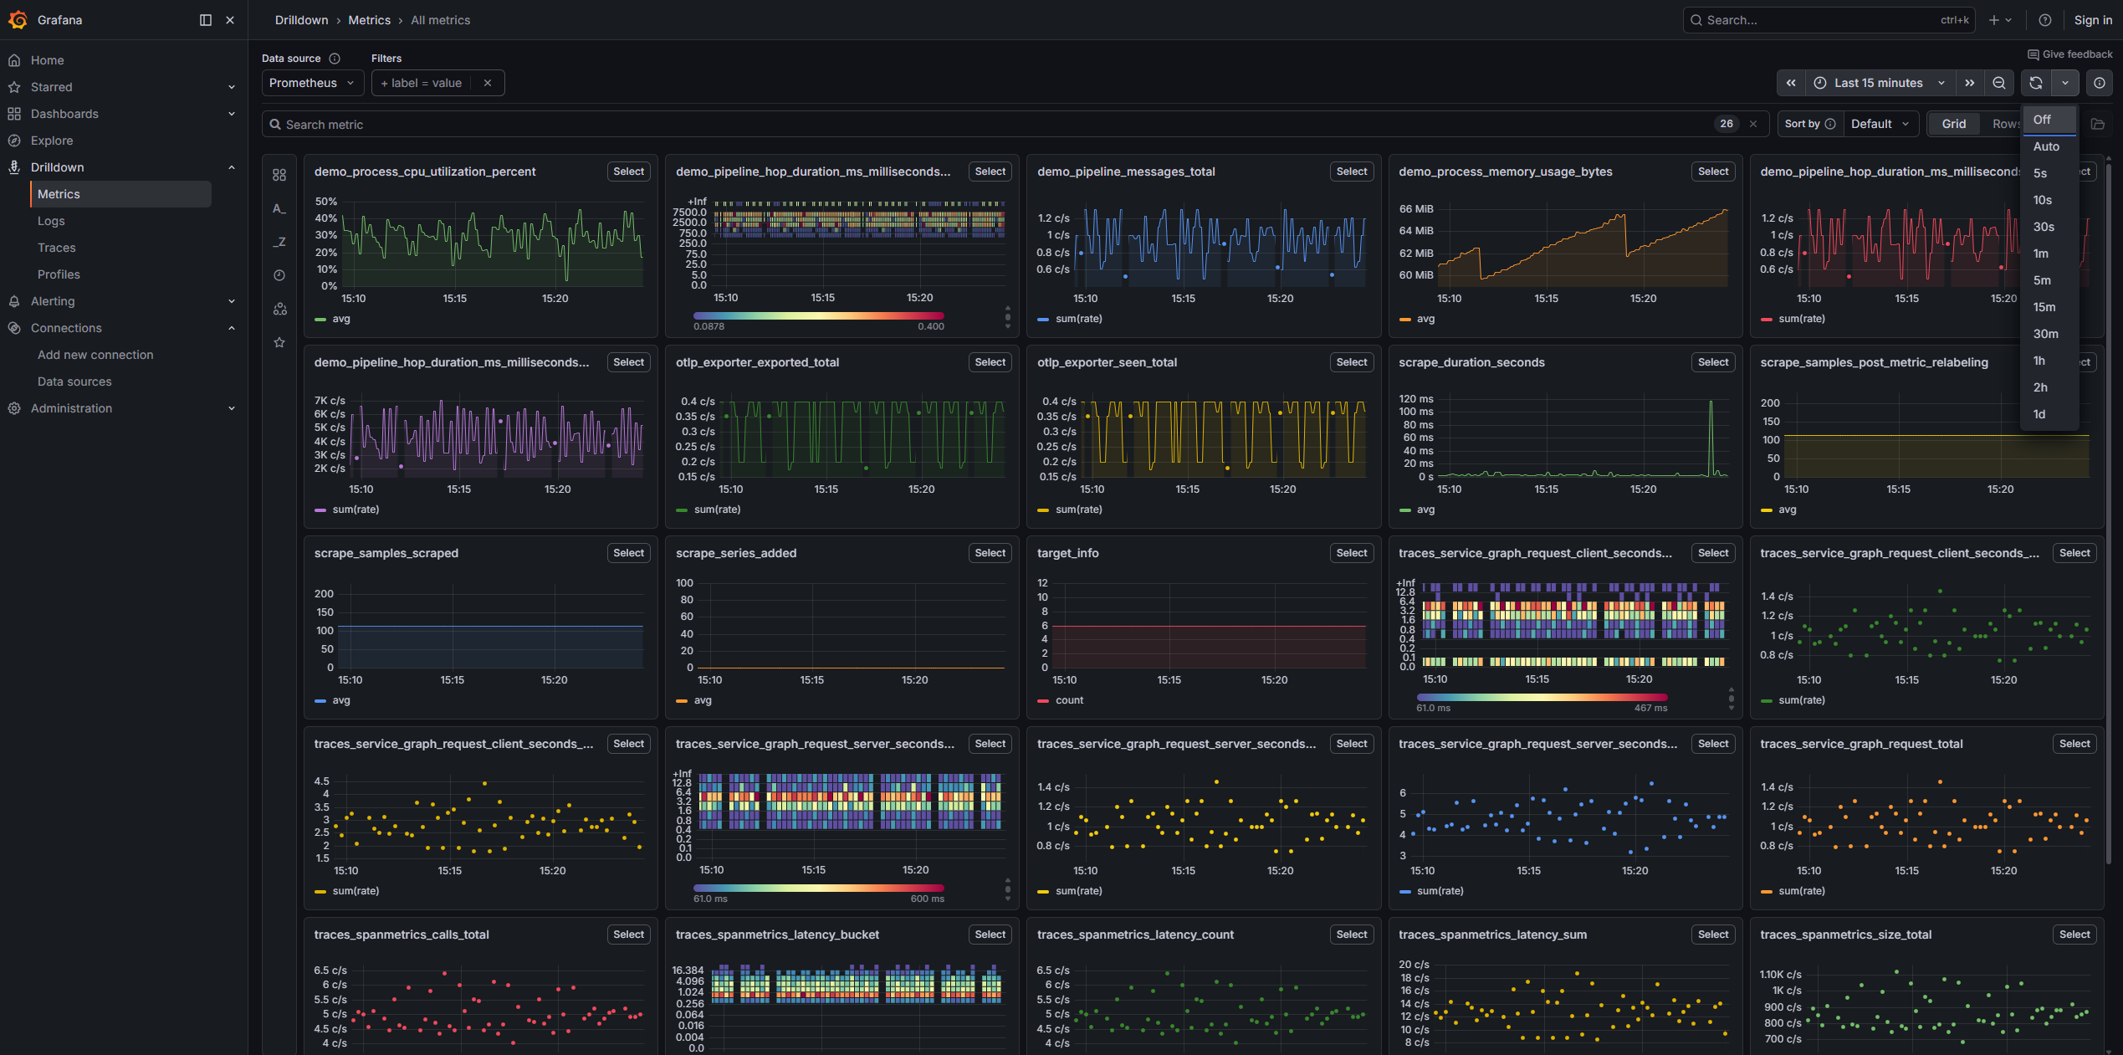
Grafana – Drilldown - Metrics

Slide 26
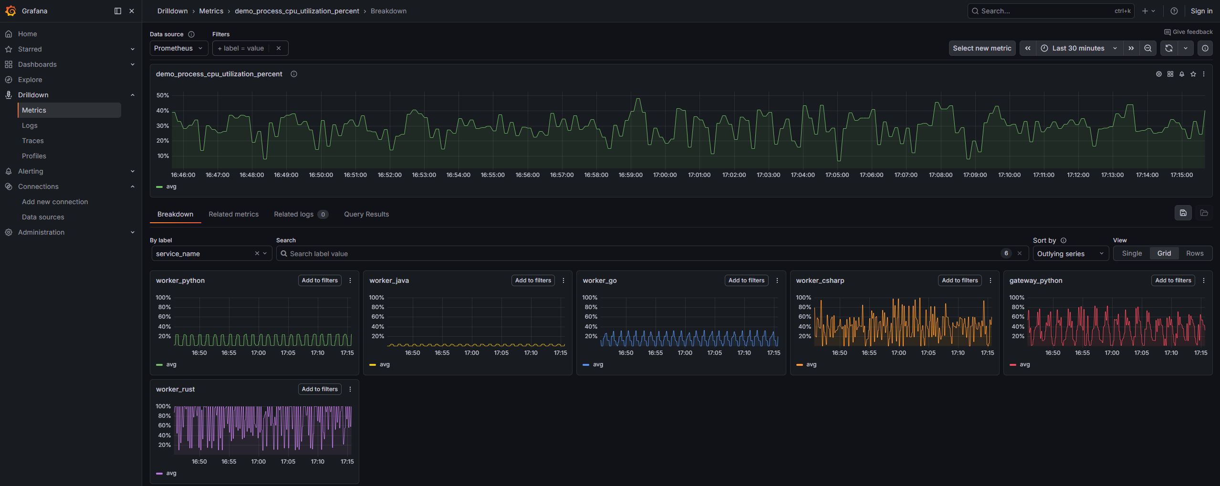
Grafana – Drilldown - Metrics

Slide 27
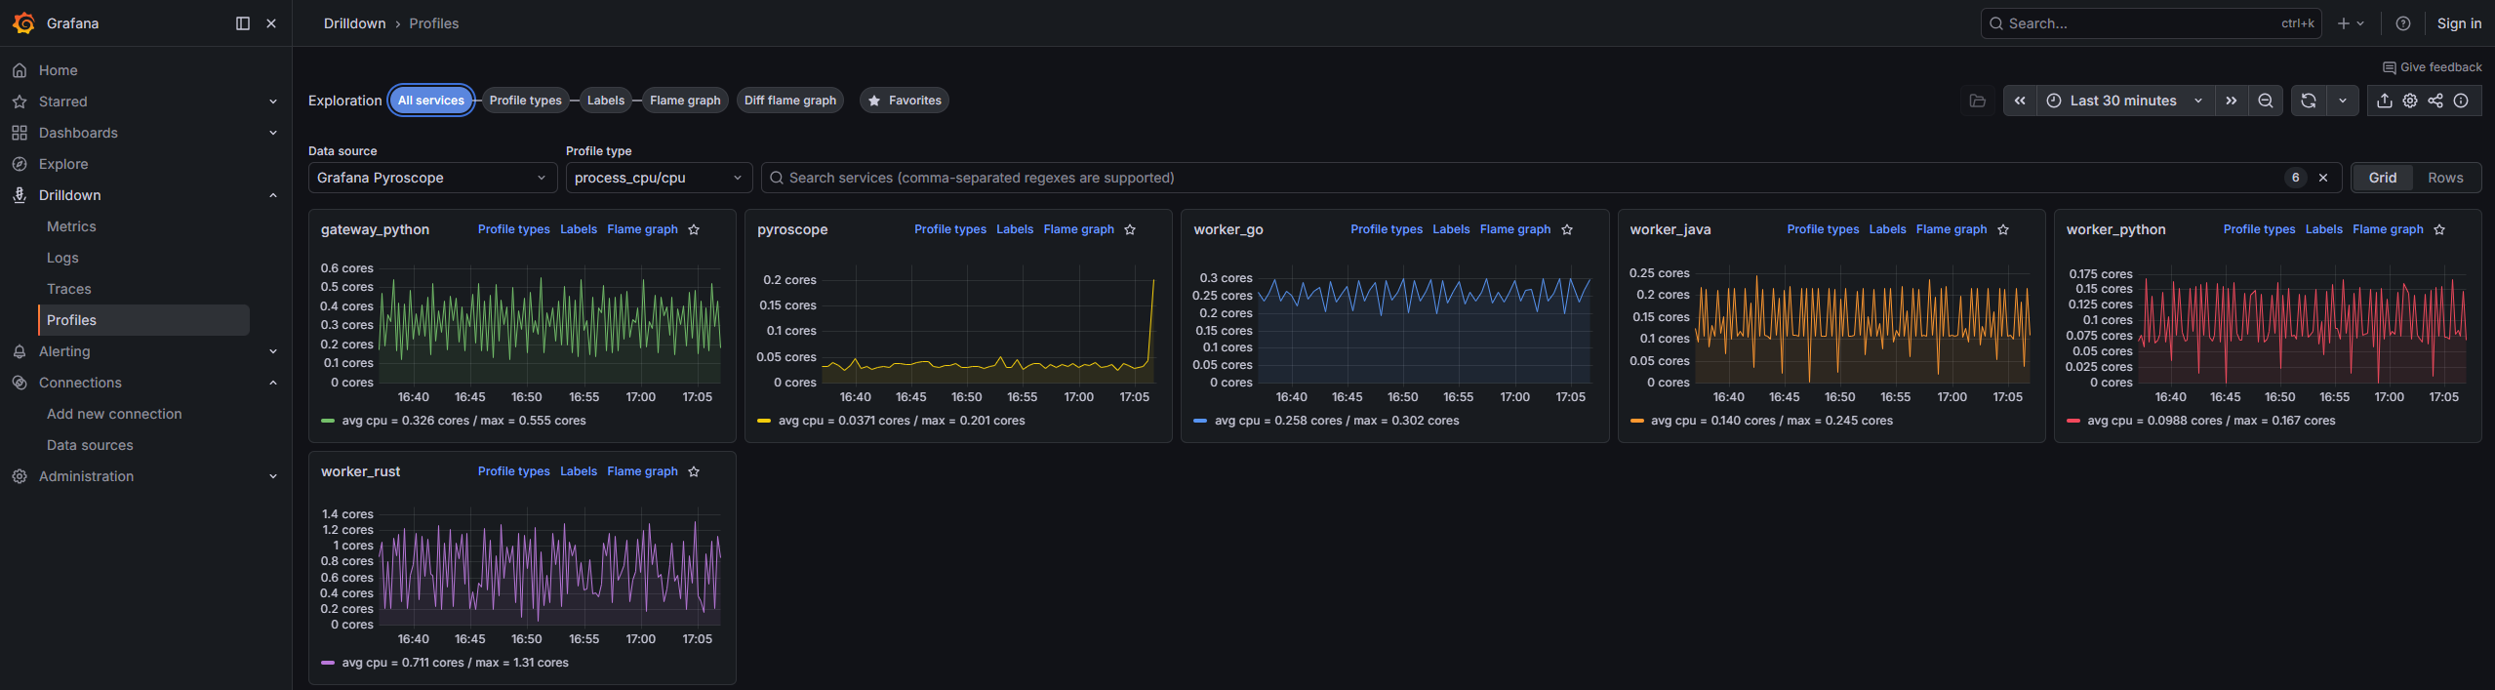
Grafana – Drilldown – Profiles

Slide 28
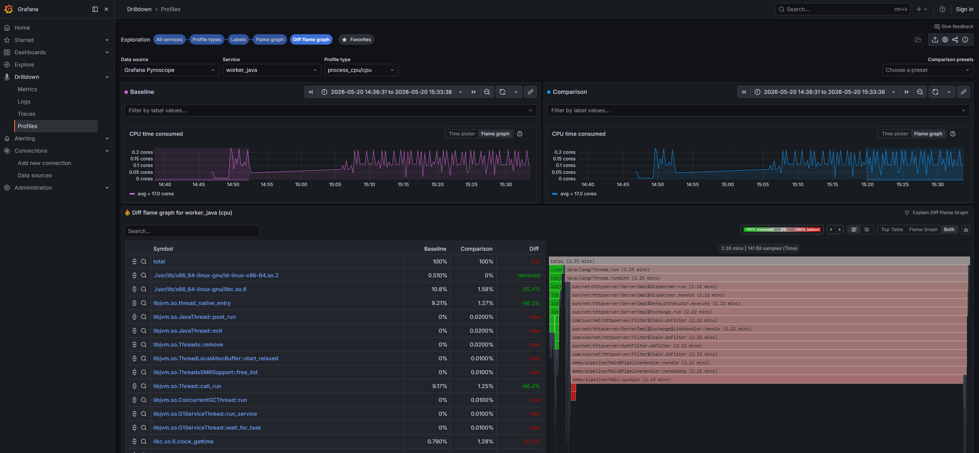
Grafana – Drilldown – Profiles

