Slide 1
Weather Forecasting using Bayesian Networks
Group 11

Slide 2
Objectives
Given meteorological data, use a Bayesian Network to model the weather variables to forecast future weather conditions.
What are we interested in?
Predicting key weather events: Fog, rain, snow, and thunder.

Slide 3
The Dataset
NSOD 2002 data: 2,788,413 data points from 9,000 weather stations across the world.
Issue: Weather data contains continuous variables such as temperature, sea-level pressure, mean wind speed, dew point, and precipitation.
Solution: Discretize the variables by creating categories and assigning ranges to organize them.
Example: Temperature (°F): cold < 32, warm > 75, else avg.

Slide 4

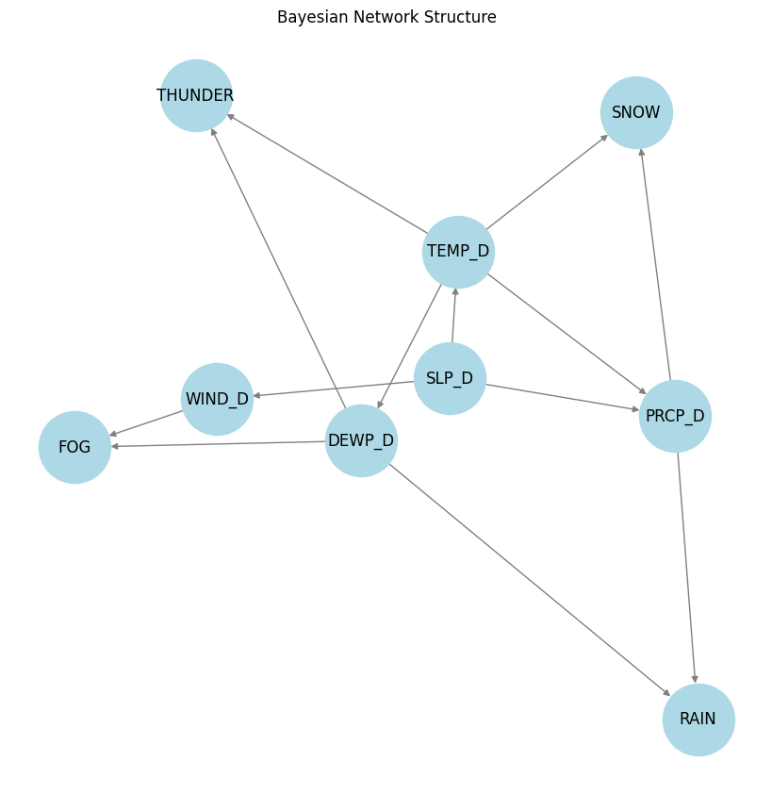
Static BN Structure

Slide 5
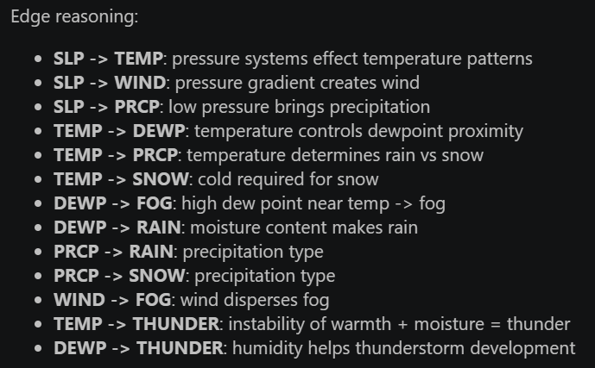
Static BN structure

Slide 6
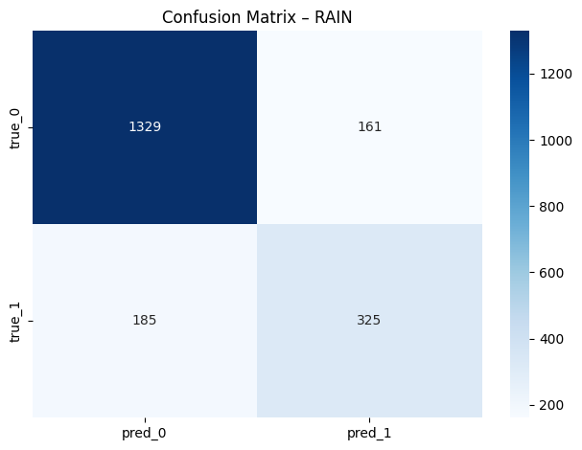
Static BN Results
Model is good at predicting no rain but struggles with rainy days.
Accuracy is a bit skewed since a model that mostly predicts no rain will have a high accuracy.
Using rain because it is the least imbalanced of the weather conditions.
Accuracy = 0.83

Slide 7
Static BN Limitations
Problem: Weather is inherently impacted by temporal factors.
Yesterday’s weather impacts today’s weather.
A static BN can’t forecast future weather conditions.
Solution: Expand the BN to a 2 time slice BN where every row is paired with yesterday’s variables.

Slide 8
Dynamic BN (2 Time Slice)
Uses interslice edges and intra slice edges.
Inter slice edges: Capture temporal persistence (cold air masses linger) and lagged atmospheric influence (yesterday’s pressure impacts today’s temperature)
Intra slice edges: Capture same day causality (same as static BN)

Slide 9

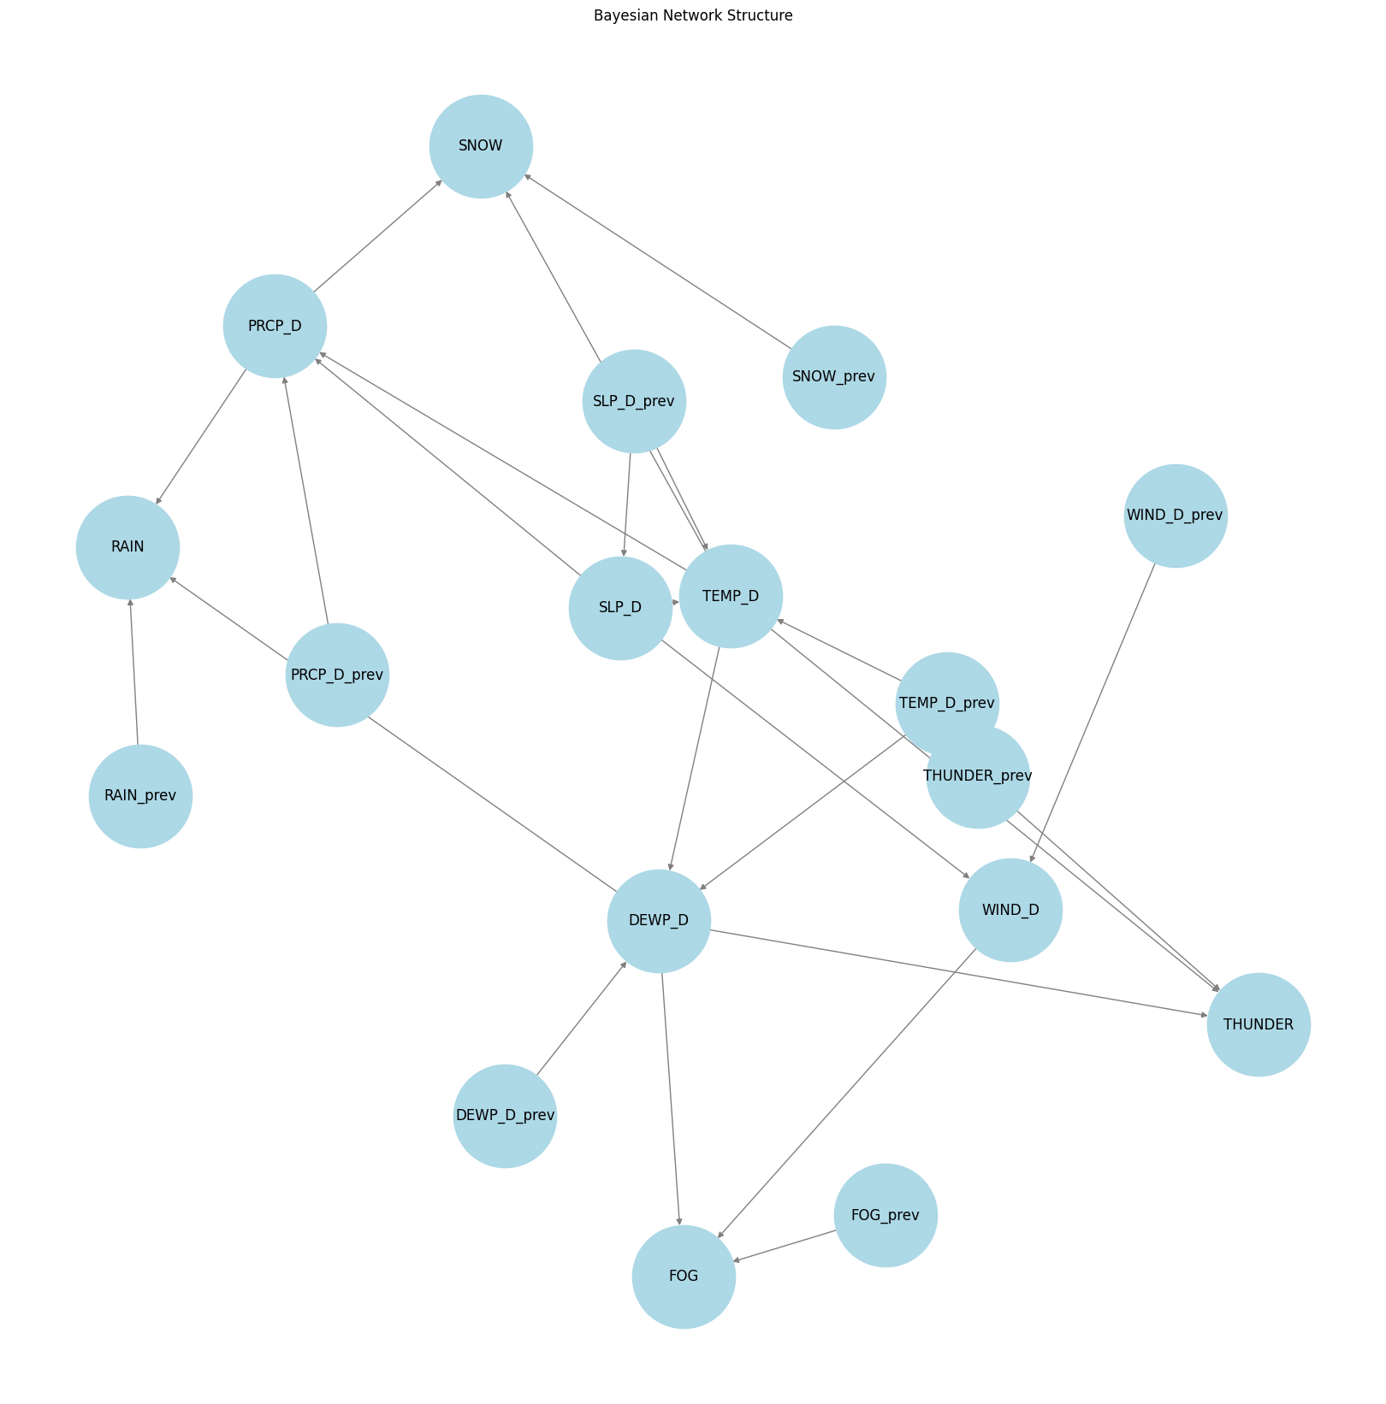
Dynamic BN (2 Time Slice) Structure
Introduction of previous-day variables and cross variable influences (Yesterday’s pressure affects today’s temperature, yesterday’s temperature affects today’s moisture)

Slide 10
Baseline
Verify the integrity of our model by testing against a baseline.
Naïve persistence baseline: Tomorrow’s weather will match today’s weather.

Slide 11
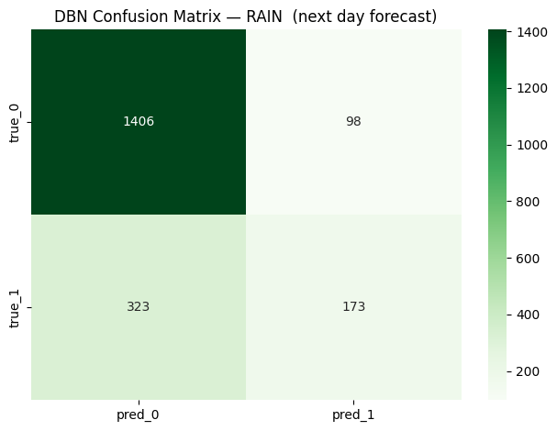
Dynamic BN Results
The DBN misses rainy days like the static BN.
Accuracy = 0.79

Slide 12
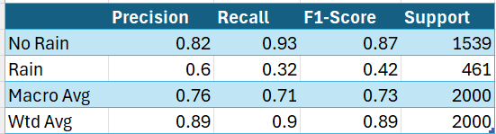
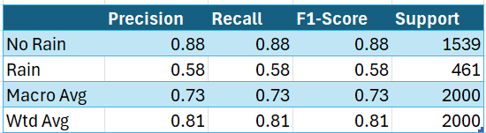
Dynamic BN Results vs. Baseline
Dynamic BN
Baseline

Slide 13
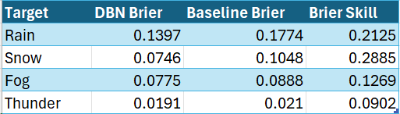
Dynamic BN Results vs. Baseline
Brier Score Comparison

Slide 14
Latent DBN
Problem: Observed variables don’t capture hidden atmospheric regimes (large scale events that influence many variables at once).
Solution: Use Gaussian Hidden Markov Model (HMM) .
Approach:
Fit a Gaussian Hidden Markov Model (HMM) on continuous weather variables to infer a small number of persistent hidden states (regimes).
Use HMM-decoded regime labels as a training-time proxy for the latent variable.
In the DBN, treat REGIME as hidden at forecast time — the model infers the regime distribution from previous-day observations and integrates over that uncertainty when predicting weather events.

Slide 15
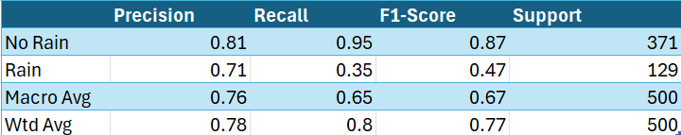
Latent DBN Results
Results are an approximation because the HMM regimes are used as hidden variables rather than observed same day variables.
(500 row sample)

Slide 16
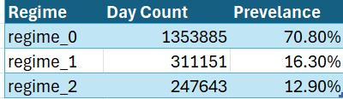
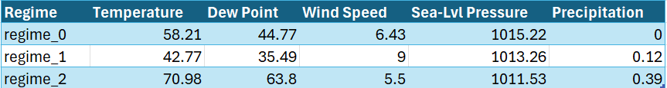
Latent DBN Results
The latent DBN model identifies 3 atmospheric patterns.
Regime 0 corresponds to a clear moderate day.
Regime 1 corresponds to colder days with little rain.
Regime 2 corresponds to warmer, humid days with some rain.

Slide 17
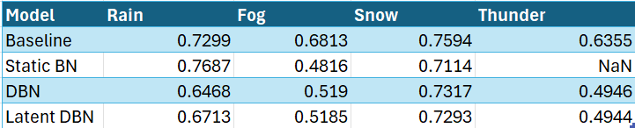
Model Comparison
Comparison of the 4 models using Macro-F1 scores due to the imbalance in the data, making sure no-event and event are weighted equally.

Slide 18
Conclusion
The persistence baseline is strong for rare events; the BN models tend to not predict the events which hurt their overall strength. This is seen for the DBN and the latent DBN where their macro-F1 scores are hurt the most.
Limitations:
Limited by the scale of the dataset (only utilizing one year).
Dataset is global, more localized sets may yield better results for the models (more distinct patterns)

