Slide 1

Crunchbase
Ariel Zhang: Data Analyst, Ang Li: Business Analyst, Johnny Qiao: Product Manager,
Richard Gao: Data Architect , Yanda Tao: Data Scientist
Github Repo: https://github.com/McGill-MMA-EnterpriseAnalytics/Crunchbase
Team Crunchbase

Slide 2
Context
-The purpose of this Project is to apply the many methods we learned in our Enterprise Machine Learning Class to come up with the best prediction model using the Crunchbase data set
-We are interested in predicting the outcome (operating, closed) for the startup companies
-We also want to apply causal inference to determine whether attributes affect the outcome of the startup.
-Through our analysis Investors and Venture Capital Firms will gain a better insight on the prevailing trends, which will service as a basis for future deal and most importantly to find that Unicorn.

Slide 3
Hypothesis
From a brief look at the data set we hypothesize that:
We can determine which startups will fail, which will stay operational using existing ML techniques and startup data such as:
Founder Ivy League education (Including Stanford, UCLA, MIT)
Country based
State (ie. California) based
Year (ie. 2006-2008) founded
Business categories such as Software, Internet service
Attended events to showcase products
Testing Strategy:
We will perform cross validation in order to test the accuracy of our model.
We will perform Causal inference and create a confidence interval for the Average estimated treatment effect.

Slide 4
Data Acquisition
The dataset we are using is the Crunchbase startup dataset. It contains information on over 1.2 million startup/investor companies. It also has data on founders such as their degrees and short descriptions.
The data has a total of 1,244,468 rows and 41 columns. The data is greatly unbalanced with under reported closed (Since most of the startups fail and never gets reported on the dataset).
Startups have information such as business categories, region, number of employee, whether or not they are still operating, acquired as well as descriptions, etc.
Our target variable is status (operating, closed)
Acquisition:
We take a sample of 10,000 startup companies (excluding investors)
Data is available via Crunchbase API (requires API key)
Data comes in separate csv files : we will use the degrees.csv, organizations.csv, founders.csv, events.csv
Data type: delimited categorical variables, datetime, integers, text, categorical.
Perform 80/20 Stratified train test split
Notes:
Q should ranking be masked

Slide 5
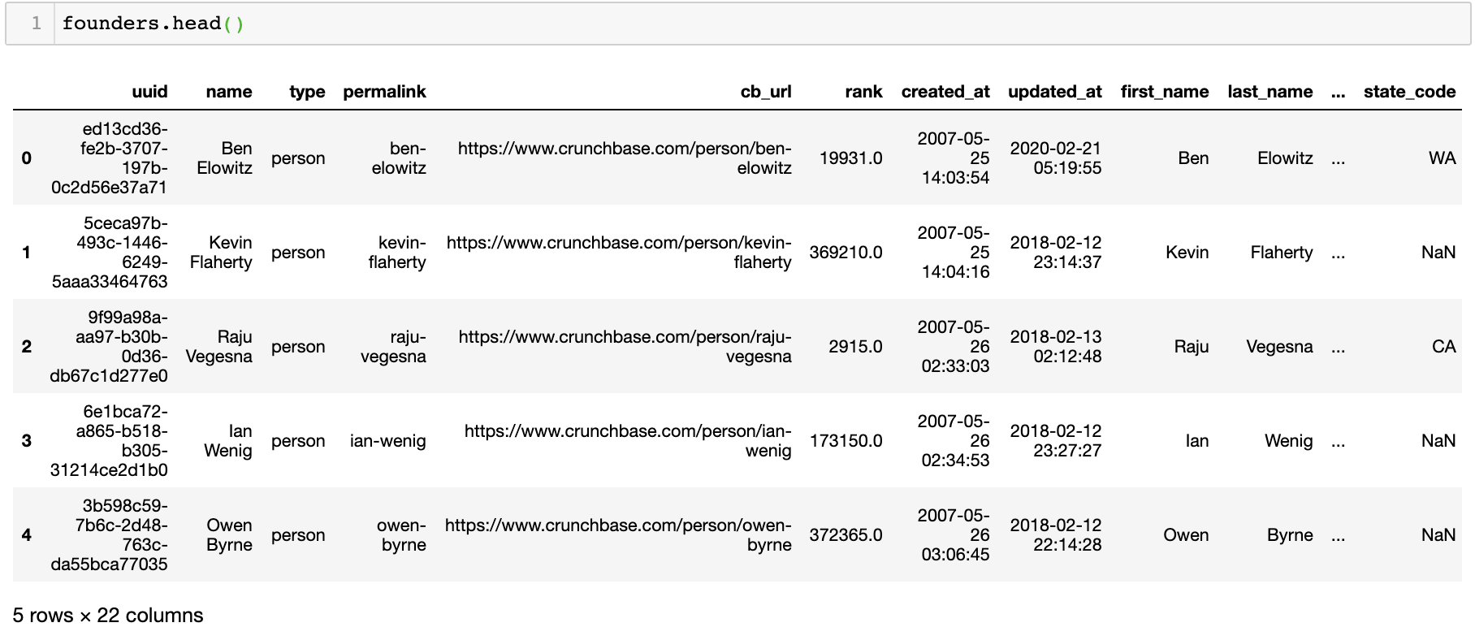
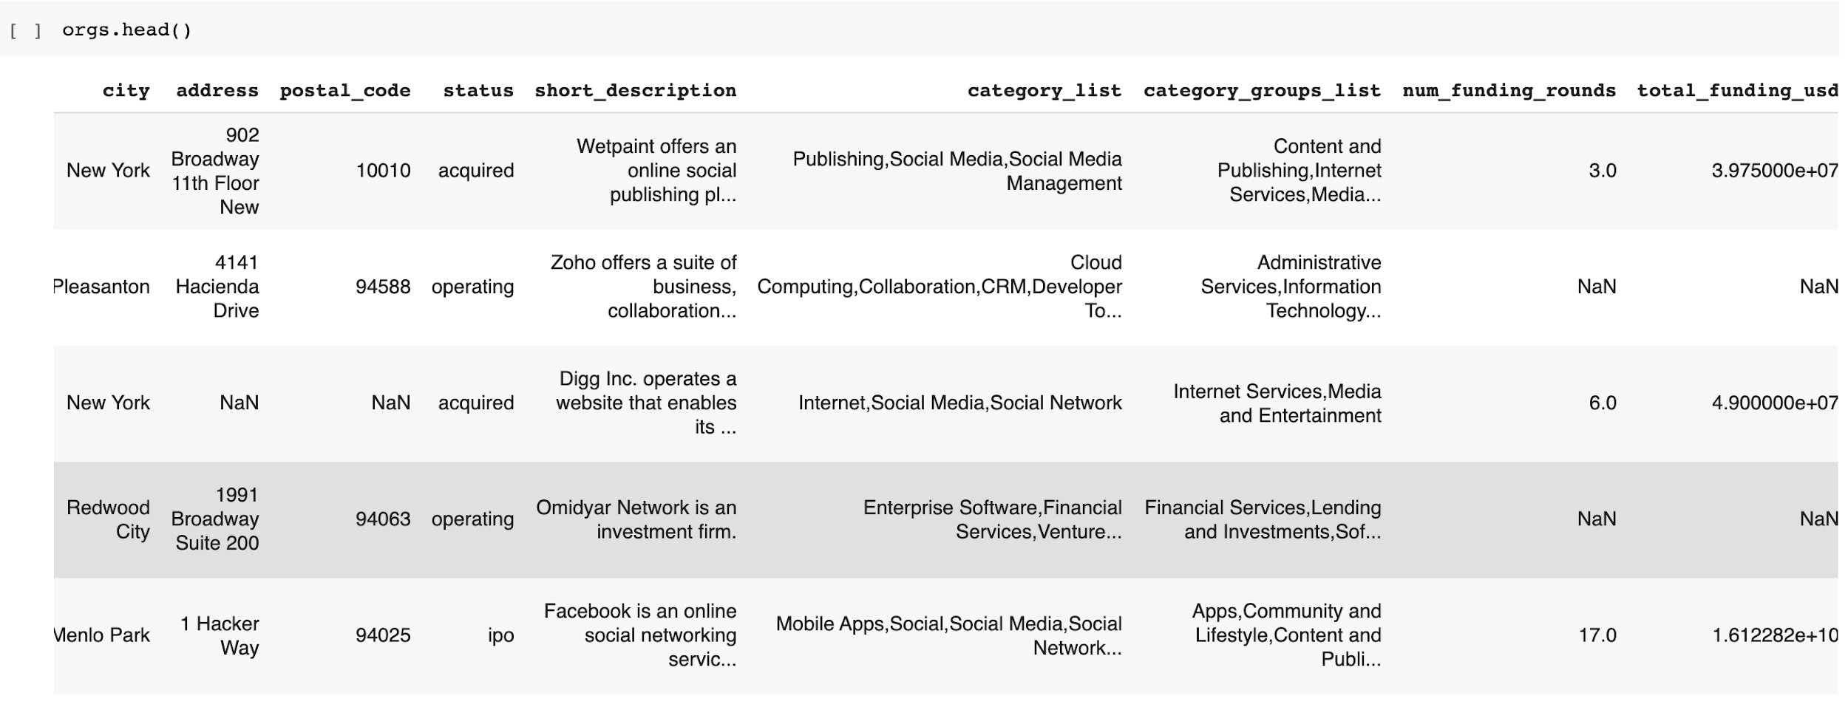
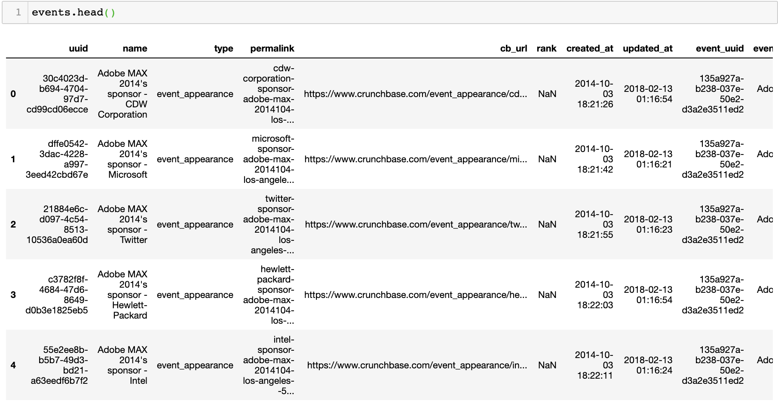
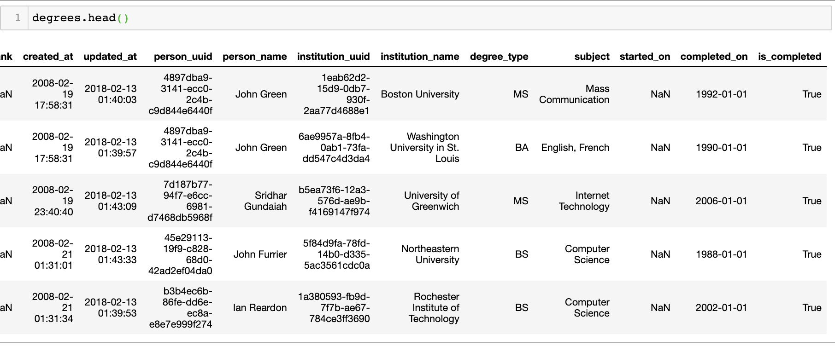
Data Acquisition

Slide 6
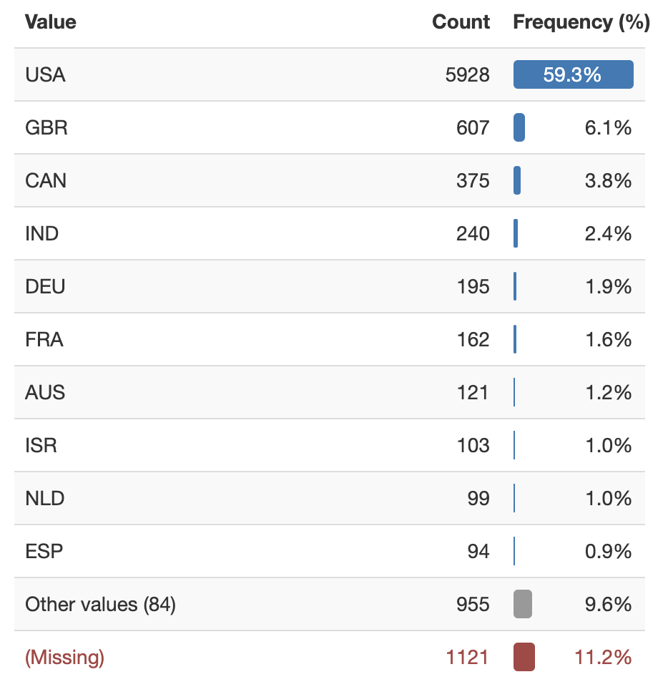
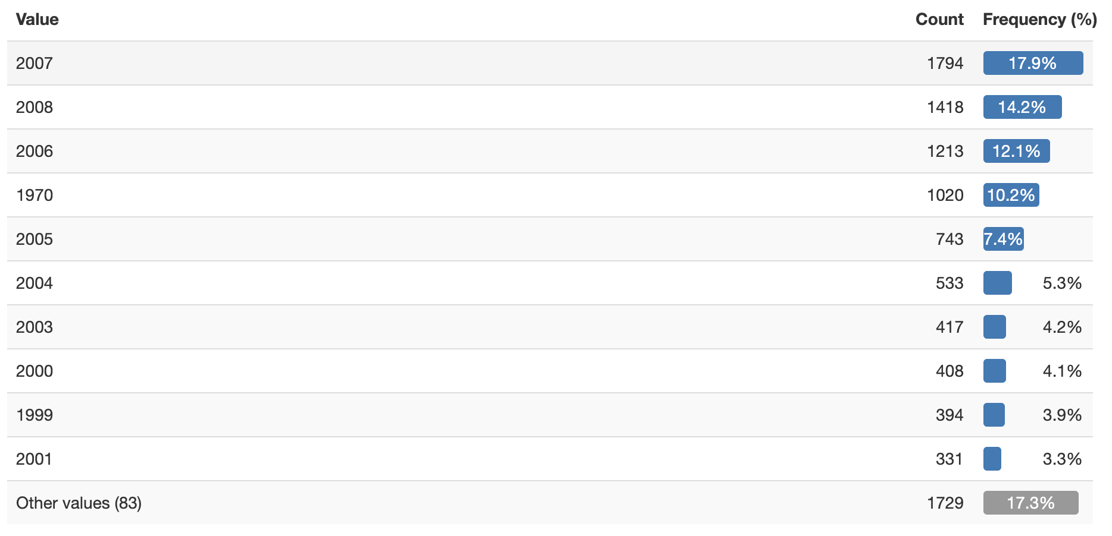
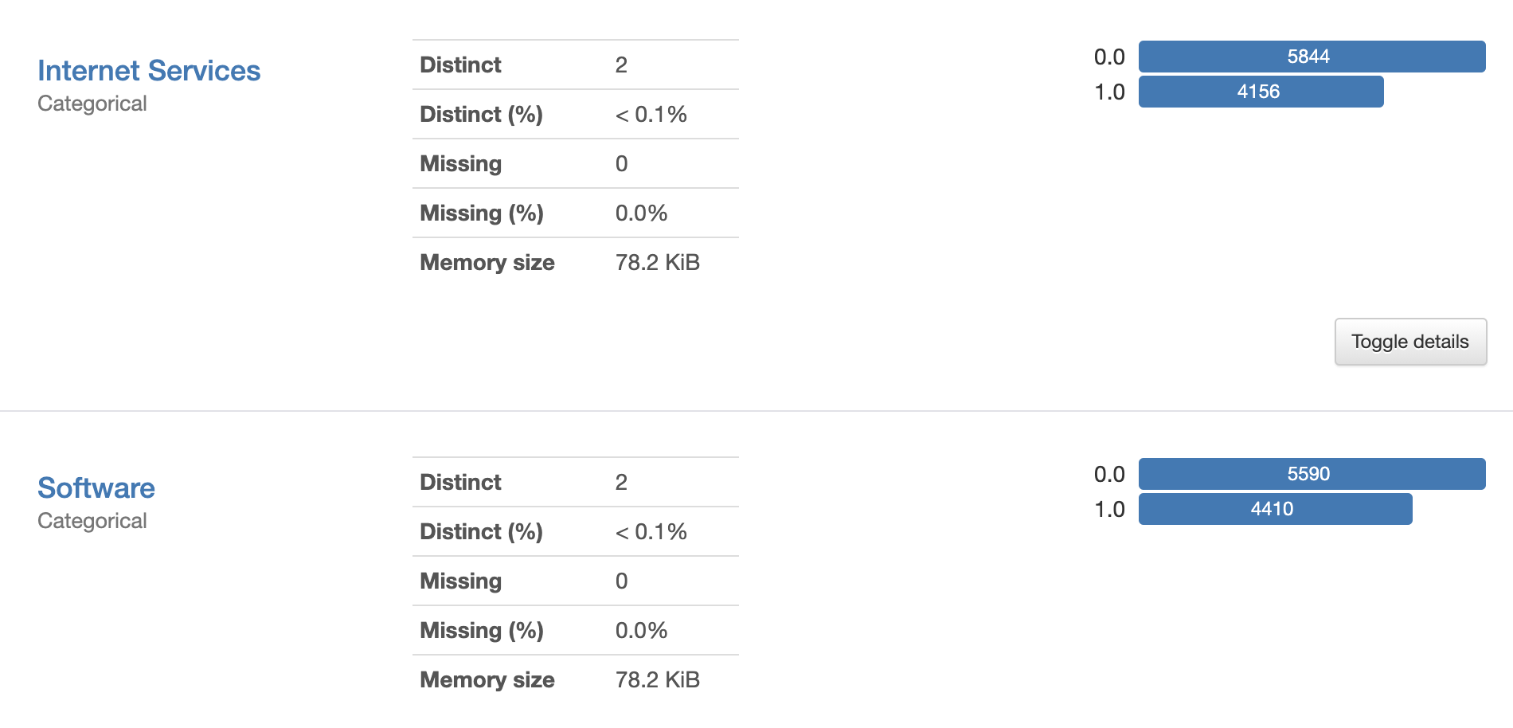
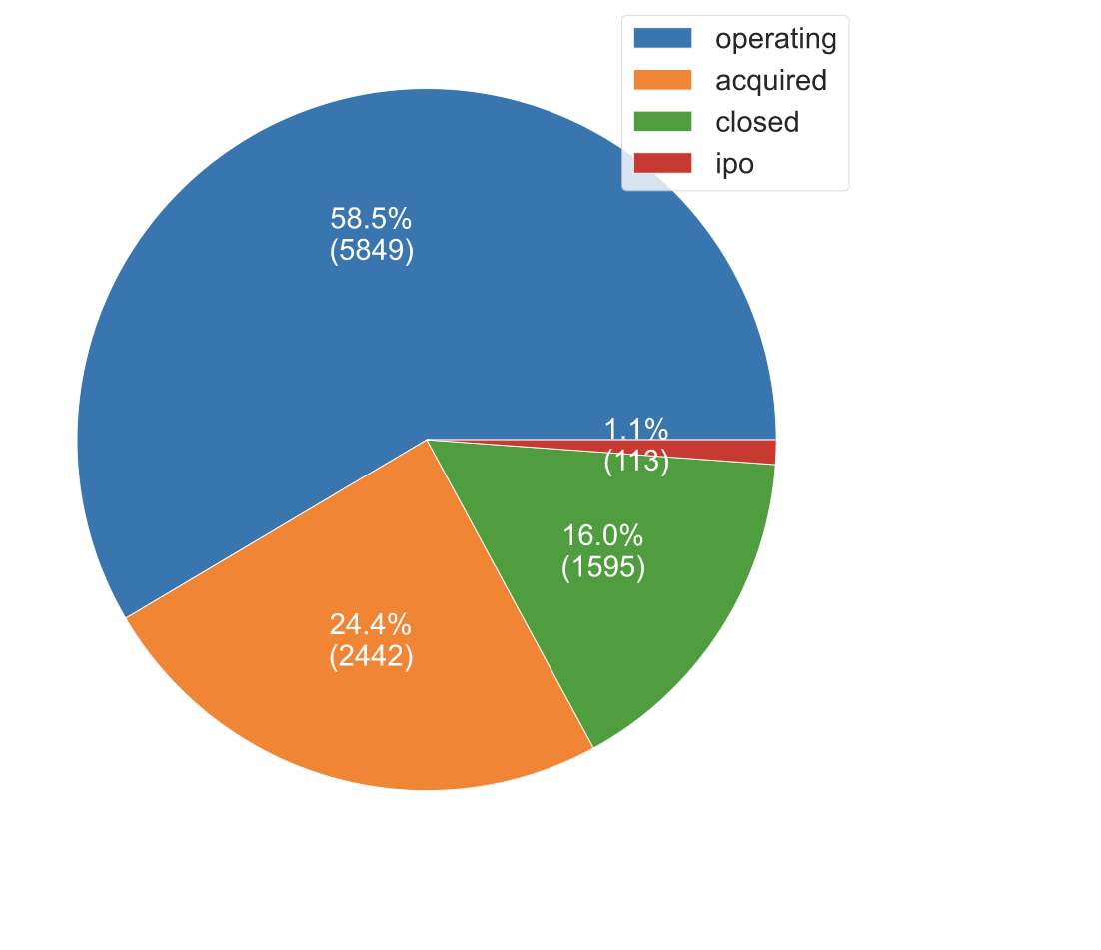
Data Exploration
Numeric: year, month, day
Categorical: Country, Region, City, University attended, Event attended
Delimited Categorical: Categorical Groups list (business categories)
Categorical Target: Status

Slide 7
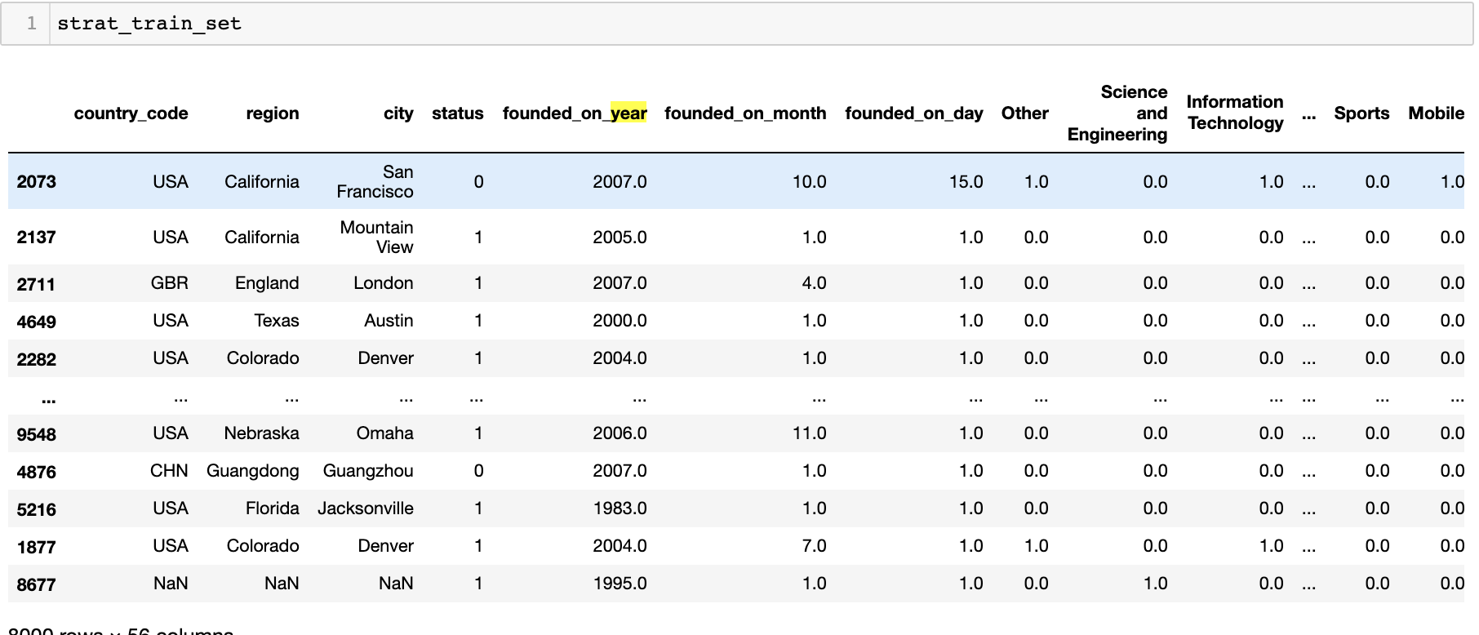
Data Preparation
Pipeline:
Filter out investors
Filter out non-categorized companies
Get rid of features involved in data leaks (ie. name,num_exits, emails, date_closed etc, num_employees…)
Convert target to binary (operating, closed)
Feature Engineering (events, ivy league, category group list)
Train test split (Stratified)
Imputer
STD Standardize numeric data
One hot encode categorical data
SMOTEENN
Random Forest Feature Selection

Slide 8
Model
Binary Supervised Model:
Best performing models: XGBoost, Randomforest
Hyperparameter Optimization:
GridSearch
Causal inference:
BaseXClassifier
LightGBM
Linear Regression
UpliftClassifer

Slide 9
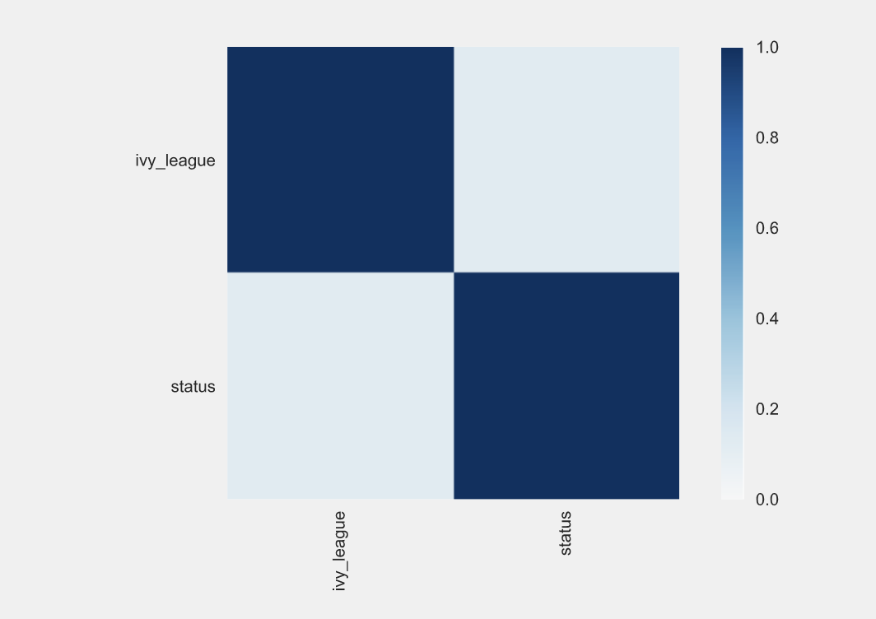
Results
w/ SMOTTEEN:
1326 True positives, 227 False positives, 92 True negatives, 355 false negatives
Test AUCROC: .58
10 CV AUCROC: .97
Accuracy: 70.9 %
Cross Validated: 88.03 %
w/o SMOTTEEN:
1667 True Positives, 318 False Positives, 1 True Negative, 14 false negatives
Test AUCROC: .57
10 CV AUCROC: .82
Accuracy: 83.4%
Cross Validated: 80.1%
Causal Inference:
Positive Average Treatment effect from going to an ivy league school.
The model is predicting at near random with an AUCROC near .5 on the test dataset. With oversampling and undersampling however, cross validation accuracy increases.

Slide 10
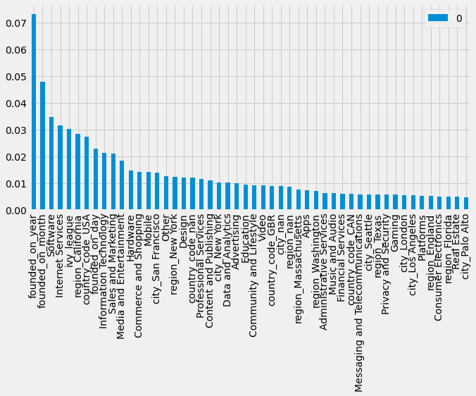
Feature Importance
Year founded: In 2019, the failure rate of startups was around 90%. Research concludes 21.5% of startups fail in the first year, 30% in the second year, 50% in the fifth year, and 70% in their 10th year. It’s possible the model is predicting in this way.
Ivy_league: Better school may imply more funding
California: Startup hub
USA: Startup hub, more likely to receive financing

Slide 11
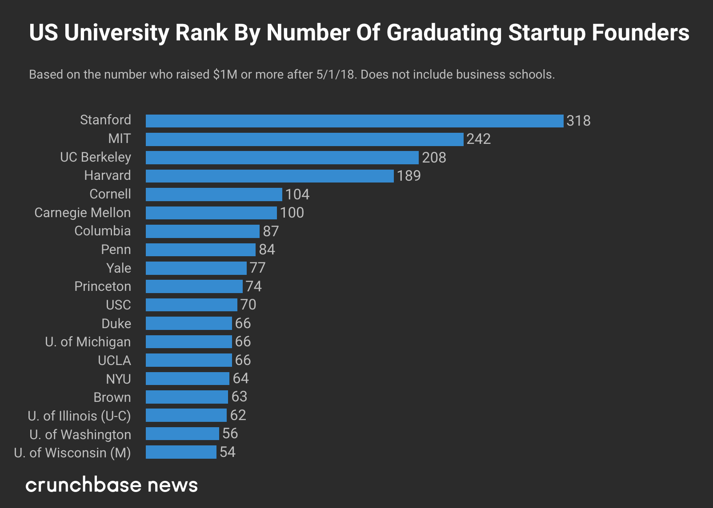
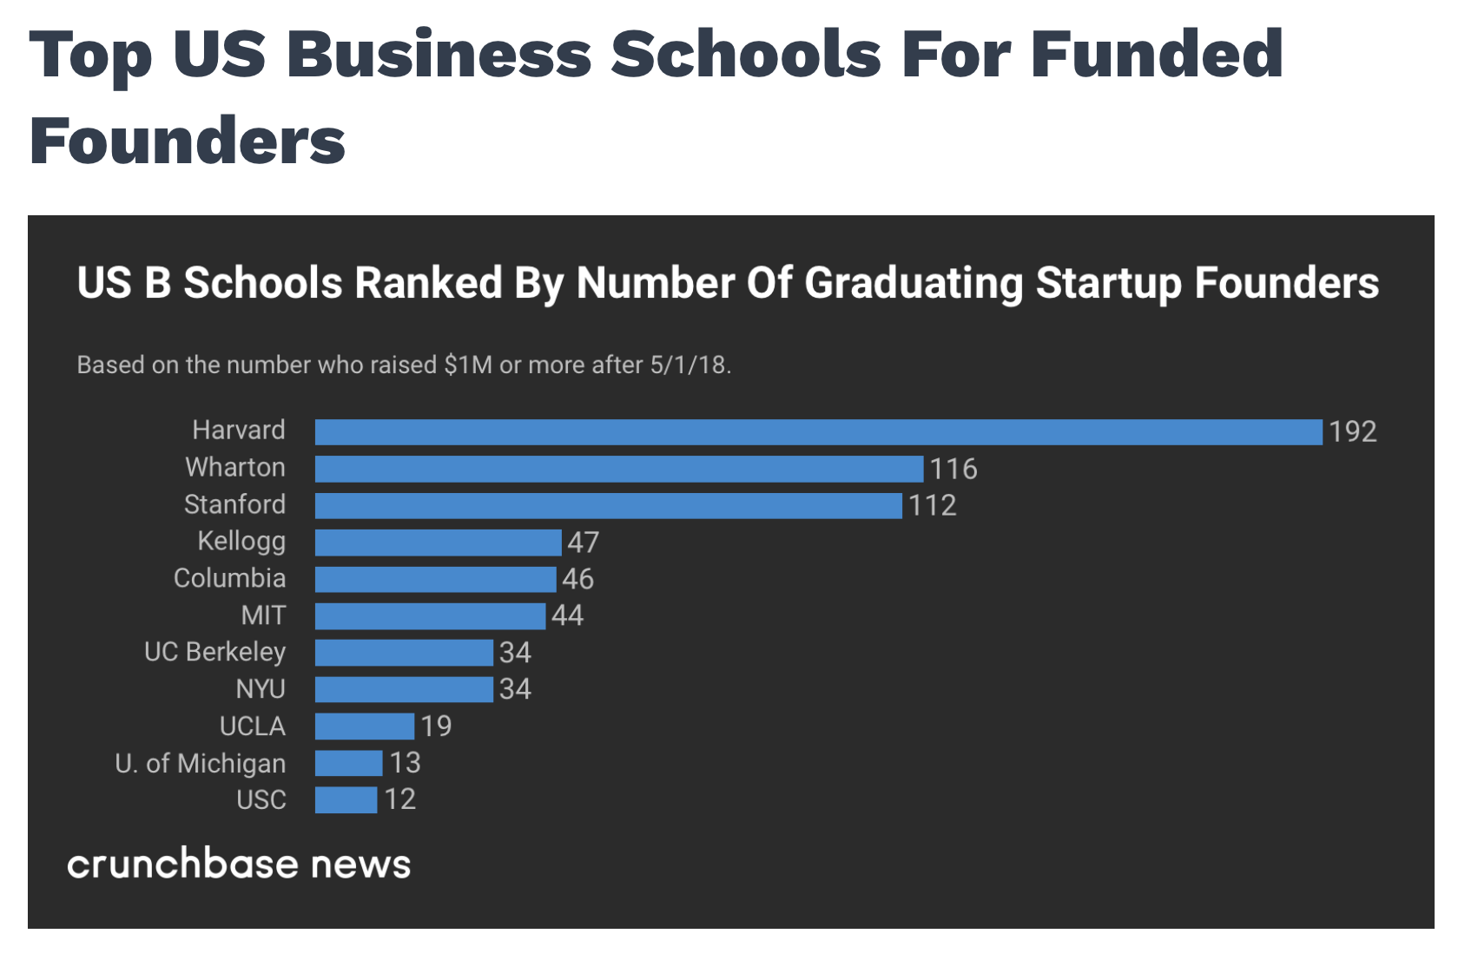
Funding by University

Slide 12
Threats to validity
Our AUC ROC score is low and near random.
In general we see that 90% of startups fail.
However Crunch base’s database does not reflect this. It’s possible failed companies never make it to crunchbase OR companies that failed are still labelled as operating.

Slide 13
Conclusion
Based off the findings, it may not be feasible to create a high performing model using just the business categories, education and founded date of the startups. Pursuit of further study not recommended unless new data can be acquired.
Further fields could be identified to improve the model such as :
Investors valuation
SEO (ie. site traffic)
Number of Customers
Revenue
In addition ensure the data is properly labelled.

