Slide 1
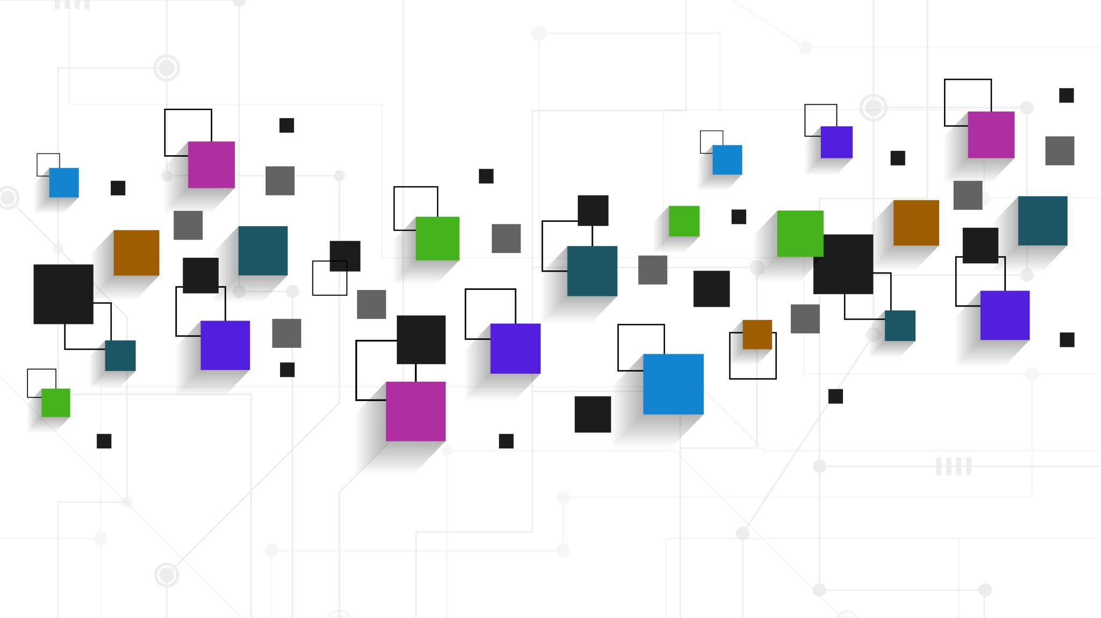
Dazed & Confusion Matrix 2.0
New. Improved.
Still Disoriented.

Slide 2
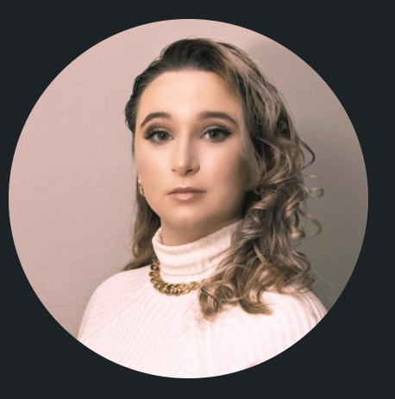
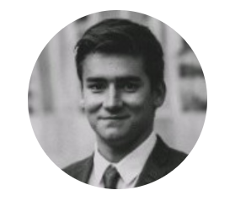
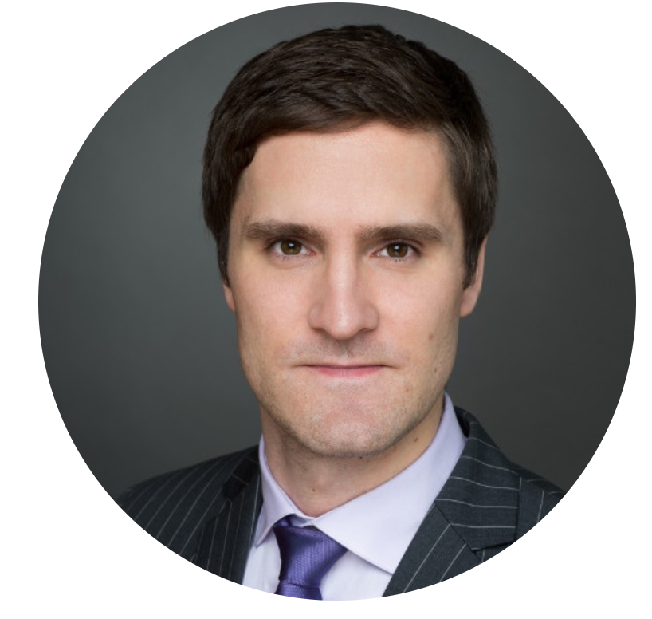


Our Team
Andrea Yzeiri (https://github.com/Andrea-Yzeiri)
Project Manager/Data Scientist
“I can throw something together.”
Bogdan Tanasie (https://github.com/bogdan-tanasie)
Software Developer/Architect
“I think it’s not letting me push.”
Marek Krowicki (https://github.com/Marek7869)
Data Analyst
“I foresee disaster.”
Sam Greene (https://github.com/samegreene55)
Business Analyst
“As long as I don’t have to do the same work as capstone.”
Tiancheng Zhang (https://github.com/tipsytc)
Data Analyst
“All I have right now is checking NULLs and fix data.”

Slide 3

UPDATE
UPDATE

Slide 4



Use case
Baltimore Crime Dataset- continue our work from last term
Predicting the type of crime that will occur based on current characteristic of crimes happening across Baltimore
Improving police response based on type of crime
Enhance preparations for an effective response
Crime deterrent
Explore model bias
Interesting case for Ethical AI
Reviewing additional options
COVID-19 World Vaccination Progress (https://www.kaggle.com/gpreda/covid-world-vaccination-progress)
Credit Card Fraud Detection (https://www.kaggle.com/mlg-ulb/creditcardfraud)

Slide 5
Work insofar
Discussion on how to expand work (brainstorming and testing)
Streamlit
https://share.streamlit.io/bogdan-tanasie/dazed-confusion-matrix?fbclid=IwAR0hEVqcOnq9BuqUS3miNnxMIcM1-QWTmh2yb_5lCsH634SfzZjGE03DyOg
Pyspark
Next Week :
Final Decision on whether to continue with this use case or another
New Framework (Adjusted for this course)
Start/continue work with different tools

