Slide 1
Additional Notes
Mudit Aggrawal , Jenny Yao , Pedro Jose Trujillo Mejia​, Liliana Tretyakova, ​ Hong-Fei Jin , Himanshu Mayank ​, Nilanjana Raghu ​, Ylfa Liang

Slide 2
Our Team
Mudit Aggarwal – Muditmoody
Hong Fei Jin – jinh1004
Ying-Fang Liang – yingfangliang
Himanshu Mayank – hm6650
Nilanjana R Raghu – Nilanjana-Raghu
Liliana Tretyakova – uliana-tr
Pedro Trujillo Mejia – PedroJoseTrujilloMejia
Jenny Yao – Jiaying-Yao

Slide 3
Team Roles
 | Product Manager | Business Analyst | Data Analyst | Data Scientist
Mudit Aggarwal | 0.5 |  |  | 0.5
Hong Fei Jin |  | 0.5 | 0.5
Ying-Fang Liang |  |  |  | 1
Himanshu Mayank |  |  |  | 1
Nilanjana R Raghu |  |  |  | 1
Liliana Tretyakova | 0.5 | 0.5
Pedro Trujillo Mejia |  | 0.5 | 0.5
Jenny Yao |  |  | 1

Slide 4
Preprocessing
& Exploratory data analysis (EDA)

Slide 5

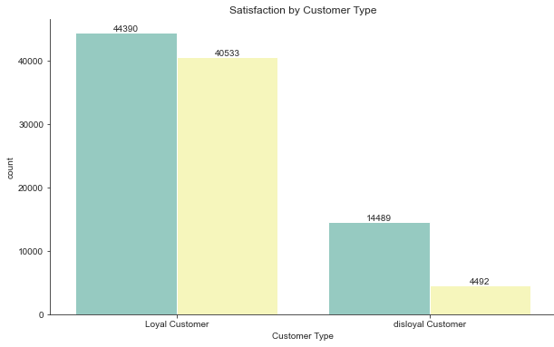
Exploration of the Data
Disloyal customers did not provide much feedback unfortunately The significantly higher rate of dissatisfied disloyal customers may be partially caused from the lack of additional services loyal members may receive (data leakage)

Slide 6
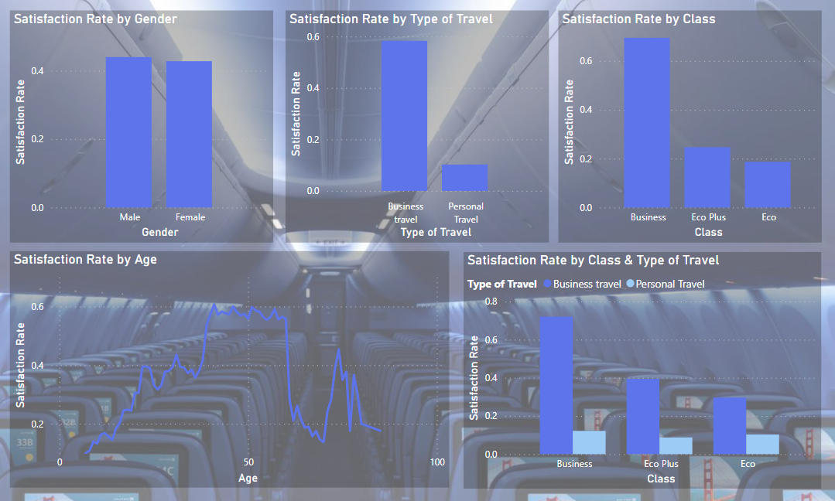
Exploration of the Data
We also note the high satisfaction rate for business travelers and those sitting in business class, which is unsurprising if we consider that such passengers typically receive better service

Slide 7
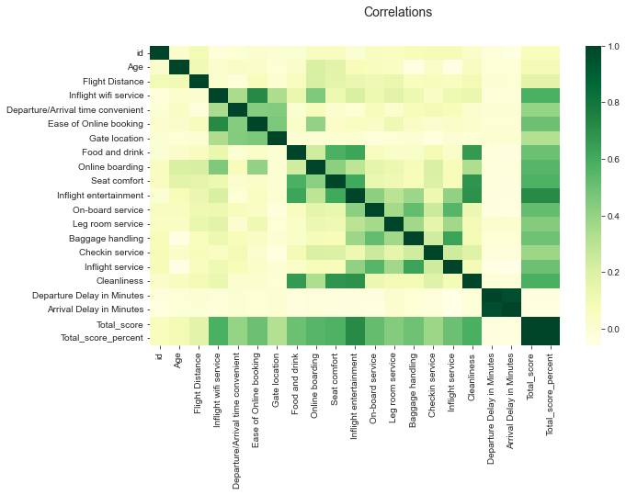
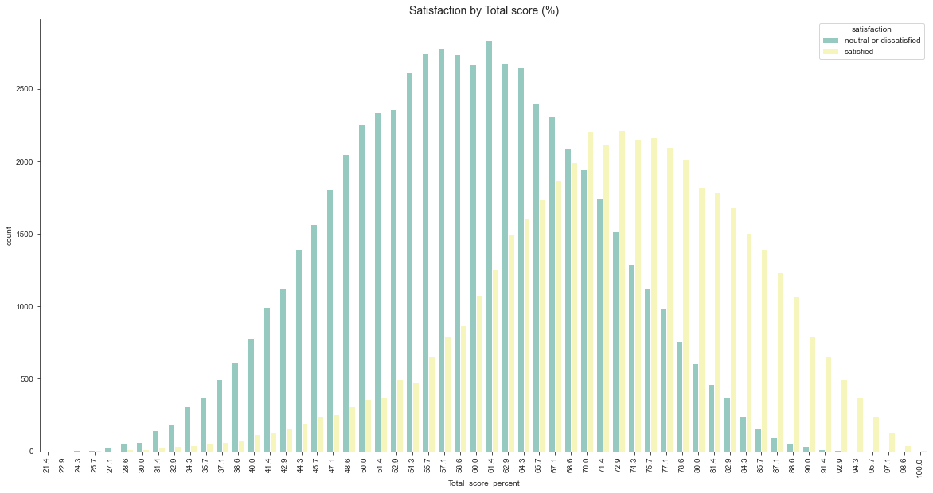
Exploration of the Data
Finally, we note that: - Satisfaction scores are normally distributed - Departure & Arrival Delay are highly correlated

Slide 8
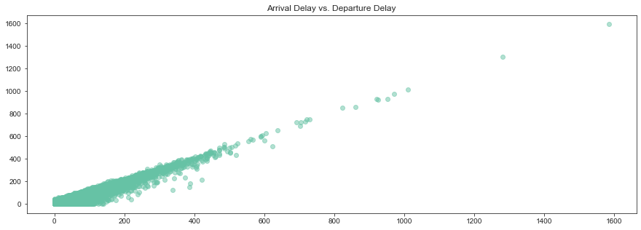
Imputing NA Values
Iterative Imputer was utilized on ‘Arrival Delay in Minutes’ with 130 missing values as it had a linear correlation with ‘Departure Delay in Minutes’

Slide 9
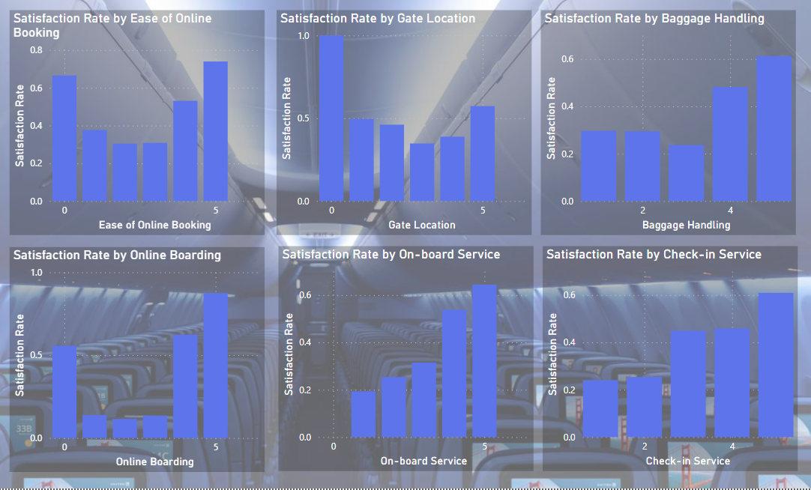
Imputing Satisfaction Scores
Satisfaction Scores are meant to be 1-5, but our dataset included many 0s
The dashboard made using after the first round of pre-processing revealed a high satisfaction rate amongst those with a satisfaction of 0, thus KNN imputer was utilized
Changing it to the median might have gotten us a 4 or a 3, which have lower rates of satisfaction in some cases

Slide 10
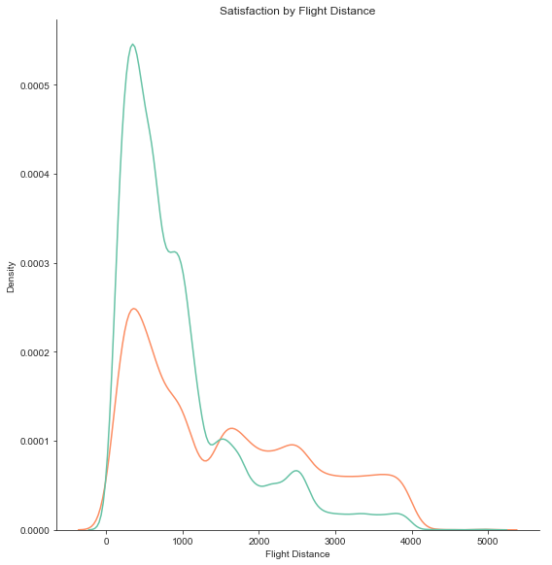
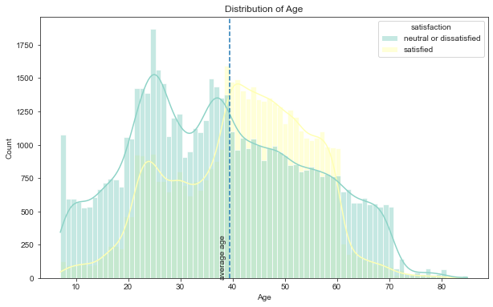
Removing Outliers & Normalization
Outliers in the training set were detected using an Isolation Forest with contamination = 0.01
Columns with a flight distance greater than 4,500 were removed
A log transformation was applied to ‘Flight Distance’ (see distribution on the left), ‘Departure Delay in Minutes’, and ‘Arrival Delay in Minutes’
Standard scaler was utilized for ‘Age’ (see distribution on the right)

Slide 11
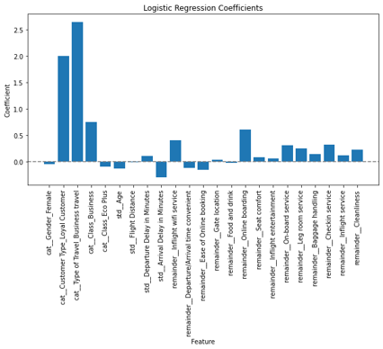
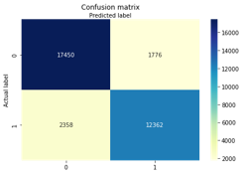
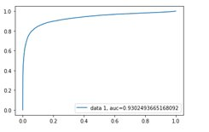
Classification – Logistic regression
87%
Precision
84%
Recall

Slide 12
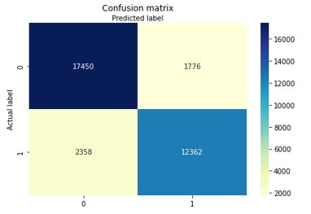
Classification - SVM
 | Precision | Recall | F1-Score | Support
Neutral or dissatisfied | 0.88 | 0.91 | 0.89 | 19226
Satisfied | 0.87 | 0.84 | 0.86 | 14720
Accuracy |  |  | 0.88 | 33946
Macro avg | 0.88 | 0.87 | 0.88 | 33946
Weighted avg | 0.88 | 0.88 | 0.88 | 33946
88%
Accuracy

Slide 13
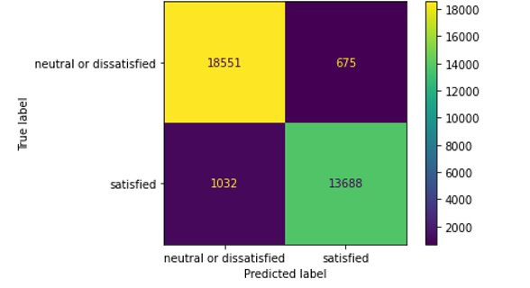
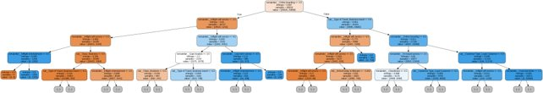
Classification – Decision trees ​
94.89%
15
94.94%
Accuracy
‘max_depth’
Accuracy
In train dataset
In test dataset
Part of the Decision tree generated

Slide 14
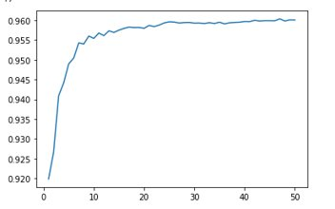
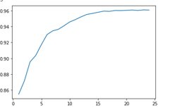
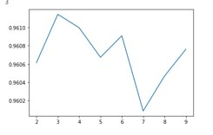
Classification – Random Forests
n_estimators vs Accuracy
Max_depth vs Accuracy
min_samples_split​ vs Accuracy​
The best classification score is 0.96​

Slide 15
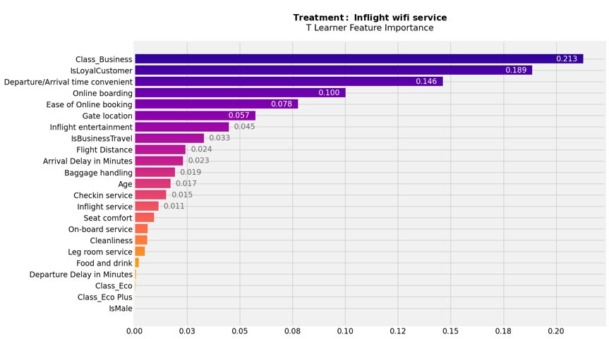
Preliminary Results
Treatment I: Inflight Wi-Fi service

Slide 16
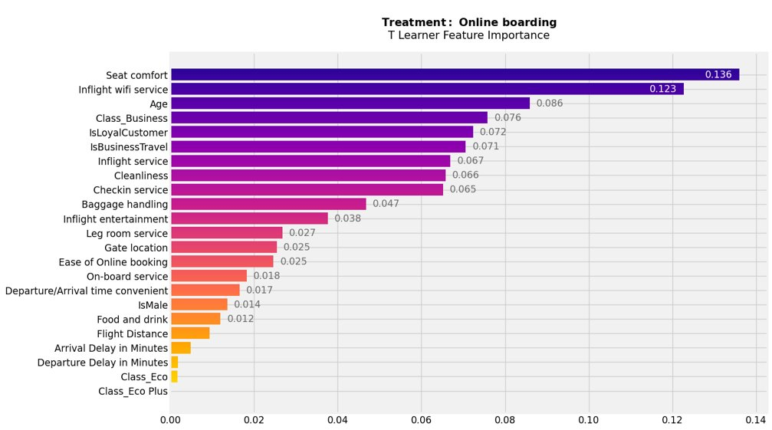
Preliminary Results
Treatment II: Online boarding

