Slide 1

Goodreads Book Recommendation
Tyler Nagano
Heidi Al-Wakeel
Konstantin Volodin
Ruhi Mahendra
Rohana Habib
Robert Prattico
Adityo Das Gupta
Hai Nguyen

Slide 2

Outline
Introduction
Industry Analysis
Getting the data
Cleaning the data
Model the data
Recommendation system
Conclusion

Slide 3

Introduction
Goodreads: books cataloging website – owned by Amazon
A model to recommend books to Goodreads users for better personalization and customization
Better books → Better user experience → More revenue

Slide 4
Industry analysis
Global book industry:
USD 138.35 billion (2021)
NA market: 33%
Hard copy: 78.7%
Online book sales in US:
USD 8.8 billion (2022)
Major players (Amazon,…): 96%
Hard copy: 56.3%
Market growth: 4.5% per year

Slide 5
Value proposition
Target market: 68 million users
Added revenue: USD 77 million (2% increase)
ROI: 1500%

Slide 6
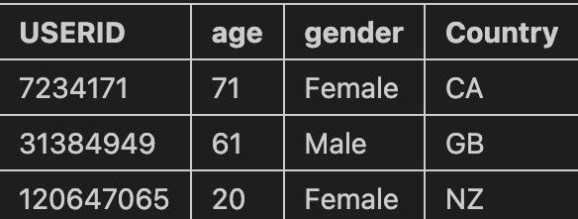
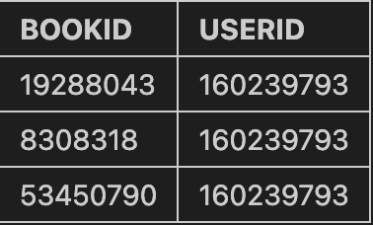
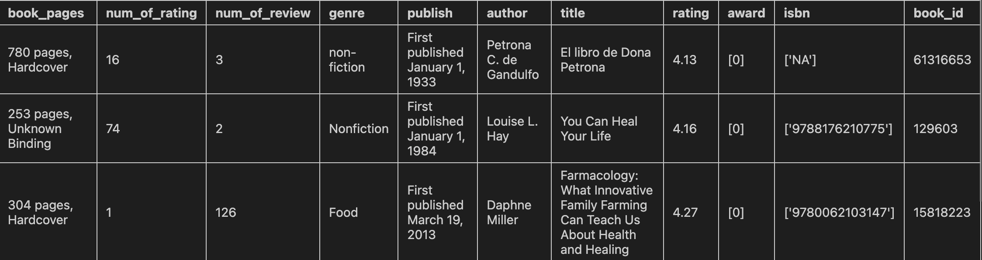
Getting the data
Webscraping was done on Goodreads to access information on ~ 300,000 books and ~7,000 Goodreads users
The Python library “BeautifulSoup” was used to perform the scraping along with the library asyncio to speed up the scraping process

Slide 7
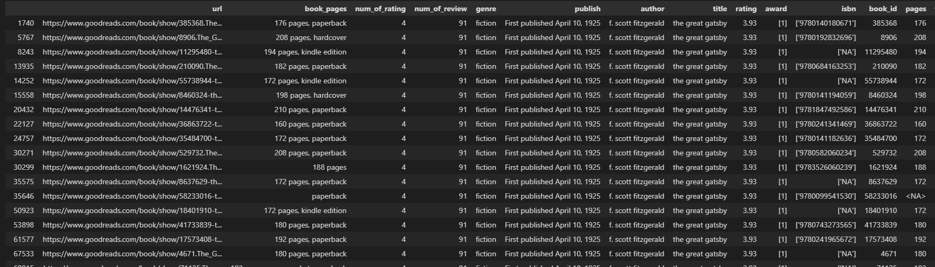
Clean the data
Many duplicates of the same book due to differences in publishers, editions, or book format.
The data was grouped up based on title, author, and review data to find and aggregate those variations

Slide 8
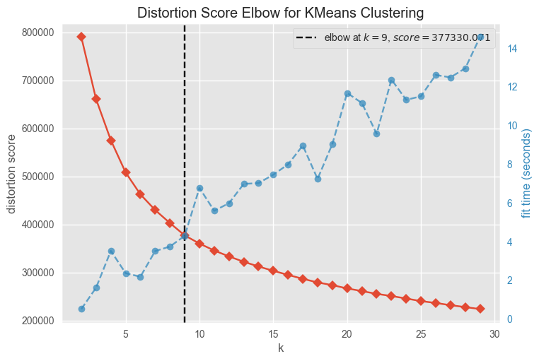
Model the data
Model selection
Number of clusters
Several clustering models were tested:
DBBSCAN
Gaussian Mixture Model
KMeans
→ KMeans model was selected
n=9 is the curve of the elbow graph

Slide 9
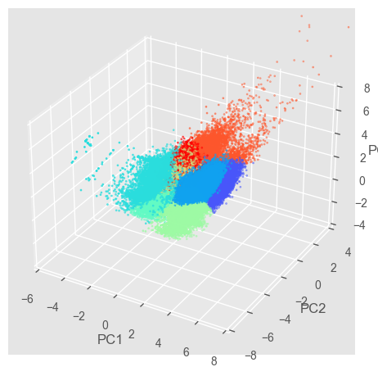
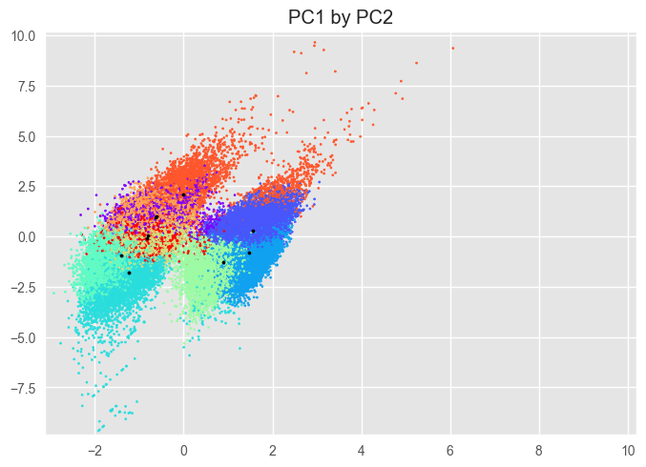
Model the data (cont.)

Slide 10



Recommendation system
D
A
R
data
algorithm
recommend
Number of users who read the book was used to give probabilities of recommending the book
Book recommendation is personalized for each user based on the percentage of books of each cluster that they have read
Books are clustered using KMeans clustering algorithm

Slide 11
Conclusion
The book recommendation system use KMeans to cluster book data from goodreads and recommend book to user
The model aims to increase traffic flow to goodreads and increase ads revenue
Goodreads can gain a competitive advantage over other book-related websites and services

Slide 12

Thank you

