Slide 1

Predicting Employee attrition
Team & Repository : HR Analytics
INSY 695 75
Enterprise Data Science & Machine Learning in Production I
Mounira Djebri : DMo-on
Jake Hogan : hoganj15
Steven Liang : StevenYML
Charles Tat : ct003
Dorothy Zou : DorothyZou
02.18.2021

Slide 2

Agenda
CONTEXT
HYPOTHESIS
DATA
MODELING & FEATURES
RESULTS & VALIDITY
LEARNED LESSONS / WHAT’S NEXT
CONCLUSION

Slide 3

CONTEXT
UNDERSTANDING ATTRITION
About Attrition
More than 27% of Americans left their job¹ voluntarily
Attrition costs are high – from 16% as much as 213% the salary in cost to replace^{2, 3}
Businesses retain employees both proactively and reactively through employee recognition programs & retention offers – not always successful
Objectives & Benefits
Predict the likelihood of voluntary employee departures through a classification model to enable an effective retention strategy and allow important cost savings
Identify factors or features contribute most to attrition to draw business insights for retention & remain competitive on the job market
Provide a scalable model to new datasets and for all industries
Measuring Performance
Accuracy
AUC ROC
Optimize model performance with SMOTE and Random Grid Search methods
¹ 2020 Retention Report, Work Institute
² HEINZ, Kate. Dangers of turnover: battling hidden costs. 22 March 2020. Built In.
³ BOUSHEY, Heather & Tanya DORISS. There Are Significant Business Costs to Replacing Employees. 2012. Center for American Progress.
Notes:
Cost of Attrition: Cost of hiring, onboarding/training, Lost productivity, Disengagement in employees who see high turnover, Customer service & errors to name a few. Can cost as much as 2x and employee’s salary
Business Assumptions:
The dataset contains valid information to create a prediction model to predict whether an employee is likely to leave a company
With sufficient predictive power and accuracy, we can utilize the tool to help businesses identify what features or determining factors lead to attrition
Vice-versa, we could also determine what factors can retain employees, enabling important costs savings for employers

Slide 4

Hypothesis
H₁ : The employee will leave the company
YearsInCurrentRole, YearsSinceLastPromotion, OverTime, BusinessTravel, DistanceFromHome, Education
H₀ : The employee will not leave the company
Age, RelationshipSatisfaction, StockOptionLevel, WorkLifeBalance, YearsAtCompany, PercentSalaryHike, JobSatisfaction, JobInvolvement, EnvironmentSatisfaction, MonthlyIncome
 | H₀ is True | H₀ is False
Reject H₀ | Type I Error Predict employee leaves, but they stay | Correct Outcome Correctly predict that the employee will leave
Fail to reject H₀ | Correct Outcome Correctly predict that the employee will stay | Type II Error Predict the employee will not leave, by they leave

Slide 5
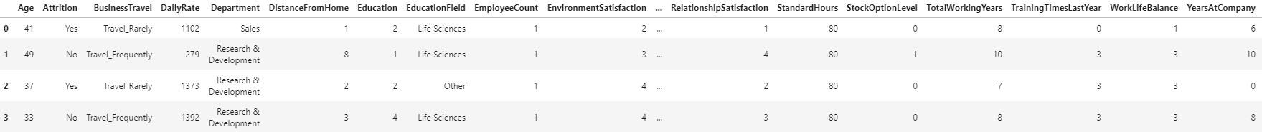
D a t a
A C Q U I S I T I O N
E X P L O R A T I O N
P R E P A R A T I O N
Age | int64 |  | HourlyRate | int64 |  | PerformanceRating | int64
Attrition | object |  | JobInvolvement | int64 |  | RelationshipSatisfaction | int64
BusinessTravel | object |  | JobLevel | int64 |  | StandardHours | int64
DailyRate | int64 |  | JobRole | object |  | StockOptionLevel | int64
Department | object |  | JobSatisfaction | int64 |  | TotalWorkingYears | int64
DistanceFromHome | int64 |  | MaritalStatus | object |  | TrainingTimesLastYear | int64
Education | int64 |  | MonthlyIncome | int64 |  | WorkLifeBalance | int64
EducationField | object |  | MonthlyRate | int64 |  | YearsAtCompany | int64
EmployeeCount | int64 |  | NumCompaniesWorked | int64 |  | YearsInCurrentRole | int64
EmployeeNumber | int64 |  | Over18 | object |  | YearsSinceLastPromotion | int64
EnvironmentSatisfaction | int64 |  | OverTime | object |  | YearsWithCurrManager | int64
Gender | object |  | PercentSalaryHike | int64
IBM HR Analytics Employee Attrition & Performance
Source: Kaggle⁴
⁴ https://www.kaggle.com/pavansubhasht/ibm-hr-analytics-attrition-dataset

Slide 6

T A R G E T
M O D E L L I N G
T U N I N G
Boolean (Attrition Y/N)
Correlation with target
Information leakage
Train-Test Split
Baseline: DummyClassifier
Logistic Regression
Random Forest
LGBMClassifier
GradientBoostingClassifier
XGBoost
AdaBoost
Randomized Search CV
Accuracy
AUC ROC
Refined Randomized Search (3-5 Iter.)
P R E D I C T O R S
P E R F O R M A N C E
Integer
Boolean / binary
categorical
Measure Accuracy & AUC ROC
Excl. & Incl. Feature Selection
Regular
SMOTE
Random Grid Search

Slide 7
Model Performance & RESULTS
Models | No Feature Selection
 | Regular |  | SMOTE |  | Rand Grid Search
 | Accuracy | AUC-ROC | Accuracy | AUC-ROC | Accuracy | AUC-ROC
Logistic Regression | 0.8263 | 0.623 | 0.6103 | 0.657
Random Forest | 0.8404 | 0.613 | 0.8451 | 0.653
LGBMClassifier | 0.8451 | 0.625 | 0.8404 | 0.65 | 0.8404 | 0.66
GradientBoostingClassifier |  |  | 0.8357 | 0.666 | 0.88 | 0.71
XGBoost | 0.8263 | 0.623 | 0.8357 | 0.666
AdaBoost | 0.8592 | 0.736 | 0.8451 | 0.746 | 0.8357 | 0.74
Models | No Feature Selection
 | Regular |  | SMOTE |  | Rand Grid Search
 | Accuracy | AUC-ROC | Accuracy | AUC-ROC | Accuracy | AUC-ROC
LGBMClassifier | 0.8451 | 0.625 | 0.8404 | 0.65 | 0.8404 | 0.66
GradientBoostingClassifier |  |  | 0.8357 | 0.666 | 0.88 | 0.71
AdaBoost | 0.8592 | 0.736 | 0.8451 | 0.746 | 0.8357 | 0.74
Models | With Feature Selection
 | Regular |  | SMOTE |  | RFE (Optimal # of Features) | SMOTE |  | Rand Grid Search
 | Accuracy | AUC-ROC | Accuracy | AUC-ROC |  | Accuracy | AUC-ROC | Accuracy | AUC-ROC
Logistic Regression | 0.8263 | 0.623 | 0.6291 | 0.659
Random Forest | 0.8404 | 0.604 | 0.7934 | 0.566
LGBMClassifier | 0.831 | 0.635 | 0.8122 | 0.605 | 22 | 0.8498 | 0.653 | 0.86 | 67.5
GradientBoostingClassifier | 0.8216 | 0.629 | 0.8169 | 0.664
XGBoost | 0.8216 | 0.629 | 0.8169 | 0.636
AdaBoost | 0.831 | 0.672 | 0.8075 | 0.658 | 29 | 0.8474 | 0.7404 | 84.5 | 74.6
Models | With Feature Selection
 | Regular |  | SMOTE |  | RFE (Optimal # of Features) | SMOTE |  | Rand Grid Search
 | Accuracy | AUC-ROC | Accuracy | AUC-ROC |  | Accuracy | AUC-ROC | Accuracy | AUC-ROC
LGBMClassifier | 0.831 | 0.635 | 0.8122 | 0.605 | 22 | 0.8498 | 0.653 | 0.86 | 67.5
AdaBoost | 0.831 | 0.672 | 0.8075 | 0.658 | 29 | 0.8474 | 0.7404 | 84.5 | 74.6

Slide 8
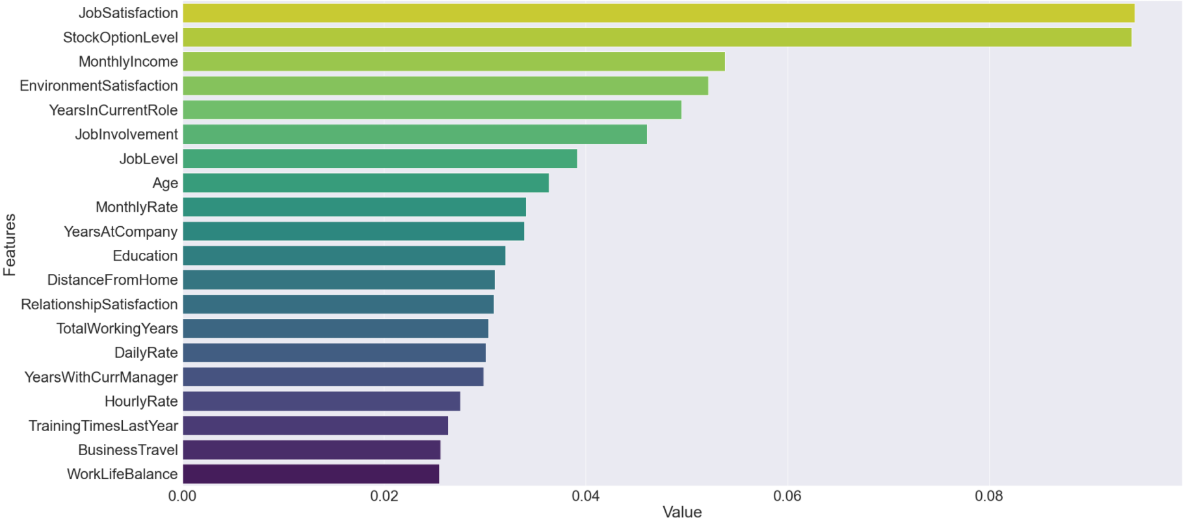
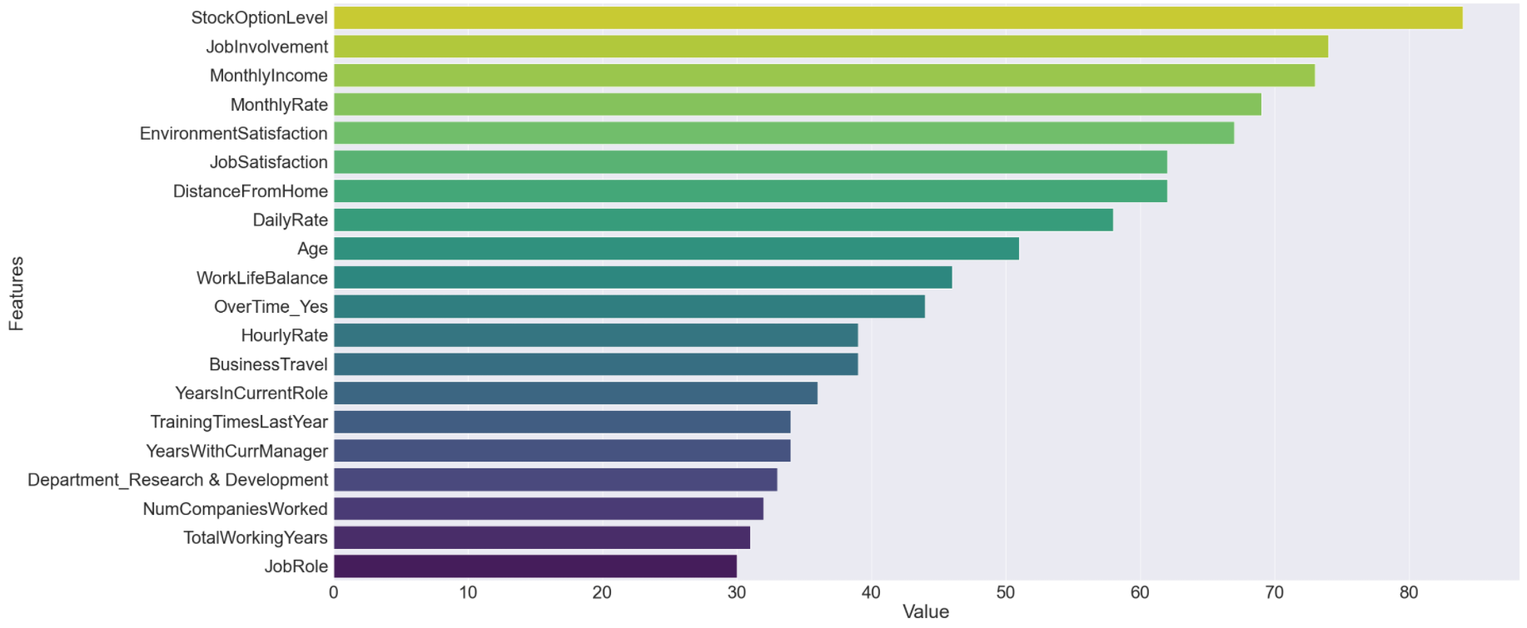
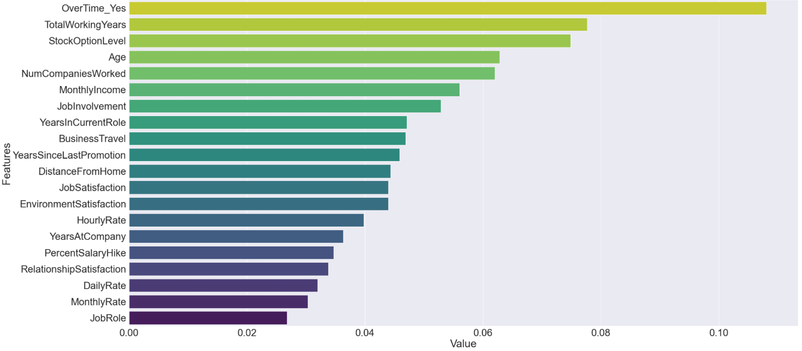
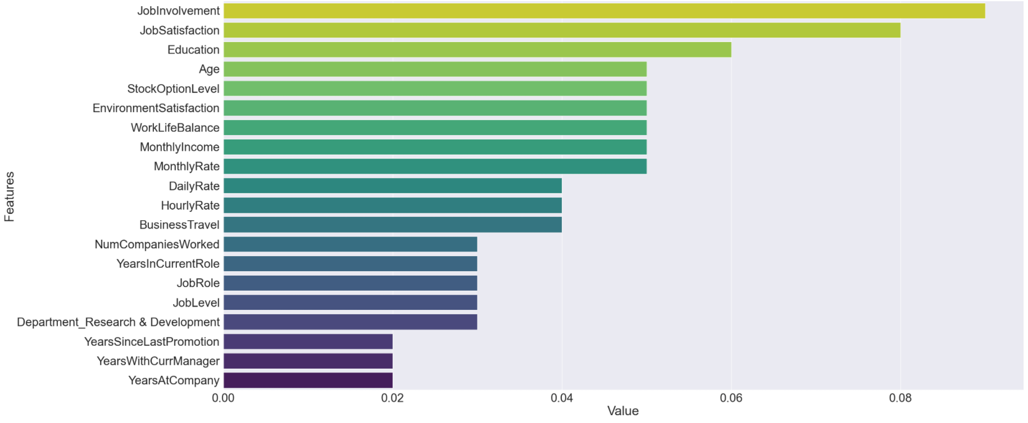
Feature Importance
R a n d o m F o r e s t s
L G B M C l a s s i f i e r
X G B O O S T
A D A B O O S T

Slide 9


Threats to validity
ASSUMPTIONS
RISKS & UNCERTAINTIES
False positives and negatives
Quality of data
Errors in data
Veracity of data
Changes in employee behavior & trends
Disruptions in the job market
Working from home
Pandemic
Notes:
Initial Business Assumptions:
The dataset contains valid information to create a prediction model to predict whether an employee is likely to leave a company
With sufficient predictive power and accuracy, we can utilize the tool to help businesses identify what features or determining factors lead to attrition
Vice-versa, we could also determine what factors can retain employees, enabling important costs savings for employers

Slide 10



Learned Lessons
EFFICIENCY
& EFFICACY
Similar model performance between selected SOTA models
Opportunity to select few features to achieve similar performance while saving computational resources
PRODUCT
OVERVIEW
High Product Owner involvement and direction to ensure scope and business alignment
Effective communication and team updates:
Minimize errors
Rate of rework
Better Code quality
ORGANIZED CODING PRACTICES
Effective code organization and annotation beneficial for clarity of presenting results
Catered for reading/writing audience

Slide 11

What’s next / Future considerations
Model /Results | Additional Data | HR Compliance and HR Legal
Accuracy %: Mid 80s AUC ROC %: Low to Mid 70s | Additional data can potentially boost model performance (ie: text data) | Work with HR departments to ensure compliant use of sensitive personnel data
Notes:
Ensemble model -> unstructured data from social media, sentimental analysis & other data can be explored to include

Slide 12

C o n c l u s I o n
VALUABLE INSIGHTS
High business value in predicting and address policy changes for reducing costs related to attrition and turnover
A look at the most important factor that impact an employee’s decision to stay or leave
OUTCOME
Adequate prediction accuracy & AUC ROC results
POTENTIAL IMPROVEMENTS
Additional data and ensemble model to improve model performance
HYPOTHESIS RESULTS
1: Business Travel and OT
0: Job Involvement, Stock Options, Environment and Job Satisfaction

Slide 13

THANK YOU
Mounira Djebri
Jake Hogan
Steven Liang
Charles Tat
Dorothy Zou

