Slide 1

Reorder Prediction Model Which products will an Instacart consumer purchase again?
Team Name : 5557 - 3
Github Repo: Instacart-Market-Basket-Analysis

Slide 2
Team Composition
Name | Github ID | Role
Krishan Gupta | krishangupta33 | Engineering Manager
Tashfeen Ahmed | TashfeenAhmed12 | Data Scientist
Yifan Lu | FrankLu0925 | Business Analyst
Avi Malhotra | avi10malhotra | Data Scientist
Yash Joshi | yash-analytics | Data Analytics
Emily Wu | cw0033 | Data Analyst

Slide 3

Objective and Hypothesis
Objective:
Predict whether a product will be reordered by a customer
Significance:
Tailored Customer Experience: Personalize the app interface and recommendations to resonate with individual shopping habits and preferences.
Enhanced Inventory Management: Use predictions to inform stock levels, reducing waste and ensuring availability of frequently reordered items.
Operational Efficiency: Implement intelligent route planning for deliveries based on predicted orders, saving time and reducing logistical costs
Hypothesis:
User's order history can signal their product preferences and future buys
Certain products will have a higher probability of being reordered.
Order timing, such as day of the week and hour, may influence purchase decisions.
InstaCart: Grocery Ordering and Delivery app
If InstaCart's basket size grows by 5% from its current size, given an annual revenue of $2.5 billion, this Project will boost their revenue by $125 million

Slide 4
Data Source and Description
Data Source
Multiple relational datasets from Kaggle describing customers’ orders over time of Instacart retail store
3 million grocery orders, 200,000 users, each user has orders between 4 to 100
Order data includes timestamps, product sequences, reordering information and customer information.
Product data encompasses product names, associated aisles, and departments.
Aisle and department list unique id for aisles and departments

Slide 5
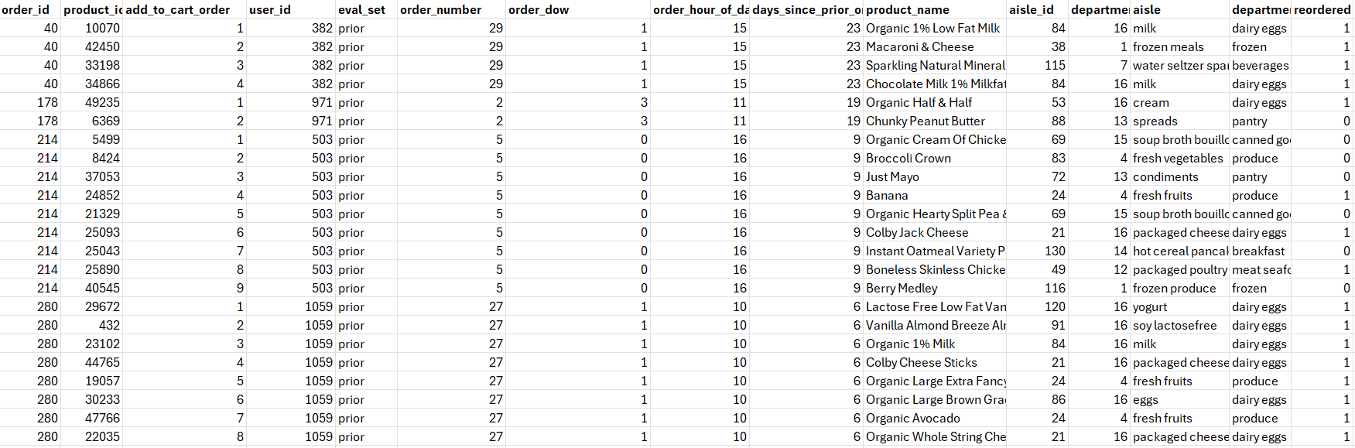
Final Combined Dataset
Order id | Product id | User id
Aisle id | Department Id | Order Hour Day
Days since prior order | Product Name | Order number
Order DOW | Department Name | Reordered
total_orders | avg_products | most_common_order_dow
avg_days_since_prior_order
Identifier | Numerical | Categorical
Target Variable

Slide 6
Modelling Approach
Preprocessing & EDA
Feature Engineering
Distribution Shift & Imbalanced Data
Feature Selection & Dimension Reduction
Modeling & Evaluation

Slide 7
Data Preprocessing and EDA
Data Preparation
Dimension tables are merged to fact table using primary keys.
Merged Dataset is analyzed for missing values, duplicates, outliers.
Pandas Profiling Report: Link
12 EDA Plots Created
Visualization | Impact
Orders by Hour | Peak order times identified
Days Since Last Order | Order frequency highlighted
Frequent Aisles | Popular aisles shown
Frequent Departments | Key departments identified
Feature Correlations | Variable relationships explored
Reorder Ratio | Product loyalty assessed
Visualization | Impact
Frequent Products | Popular products ranked
Organic vs Non-Organic | Organic preference shown
Organic Reorder Ratio | Organic loyalty compared
Products per Order | Order size distribution
Orders by Weekday | Weekly order trends
Order Frequency Heatmap | Detailed order patterns

Slide 8
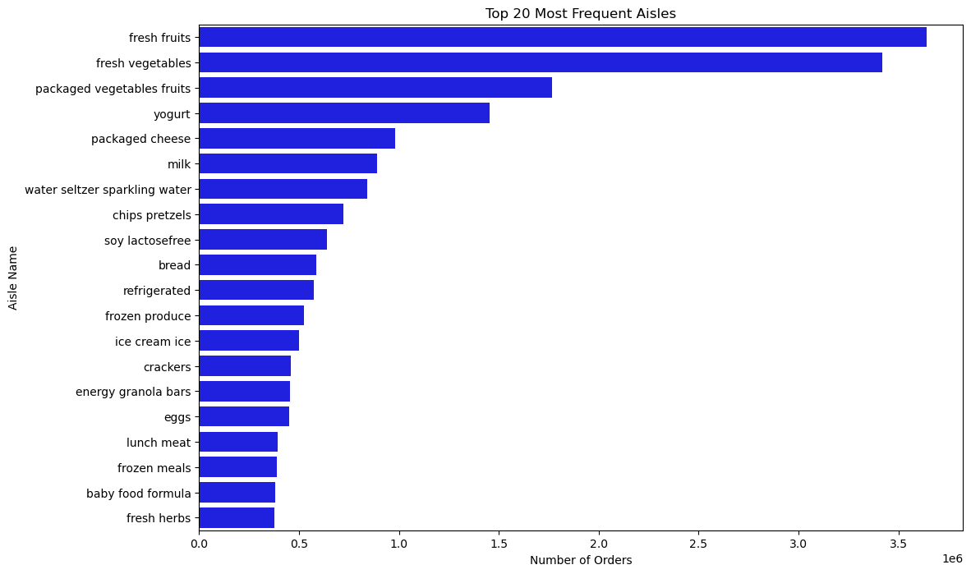
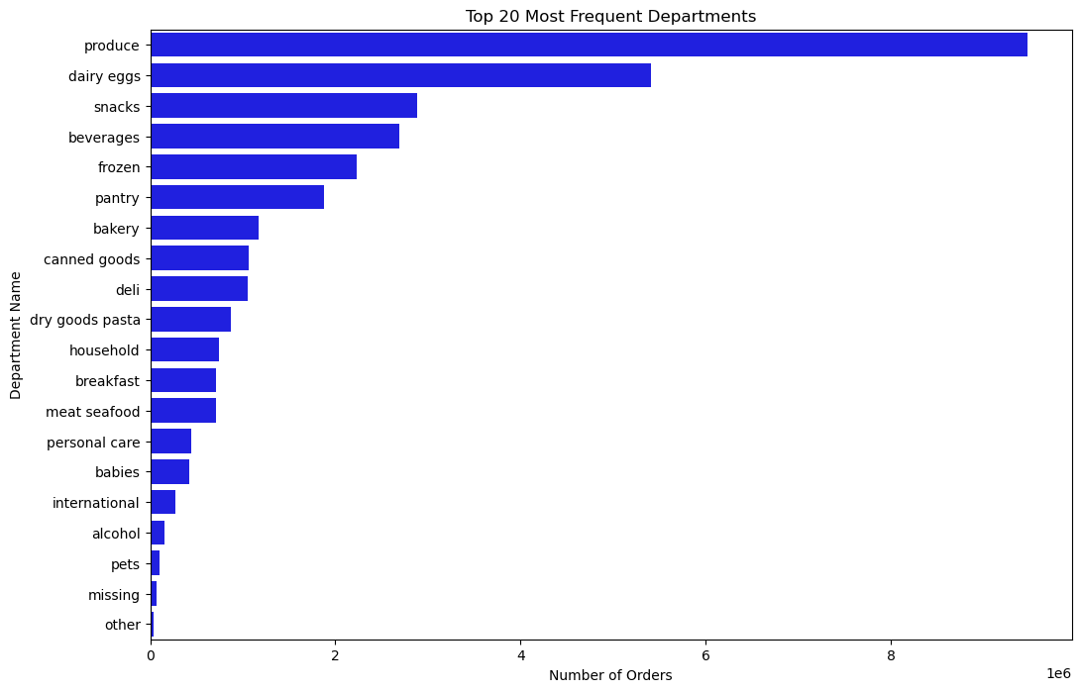
Data Preprocessing and EDA
Visualization | Impact
Frequent Aisles | Popular aisles shown
Visualization | Impact
Frequent Departments | Key departments identified

Slide 9
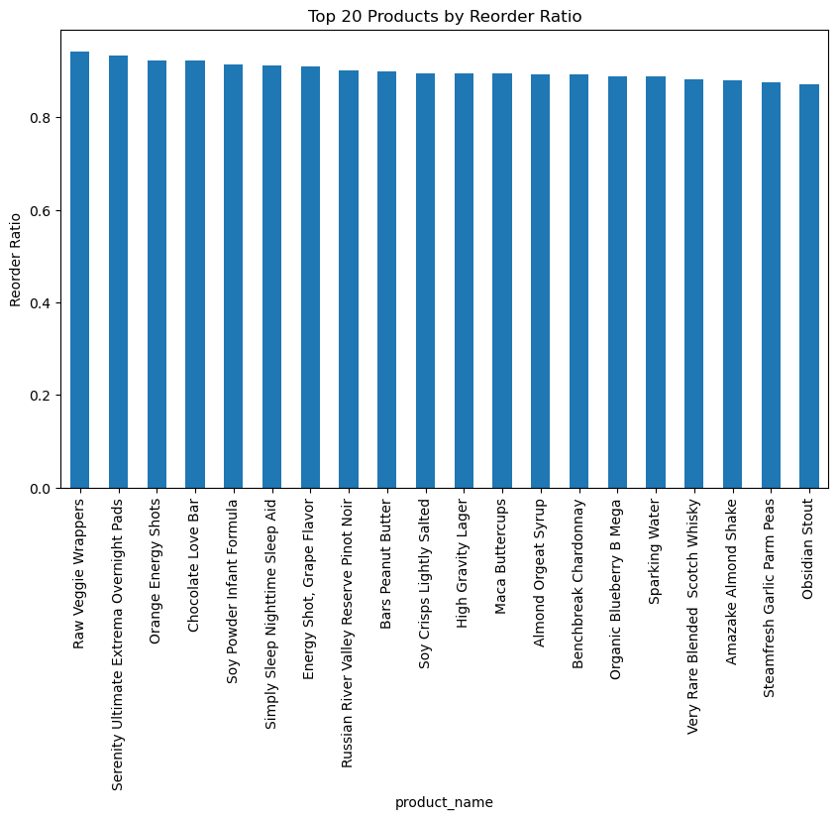
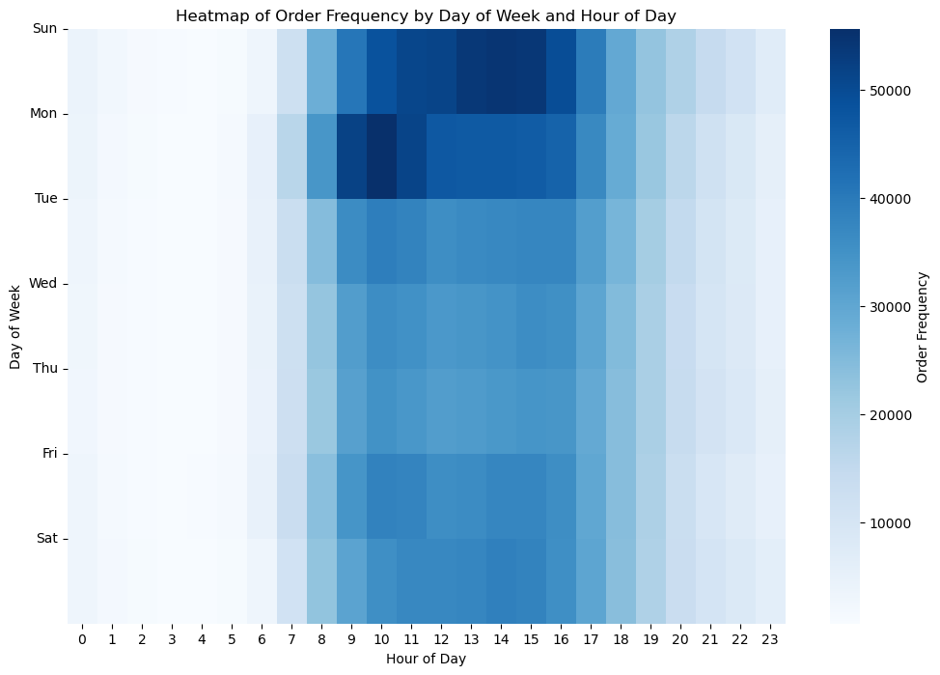
Data Preprocessing and EDA
Visualization | Impact
Order Frequency Heatmap | Detailed order patterns
Visualization | Impact
Reorder Ratio | Product loyalty assessed

Slide 10
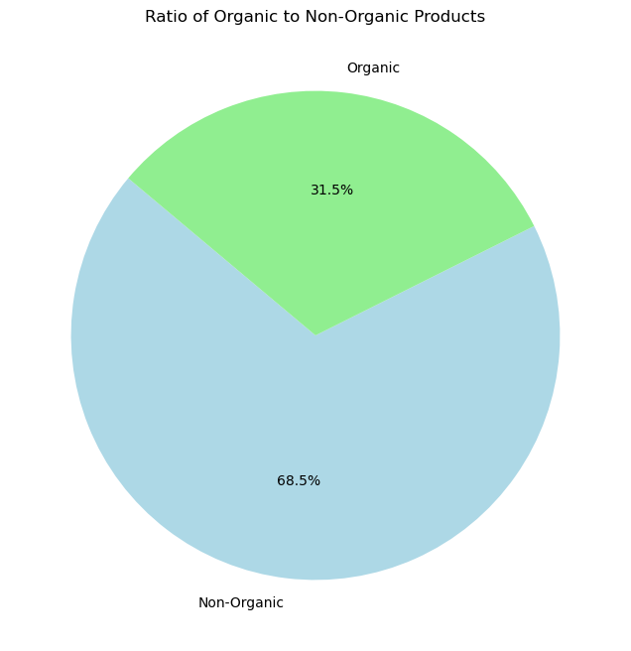
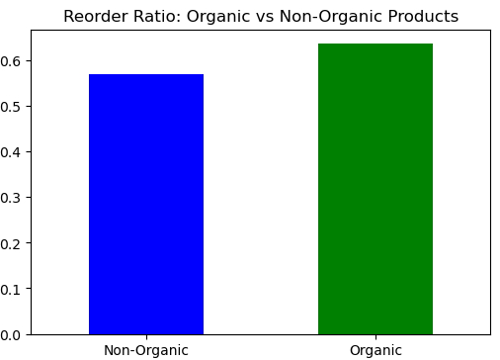
Data Preprocessing and EDA
Visualization | Impact
Organic vs Non-Organic | Organic preference shown
Visualization | Impact
Organic Reorder Ratio | Organic loyalty compared

Slide 11
Feature Engineering
Following metrics were created to capture more details for each user
Total orders
Average number of products per order
Average days between orders
Most common order day of week
Most Common Order Hour
Handling Categorical Features:
One Hot Encoding
Ordinal and Frequency Encoding

Slide 12
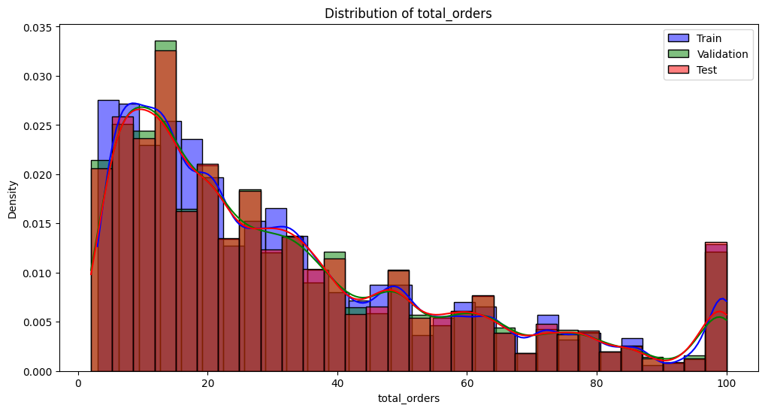
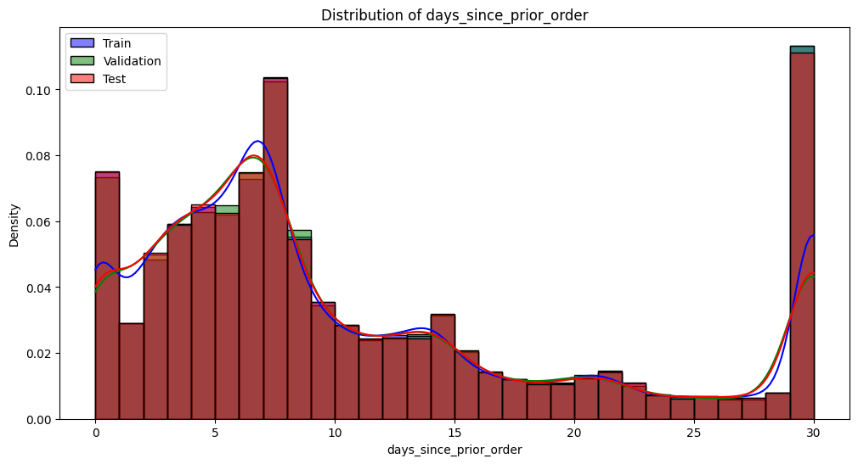
Distribution Shift
Compare distribution of key features across our train, validation, and test sets
Kolmogorov-Smirnov Tests: To statistically examine the distribution differences
Findings: differences in distributions for certain features
Resampling Strategy: we resample the train set to better match the validation set
Post-Resampling Analysis: After resampling, we conduct KS tests again
Variable | Statistic | P-Value
add_to_cart_order | 0.0062 | 0.0741
days_since_prior_order | 0.0044 | 0.369
total_orders | 0.0094 | 0.0010

Slide 13
Handling Imbalanced Data
Target Variable | % Values
1 | 58.35
0 | 41.6
Target variable is somewhat imbalanced
Random Oversampling: Equalizes class distribution by replicating minority class instances
Target Variable Distribution before Resampling
Target Variable | % Values
1 | 50
0 | 50
Target Variable Distribution after Resampling

Slide 14
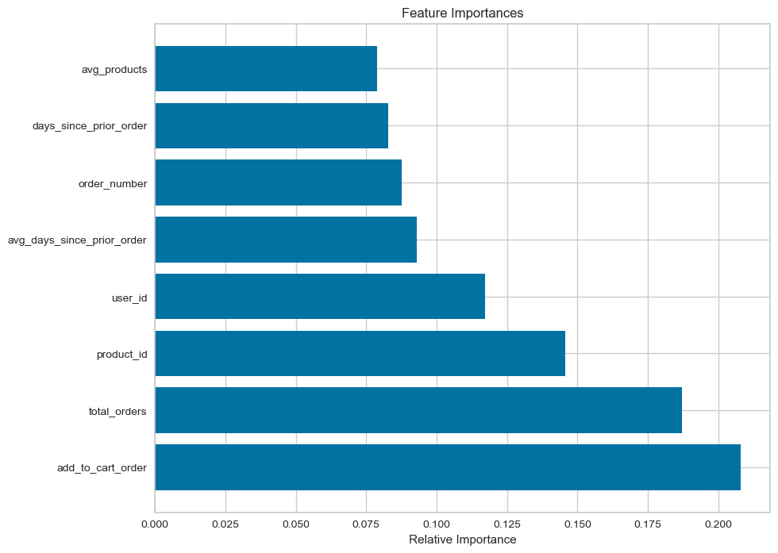
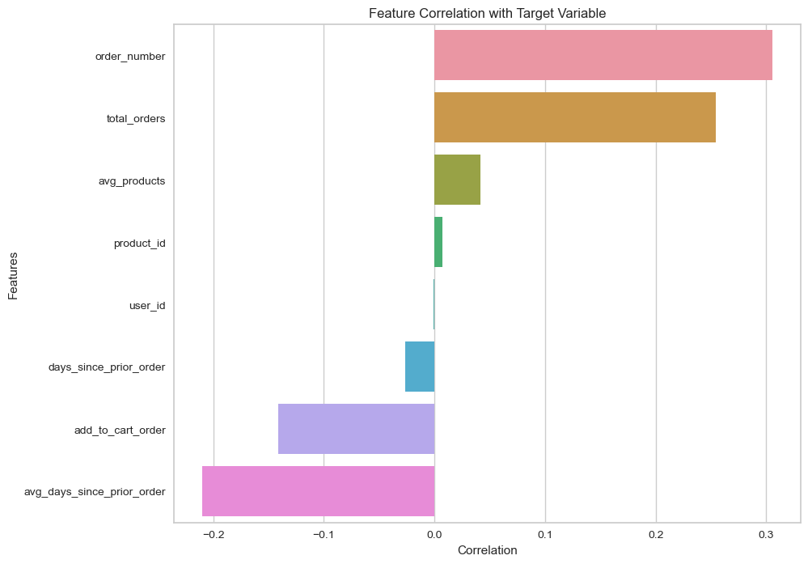
Information Leakage Analysis
The feature importance scores align with projected influences, with no extreme values
Correlation analysis between features and the target variable reveals no excessive links, reducing the concern for potential information leakage.
Random Forest Feature Importance Variables
Feature Correlation with Target Variable

Slide 15
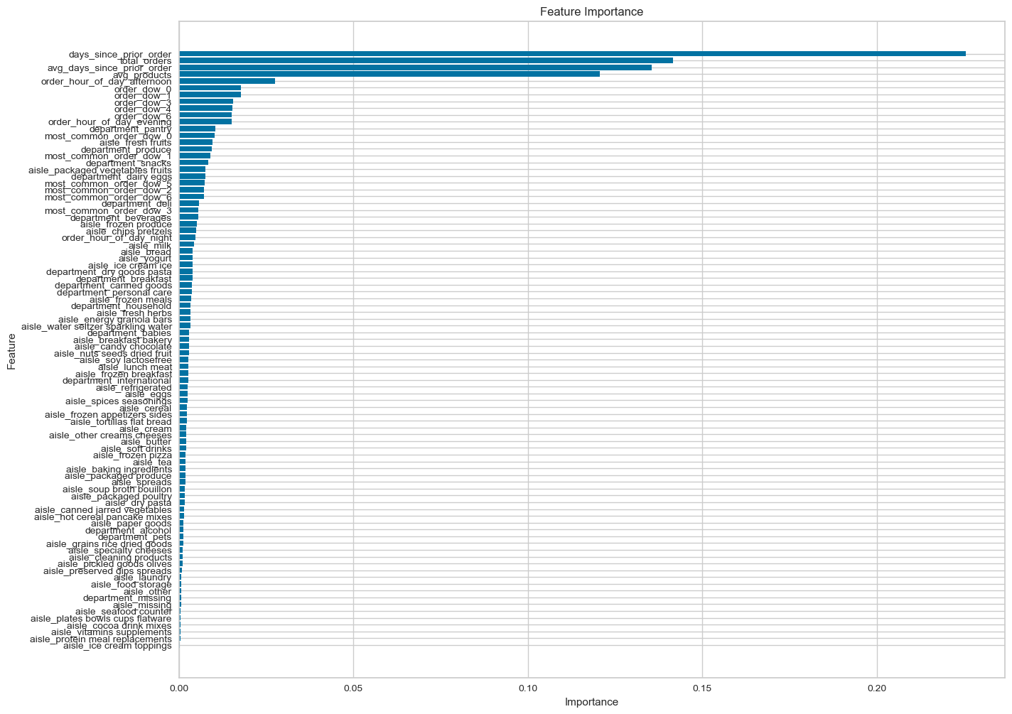
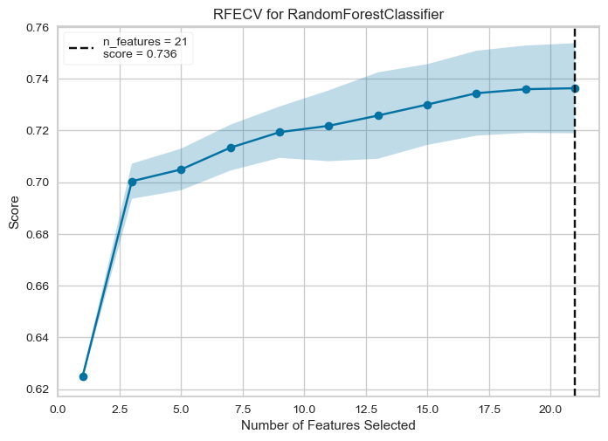
Feature Selection
Implemented Lasso regularization to exclude irrelevant features
Utilized a Random Forest classifier to rank feature importance
Perform RFECV base on Top20 features
Validated model predictions against the validation set
Top 20 feature selected in analysis
Feature Importance using Lasso
RFECV Random Forest

Slide 16
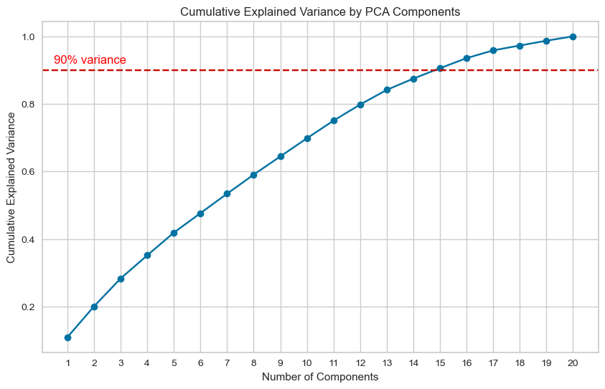
Dimension reduction - PCA
PCA Analysis
Cumulative Explained Variance plot showed a linear trend without a plateau
Indicating PCA contributed similarly to variance suggested no inherent lower-dimensional structure
Feature Importance using Lasso

Slide 17
Modelling
Model | Accuracy | Recall | Precision | F1Score | True Negative | True Postive | False Negative | False Positive
XGB Classifier | 0.65 | 0.77 | 0.68 | 0.72 | 11143 | 24214 | 7364 | 11363
LGBM Classifier | 0.67 | 0.83 | 0.67 | 0.74 | 9829 | 26510 | 5068 | 12677
CatBoost Classifier | 0.66 | 0.78 | 0.68 | 0.73 | 11019 | 24635 | 6943 | 11487
Stacking Classifier | 0.64 | 0.70 | 0.68 | 0.69 | 12242 | 22110 | 9468 | 10264
Result Metrics of all models are approximately the same
Specifically, LGBM and CatBoost are very similar
Achieving High Accuracy, F1 Score with other metrics balanced results is our objective

Slide 18
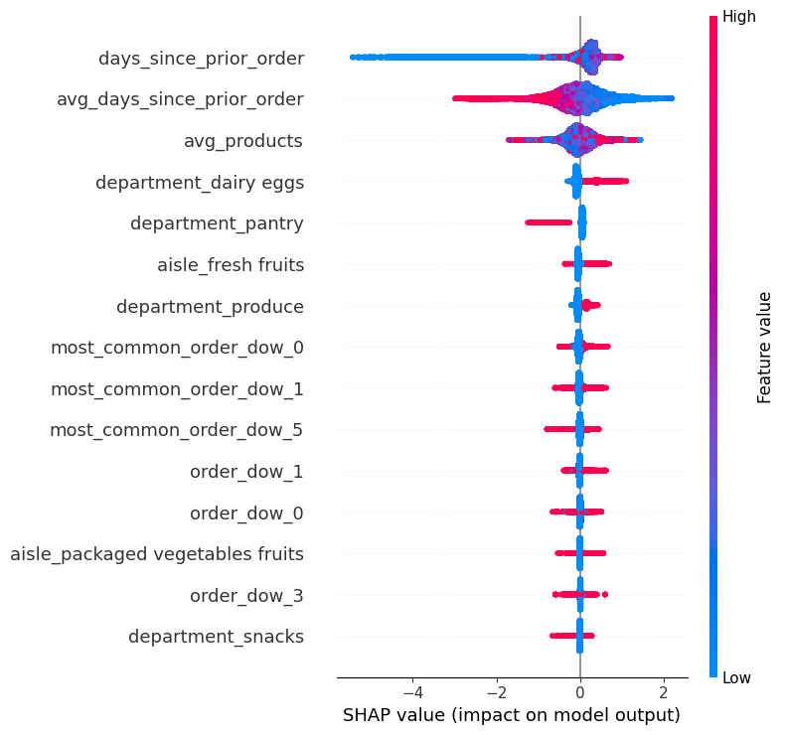
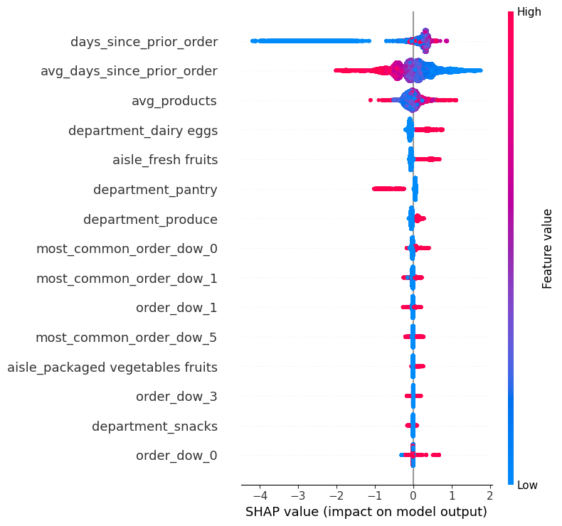
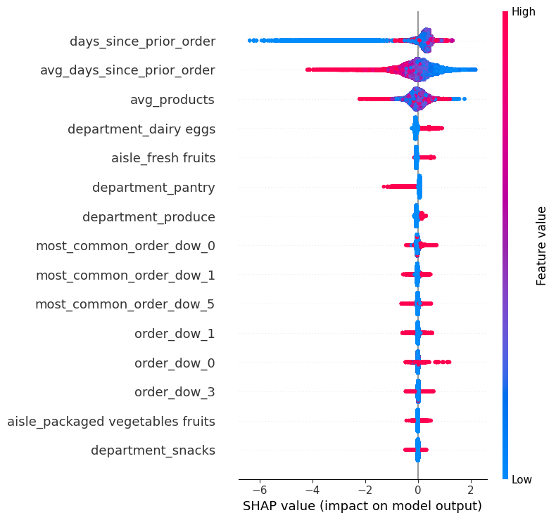
SHAP Bee swarm Plots
XGBoost Shap
LightGBM Shap
CatBoost Shap

Slide 19
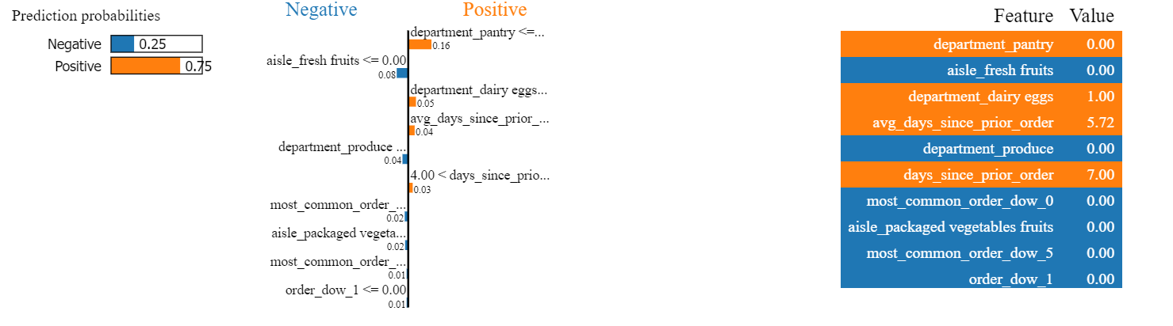
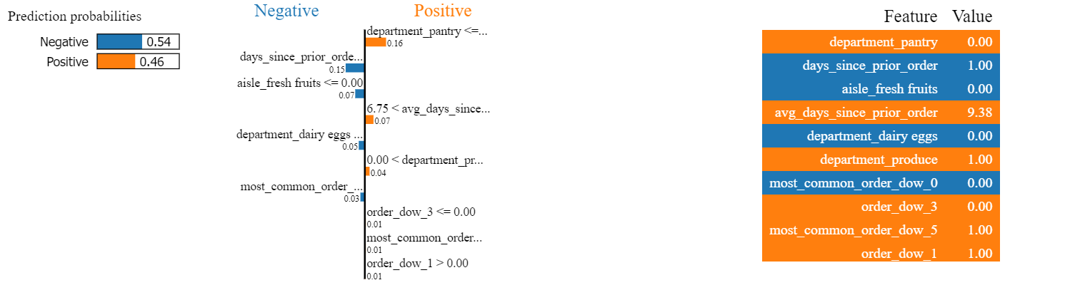
LIME Plots for Stacking Classifier
Instance –1
Instance –2

Slide 20
Final Model CatBoost
CatBoost can handle categorical variables directly simplifying pipeline
It includes built in mechanism to prevent overfitting
Best Parameters using Optuna
Best trial: {'iterations': 257, 'depth': 9, 'learning_rate': 0.07493298730822277, 'random_strength': 56, 'bagging_temperature': 0.26630241045034553, 'od_type': 'IncToDec'}
Optuna Tuned Model | Accuracy | Recall | Precision | F1 Score
CatBoost | 67.5% | 85.3% | 67.5% | 75.4%

Slide 21
Conclusion
Final Model : Has high accuracy and f1 Score showing good predictive power in decide whether a customer have a certain product reordered or not
Threats to Validity:
Change in environmental factors or Data Integrity may affect results. For instance, economic shifts, new market entrants, or changes in consumer preferences could alter purchasing patterns
If the underlying data generating process changes over time model drift might happen
Next Steps
Optuna to optimize multiple scores concurrently
To further optimize the models use custom loss function such as focal loss
Integrate advance feature engineering to capture aggregated measures

Slide 22


https://predicting-appucts-reordered-by-customer-7852zyrzsf2axkrqwx8l8.streamlit.app/

Slide 23
Thank you

Slide 24
Appendix

Slide 25
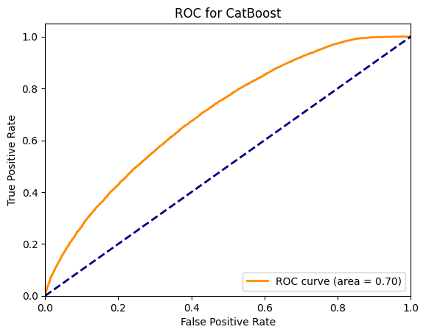
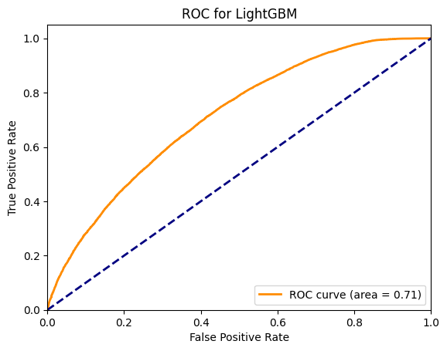

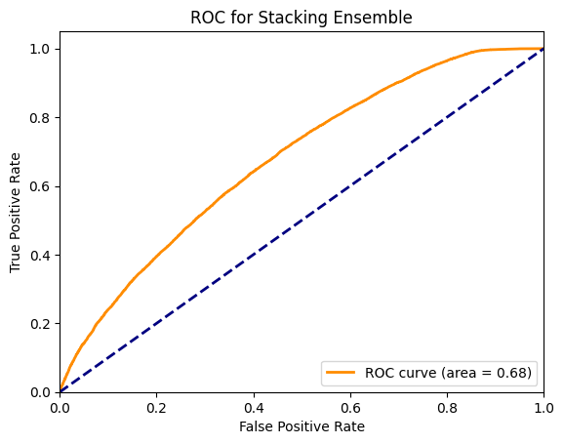
ROC Curves

Slide 26
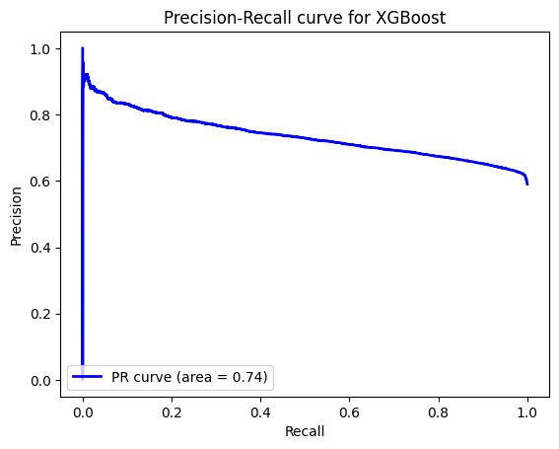
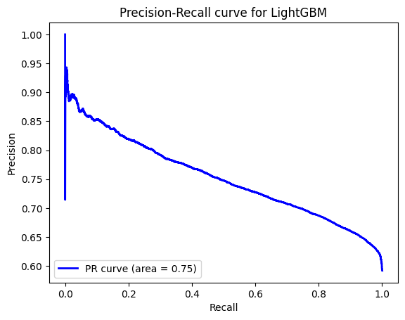
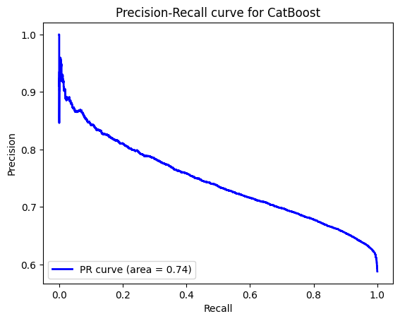
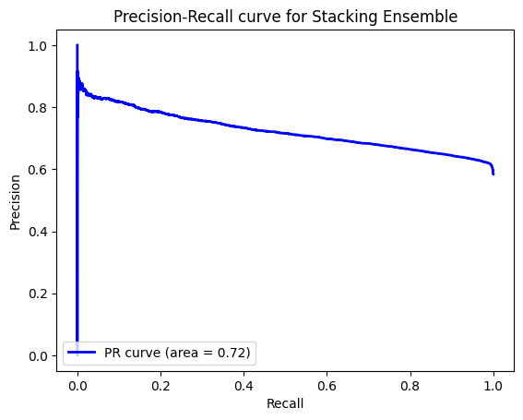
Precision Recall Curves

