Slide 1
Notes:
The McGill initiative on Computational Medicine was formed in 2017 and aims to deliver inter-disciplinary research programs and empower the use of data in health research and health care delivery
Located at the Genome Center
They have a newsletter were you can subscribe to
more info on the web site

Slide 2
R - Beyond the Basics
Yi Lian
Audrey Baguette

Slide 3
Efficiency
Coding
Computing

Slide 4
Why?
Coding – short and clean codes make everything easier
Edit
Debug
Share
Collaborate
Computing – short runtime, even make impossible possible
Big data
Machine learning/AI
Slow computer!
Deadlines!!!

Slide 5
General Rules
It takes resources to run programs
Processor (CPU, GPU)
Memory (RAM)
Time
…
Efficient coding ≠ Efficient computing
Short codes do not necessarily lead to short runtime
Avoid duplicated operations, especially expensive ones
Matrix multiplication/inversion, etc.

Slide 6

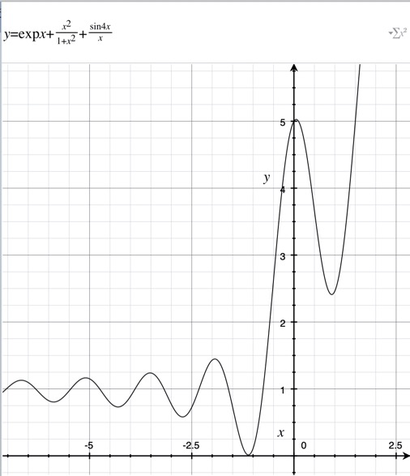
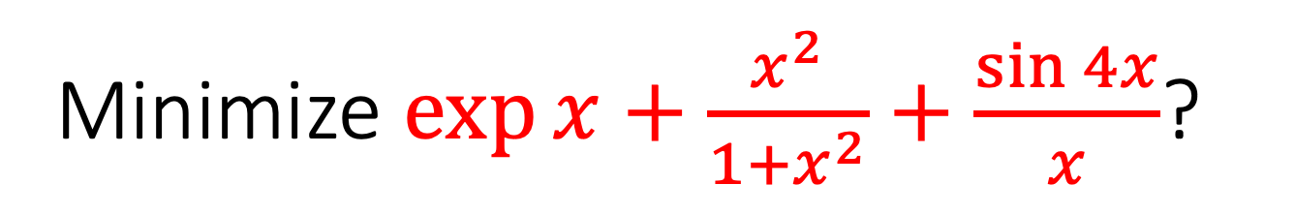
Minimize $\exp{x}+\frac{x^{2}}{1+x^{2}}+\frac{\sin{4x}}{x}$?
Shortest code
How?
Will it be fast?
Shortest runtime
How?
Newton’s method?
Gradient descent?
How long is the code?

Slide 7
R Rules
R emphasizes flexibility
Very good for research
R is better with vectorized operations but not loops
By default, R uses one CPU core
Use established R functions and packages
These functions usually make coding and computing more efficient at the same time
Some of them have core computations written in other languages, e.g. C, C++, Fortran
Some of them implement parallel (multi-core) computing

Slide 8
Today’s plan
Efficient coding
R objects (if necessary)
Powerful R functions
aggregate(), by(), apply() family
ifelse()
cut(), split()
Writing our own functions
function()
Efficient computing (will not be covered today)
Parallel computing
Mixed programming (Rcpp, etc.)

Slide 9
Hands-on -> https://github.com/ly129/MiCM2020

