Slide 1
Data wrangling in R programming
Instructor: Lang Liu

Slide 2
Notes:
The McGill initiative on Computational Medicine was formed in 2017 and aims to deliver inter-disciplinary research programs and empower the use of data in health research and health care delivery
Located at the Genome Center
They have a newsletter were you can subscribe to
more info on the web site

Slide 3
Agenda
0. Introduction
Objective
Instructor Biography
Workshop prerequisite and setup
Obtain workshop materials
Software installation
2. Introduction to data wrangling
What is data wrangling
Raw data exploration
Feature extraction
Data cleaning
Integration
Tidyverse
Tibbles
Dplyr
Tidyr
4. Practice

Slide 4
Introduction – objective
To understand the fundamental principles behind data wrangling, from ingestion of raw data to its final form as a well-structured, annotated, and clean dataset.
To become proficient with data manipulation in R using the tidyverse packages.

Slide 5
Instructor Biography
I’m Lang, a PhD student in the department of Human Genetics, supervised by Dr. Ziv Gan-Or and Dr. Alain Dagher. My thesis projects focus on discovering the link between neurogenetics and neuroimaging.
Linkedin: https://www.linkedin.com/in/langliu/
Our lab welcomes collaborations in neurogenetics. Email me if you need technical support in analyzing genetic data.
Master Education: Queen’s University - Biomedical informatics.
Undergraduate Education: University of Toronto – Honour of Cell and System Biology, Statistics and mathematics major
Outside of work, I enjoy hiking, frisbee, snowboarding and EDM.

Slide 6
Here we go!

Slide 7
Workshop prerequisite and setup
Download the files I attached in the email I sent this morning.
It contains the slide, datasets and scripts.

Slide 8
Workshop prerequisite and setup
R package installation
In this workshop, we are going to use tidyverse on R.
Tidyverse is a third-party package and it is not pre-installed in R.
Run the script below in your console.
> install.packages("tidyverse")

Slide 9
Data wrangling
Notes:
data wrangling is for the purpose of data preparation, data visualization and following analysis

Slide 10
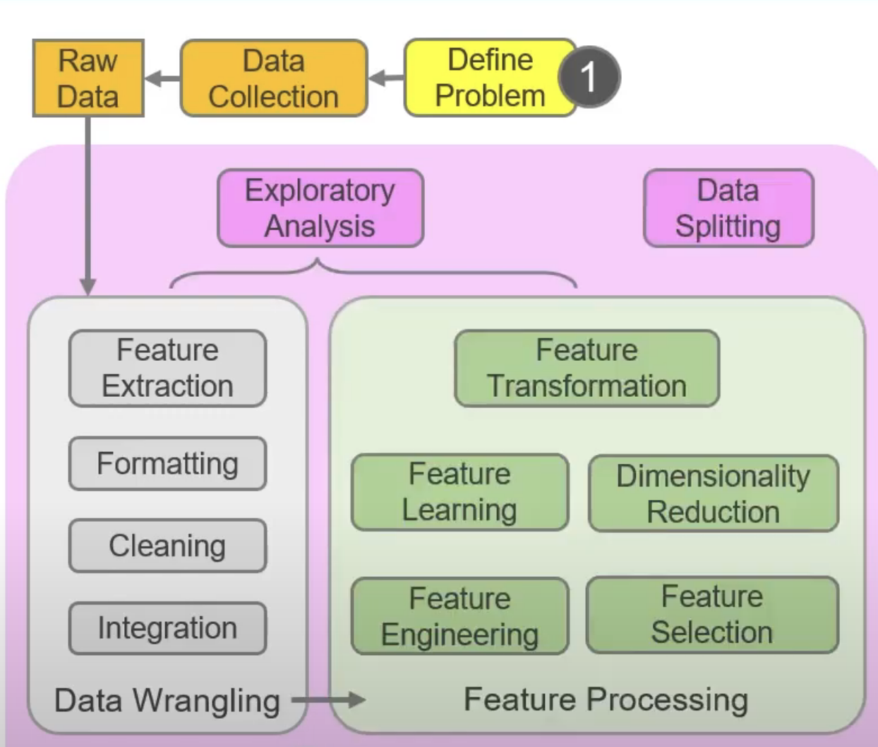
Overview

Slide 11
Overview
Examples of data wrangling
Merging several data sources into one data-set for analysis
Identifying gaps or empty cells in data and either filling or removing them
Deleting irrelevant or unnecessary data
Identifying severe outliers in data and either explaining the inconsistencies or deleting them to facilitate analysis

Slide 12
Overview
1. Data exploration
2. Feature extraction
3. Data cleaning
4. Integration

Slide 13
Data exploration
Understand the dataset
Read the documentation
Identify the variables and data types
Analyze the basic metrics
Non-graphical univariate analysis
Graphical univariate analysis (Not covered in this workshop)
Notes:
Sometimes they are not raw. In a collaborative project, the datasets may be on the different stages.

Slide 14
Feature extraction
Select or Transform features for further analysis
Select features of interest (it is not to select important features for machine learning)
Transform features into appropriate types
datetime to continuous values, normalization, etc…
Getting average, sum, quantiles to collapse your features
Text preprocessing to get desired values

Slide 15
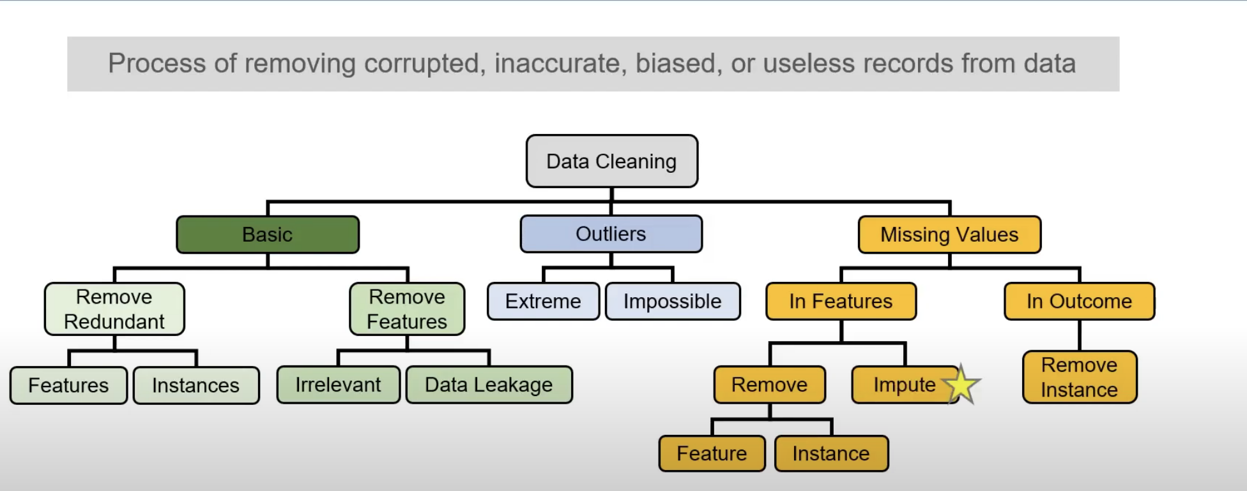
Data Cleaning

Slide 16
Data Cleaning
Remove missing values (rows, column)
Replace missing values with mean, median, average

Slide 17
Data Integration
combine features and/or instances from different resources/studies
Example:
Clinical data + genotyping data + imaging data
GWAS data from different resources

Slide 18
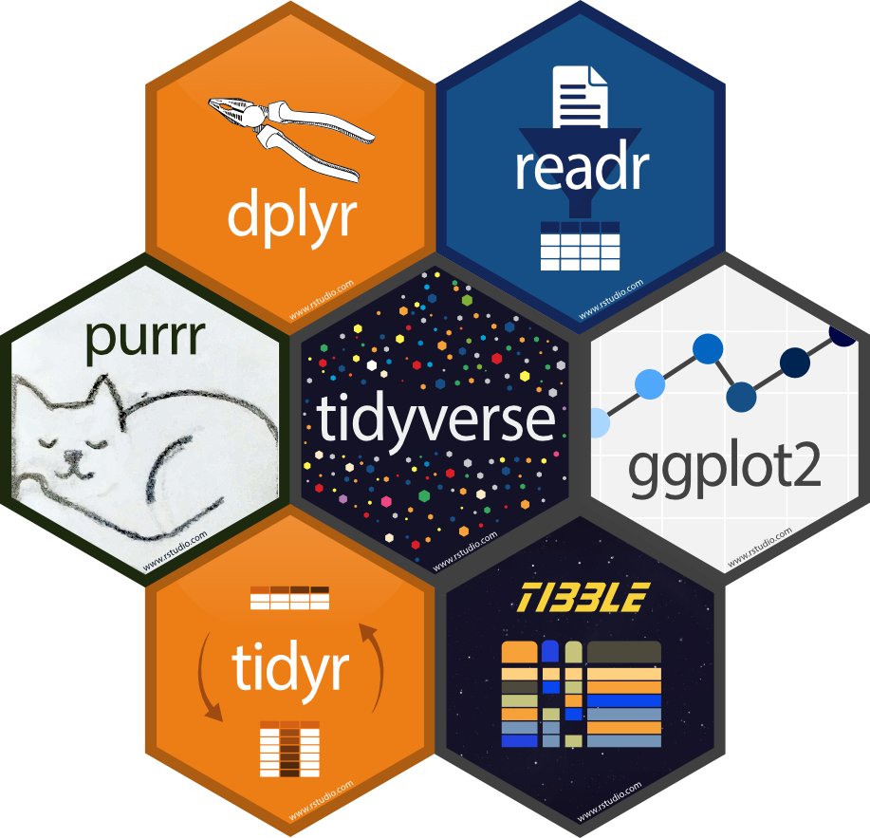
Tidyverse package
A collection of R packages
dplyr
ggplot2
readr
tidyr
tibble
Etc…..

Slide 19
What is a dataframe?
> data(iris)
> class(iris)
[1] "data.frame”
> head(iris)
Sepal.Length Sepal.Width Petal.Length Petal.Width Species
1 5.1 3.5 1.4 0.2 setosa
2 4.9 3.0 1.4 0.2 setosa
3 4.7 3.2 1.3 0.2 setosa
4 4.6 3.1 1.5 0.2 setosa
5 5.0 3.6 1.4 0.2 setosa
6 5.4 3.9 1.7 0.4 setosa
Notes:
Show > iris_tibble

Slide 20
Tibble dataframe
> library(tibble)
> iris_tibble = as_tibble(iris)
> head(iris_tibble)
# A tibble: 6 × 5
Sepal.Length Sepal.Width Petal.Length Petal.Width Species
<dbl> <dbl> <dbl> <dbl> <fct>
1 5.1 3.5 1.4 0.2 setosa
2 4.9 3 1.4 0.2 setosa
3 4.7 3.2 1.3 0.2 setosa
4 4.6 3.1 1.5 0.2 setosa
5 5 3.6 1.4 0.2 setosa
6 5.4 3.9 1.7 0.4 setosa

Slide 21
Tibble dataframe
> iris_tibble
# A tibble: 150 × 5
Sepal.Length Sepal.Width Petal.Length Petal.Width Species
<dbl> <dbl> <dbl> <dbl> <fct>
1 5.1 3.5 1.4 0.2 setosa
2 4.9 3 1.4 0.2 setosa
3 4.7 3.2 1.3 0.2 setosa
4 4.6 3.1 1.5 0.2 setosa
5 5 3.6 1.4 0.2 setosa
6 5.4 3.9 1.7 0.4 setosa
7 4.6 3.4 1.4 0.3 setosa
8 5 3.4 1.5 0.2 setosa
9 4.4 2.9 1.4 0.2 setosa
10 4.9 3.1 1.5 0.1 setosa
# … with 140 more rows
# i Use `print(n = ...)` to see more rows

Slide 22
Tibble dataframe
int = integers
dbl = doubles (double-precision floating point numbers)
chr = strings (character vectors)
lgl = logicals (true or false boolean values)
fctr = factors
date = date

Slide 23
Tibble dataframe vs dataframe
tibble dataframe is an enhanced R dataframe
It is smarter in printing and subsetting
It displays class, number of rows & columns and data type for every column.
It displays only the first 10 rows
> class(iris_tibble)
[1] "tbl_df" "tbl" "data.frame"
> class(iris)
[1] "data.frame”
> iris$workshop
NULL
> iris_tibble$workshop
NULL
Warning message:
Unknown or uninitialised column: `workshop`.

Slide 24
readr
A package that help you read and write data
read_*()
read_csv()
read_tsv()
write_*()
write_csv()
write_tsv()

Slide 25
Working directory
What is a working directory?
It is the file system of your environment.
By default, the current working directory is the directory of your script file.
For example, the working directory when you run a script who is stored at "/Users/lang” is "/Users/lang”

Slide 26
Working directory
There are two ways to read your files
Absolute path – the full path to your file
Relative path – the path relative to your current working directory

Slide 27
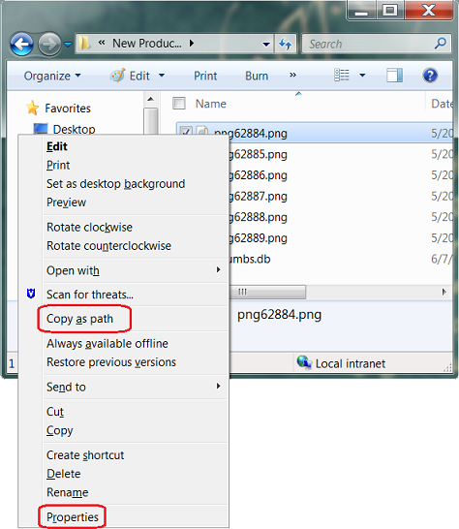
Absolute path
Windows
Right-click the file with pressing shift button

Slide 28
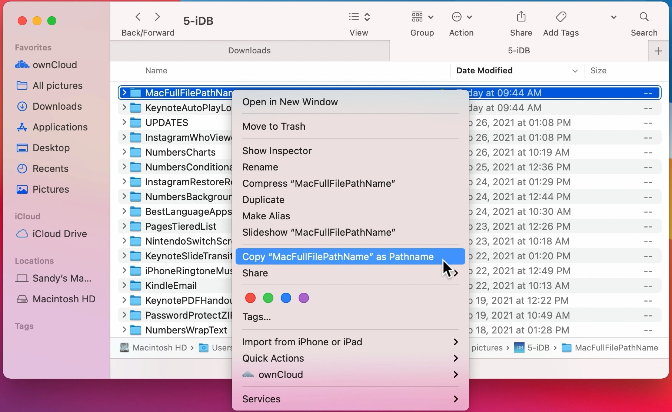
Absolute path
Mac
Right-click the file with pressing option button

Slide 29
Relative path
Suppose your current working directory is "/Users/lang”
And your file workshop.csv is stored under "/Users/lang/data”
Then the relative path of your csv file is “data/workshop.csv”

Slide 30
Working directory
There are two ways to read your files
Absolute path – the full path to your file
Relative path – the path relative to your current working directory
To read your file (ex: workshop.csv) when your current working directory is /Users/lang/
Absolute path - "/Users/lang/data/workshop.csv”
Relative path – “data/workshop.csv”

Slide 31
Working directory - practice
decompress the file I attached in the email and open the Rscript called script.R in Rstudio
Replace “directory/to/your/file” in path1 <- “directory/to/your/file” with the absolute path of breast_cancer.csv
For windows user, “directory\to\your\file” can’t be recognized by R because of “\”. You should change it to “/”
Run df <- read_csv(path1)

Slide 32
Working directory - practice
Set working directory
Replace “working/directory” in path2 <- “working/directory” with the absolute path of workshop folder
setwd(path2) sets the current working directory to path variable
getwd() displays your current working directory.
Run df <- read_csv("breast_cancer.csv")

Slide 33
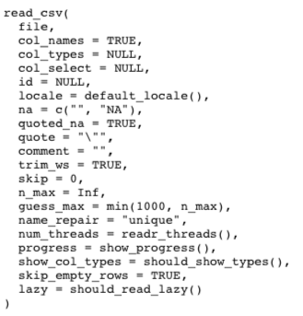
read_csv()
read_csv() can only read a csv file. It is a readr function.
It is different from read.csv() function which reads file as a data.frame in R.
read_csv() has some useful arguments
col_names = TRUE when the csv file comes with headers
col_names = FALSE when the csv file doesn’t come with headers
col_names = c(“x”,”y”,”z”) can change the column names
skip = 1 will skips the first line and read the following lines

Slide 34
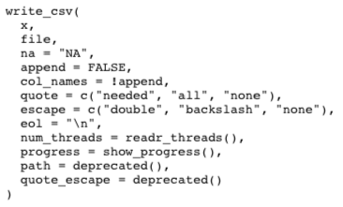
write_csv()
write_csv() can only write a csv file. It is a readr function.
It is different from write.csv() function which is stupid.
Because by default, write.csv() will write the index as a separate column in your output file.

Slide 35
dplyr
Designed for dataframe manipulation
Common functions:
filter() – pick out rows that satisfies certain conditions
select() – select columns
slice() – select rows
mutate() – create new columns
distinct() - select only unique rows
summarise() – collapse a column into a single summary (ex: minimum, maximum, median, quantiles)
summarise_all() – similar to summarise() but it applies the operations on all the columns
arrange() – reorder samples
group_by() – ask the following operations to be grouped
More details can be found in the MiCM_Data_Wrangling_workshop.Rmd files

Slide 36
Piping with magrittr
Pipe operator %>% helps your structure the data manipulation with dplyr functions
select(df,col1) is equivalent to df %>% select(col1)
Strongly recommended when you have multiple manipulations on a dataframe.
Trick:
The pipe operator can be typed in one shortcut
Windows: ctrl + shift + M
Mac: cmd + shift + M

Slide 37
pivot_longer() and pivot_wider()
These two functions can rearrange the dataframe
pivot_longer() can make the data “longer”
pivot_wider() can make the data “wider”
With both function, you can transpose a dataframe.

Slide 38
tidyr
tidyr is specific for data cleaning
Useful functions:
drop_na()
fill()
replace_na()
Before we work with missing values, how do we know if missing values are present in our data?

Slide 39
is.na()
is.na(x) returns a vector of logical values (TRUE/FALSE) corresponding to the presence of missing values in x.
> x <- c(1,NA,2)
> is.na(x)
[1] FALSE TRUE FALSE
> sum(is.na(x))
[1] 1
How can we summarise the missing values of all columns in a dataframe?

Slide 40
tidyr
tidyr is specific for data cleaning
Useful functions:
drop_na() - Drop rows containing missing values
fill() – by default, it fills the missing value with the non-missing value below
replace_na() - Replace NAs with specified values

Slide 41
Data aggregation
Union
Intersection
difference
Notes:
Data aggregation involves group_by() and summarise()

Slide 42
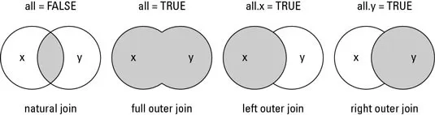
Data aggregation – Union & intersection
There are multiple ways to do union or intersection between two datasets
A base function merge() can finish inner join, outer join, left join and right join with different arguments.

Slide 43
Data aggregation – difference
We’d like to see how many rows are merged together when we do inner join.
We can compare the dimension of merged dataset, dataset 1 and dataset 2
We can also use a dplyr function called anti_join to see the difference between two datasets
In dplyr, there is a function called semi_join which can inner join two datasets.

Slide 44
PRATICE TIME!

Slide 45
Breast cancer microarray data
It has been demonstrated that cancer microarray datasets can be trained in machine learning algorithms to classify cancer types.
There is a breast cancer microarray dataset from the Curated Microarray Database (CuMiDa). (https://sbcb.inf.ufrgs.br/cumida)
I downloaded the datasets from the website and preprocess them. I list some tasks in the next slides. Please finish them in 20 mins.

Slide 46
Breast cancer microarray data
Read two datasets breast_cancer1.csv and breast_cancer2.csv as tibble dataframe.
Read GPL570.annot as a tibble dataframe
Discover these three datasets by using head()
Merge breast_cancer1 and breast_cancer2
Replace the probe name with gene symbol in GPL570.annot
Get the average expression of all genes in 6 types of breast cancer sample (basal,cell_line, HER, luminal_A, luminal_B, normal)
Find the top 10 genes that are expressed the highest on average in basal type

Slide 47
COVID-19 data in US
During pandemic, we care about the number of cases and deaths everyday. Analyzing the trend of pandemic can help the public health unit adjust the measures.
A dataset was created by scraping public data from multiple resources. https://www.kaggle.com/code/johnjdavisiv/us-counties-weather-health-hospitals-covid19-data/data?scriptVersionId=48607875
In the following tasks, we’d like prepare a dataset, to plot a graph for deaths and cases in Texas.

Slide 48
COVID-19 data in US
1. Read US_counties_COVID19_health_weather_data_trimmed.csv into Rstudio
2. Only look at columns of date, county, state, cases, deaths and total_population
3. Remove rows of missing values.
4. Calculate the total cases and total deaths in Texas per date
5. Normalize the data with total population of Texas
6. Obtain a dataset of normalized total case and normalized total deaths in Texas with ascending date.

Slide 49
Solutions
Solutions will be sent to your mailbox after the workshop.

