Slide 1
Long read transcriptomics
Dec 1 2022

Slide 2
What is an isoform?
Anything that creates transcript variation on a sequence level.
Can occur during transcription by alternative TSS (transcription start site) and TTS (transcription termination site) by shortening of the UTRs [1]
During pre-mRNA processing, eliminate or retain introns and exons

Slide 3
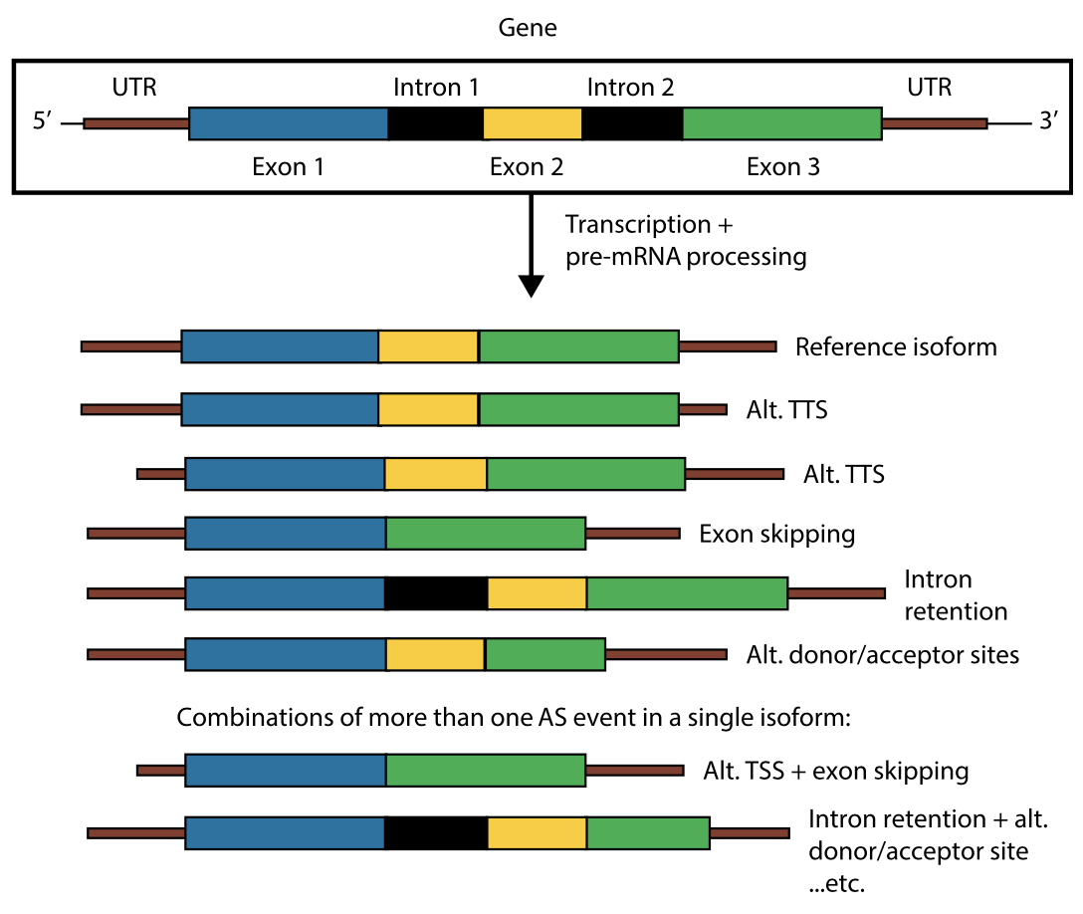
Figure 1B [1]
Notes:
Sources of transcript variation that yield alternative isoforms and their position along the transcript. When compared with a reference isoform (for convenience, that including all exons, no introns and the complete UTRs), alternative TSSs (transcription start sites) and TTSs (transcription termination sites) are generated during the transcription process by shortening of the UTRs. Processing of the pre-mRNA eliminates or retains introns and exons, adding variability to the isoforms that can be generated from the gene. In addition, more than one event can simultaneously be present in the same isoform, and consequently isoform diversity will increase with the number of possible combinations of AS events.

Slide 4
Short read sequencing
Pros | Cons
Cost-effective Accurate supported by many analysis tools High read depth | Produce reads up to 600bp, falls short of the actual length of RNA molecules [10] Have amplification bias No base modification detection Do not allow for full-length transcripts and isoform detection*
*81% of isoforms have length greater than 500 bp in the GENCODE annotation (median = 1543 bp and mean = 2121 bp) [10]

Slide 5
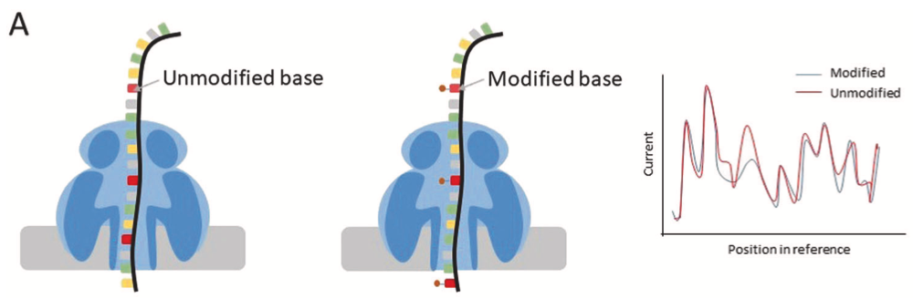
Long read seq (Oxford Nanopore)
Pros | Cons
Produce reads ranging from 500bp to record of 2.3 Mb[10] identification of modified bases using ”squiggles” from electric current inside nanopore | High error rate (~5%) [10] In Nanopore direct mRNA sequencing protocol, pore block and fragmentation can result in truncated reads, leading to biased coverage toward the 3′ end of a transcript
[11], Fig 1A

Slide 6
Long read seq (PacBio)
Pros | Cons
HiFi read technology became available circa 2019 (99.9% accurate) [PacBio website] Allow for full-length transcripts + isoforms Read length 5kb-25kb | Low read depth (precise quantification difficult, transcript dropouts ) Cost is prohibitive No “gold standard” analysis methods Requires conversion of RNA to cDNA (modified base info lost) [10]

Slide 7
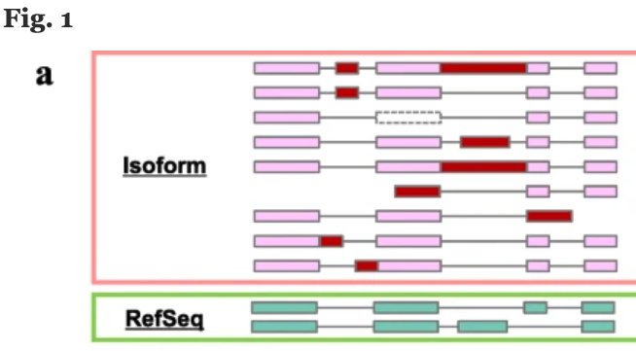
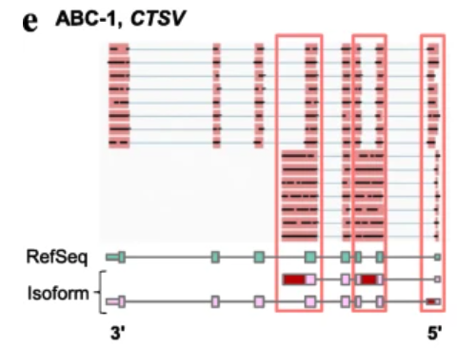
Use of long reads to identify aberrant splicing isoforms in cancer
https://genomebiology.biomedcentral.com/articles/10.1186/s13059-020-02240-8
Identification of aberrant splicing isoforms in cell lines. a Classification of aberrant splicing events.
Pink boxes represent constitutively spliced exons. Red and dotted-line boxes represent alternatively spliced exons.

Slide 8
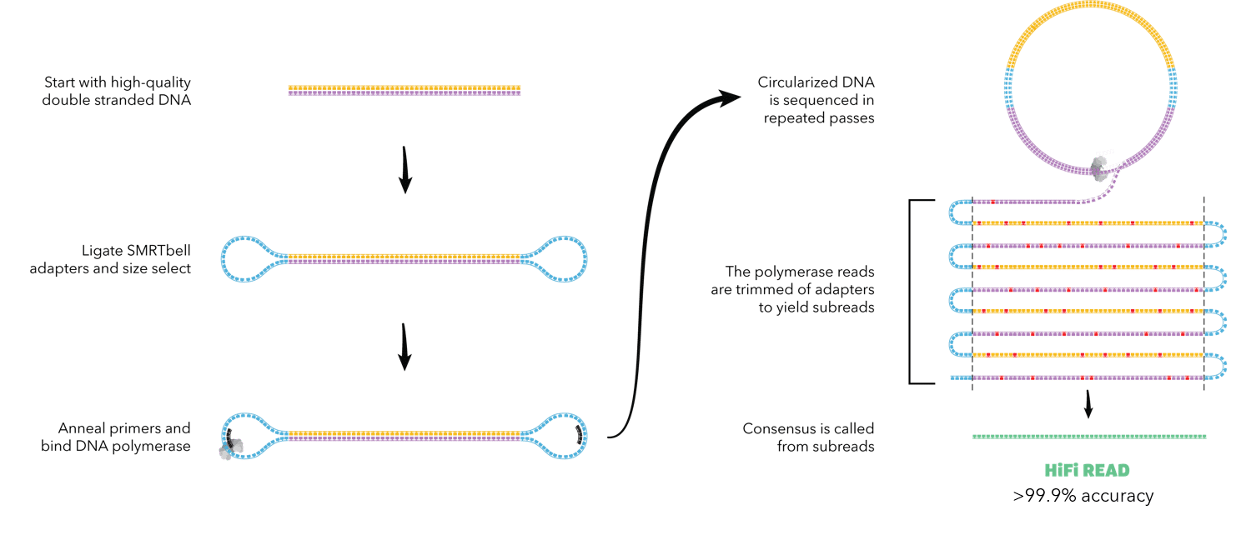
PacBio generate CCS
https://www.pacb.com/smrt-science/smrt-sequencing/hifi-reads-for-highly-accurate-long-read-sequencing/

Slide 9
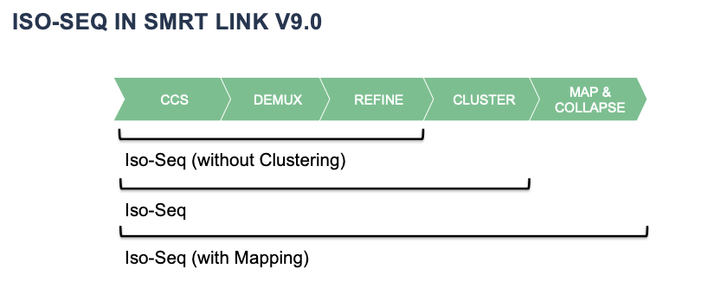
Iso-seq workflow
Pipeline (isoseq3) performs various processing steps to
generate CCS (circular consensus sequence)
demultiplex (remove primers)
refine to remove concatemers (reads which are attached end-to-end) + polyA tails
cluster reads which are the same transcript
Map & collapse to condense data into a transcriptome (fasta + GFF) and provide counts
Isoseq3 pipeline outputs: transcriptome (fasta + GFF), abundance count file (FL count)
https://www.pacb.com/smrt-science/smrt-sequencing/hifi-reads-for-highly-accurate-long-read-sequencing/

Slide 10
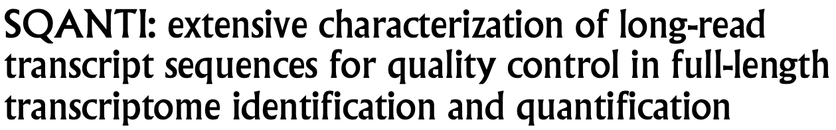
SQANTI for annotation and quality control downstream of isoseq3

Slide 11
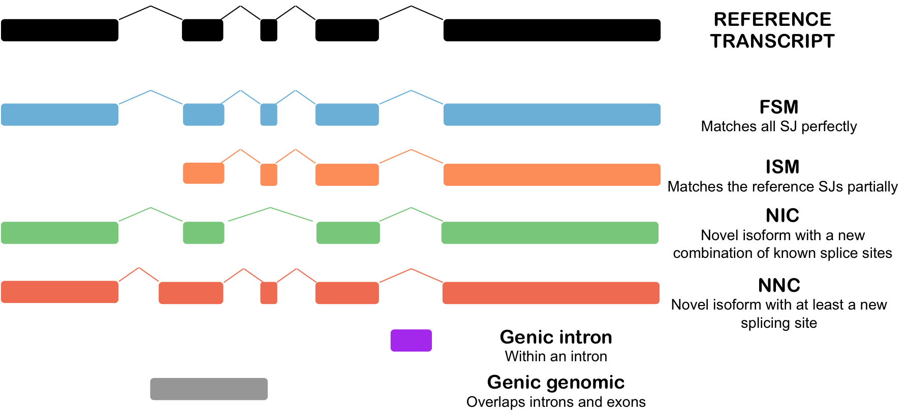
SQANTI category annotation
SQANTI categorizes transcripts based on several categories
Reference: [6]

Slide 12
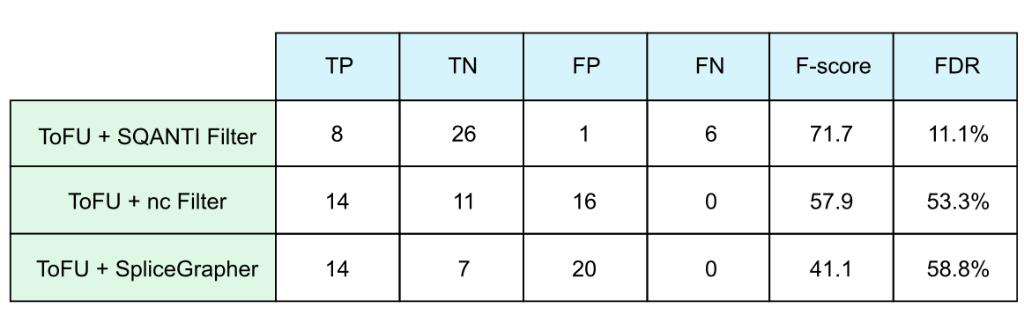
Why do we need SQANTI QC?
SQANTI performs quality control which minimizes FDR, allowing for generation of high-confidence GFF transcriptome. High confidence GFF is important for easy interpretation of transcriptome
Side question: Is there some way to increase capture of the FNs without increasing FPs?
Reference: [6], Figure 4C, benchmarking the set of novel isoforms assayed by RT-PCR

Slide 13
SQANTI3 allows for integration of several supporting data types
1) CAGE peak data (refTSS database)
“The refTSS is an annotated reference dataset for transcriptional start sites (TSS) in human and mouse. The dataset is generated by collecting, reprocessing and assembling various public resources.” [8]
-input CAGE peak reference file, provides reference TSS locations
-get distance (or exact TSS match) and direction (upstream/downstream) of PacBio TSS from CAGE Peak reference TSS
2) Splice junction coverage (STAR junctions or Intropolis):
i) Intropolis: “Intropolis is a list of exon-exon junctions found across 21,504 human RNA-seq samples on the Sequence Read Archive (SRA) from spliced read alignment to hg19 with Rail-RNA.” [9]
-coverage from 21k reference RNA samples used
ii) STAR: high confidence collapsed splice junctions file from STAR aligner (SJ.out.tab) from SR-RNA-seq data

Slide 14
SQANTI3 allows for integration of several supporting data types
3) polyA site data and polyA motif list
-allows for annotation of isoforms with the distance to nearest polyA site/motif
4) Short read expression data:
-RSEM or Kallisto
5) tappAS annotation file
-A GFF3 file which contains functional annotations of a reference transcriptome (e.g. Ensembl) at the isoform level.
Reference: [6]

Slide 15
Paper: Long-read transcriptome sequencing reveals abundant promoter diversity in distinct molecular subtypes of gastric cancer [5]
Authors use IsoSeq on 10 gastric cancer cell lines, identify 60K non-redundant transcripts, ~40k novel isoforms
Novel isoforms more likely cell line specific, expressed at lower levels
Tumor-specific ones change protein-coding sequence more often than others
Support for cell-line specific transcriptomes. …”Interrogating the transcriptomic landscape of novel isoforms remains a rich area of untapped biological diversity.”
Majority of splicing changes are due to transcriptional deregulation and not due to splice site mutations

Slide 16
Paper: Long-read transcriptome sequencing reveals abundant promoter diversity in distinct molecular subtypes of gastric cancer [5]
Stringtie +SQANTI2 → 67% of isoforms identified in LR could not be recovered from SR alone.
Many predicted SR isoforms are fragments of LR ones, since isoforms are much shorter, contain fewer exons, and less CAGE support
Overall, Stringtie for isoform discovery is not a good method
Iso-seq and RNA-seq are complementary : Iso-seq for isoform identification, SR RNA-seq enables accurate gene expression
Iso-seq expression only weakly correlated to RNA-seq SR expression, likely due to low read depth in Iso-seq
Authors used Kallisto to quantify with SR data, but used GTF from SQANTI2 as reference transcriptome (instead of generic reference transcriptome)

Slide 17
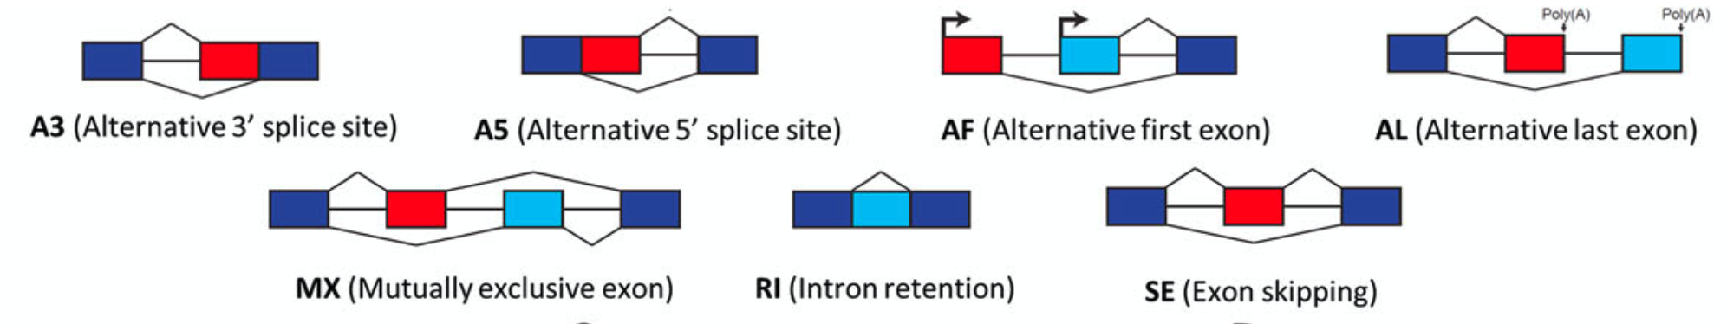
Paper: Long-read transcriptome sequencing reveals abundant promoter diversity in distinct molecular subtypes of gastric cancer [5]
SUPPA2 used to quantify alternative splicing events. AF (alternative first exon) most common one (35%)
AF events more common in novel isoforms than in known isoforms, which supports alternative promoter usage as a major source of transcript diversity in cancer
Figure 3A [5]

Slide 18
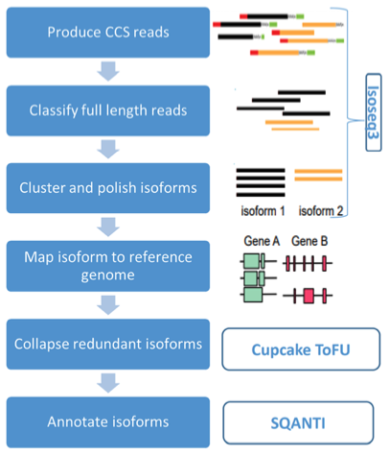
Paper: Long-read transcriptome sequencing reveals abundant promoter diversity in distinct molecular subtypes of gastric cancer [5]
Workflow in [5] for isoform detection and quantification (Figure 1A )
CCS = Circular consensus sequence
e.g. minimap2, *GMAP, STAR, pbmm2
*used by [5]
Also isoseq3 collapse

Slide 19
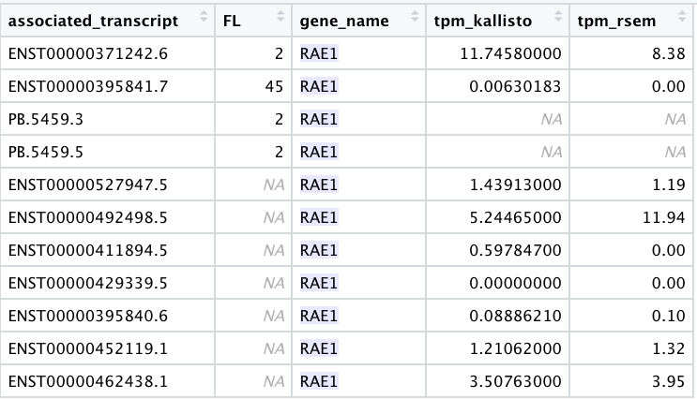
Example: Kallisto makes mistakes in predicting TPM using SR data
Comparison of SR and LR expression data for our “sample1”

Slide 20
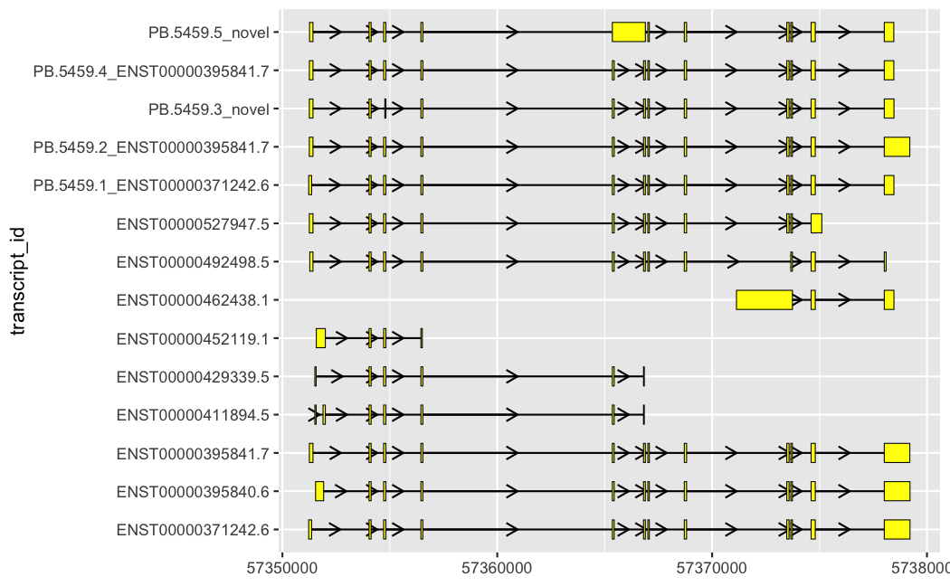
Short-read tools have trouble correctly assigning reads to the right transcript
RAE1
ISOSEQ
KALLISTO
RSEM

Slide 21
Goals
Exploratory analysis goals:
Identification of interesting/novel splicing isoforms from an unnamed cancer cell line
Identify transcripts which are quantified differently by SR and LR tools
Ultimate research goal: Creation and quantification of long-read transcriptomes by integrating both LR and SR counts
Questions
How to determine which transcripts are in a sample or are likely to be there? How to quantify these?
How to validate a method’s ability to detect isoforms that exist and their quantities
How to use isoform quantification data to answer biologically meaningful questions?

Slide 22
References
[1] Single-cell RNAseq for the study of isoforms—how is that possible? (Figure 1B) (https://doi.org/10.1186/s13059-018-1496-z)
[2] Functional consequences of developmentally regulated alternative splicing (https://pubmed.ncbi.nlm.nih.gov/21921927/)
[3] A pan-cancer transcriptome analysis of exitron splicing identifies novel cancer driver genes and neoepitopes
(https://www.cell.com/action/showPdf?pii=S1097-2765%2821%2900223-9)
[4] SQANTI: extensive characterization of long-read transcript sequences for quality control in full-length transcriptome identification and quantification (http://www.genome.org/cgi/doi/10.1101/gr.222976.117)
[5] Long-read transcriptome sequencing reveals abundant promoter diversity in distinct molecular subtypes of gastric cancer
[https://genomebiology.biomedcentral.com/articles/10.1186/s13059-021-02261-x]
[6] https://www.ncbi.nlm.nih.gov/pmc/articles/PMC5848618/
, https://github.com/ConesaLab/SQANTI3
[7] GenPipes: an open-source framework for distributed and scalable genomic analyses
https://academic.oup.com/gigascience/article/8/6/giz037/5513895?login=true
[8] refTSS [http://reftss.clst.riken.jp/datafiles/current/00README.txt]
[9] Intropolis [https://github.com/nellore/intropolis/blob/master/README.md]
[10] Opportunities and challenges in long-read sequencing data analysis [https://doi.org/10.1186/s13059-020-1935-5]
[11] Recent advances in the detection of base modifications using the Nanopore sequencer [https://doi.org/10.1038/s10038-019-0679-0]
[12] LIQA: long-read isoform quantification and analysis [https://genomebiology.biomedcentral.com/articles/10.1186/s13059-021-02399-8]

