Slide 1
Intro to Python Benjamin Rudski PhD Student Quantitative Life Sciences, McGill University
"Python" and the Python logos are trademarks or registered trademarks of the Python Software Foundation

Slide 2
Notes:
The McGill initiative on Computational Medicine was formed in 2017 and aims to deliver inter-disciplinary research programs and empower the use of data in health research and health care delivery
Located at the Genome Center
They have a newsletter were you can subscribe to
more info on the web site

Slide 3

National Day for Truth and Reconciliation
https://www.canada.ca/en/canadian-heritage/campaigns/national-day-truth-reconciliation.html

Slide 4
About me
BSc from McGill in Hon. CS/Bio, Minor Math
Second-year PhD student in Quantitative Life Sciences (QLS)
Research on trabecular bone structure in the Reznikov Lab, McGill Bioengineering
https://github.com/bzrudski

Slide 5
Outline: (times are very approximate)
Module 1 – Introduction to Programming (30 minutes)
Basic Concepts and Definitions
Welcome to Python
Module 2 – Python Basics (1 hour)
Foundations of Python
Numbers and Comparisons
Intro to Control Flow and Loops
Exercise: Numbers and Loops
Module 3 – Strings (40 minutes)
String slicing
String Operations and Methods
Iteration and the for loop
Exercise: DNA transcription and mRNA processing

Slide 6
Outline (continued):
Module 4 - Collection Types (45 minutes)
Tuples
Lists
Dictionaries
Exercise: Translation from mRNA to protein
Module 5 – Functions (35 minutes)
Intro to Functions
Exercise: Write a function to perform transcription and translation
Module 6 – Modules and Packages
Using modules
Package management
Where to go from here (10 minutes)
Where to go for help
Closing remarks

Slide 7
Module 1 Introduction to Programming

Slide 8
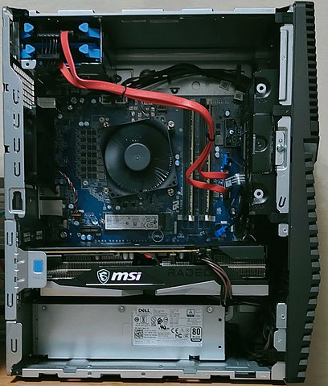
Basic Concepts and Definitions
What is a computer?
Hard drive
CPU
RAM
Motherboard
Graphics Card
Power Supply
Dell G5 5000 motherboard.jpg, by Project Kei, licensed under the Creative Commons Attribution-Share Alike 4.0 International license.

Slide 9
Basic Concepts and Definitions
What is a computer?
RAM: memory – store data
CPU: processor – perform operations on data
How do we tell it what operations to do on what data?...
Programming!
Program is a text file that contains instructions:
What operations to do
On what data

Slide 10
Basic Concepts and Definitions
What is a program? – Instructions
How do we write a program?
Using a programming language
Poll: Who does the programming language help?

Slide 11
Basic Concepts and Definitions
DNA
mRNA
Protein
Program (text file)
Executable (binary instructions)

Slide 12
Basic Concepts and Definitions
What’s with all those different languages????
Poll: Let’s see how many of you know Shrek…
Programming languages are like onions…
LAYERS!

Slide 13
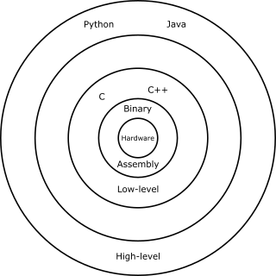
Basic Concepts and Definitions

Slide 14
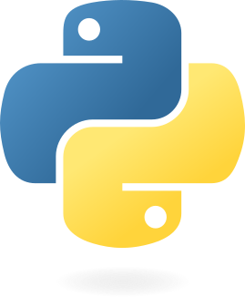
Welcome to the Python Programming Language!
For more history:
https://en.wikipedia.org/wiki/History_of_Python
https://www.geeksforgeeks.org/history-of-python/
https://docs.python.org/3/faq/general.html
Introduced in 1991 by Guido van Rossum
Features:
Free and Open Source
Interpreted
Object-Oriented
https://python.org

Slide 15
Welcome to the Python Programming Language!
Free and Open Source
Anyone can download, use, modify and distribute the Python programming language.
Interpreted
Python scripts are run line-by-line
Can easily launch it from the command line and have access to interactive shell
Object-Oriented
“Objects” – collections of data and manipulations that make it easier to represent the real world

Slide 16
Interactive Workshop!
That’s pretty much all that will be in the slides… For the rest, we’ll go to a Jupyter Notebook:
Go to Jupyter Notebook
https://github.com/bzrudski/micm_intro_to_python_fall_2022

Slide 17
Acknowledgements
Thank you to MiCM for giving me this opportunity and for helping me along the way.
Thank you to the professors from the McGill School of Computer Science for helping me along my programming journey and for inspiring me to share my programming experience with others.
Thank you to Professor Mathieu Blanchette, whose COMP 204 course helped to introduce me to Python (back in Fall 2018).
Diagrams in Jupyter Notebook made using Inkscape (https://inkscape.org).

