Slide 1
The Biology Department and You.
THINGS I WISHED I KNEW WHEN I STARTED
Biology Graduate Students Association Orientation Day

Slide 2
The Biology Graduate Student Association is…
An association under the Post-Graduate Student Society (PGSS)
You!
Execs:
  President
  V-P
  Finance Officer
  Secretary
Councillors: 16
Representatives
The BGSA

Slide 3
The Biology Department is…
Three overlapping subdivisions: Molecular, Ecology and Evolution, Neurobiology
Three buildings
The Biology Department

Slide 4
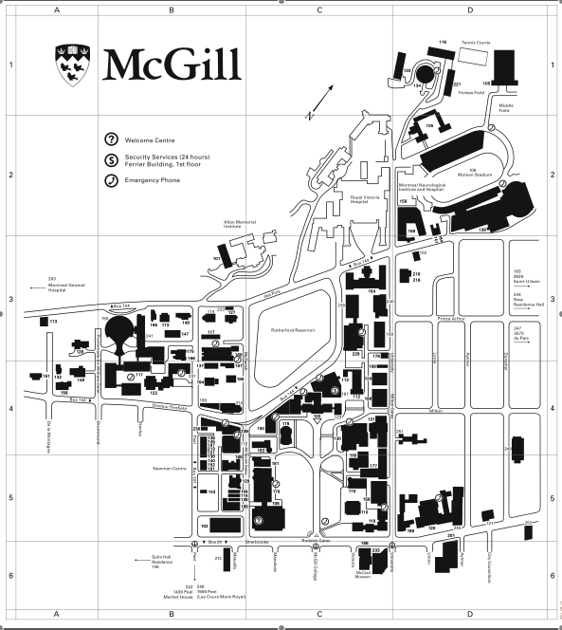
BELLINI
STEWART BIOLOGY
REDPATH MUSEUM
IMPORTANT PLACES

Slide 5
The Biology Department is…
Three overlapping subdivisions: Molecular, Ecology and Evolution, Neurobiology
Three buildings
Students, Faculty, and Staff
The Biology Department

Slide 6
Prof. Graham Bell- Department Chair
Prof. Rudiger Krahe- Building Director
Carole Smith- Deputy Building Director, Safety
Ancil Gittens- Course Coordinator
Sonal Patel- Awards and Stipends
Susan Gabe- TAships
Lucy Scigliano- Payment of TAs
Marisa Mastroberardino- Expense Reports
IMPORTANT PEOPLE

Slide 7
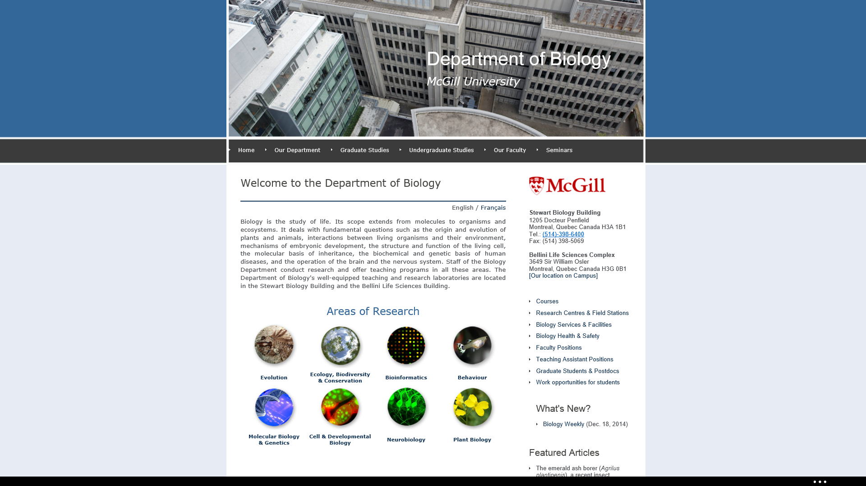
www.biology.mcgill.ca
GETTING STARTED

Slide 8
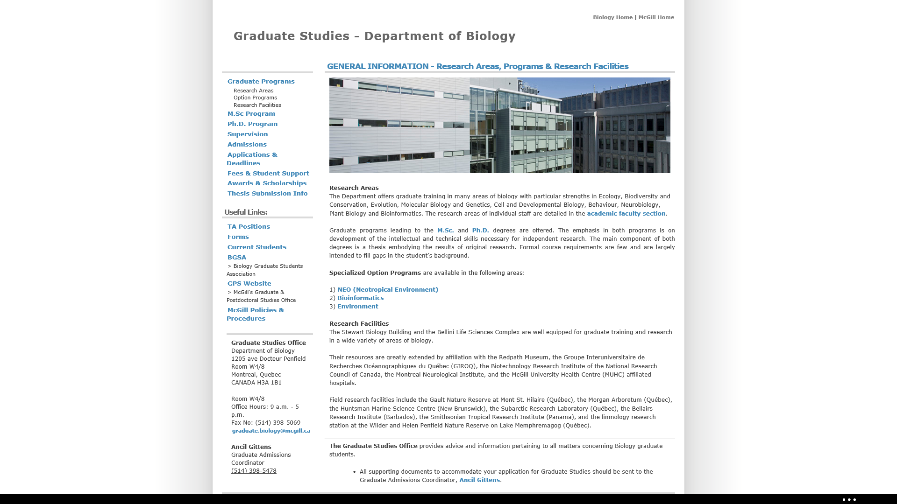
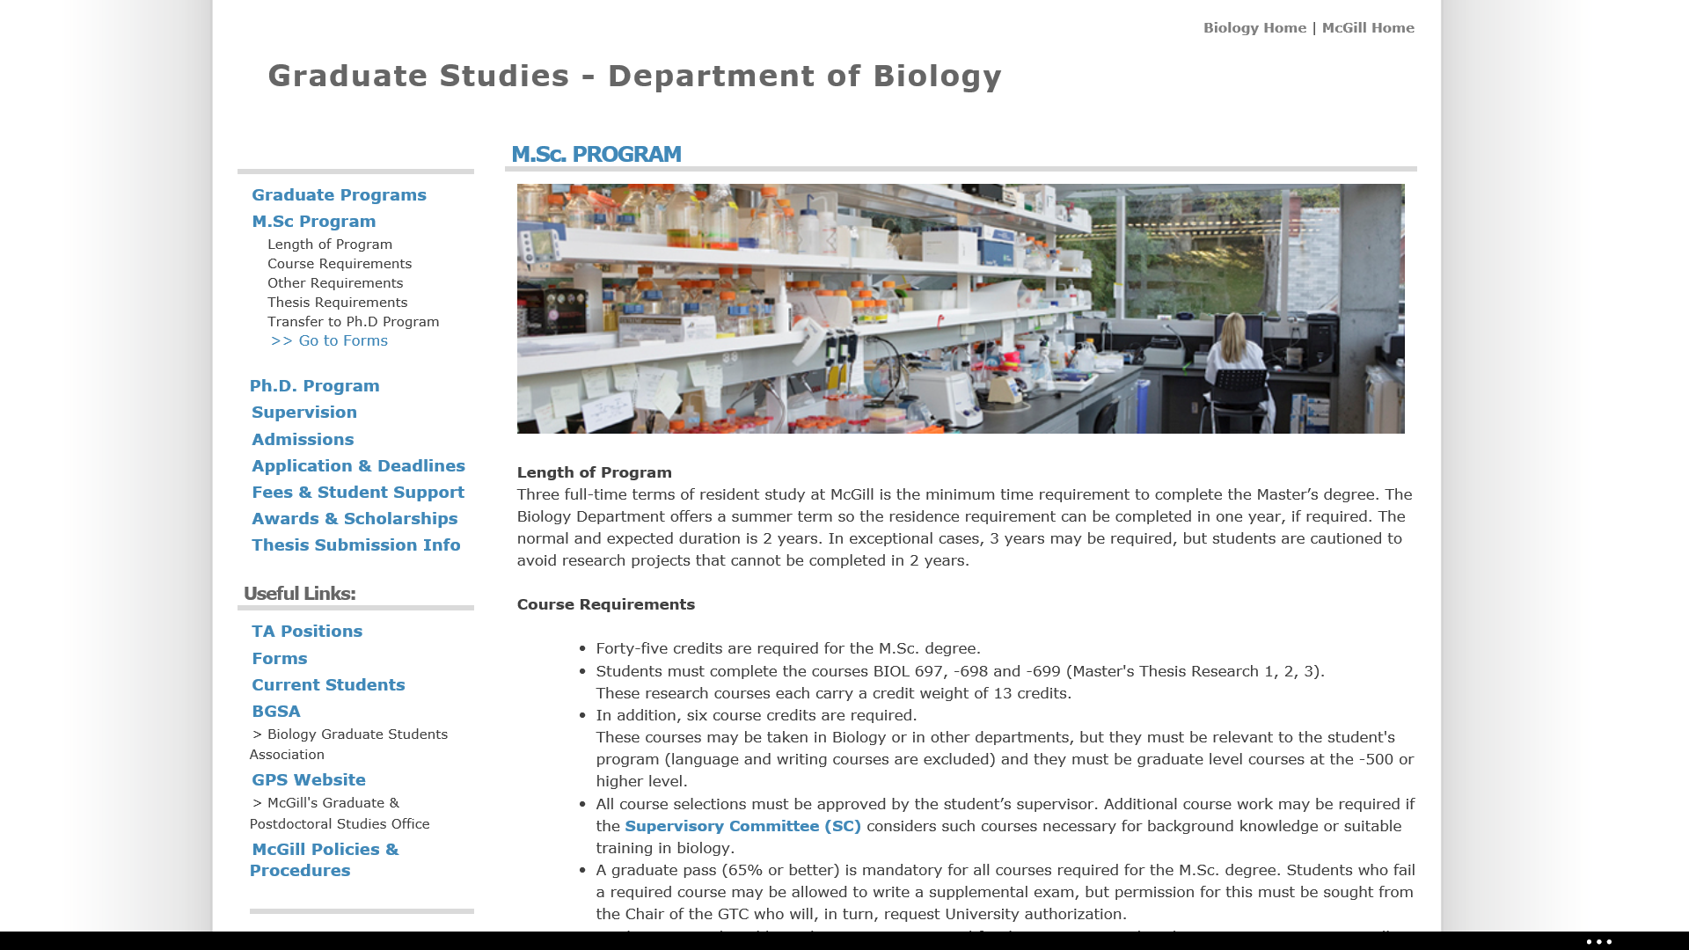
GETTING STARTED

Slide 9
Talk to your supervisor about:
  Courses
  TAing
  Safety courses needed
  Supervisory Committee
  Funding (deadlines usually in Fall)
Safety Courses: mcgill.ca/ehs/training
  WHMIS
  Introduction to Biosafety
  Others might include: Hazardous Waste Disposal, Biological Safety Cabinet Training, Radiation, Lasers
GETTING STARTED

Slide 10
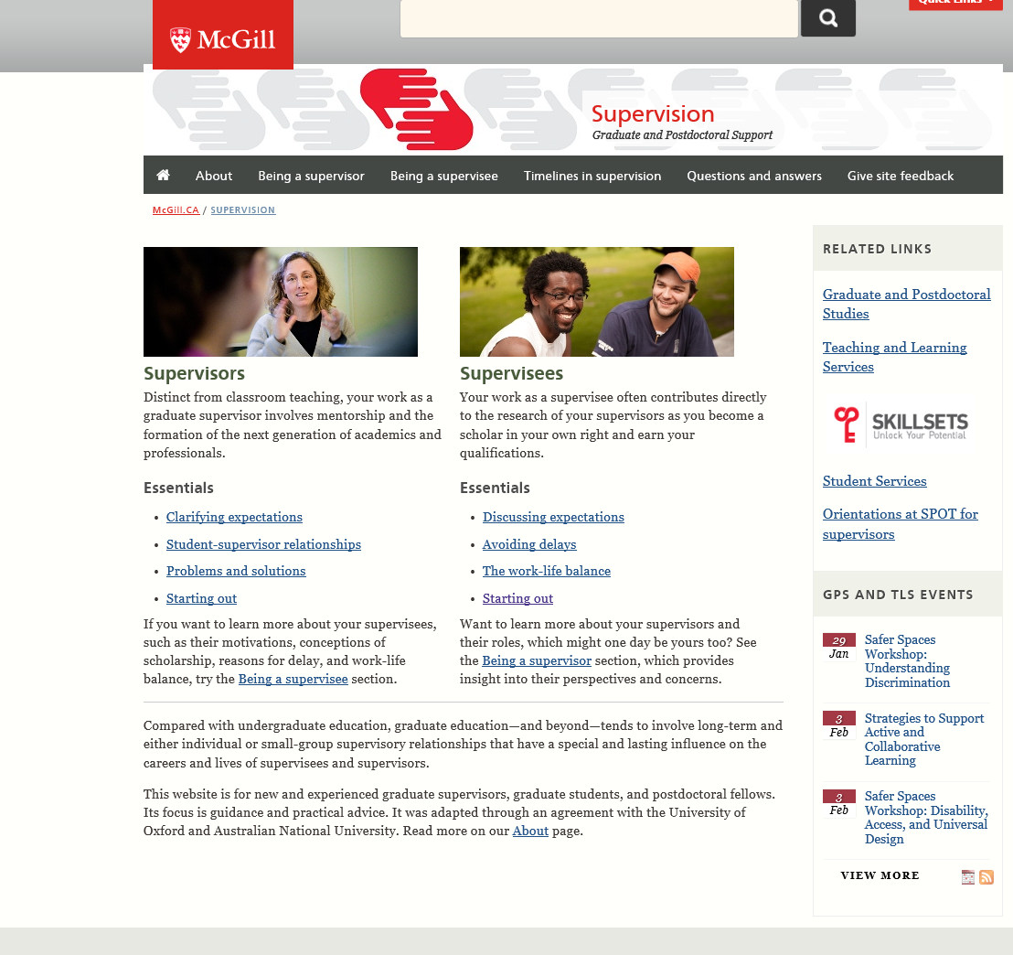
Other useful resources:
  GPS: McGill’s Graduate and Postdoctoral Studies – university wide guidelines, funding opportunities, travel awards (GREAT), leaves of absence
  Supervisor-supervisee website http://www.mcgill.ca/gradsupervision/
  AGSEM
GETTING STARTED

Slide 11
The BGSA can help you out…
ACADEMICALLY
Involved in seminars series
Members (help) organize CEEB Retreat and Molecular Symposium
Organize workshop(s)
SOCIALLY
Monthly socials of some sort
Camping and cabin trips
WHAT CAN BGSA DO FOR YOU?
Notes:
Smarter: EEL, Stats workshops
Wealthier: BGSA fall and winter travel grants
More fun: holiday party, intramurals, fall & winter retreats

Slide 12
Some things that are going on right now…
BGSA
New room: Stewart Bio N2/5
Travel grant existence
PGSS
CFS Referendum
Biology Department/ Buildings
Stewart Biology renovations
New hires
CURRENT NEWS
Notes:
Smarter: EEL, Stats workshops
Wealthier: BGSA fall and winter travel grants
More fun: holiday party, intramurals, fall & winter retreats

Slide 13
Important upcoming dates
CFS Referendum: January 15 + 16
Winter Cabin Retreat: February 27-March 1
Notes:
Smarter: EEL, Stats workshops
Wealthier: BGSA fall and winter travel grants
More fun: holiday party, intramurals, fall & winter retreats

Slide 14
BELLINI
STEWART BIOLOGY
THOMSON HOUSE
REDPATH MUSEUM
DECENT SUBWAY
SSMU
SUPER SANDWICH
IMPORTANT PLACES

Slide 15
How do I get involved?
Notes:
Attend events, become a councilor or volunteer.

Slide 16
mcgillbgsa.com
mcgillbgsa@gmail.com
Twitter: @McGillBGSA
Instagram: mcgillbgsa
Facebook Group: McGill BGSA
Notes:
Attend events, become a councilor or volunteer.

