Slide 1

Feature REDUCTION
From 117 features to 35 FEATURES

Slide 2
Recursive FEATURE ELIMINATION
RFE is a wrapper function that recursively eliminates unimportant features
RFE needs a model and the number of features
XGB is used as the model for RFE
Different number of features are tried and validated based on 5-Fold validation
Derived 35 as the optimal number of features

Slide 3
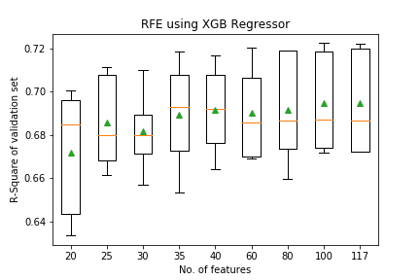

Slide 4
Selected FEATURES
['sqft', 'bedrooms', 'bathrooms', 'image_False', 'FSA_M1B', 'FSA_M1M',
'FSA_M1P', 'FSA_M1V', 'FSA_M1W', 'FSA_M2M', 'FSA_M3C', 'FSA_M3K',
'FSA_M4E', 'FSA_M4V', 'FSA_M4W', 'FSA_M5G', 'FSA_M5J', 'FSA_M5R',
'FSA_M5S', 'FSA_M5V', 'FSA_M6B', 'FSA_M6E', 'FSA_M6G', 'FSA_M6J',
'FSA_M6K', 'FSA_M6M', 'FSA_M6P', 'rental_type_apartment',
'rental_type_condo', 'rental_type_house', 'rental_type_loft',
'rental_type_townhouse', 'furnished_NOT', 'furnished_YES',
'pet_friendly_False']

Slide 5
MODEL COMPARISON
COMPARISON OF THE BEST 4 models BASED ON TEST R-SQUARE

Slide 6
MODEL COMPARISON
MODEL | DECISION TREE (WITH KNN (K=3) IMPUTATION) | RANDOM FOREST (WITH KNN (K=3) IMPUTATION) | XGBOOST | DEEP LEARNING
R-SQAURE AFTER GRID SEARCH | 0.624 | 0.687 | 0.713 | 0.612
OPTIMAL PARAMETERS | max_leaf_nodes=200 min_samples_split=90max_depth=35 | max_depth': None min_impurity_decrease: 0.05 min_samples_split: 4 n_estimators: 100 | eta: 0.2 gamma: 0.01 max_depth: 8 min_child_weight: 1 | Dropout Layer Dense Layer (50) Dense Layer (20) Dense Layer (1) Activation: Relu Kernel Initializer: Normal Optimizer: Adam

Slide 7
MODEL DEPLOYMENT
XGBOOST MODEL IS DEPLOYED IN THE SCHEDULER TO ESTIMATE THE RENTAL PRICE FOR EACH POSTING

Slide 8
FEATURE IMPORTANCE
XGBOOST MODEL IDENTIFIES THE IMPORTANT FEATURES

Slide 9
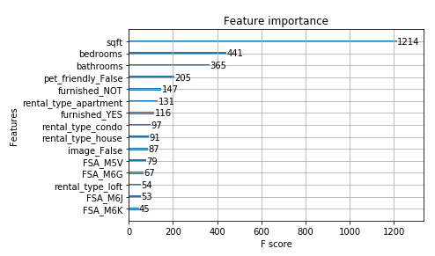
TOP FEATURES – Identified BY THE MODEL

