Slide 1
回溯(Backtracking)
宫秀军
天津大学计算机科学与技术学院
gongxj@tju.edu.cn
http://cs.tju.edu.cn/faculties/gongxj/course/algorithm
http://groups.google.com/group/algorithm-practice-team

Slide 2

Greedy
Algorithm
Optimal
Substructure
（step by step)
DP
Algorithm
Optimal Substructure
&&
Overlapping
Problem
decomposition
D & C
Algorithm
No overlapping
Subproblems
(Blocks)
Optimization
problems
Backtracking
Solution Space
decomposition

Slide 3
Outline
Intros
  Main idea
  Some concepts
  Steps
Applications
  Container-loading
  0/1Knapsack
  Max Clique
  TSP

Slide 4
Problem statements
Problem：A solution to the problem can be represented by n- turple (x₁,…,x_{n}), where x_{i} comes from a limited set S_{i}
Solution space：X= {(x₁,…,x_{n})| x_{i} ∈S_{i} }
  the number of possible elements (size ) is m=m₁m₂…m_{n}
Not all x ∈ X is the solution to the problem
  Constrains: g(x)=true
    Existence：Feasible Solution
  Optimization: target function max{f(x)}
    Optimal Solution x₀ st f(x₀)=max{f(x)}
How to get the feasible /optimal solution from SS?

Slide 5
Define solution space（1）
Eight queens puzzle
  The queens must be placed in such a way that no two queens would be able to attack each other.
  The solution can be represented by 8- turple (x₁,…,x₈) where x_{i} is the column number of queen i
  The size of SS is 8⁸
  Constrain
    x_{i}≠x_{j} |x_{i}-x_{j}|≠| j-i | for all i, j
1 2 3 4 5 6 7 8
₁
₂
₃
₄
₅
₆
₇
₈
Q
Q
Q
Q
Q
Q
Q
Q
8×8 chessboard

Slide 6
Define solution space （2）
Subset sum problem
  A pair (S, M), where S is a set {w₁, w₂, ..., w_{n}} of positive integers and M is a positive integer.
  Exists there a subset of S that adds up exactly to the target value M?
  Solution space represented by
    A vector with the index of w_{i}
    A n-turple (x₁,…,x_{n})
n=4, M=31, W=(11,13,24,7)
(11,13,7) and（24,7）
(1,2,4) and (3,4)
(1,1,0,1) and (0,0,1,1)

Slide 7
Organize the solution space
The principle for model selection：
  Depending on the definition of SS
  Benefiting for searching the solutions
Two models：
  Tree
  Graph
Tree model is commonly used because it is helpful
  To enumerate the components of a turple
  To design the searching algorithm
  To use the bounding functions

Slide 8
State space tree
Problem state: each node in the tree
State space: all paths from root to a node in the tree
Solution state: a path from root to current node
Answer state: a path satisfying constrains
State space tree is the tree organization of the solution space
Marking a node k using a path from root to k (x(1),…,x(k))

Slide 9
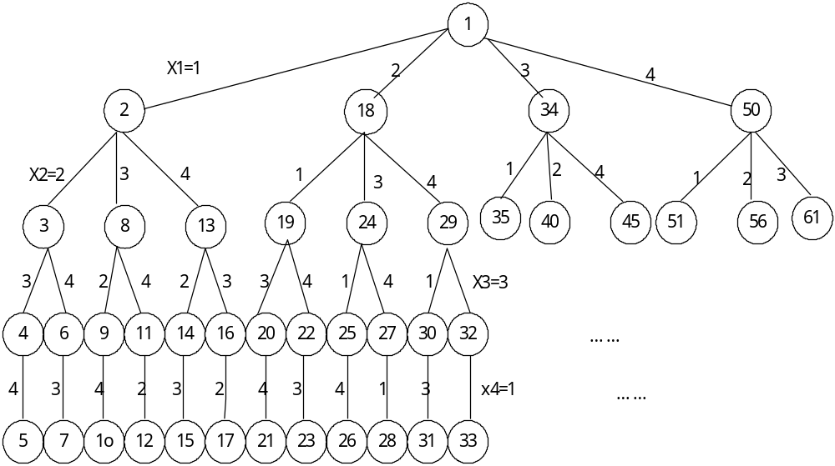
SST for 4 queens puzzle
The node number is encoded by the order of DFS
The edge is marked by the values of x_{i.} . This tree is also called Permutation Tree.
A solution is defined by the path from root to leaf.

Slide 10
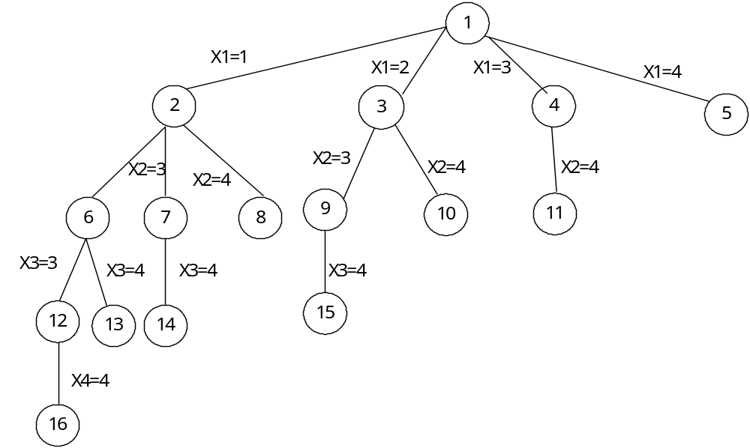
SST for subset sum (1)
Represented by a vector with the index of w_{i}
n=4, M=31, W=(11,13,24,7)

Slide 11
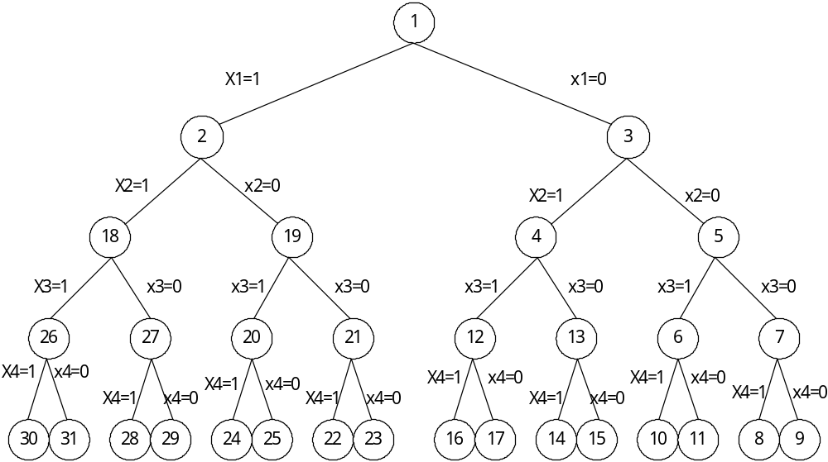
SST for subset sum (2)
Represented by n-turple
n=4, M=31, W=(11,13,24,7)

Slide 12
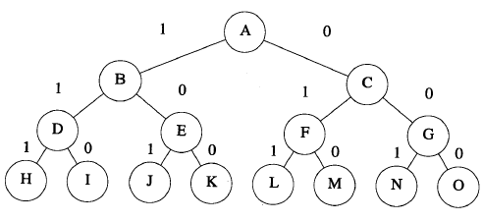
SST ( an example of 0/1 knapsack)
n=3，w= [ 20 , 15 , 15 ]，p= [ 40 , 25 , 25 ] , c= 30。

Slide 13
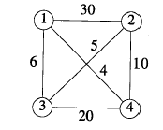
TSP

Slide 14
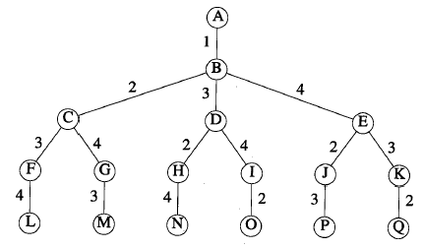
SST of TSP

Slide 15
Searching solution space: searching methods
Searching solutions equals to traverse the state space tree
Node states during expending a tree
  Live node： A node that has been reached, but not all of its children have been explored
  Died node： A node where all of its children have been explored
  E-Node (expansion node)： A live node in which its children are currently being explored.

Slide 16
Searching solution space: searching methods
Depth First Search: DFS
  A node has one/more chance(s) to be a E-Node
  Backtrack: A variant version of DFS with a bound function
Breadth-first search
  A node has only one chance to be a E-Node
  Live nodes are stored in a list
  Branch-bound: A variant version of BFS with a bound function
Best first search
  Explores a tree by expanding the most promising node chosen according to a specified rule.

Slide 17
Bounding
A boolean function to kill a live node
B_{i}(x₁,x₂,…,x_{i})=true iff (x₁,x₂,…,x_{i}) is impossible to be expended to an answer node
Bounding function:
  Obtained by some heuristics from constrains
  Must be simple

Slide 18
Backtrack algorithm
procedure BACKTRACK(n)
integer k,n; local X(1:n）
k←1
while k>0 do
if there exists X(k) st
X(k) ∈ T(X(1),…,X(k-1)) and B(X(1),…,X(k))=false
then if (X(1),…,X(k)) is an answer
then
print (X(1),…,X(k))
endif
k ←k+1// loop next //
else k ←k-1 //backtrack //
endif
end BACKTRACK
Solution is store in X(1：n) , once it is decided, output it
T(X(1),…,X(k-1)) is a set contains all possible values x(k), given X(1),…,X(k-1)
B(X(1),…, X(k)) judge whether X(k) satisfies constrains

Slide 19
Backtrack algorithm: recursive version
procedure RBACKTRACK(k)
/* X(1),…,X(k-1) has been assigned value*/
global n, X(1：n)
for each X(k)
X(k) ∈ T(X(1),…,X(k-1)) and B(X(1),…,X(k))=false do
if (X(1),…,X(k)) is an answer
then print (X(1),…,X(k))
endif
call RBACKTRACK(k＋1)
endfor
end RBACKTRACK

Slide 20
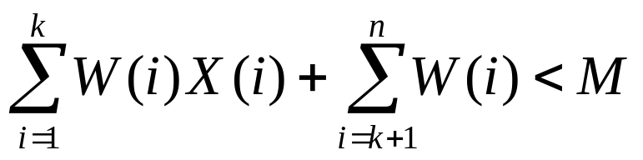
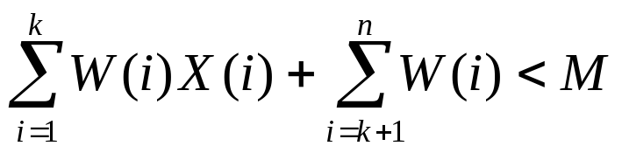
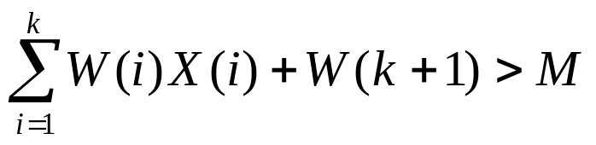
Bounding function: Subset sum problem
Simple bounding：B(X(1),…,X(k))=true iff
Tighter bounding：
  Sorting W(i) by non-decreasing order
  B(X(1),…,X(k))=true iff

Slide 21
Subset sum problem: pseudo code
Let s=w(1)x(1)+…+w(k-1)x(k-1)
r=w(k)+…+w(n),assume s+r≥M
Expanding left child node
  If S+W(k)+W(k+1)>M then
    stop expanding
    r←r-w(k),
    Expanding right child node;
  Else
    X(k)←1 ,
    s←s+w(k)，
    r←r-w(k)，let (x(1),…,x(k)) be E-Node;
Expanding right child node ：
  If s+r<M or s+w(k+1)>M then stop expanding ;
  Else ,X(k)←0;

Slide 22
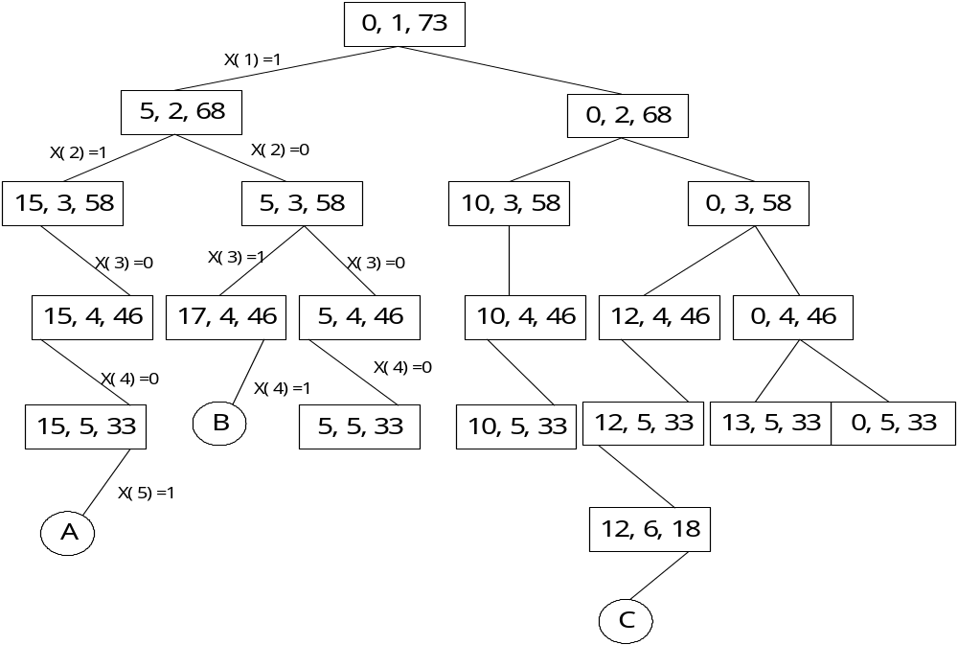
State space tree ( an example of SSP)
n=6,M=30 w=(5,10,12,13,15,18)
Notes:
n=6,M=30和W(1:6)=(5,10,12,13,15,18)时回溯法展开的部分状态空间树
图中矩形结点内的数字是s, k, r的值。
圆形结点表示一个答案节点，其对应的子集和数为M。这些节点是：A=(1,1,0,0,1,0),B=(1,0,1,1,0,0)和C=(0,0,1,0,0,1)。
图6.9中的树只有20个矩形结点，而n=6的满状态空间树有 2⁶-1=63个节点。

Slide 23
Backtrack: summary
Steps ：
  Define a solution space
  Organize the solution space
  Search the solution space
Applications
  Container loading
  0/1 Knapsack
  Max clique
  TSP
Notes:
the term "backtrack" was coined by American mathematician D. H. Lehmer in the 1950s

Slide 24
Container Loading Problem: CLP
Problem statements：
  Given
    A ship has capacity c
    n containers with weights w₁,…,w_{n} are available for loading
  Aiming at loading as many containers as is possible without sinking the ship.
A variant of CLP:
  Given
    Two ships with capacities c1 and c2 respectively
    n containers with weights w₁,…,w_{n} ∑w(i)≤c1+c2
  Aiming at how to load all n containers

Slide 25
Container Loading Problem: an example
For n= 3，c₁ =c₂ = 50，w=[10,40,40]
  A solution c1=[1,1,0] c2=[0,0,1]
For n= 3，c₁ =c₂ = 50，w =[20,40,40]
  No solution
When c₁ =c₂ and ∑w(i)≤2c₁ then CLP equals partition problems.
  NP hard problem

Slide 26
CLP solution
Solution：maximize the firs ship loading, load remainder containers into second ship
  Maxmize ∑w(i)x(i)
  Subject to ∑w(i)x(i)≤c₁ and x(i) ∈{0,1}
Methods
  DP
  Greedy
  Backtrack

Slide 27
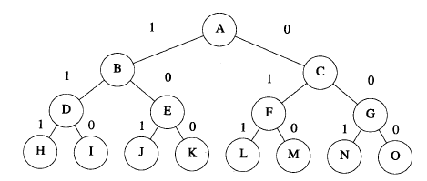
CLP：State space tree
n= 4，w= [ 8 , 6 , 2 , 3 ]，c₁ = 12
Leaf nodes are not shown

Slide 28
CLP: Bounding
Method 1：let cw be total weight of containers that have been loaded already if cw＋w(i)>c₁ then kill node i.
Method 2：let bestw be the optimal total weight up to now， r be the total weight of unloaded containers，if cw+r<=bestw, then stop expanding node i.
Above two methods can be used at same time

Slide 29
CLP: procedures（1）
Let x=(x(1),…,x(k-1)) be the current E-Node (cw+r>bestw);
Expanding left node
  If cw+w(k)>c1,then
    stop expanding the left node,
    r←r-w(k)
    Expanding the right node;
  Else
    x(k)←1, cw←cw+w(k), r←r-w(k)
    Let x=(x(1), …,x(k)) be the E-node;
Expanding right node
  If cw+r≤bestw then
    Stop expanding, backtrack to the nearest live node
  Else let x(k)=0, (x(1), …,x(k)) be E node.

Slide 30
CLP: procedures（2）
Backtrack:
  From i=k-1 to 1
    If x[i]==1 then
      cw←cw-w(i), r←r-w(i).
      break
If k==n and cw+w(n)>c1, then
  If cw>bestw, then bestw←cw, x(n)←0;
  Else backtrack
If (cw+w(n)≤c1,
  cw←cw+w(n),
  if cw>bestw, bestw←cw, x(n)←0;
  Else backtrack.

Slide 31
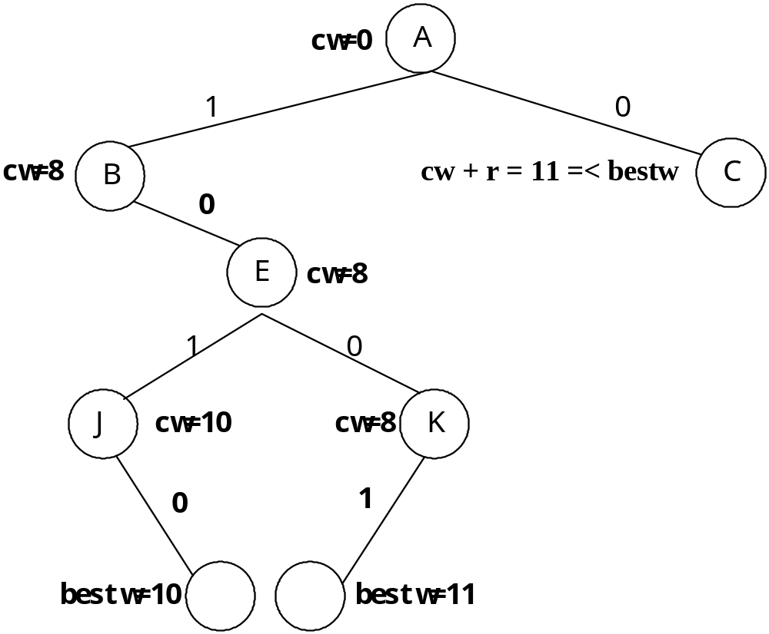
CLP: part of state space tree

Slide 32
0/1背包问题
使用定长元组表示，其状态空间树同于装船问题。
设x=(x(1),…,x(k)),为状态空间树的节点, bestp是算法当前获得最优效益值,
cp=x(1)p(1)+…+x(k)p(k).
收益密度：d=p/w
定义节点x的效益值的上界: bound(x)＝cp+其余物品的连续背包问题的优化效益值(贪心法得到).
如bound<＝bestp则停止展开x.

Slide 33
状态空间树

Slide 34
背包问题回溯法
按密度降序对物品排序
bestp←-∞
设x=(x(1),…,x(k-1)),为当前E节点(bound>bestp成立);
展开左子节点：
  如果cw+w(k)≤c, 则装入物品k, 且
cw←cw+w(k), cp←cp+p(k),
x(k)←1
  否则, 展开右子节点.

Slide 35
背包问题的回溯法
展开右子节点：
  如果bound≤bestp则停止产生
右子树,
  否则, x(k)←0,并令(x(1),…,x(k))为E节点;
回溯的细节类似装船问题

Slide 36
例题16.7
考察一个背包例子： n= 4，c= 7，p= [ 9 , 10 , 7 , 4 ]，w= [ 3 , 5 , 2 , 1 ]。这些对象的收益密度为[ 3 , 2 , 3 . 5 , 4 ]。
按密度排列为：（4，3，1，2)
w’=[1,2,3,5],p’=[4,7,9,10]

Slide 37
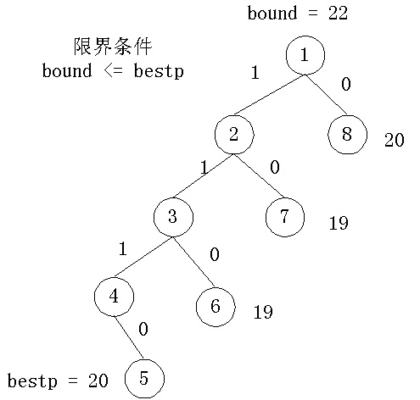
展开的部分状态空间树
在结点5处得到bestp=20；结点6处bound=19,故限界掉；类似，结点7，8也被限界掉
解为x=[1,1,1,0]，回到排序前为x=[1,0,1,1]

Slide 38
最大集团(Max clique)：相关概念
完全子图:令U为无向图G的顶点的子集，当且仅当对于U中的任意点u 和v，(u , v)是图G的一条边时，U定义了一个完全子图（complete subgraph）。子图的尺寸为图中顶点的数量。
集团(Clique):当且仅当一个完全子图不被包含在G的一个更大的完全子图中时，它是图G的一个集团。最大集团是具有最大尺寸的集团。
独立(顶点)集:无边相连的顶点集合且包含意义下最大的集合
最大独立集：顶点数最多的独立集合

Slide 39
Max clique: 示例
子集{ 1 , 2 }是尺寸为2的完全子图，但不是一个集团，它被包含在完全子图{ 1 , 2 , 5 }中
{ 1 , 2 , 5 }为一最大集团。点集{ 1 , 4 , 5 }和{ 2 , 3 , 5 }也是最大集团
{ 2 , 4 }定义了a的一个空子图，它也是该图的一个最大独立集
{ 1 , 2 }定义了b 的一个空子图，它不是独立集，因为它被包含在{ 1 , 2 , 5 }中
{2,3}和{1,2,5}是b 中图的独立集.{1,2,5}是最大独立集
1
2
3
4
5
a
1
2
3
4
5
b

Slide 40
Max clique：小结
G的集团是其补图的独立集，反之亦然
用于网络密集度分析
  电信网络
  生物信息网络
    蛋白质相互作用网络
    基因相互作用网络
两个问题都是NP－难度问题

Slide 41
Max clique： 回溯求解
最大集团问题的状态空间树：
  元组长度等于图的顶点数
  分量取值0/1：x_{i}=1表示顶点i在所考虑的集团中
  状态空间树类似0/1背包问题的状态空间树。
扩展：检查根节点到达一问题节点的路径上的部分元组是否构成图的一个完全子图。
限界：用当前集团的顶点数cn＋剩余顶点数≤bestn 进行限界

Slide 42
Max clique：程序实现（1）
void AdjacencyGraph::maxClique(int i)
{// Backtracking code to compute largest clique.
if (i > n) {// at leaf
// found a larger clique, update
for (int j = 1; j <= n; j++)
bestx[j] = x[j];
bestn = cn;
return;}
// see if vertex i connected to others
// in current clique
int OK = 1;
for (int j = 1; j < i; j++)
if (x[j] && a[i][j] == NoEdge
{
// i not connected to j
OK = 0;
break;
}
if (OK)
{// try x[i] = 1
x[i] = 1; // add i to clique
cn++;
maxClique(i+1);
x[i] = 0;
cn--;
}
if (cn + n - i > bestn)
{// try x[i] = 0
x[i] = 0;
maxClique(i+1);
}
}//end of maxClique

Slide 43
Max clique：程序实现（2）
int AdjacencyGraph::MaxClique(int v[])
{// Return size of largest clique.
// Return clique vertices in v[1:n].
// initialize for maxClique
x = new int [n+1];
cn = 0;
bestn = 0;
bestx = v;
// find max clique
maxClique(1);
delete [] x;
return bestn;
}

Slide 44
旅行商问题: Traveling Sales Problem
TSP起点无关性：前缀表示
TSP的状态空间树
  元组长度等于图的顶点数
  分量取值0/1：x_{i}表示第i个位置的节点号
  TSP的状态空间树是一置换（Permutation）树

Slide 45
TSP: 限界条件
(1) i-1级节点x[i-1]和它的子节点x[i]之间有边相连(!=NoEdge)
(2)设bestc为当前得到的最优解的成本值；路径x[1:i]的长度<bestc
若满足（1）（2） 则搜索继续向下进行；否则施行限界

Slide 46
TSP:算法实现（Preprocessor）
template<class T>
T AdjacencyWDigraph<T>::TSP(int v[])
{// Traveling salesperson by backtracking.
// Return cost of best tour, return tour in v[1:n].
// initialize for tSP
x = new int [n+1];
// x is identity permutation
for (int i = 1; i <= n; i++)
x[i] = i;
bestc = NoEdge;
bestx = v; // use array v to store best tour
cc = 0;
// search permutations of x[2:n]
tSP(2);
delete [] x;
return bestc;
}
x is used to hold path to current node
bestx is used to hold best tour found so far
cc is used to hold cost of partial tour at current node
bestc is used to hold the cost of best solution found so far

Slide 47
TSP:算法实现（recursive process）
template<class T>
void AdjacencyWDigraph<T>::tSP(int i)
{// Backtracking code for TSP
if (i == n) {// at parent of a leaf
// complete tour by adding last two edges
if (a[x[n-1]][x[n]] != NoEdge &&
a[x[n]][1] != NoEdge &&
(cc + a[x[n-1]][x[n]] + a[x[n]][1] < bestc ||
bestc == NoEdge)) {// better tour found
for (int j = 1; j <= n; j++)
bestx[j] = x[j];
bestc = cc + a[x[n-1]][x[n]] + a[x[n]][1];}
}
else {// try out subtrees
for (int j = i; j <= n; j++)
// is move to subtree labeled x[j] possible?
if (a[x[i-1]][x[j]] != NoEdge &&
(cc + a[x[i-1]][x[i]] < bestc ||
bestc == NoEdge)) {// yes
// search this subtree
Swap(x[i], x[j]);
cc += a[x[i-1]][x[i]];
tSP(i+1);
cc -= a[x[i-1]][x[i]];
Swap(x[i], x[j]);}
}
}

Slide 48
perm程序
// output all permutations of n elements
#include <iostream.h>
#include "swap.h"
template<class T>
void Perm(T list[], int k, int m)
{// Generate all permutations of list[k:m].
int i;
if (k == m) {// list[k:m] has one permutation, output it
for (i = 0; i <= m; i++)
cout << list[i];
cout << endl;
}
else // list[k:m] has more than one permutation
// generate these recursively
for (i = k; i <= m; i++) {
Swap(list[k], list[i]);
Perm(list, k+1, m);
Swap(list[k], list[i]);
}
}

