Slide 1
NP-完全问题(NP Complete Problem)
Thinking about Algorithms Abstractly
宫秀军
天津大学计算机科学与技术学院
gongxj@tju.edu.cn
Notes:
算法是指完成一个任务所需要的具体步骤和方法。也就是说给定初始状态或输入数据，经过计算机程序的有限次运算，能够得出所要求或期望的终止状态或输出数据。
算法常常含有重复的步骤和一些比较或逻辑判断。如果一个算法有缺陷，或不适合于某个问题，执行这个算法将不会解决这个问题。不同的算法可能用不同的时间、空间或效率来完成同样的任务。一个算法的优劣可以用空间复杂度与时间复杂度来衡量。

Slide 2
主要内容
NP-完全问题：一些典型的例子
NP-完全问题：相关定义
近似算法
两种新的计算模型

Slide 3
NP-Complete: 涵义
N-Nondeterministic
  Deterministic algorithm: Given a particular input, it will always produce the same correct output
  Non-deterministic algorithm: with one or more choice points where multiple different continuations are possible, without any specification of which one will be taken
P-Polynomial (time)
  Computable
  Polynomial time is assumed the lowest complexity
Complete
  Reducible
输入/输出
算法复杂性
变换/封闭性
Notes:
"A Turing machine is a finite-state machine associated with an external storage or memory medium." (Minsky (1967) p. 117)
"A Turing machine is essentially a finite-state sequential machine that has the ability to communicate with an external store of information"(Booth (1967), p. 354)
In complexity theory, the NP-complete problems are the most difficult problems in NP ("non-deterministic polynomial time") in the sense that they are the smallest subclass of NP that could conceivably remain outside of P, the class of deterministic polynomial-time problems. The reason is that a deterministic, polynomial-time solution to any NP-complete problem would also be a solution to every other problem in NP. The complexity class consisting of all NP-complete problems is sometimes referred to as NP-C. A more formal definition is given below.
One example of an NP-complete problem is the subset sum problem which is: given a finite set of integers, determine whether any non-empty subset of them sums to zero. A supposed answer is very easy to verify for correctness, but no one knows a significantly faster way to solve the problem than to try every single possible subset, which is very slow. Formal definition of NP-completeness
A decision problem C is NP-complete if it is complete for NP, meaning that:
it is in NP and
it is NP-hard, i.e. every other problem in NP is reducible to it.
"Reducible" here means that for every problem L, there is a polynomial-time many-one reduction, a deterministic algorithm which transforms instances l ∈ L into instances c ∈ C, such that the answer to c is YES if and only if the answer to l is YES. To prove that an NP problem A is in fact an NP-complete problem it is sufficient to show that an already known NP-complete problem reduces to A.
A consequence of this definition is that if we had a polynomial time algorithm for C, we could solve all problems in NP in polynomial time.
This definition was given by Stephen Cook in a paper entitled 'The complexity of theorem-proving procedures' on pages 151-158 of the Proceedings of the 3rd Annual ACM Symposium on Theory of Computing in 1971, though the term "NP-complete" did not appear anywhere in his paper. At that computer science conference, there was a fierce debate among the computer scientists about whether NP-complete problems could be solved in polynomial time on a deterministic Turing machine. John Hopcroft brought everyone at the conference to a consensus that the question of whether NP-complete problems are solvable in polynomial time should be put off to be solved at some later date, since nobody had any formal proofs for their claims one way or the other. This is known as the question of whether P=NP.
Nobody has yet been able to prove whether NP-complete problems are in fact solvable in polynomial time, making this one of the great unsolved problems of mathematics. The Clay Mathematics Institute in Cambridge, MA is offering a $1 million reward to anyone who has a formal proof that P=NP or that P≠NP.
At first it seems rather surprising that NP-complete problems should even exist, but in the celebrated Cook-Levin theorem (independently proved by Leonid Levin), Cook proved that the Boolean satisfiability problem is NP-complete (a simpler, but still highly technical proof of this is available). In 1972 Richard Karp proved that several other problems were also NP-complete (see Karp's 21 NP-complete problems); thus there is a class of NP-complete problems (besides the Boolean satisfiability problem). Since Cook's original results, thousands of other problems have been shown to be NP-complete by reductions from other problems previously shown to be NP-complete; many of these problems are collected in Garey and Johnson's 1979 book Computers and Intractability: A Guide to NP-Completeness.
A problem satisfying condition 2 but not necessarily condition 1 is said to be NP-hard. Informally, an NP-hard problem is "at least as hard as" any NP-complete problem, and perhaps harder. For example, choosing the perfect move in certain board games on an arbitrarily large board is NP-hard or even strictly harder than the NP-complete problems.

Slide 4
NP-C:典型的问题（1）
问题1 图着色问题
  判定问题：是否存在不超过k种颜色的着色方案?
  优化问题：求图的最小着色数和着色方案
问题2 作业调度问题
  判定问题：是否存在罚款额不超过k的作业调度?
  优化问题：求最小罚款额调度
Notes:
In the theory of computation, a nondeterministic algorithm is an algorithm with one or more choice points where multiple different continuations are possible, without any specification of which one will be taken. A particular execution of such an algorithm picks a choice whenever such a point is reached. Thus, different execution paths of the algorithm arise when it is applied to the same input / initial state, and these paths, when they terminate, generally produce different output / end in different final states.
Deterministic algorithm
In computer science, a deterministic algorithm is an algorithm which, in informal terms, behaves predictably. Given a particular input, it will always produce the same correct output, and the underlying machine will always pass through the same sequence of states. Deterministic algorithms are by far the most studied and familiar kind of algorithm, as well as one of the most practical, since they can be run on real machines efficiently.
One simple model for deterministic algorithms is the mathematical function; just as a function always produces the same output given a certain input, so do deterministic algorithms. The difference is that algorithms describe precisely how the output is obtained from the input, whereas abstract functions may be defined implicitly.

Slide 5
NP-C:典型的问题（2）
问题3 Bin packing问题：假设有n种物品，它们的尺寸分别为s₁,…,s_{n}，0<s_{i}≤1另有任意多个箱子(Bins)，箱子的容量为1，
  判定问题：任意给定k，是否存在一种装箱方法使用的箱子数≤k？
  优化问题：求使用最小箱数的装箱方法

Slide 6
NP-C:典型的问题（3）
问题4 背包问题
  判定问题：是否存在效益值至少为k的可行子集?
  优化问题
问题5 子集和数问题s₁,s₂,┅,s_{n},C
  判定问题：是否存在和数等于C的子集?
  优化问题：求≤C的最大子集和数.
  可归约为背包问题: p_{i}=w_{i}.

Slide 7
NP-C:典型的问题（3）
问题6 CNF(合取范式)-可满足问题(SAT)
  判定问题：是否存在真假赋值使得该CNF为真.合取范式例:
问题7 Hamiltonian 回路
  判定问题
问题8 TSP(旅行商)问题
  判定问题：任意给定一整数k，是否存在一长度不超过k的Hamiltonian回路？
  优化问题
Notes:
CNF： Conjunctive normal form
CNF Satisfiability

Slide 8
NP-C:典型的问题（4）
问题9:节点覆盖:无向图中的每一条边都被某些节点关联
  判定问题：给定无向图G和正整数k,是否存在一k节点覆盖.
  优化问题：最小节点覆盖
问题10: 给定一无向图G, k-独立集;最大独立集.
问题11: 给定一无向图G , k-集团;最大集团.
问题10和11可互相转化: 边互补图
目标函数取整数值时,优化值问题和判定问题等价我们可用二分查找从判定问题解得到优化值的问题的解

Slide 9
类P与类NP
（Class P & Class NP）

Slide 10
类P(1)
算法输入为问题实例的二进制编码. 定义该0/1字符串的长度为输入长度. 例如n个节点和m条边的图的长度为Θ(mlogn)(见图13.1).
多项式界:如一算法的最坏情形时间复杂度T(n)=O(p(n)),其中p(n)为输入长度n 的多项式, 则称该算法有多项式界.
如一个问题有多项式界的算法,则称该问题有多项式界.

Slide 11
类P(2)
类P的定义
  一个算法解决判定问题指: 对该判定问题的yes实例, 算法要停机并给出yes回答.对no实例算法要停机并给出no的回答.
  具有多项式界的判定问题组成的类称为类P.
  多项式的相加,相乘及复合仍为多项式; 所以一个有多项式界的算法调用另一有多项式界的算法构成的算法仍有多项式界.

Slide 12
类NP
Non-deterministic--不确定的算法：对给定输入字符串w,
1. Guessing
不确定地写一个称为”certificate” (guessed 解)的字符串c .
c 实际上是可行解的一种表示; 例如, 表示背包问题的n元组, 表示图的字符串或邻接矩阵.
2. checking
使用一确定的有多项式界的算法验证c是否为问题的答案. 如果是给出yes, 反之, 不回答.
Polynomial--多项式界: 写c 和验证的时间为O(q(|w|)), q( )为某一多项式, w为输入长度.

Slide 13
不确定的算法:伪代码
Void nondetA(String input)
String s=genCertif();
boolean checkOK=verifyA(input,s)
if (checkOK)
Output “yes“
return
checOK为false时不作反应.

Slide 14
类NP：几点说明
“不确定” 指:对同一输入w, 算法使用任意多个不同的c ,进行验证. 对不同c 的这些计算,可以看作是同时进行的.
一个不确定算法解决判定问题指:对输入w, 如果它有解, 不确定算法一定会写出一个c ,使得验证阶段能通过, 并返回一个yes回答.
如果一个判定问题有不确定的多项式界的算法则称它属于类NP.

Slide 15
图着色问题
Input: (着色数)k, (节点数)5 ,(图的边) (1,2)(1,4)...
Guessing 指写出长度为n(节点数)的字符串,例如,RGRBG, RGRB, RBYGO, RGRBY, R%*$@等.至少有k^{n}个“guessings”.
Checking 指检查一guessed字符串是否合法及是否是一个k-着色.
如果写字符串的时间是O(p₁(n)),checking时间是O(p₂(n));而且p₁(n), p₂(n)是n的多项式(从而也是输入长度的多项式),则该不确定算法有多项式界.
如果输入的图能k着色则不确定算法停机并给出yes回答.
1
2
4
3
5

Slide 16
P=NP?
类NP：由不确定的多项式界算法的判定问题构成的类称为类NP。
P=NP?是计算机科学中最大的问题之一

Slide 17
输入尺寸（the size of input）(1)
是否存在j, k>1使得n= jk?即n 是否为一合数?
factor=0;
for (j=2;j<n;j++)
if ((n mod j)==0)
factor=j;
break;
return factor
(n mod j)计算时间为Θ(log²n)(bit级运算).
算法的复杂度为Θ(nlog²n).但n是输入长度m=log₂n 的指数函数.所以它是指数复杂度算法.
Manindra Agrawal 等证明了: ”n是否为一素数?” 属于P
  Manindra Agrawal, Neeraj Kayal, Nitin Saxena, "PRIMES is in P", Annals of Mathematics 160 (2004), no. 2, pp. 781–793.

Slide 18
The size of input (2)
背包问题输入长度m为
m=Θ(log₂n+log₂c+Σlog₂p_{i}+ Σlog₂w_{i})
假定p_{i}=O(c) w_{i}=O(c),则m=O(nlog₂c)
Θ(nc)不能以m的多项式加以限界, 即
nc=O(m^{k})
不成立, 因为nc/(nlog₂c)^{k}→∞(c→∞), 对所有常数k.
除了涉及数的计算外, 以前我们分析的多项式复杂度算法,在以字符串为输入时,仍是多项式复杂度算法.

Slide 19
多项式约化
问题P 可多项式地约化为问题Q ,如果
  存在一个有多项式界的确定性算法T,使得：
    对每个输入字符串x, T产生一字符串T(x).
    x是P的合法输入且P对x有yes答案当且仅当T(x) 是Q的合法输入且有yes答案
证明多项式约化关键在“当且仅当”
问题 P 可多项式地约化为 Q, 表示为：P ≤_{p}Q
x
T
T(x)
P
Q
Yes / no answer

Slide 20
多项式约化
定理13.3 If P ≤_{p}Q且Q在P中则P也在P中
  存在解Q的算法有多项式界q,
  设T的复杂度为多项式p.则T(x)的长度O(p(|x|))
  对输入T(x)所需时间为O(q(p(|x|)))
  解P的复杂度为O(p(|x|)+q(p(|x|)))
可约化的意义:Q至少和P一样“难”
约化关系有传递性
Notes:
L, the class of problems decidable in a logarithmic amount of memory space
AL： the set of problems solvable in logarithmic memory by alternating Turing machines
PSPACE, the class of problems decidable in polynomial space
EXPTIME is the class of problems solvable in exponential time

Slide 21
子集和数可约化为调度问题
多项式变换
  子集和数问题的实例:
s₁,s₂,┅,s_{n},C;假定S=∑_{1≤i≤n}s_{i}>C
  对应调度问题实例
p_{i}=t_{i}=s_{i} ,d_{i}=C, k=S-C
if部分:子集和数有解则调度问题有解
only if:假定上述调度问题有罚款额≤k的解
  该可行调度的执行时间t_{i}之和≤C(可行性)
  又因t_{i}=p_{i}=s_{i},所以该可行调度对应罚款额=S-Σp_{i} =S-Σt_{i}≥S-C=k
  所以其罚款额＝k，而且被调度的作业的时间之和＝C

Slide 22
NP-难度和NP-完全问题
问题Q是NP-难度问题，如果：
  每个NP问题都可多项式地约化为问题 Q.
问题 Q 是 NP-完全问题. 如果:
  它是NP问题, 同时它还是NP-难度问题.
NP-完全问题的性质
  所有NP-完全问题,相对于多项式约化关系,是自反,对称,传递的,即构成一个闭类.
  如果能找到一个NP完全问题的多项式算法则P=NP
  有NP-难度问题但不知它是否在NP类内(第k_{th}重子集问题)

Slide 23
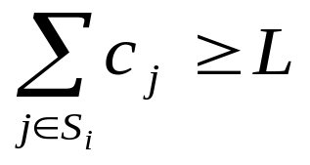
Problems-unknown in NP
K_{th}重子集问题:任给定n+2 个正整数 c₁,┅c_{n}, k, L; 是否存在{1,2,┅,n} 的k 个不同子集S₁,┅S_{k} 使得对所有i=1,┅,k 有
Σ部分称为子集的重量, 重量排序第k的子集.
当k=2^{n-1}时,表示可行解的字符串的长度有指数的长度.我们不知道该问题是否在NP中.
图G的最大集团的节点数是否=k? 上述问题是否在NP?也是未知的! (验证最大集团,不能在多项式时间内做到)

Slide 24
CNF-satisfiablity问题是NP-完全问题
定理13.5 CNF-satisfiablity问题是NP-完全问题
这是著名的Cook定理
Cook 定理的推论:如果CNF-可满足问题有多项式界的算法，则P=NP.

Slide 25
NP-完全问题证明
证明问题Q是NP-完全问题的步骤：
(1)选择一已知的NP-完全问题P。
  (2)证明P可多项式的约化为 Q
背包问题属于NP＝>子集和数属于NP
子集和数问题属于NP＝>调度问题属于NP
不计其数的这种推导.

Slide 26
Lists of NP-Complete problems
Boolean satisfiability problem (SAT)
N-puzzle
Knapsack problem
Hamiltonian path problem
Traveling salesman problem
Subgraph isomorphism problem
Subset sum problem
Clique problem
Vertex cover problem
Independent set problem
Graph coloring problem

Slide 27
What makes a problem hard(1)
限定问题的一般性（问题的附加限制）
  实际应用中有特殊性, 有可能找到多项式算法
    例：Hamiltonian回路顶点度<=2时，Hamiltonian回路问题有多项式算法
  工程中有灵活性,以某种方式优化是NP-难度问题;但以另一方式提出问题可能不是(优化标准)
了解“难问题”的特点

Slide 28
What makes a problem hard(2)
3-满足问题仍为NP-完全问题,但2-满足问题有多项式算法
集团问题,当顶点度<=常数d时属于类P
平面图集团问题属于类P，因为平面图至多有4-集团
实际有意义的做法是提出合理的限制条件和求近似解, 研究启发式算法.

Slide 29
优化问题和判定问题
3种问题
  判定问题
  求优化值问题
  求优化解问题
优化问题至少与判定问题一样“难”
  优化值问题有多项式算法，则判定问题有多项式算法
  多数情况下，如果能在多项式时间内求解决策问题，那么也能在多项式时间内获得最优值（图着色问题）；有时则不能（TSP）

Slide 30
近似算法（1）
返回次优解的算法。这种算法经常可以通过启发式方法得到，例如：贪心法。
近似算法必须是多项式时间算法。
为量度近似解对优化解的近似程度定义以下术语
  FS(I) 是输入I的可行解集。
  Val(I,x):实例I的可行解x的目标函数值
  opt(I):实例I的优化解的值

Slide 31
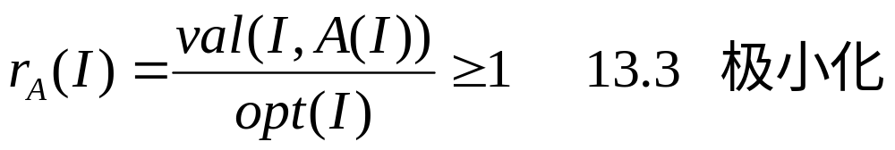
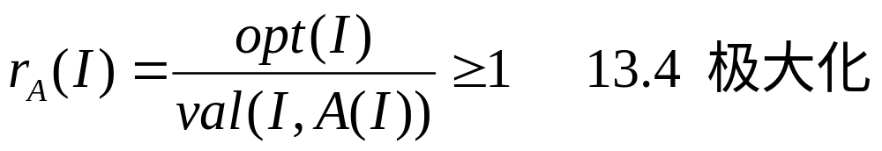
近似算法（2）
设A为一近似算法,令A(I)为输入I时该算法输出的可行解
极小化和极大化问题度量近似性能的指标r_{A}(I)

Slide 32
续
式(13.5)定义的R_{A}(m)为最坏情形rA(I)的值,是与输入I无关的指标: 在固定优化值m下求最坏情形的比值
式(13.6)定义的S_{A}(n)也是一与输入独立的指标

Slide 33
Bin-Packing的近似算法
怎么装不同大小、不同形状的货物才能使占用的箱子数最少。该问题形式化如下：
装箱问题
  设S = (s₁, …, s_{n})
    0 < s_{i} <= 1 ， 1 <= i <= n
  将 s₁, …, s_{n} 装入尽可能少的箱子里。假定每个箱子都有容量1。
装箱问题是NP-难度问题
  搜索算法有指数的复杂度：须试所有可能的S的分划。

Slide 34
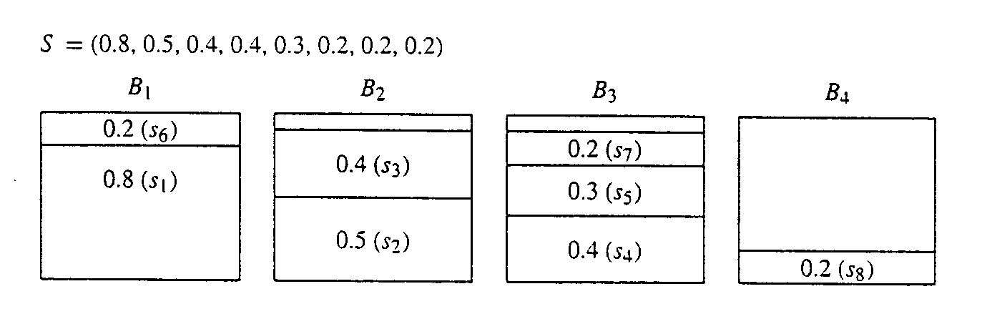
装箱问题：FFD算法（贪心法）
将物品按尺寸递减排序，箱子从左到右排列并尽可能放在前面的箱子里。
算法的时间复杂度t(n)=θ(n²)

Slide 35
算法：装箱问题
输入: S=(s_{1,….,}s_{n}) ，0<s_{i}≤1 ，1≤i≤n. S 代表货物1,...,n 的尺寸，每个箱子的容量都是1.0。
输出: bin[i]是放物品i的箱子号,1≤i≤n. 为了使算法简单，在装箱前，货物已经按尺寸从大到小排序。

Slide 36
装箱问题的程序
binpackFFd(S,n,bin)
{
float[] used=new float[n+1];
//used[j] 是箱子j已经使用的空间
int i,j;
// used[j] 初始为0，S已按降序排列s₁>=S₂>=…>=S_{n.}
for(i=1;i<=n;i++)
{//寻找能装下 s[i] 的箱子.
for(j=1;j<=n;j++)
{if(used[j]+s_{i}<+1.0)
//+1.0， 每个箱子的容量都是1.0
bin[i]=j;
used[j] += s_{i};
break; //装完退出循环j,装下一个箱子，继续循环i.
}
}
}

Slide 37
近似分析
引理13.9 :设S为算法的输入.令opt(S)为优化的装箱数.令i为第一个被FFD算法装入第opt(S)+1号箱子的物品,则s_{i}<＝1/3
证明:(反证法)
假设 s_{i}>1/3, 则FFD算法在装到s_{i} 时, 前面的箱子的不会如图13.7的情形. 产生的装箱情况如图13.8.(k≥0):
k个箱子只放一个物品; opt-k个箱子放2个size>1/3的物品.

Slide 38
近似分析
FFD算法没把物品k+1,…,i -1放在前k个箱子内(放不下), 这些物品的数目为2(opt-k)
尽管优化解的装箱情况和FFD不同, 但前k个物品在优化解中也必须分放在k个箱子里: 前k个物品中任2个都不能放在一个箱子内.
优化解中物品k+1,…,i-1,放在其余的opt-k个箱子内. 因为这些物品的尺寸均>1/3. 所以这些箱子中每个箱子都要放2个, 尽管放法和FFD不一定相同.
因此 s_{i} 在优化解中无法安排,矛盾.

Slide 39
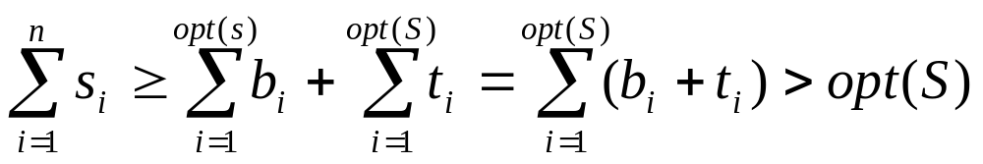
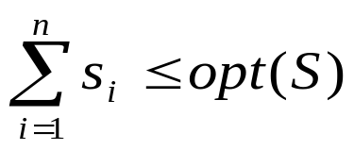
近似分析
引理13.10 :FFD在前opt(S)箱子装不下的物品数量至多为opt(S)-1
反证法:如有opt(S)个物品放在多用的箱内,则有:
但
其中b_{i}为装在第i个箱子内物品的总量;t_{i}为前opt箱子装不下的物品的重量;按FFD算法后者不能装入第i个箱子.所有b_{i}+t_{i}>1.
定理13.11 R_{FFD}(m)<=(4/3)+(1/3m);
S_{FFD}(n)<=3/2

Slide 40

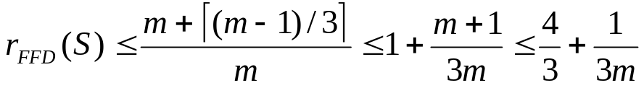
近似分析
FFD至多有m-1个物品放在extra箱子内,放的物品size<=1/3,所以FFD多用的箱子数不超过
更强的结果为R_{FFD}(m)≤11/9+4/m
对任意大的m有例子证明R_{FFD}≥11/9,即
最坏情形22％的误差(较优化解多用的箱数)是紧上界(tight bound)

Slide 41
Best Fit, Next Fit Heuristics
Best Fit :尺寸s的物品放入满足条件used[j]+s≤1,且used[j]最大的箱内
当物品按尺寸s的非增顺序排列时Best Fit 策略和FFD产生的装箱方法差不多相同
Next Fit :物品不排序,所以可用于在线应用;如果下一物品不能放入当前使用的箱子,则使用一个新箱子
Next Fit 至多用2opt(S)个箱子:产生的方案中相邻的2个箱子装入的物品尺寸>1.

Slide 42
背包和子集和数问题
当所有p_{i}=s_{i}时，背包问题转化为子集和
数的优化问题
算法13.2为上述简化的背包问题的近似算法sKnap_{k}，类似k－优化的背包问题的贪心算法。
定理13.13 R_{sKnapk} (m)和S_{sKnapk}(n)均<=1+1/k

Slide 43
续
定理13.13证明要点：设T是优化解中k个重量最大的物品构成的子集, k-优化算法考虑过先装这k 种物品的情形; 设 j是优化解中第一个未被贪心法在这种情形加入T中的物品的下标.
Opt(I)=m>=k个最重的重量之和+S_{j}>=(k+1)S_{j} ,所以S_{j} <=m/(k+1)
因S_{j} 被贪心法拒绝，所以 Val(sKnapk(I))+S_{j}>C>=m ,所以
Val(sKnap_{k}(I))>m-S_{j}>=m-(m/(k+1))
=mk/(k+1)
r(I)=m/Val<(k+1)/k=1+1/k

Slide 44
图着色
算法13.3
for (i=1;i≤n;i++)
for (c=1;c≤n;c++)
{如没有与v_{i} 相邻的顶点有着色c ,对 v_{i} 着色c 并break;}
Fig.13.11 如按先a类顶点后b类顶点着色算法13.3只需2种颜色;如交叉进行则需k种颜色
R_{SC}(2)=∞;S_{SC}(n)≥n/4 (k=n/2,opt=2)

Slide 45
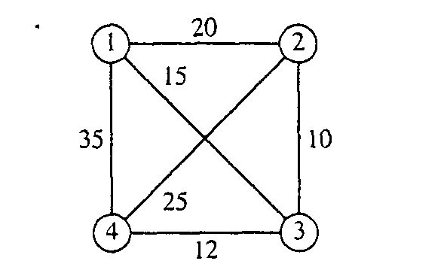
旅行商问题
  给定一个带权重的完全图
  找具有最小权重的周游路线（通过所有顶点的环）。

Slide 46
旅行商问题的近似算法
最近邻居策略
  NearestTSP(V, E, W)
  选择任一顶点s作为周游路线C的起点
  v = s;
  While 有顶点不再C中:
    {选择有最小权重的边vw，其中 w 不在C中.
    将边vw加入C中;
    v = w;}
  将边vs加入C.
  return C;
时间复杂度t(n) = O(n²)
    n 是顶点的数量

Slide 47
续
最短链路策略:与C中边不构成环路且不构成与v或w伴随的第3条边(无向图)最小权值边(v,w)
上述两个算法都不保证产生优化解，而且对其近似程度也不能给出界
定理13.22 设A是TSP问题的近似算法，如对任何输入I有r_{A}(I)<=c，则P＝NP
从该定理可看出TSP的难度

Slide 48
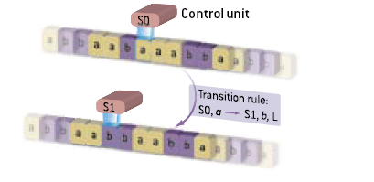
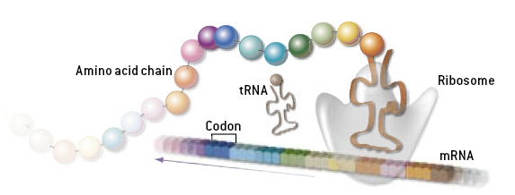
DNA Computer
TURING MACHINE
Origin from similarity with Turing-computing
  Codes: (0,1)→(A,T,G,C)
  Operator: (and,or, not)→(copy, cut, paste)
  Initiated by Leonard Adleman for solving Hamiltonian path problem in 1994.
  Increasing performance (faster, tiny), but not reducing the computational complexity
Capability
  Highly parallel
  Huge Volume of storage
Main bottleneck
  Materials
DNA MACHINE
--- Shapiro E, Benenson Y (2006) Bringing DNA Computers to Life. Scientific American,

Slide 49
Quantum Computer
Motivation
  Moore’s Law: We hit the quantum level 2010~2020.
  Quantum computation is more powerful than classical computation.
  More can be computed in less time—the complexity classes are different!
A computation model based on quantum principles of physics(The physical universe is irreducibly random)
Storage capability
  Conventional bits hold flat binary data (0 or 1)
  Quantum Bits (Qubits) hold probabilities of values (superposition)
Power of Quantum Parallelism
  A single operation applies to all superpositions at once
  All possible results of an operation are retrieved
  Shor's Algorithm - quantum computing algorithm to actually factor large numbers in polynomial time.
Notes:
A quantum computer is any device for computation that makes direct use of distinctively quantum mechanical phenomena, such as superposition and entanglement, to perform operations on data. In a classical (or conventional) computer, the amount of data is measured by bits; in a quantum computer, the data is measured by qubits. The basic principle of quantum computation is that the quantum properties of particles can be used to represent and structure data, and that quantum mechanisms can be devised and built to perform operations with these data.[1]
Though quantum computing is still in its infancy, experiments have been carried out in which quantum computational operations were executed on a very small number of qubits. Research in both theoretical and practical areas continues at a frantic pace, and many national government and military funding agencies support quantum computing research to develop quantum computers for both civilian and national security purposes, such as cryptanalysis.[2] (See Timeline of quantum computing for details on current and past progress.)

