Slide 1

JSON and REST
The New Kids on the Data Block

Slide 2
REST
What does it stand for?:
Representational State Transfer
What Is it?
A style of software architecture for distributed systems
Who/Where/When?
Came about in 2000 doctoral dissertation of Roy Fielding – but it’s been used for much longer

Slide 3
REST – Core Principal
Resources: Data, files, methods
Where: URL based
How: HTTP
What: Up to you

Slide 4
REST – Where/How: Simple Example
Premise:
Data in a table could be a resource we want to read
Database server called bbddb01
Database called northwind
Table called users
http://bbddb01/northwind/users

Slide 5
What, What, What?
What type of content you return is up to you.
Compare to SOAP where you must return XML.
Most common are XML or JSON. You could return complex types like a picture.

Slide 6

REST – Is it used?
Web sites are RESTful
RSS is RESTful
Twitter, Flickr and Amazon expose data using REST
Some things are “accidentally RESTful” in that they offer limited support.

Slide 7

Real Life: Flickr API
Resource: Photos
Where:
http://farm{farm-id}.static.flickr.com/{server-id}/{id}_{secret}.jpg
http://farm{farm-id}.static.flickr.com/{server-id}/{id}_{secret}_[mstb].jpg
http://farm{farm-id}.static.flickr.com/{server-id}/{id}_{o-secret}_o.(jpg|gif|png)
What: JPEG, GIF or PNG (defined in the URL)
http://farm1.static.flickr.com/2/1418878_1e92283336_m.jpg

Slide 8
REST – Methods
HTTP Methods are a key corner stone in REST.
They define the action to be taken with a URL.
Proper RESTful services expose all four – “accidental” expose less.
Nothing stopping you doing some Mix & Match
Some URL’s offering all of them and others a limited set
What are the four methods and what should they do?
REST | CRUD (Create, Read, Update, Delete)
POST | Create
GET | Read
PUT | Update or Create
DELETE | Delete

Slide 9
REST – Methods Example
http://bbddb01/northwind/users[firstname=“rob%”]
+ POST = Error
+ GET = Returns everyone who begins with rob
+ PUT = Error
+ DELETE = Deletes everyone who begins with rob
http://bbddb01/northwind/users
& we add some input data
+ POST = Creates a new user
+ GET = Returns everyone who meets criteria
+ PUT = Creates/Updates a user (based on data)
+ DELETE = Deletes everyone who meets criteria

Slide 10
REST – Methods Example
http://bbddb01/northwind/users[firstname=“rob%”]
+ POST = Error
+ PUT = Error
What would the error be?
HTTP 400 or 500 errors are normally used to indicate problems – same as websites

Slide 11
REST – Commands
You can associate commands with a resource.
Commands can replace the need for using HTTP methods and can provide a more familiar way of dealing with data.
Example:
userResource = new Resource('http://example.com/users/001') userResource.delete()

Slide 12

FIGHT: REST vs. SOAP
Comparing apples and oranges

Slide 13
REST vs. SOAP – pt I: Technology
REST | SOAP
A STYLE | A Standard
Proper REST: Transport must be HTTP/HTTPS | Normally transport is HTTP/HTTPS but can be something else
Response data is normally transmitted as XML, can be something else. On average the lighter of the two as does not have SOAP header overhead | Response data is transmitted as XML
Request is transmitted as URI Exceptionally light compared to web services Limit on how long it can be Can use input fields | Request is transmitted as XML
Analysis of method and URI indicate intent | Must analyse message payload to understand intent
… | WS* initiatives to improve problems like compression or security

Slide 14
REST vs. SOAP – pt II: Languages
REST | SOAP
Easy to be called from JavaScript | JavaScript can call SOAP but it is hard, and not very elegant.
If JSON is returned it is very powerful (keep this in mind) | JavaScript parsing XML is slow and the methods differ from browser to browser.
C# (Visual Studio) parsing of REST means using HttpWebRequest and parsing the results (string/xml) or normal service consumption (.NET 3.5 SP 1 and later). | C# (Visual Studio) makes consuming SOAP very easy and provides nice object models to work with.
C# version 4 should make this easier thanks to new dynamic methods. | ...
There are 3rd party add-on’s for parsing JSON with C# so that may make it easier. | ...

Slide 15
REST vs. SOAP – pt III: Tools
REST | SOAP
Basic support for REST in BizTalk | BizTalk and SOAP are made to be together.
WCF can consume REST. | WCF can consume SOAP.
WCF can serve REST with a bit of tweaking. | WCF can server SOAP.
The new routing feature in ASP.NET 3.5 SP1 makes building a RESTful service easy. | ...

Slide 16
FAQ about Security?
Are RESTful services secure?
It’s a style, not a technology so that depends on how you implement it.
Are you open to SQL injection attacks?
When you look at http://bbddb01/northwind/users[firstname=“rob%”], you may think so but you shouldn’t be. Because:
The parameter shouldn’t be SQL
If it is SQL, why are you not filtering it?
Remember the old rule: Do not trust user input

Slide 17
FAQ about Security?
How can I do authentication?
It’s built on HTTP, so everything you have for authentication in HTTP is available
PLUS
You could encode your authentication requirements into the input fields

Slide 18

Building a RESTful database with ADO.NET Data Services
DEMO
Notes:
Start up Visual Studio 2008
Create web site new project
Add a new ADO.NET entity data model item – generate from database, select space data, select agencies tables
Add new ADO.NET Data service – call it astro
First line should be: DataService<SpaceDataEntities>
Set access to: config.SetEntitySetAccessRule("*", EntitySetRights.AllRead);
Run – show them content is provided in XML (ATOM format). Go to: http://localhost:6539/Astro.svc/Agencies (note feed reading view)
Turn off feed reading view and restart and go to agencies
Now show http://localhost:6539/Astro.svc/Agencies(1) to generate an error
Demo links:
http://localhost:6539/Astro.svc/Agencies?$top=2
http://localhost:6539/Astro.svc/Agencies?$top=2&$skip=2
Grab the direct url to one of them, should be like: http://localhost:6539/Astro.svc/Agencies(guid'bfda451e-ecfb-46d0-b889-2da55b35522b')
http://localhost:6539/Astro.svc/Agencies?$filter=Name eq 'NASA‘
http://localhost:6539/Astro.svc/Agencies?$orderby=Name
Start a second instance of visual studio and create a new console application
Right click, Add service reference and point it to the http://localhost:6539/Astro.svc/
In the console app add: ServiceReference1.SpaceDataEntities spaceData = new ConsoleApplication1.ServiceReference1.SpaceDataEntities(new Uri("http://localhost:6539/Astro.svc/"));
Point out the AddToAgencies method
Also point out the static method: ServiceReference1.Agencies.CreateAgencies()
Now add the following code and run it:
var agencies = from a in spaceData.CreateQuery<ServiceReference1.Agencies>("Agencies")
select a;
foreach (var item in agencies)
{
Console.WriteLine(item.Name);
}
Console.ReadKey();

Slide 19
JSON – What is it?
“JSON (JavaScript Object Notation) is a lightweight data-interchange format. It is easy for humans to read and write. It is easy for machines to parse and generate” – JSON.org
Importantly: JSON is a subset of JavaScript

Slide 20
JSON – What does it look like?
{
"firstName": "John",
"lastName": "Smith",
"address": {
"streetAddress": "21 2nd Street",
"city": "New York",
"state": "NY",
"postalCode": 10021
},
"phoneNumbers": [
"212 555-1234",
"646 555-4567"
]
}
Name/Value Pairs
Child properties
String Array
Number data type

Slide 21
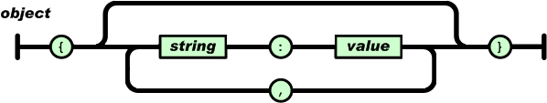
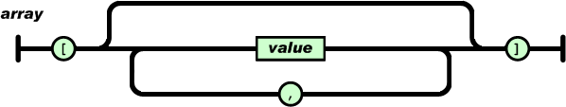
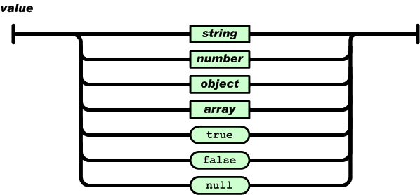
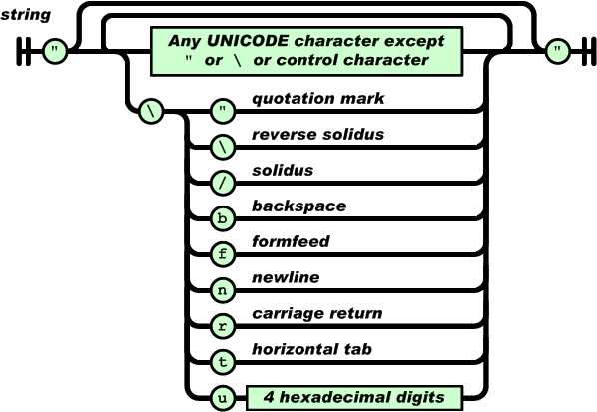
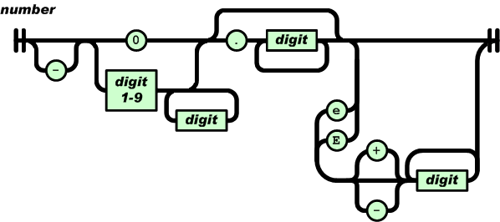
JSON Data Structures
Notes:
Point out that DateTime are missing! Some implementations are putting in dates in DateTime string while others using number to represent milliseconds since epoch

Slide 22

JSON Basics
Demo
Notes:
Open JSON1 Demo.html
Show the code/html
Close it and run it.

Slide 23

ADO.NET Data Services & JSON
Demo
Notes:
Start the web app from before
Now run Fiddler (turn off capture F12 if needed)
Go to the request builder tab and request – click Execute
Double click the result and show the XML view
Go back to the request builder and add the following header: Accept: application/json – click Execute
Double click the result and show the text view
Next stop add the jQuery.js file and json2.html file to the web solution, update the URL and run it to show json parsing

Slide 24

More on jQuery?
What: jQuery TR
Who: Rein
Where: BB&D Collab
When: 20th May 2009

Slide 25

FIGHT: JSON vs XML
Aren’t they the same?

Slide 26
JSON vs. XML
JSON | XML
Data Structure | Data Structure
No validation system | XSD
No namespaces | Has namespaces (can use multiples)
Parsing is just an eval Fast Security issues | Parsing requires XML document parsing using things like XPath
In JavaScript you can work with objects – runtime evaluation of types | In JavaScript you can work with strings – may require additional parsing
Security: Eval() means that if the source is not trusted anything could be put into it. Libraries exist to make parsing safe(r) | Security: XML is text/parsing – not code execution.

Slide 27
JSON vs. XML which to use?
Scenario 1: You have a website (say Twitter.com) and you want to expose a public API to build apps.
Issue | JSON | XML
The public will be parsing data in. You must make it secure. | Run checks against the data in the object to make sure it’s secure. You are working on objects so you must also check for potential code access issues. | Run checks against the data to make sure it’s secure.
Data must be in a specific format. | Build something that parses the objects. | XML Schema

Slide 28
JSON vs. XML which to use?
Scenario 2: You have a website (say gmail.com) and your front end needs to show entries from a mailbox, but needs to be dynamic and so you will use a lot of JavaScript.
Issue | JSON | XML
Your in house developers know objects and would like to use them. | JSON is JavaScript objects. | Write JavaScript to parse the XML to objects.
The site is secure but you worry about people checking the page source. | You page has JavaScript in it and (maybe) code which communicates with a private backend server. No major issues. | You page has JavaScript in it and (maybe) code which communicates with a private backend server. No major issues.

Slide 29
JSON vs. XML
Which of them should you use?
Use Both – They both have strengths and weaknesses and you need to identify when one is stronger than the other.

