Slide 1
PORT Figures
Thomas McGregor

Slide 2
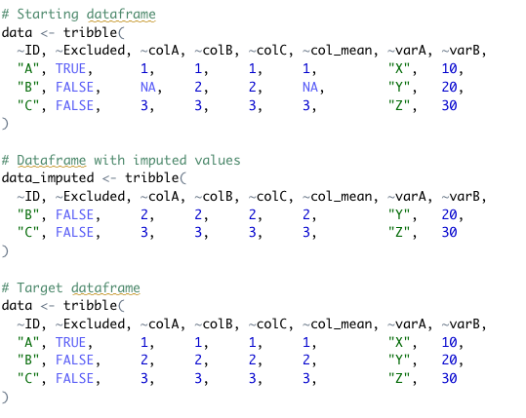
If col_mean is missing…
Use values from
imputed dataframe…
And replace them in
the original dataframe

