Slide 1
Database Deep Dive
- Rockbuster -
by Julian Hempe

Slide 2
Agenda
Goal of the analysis
Descriptive statistics for film table
Descriptive statistics for customer table
Top 10 countries for Rockbuster in term of customer numbers
Top 10 cities within the top 10 countries
Top 5 customers in the top 10 cities who have paid the highest total amounts to Rockbuster
Recommendations

Slide 3
Goal of the analysis
The goal of my analysis is to really understand where our customers live and on which countries we should focus to increase our profits

Slide 4
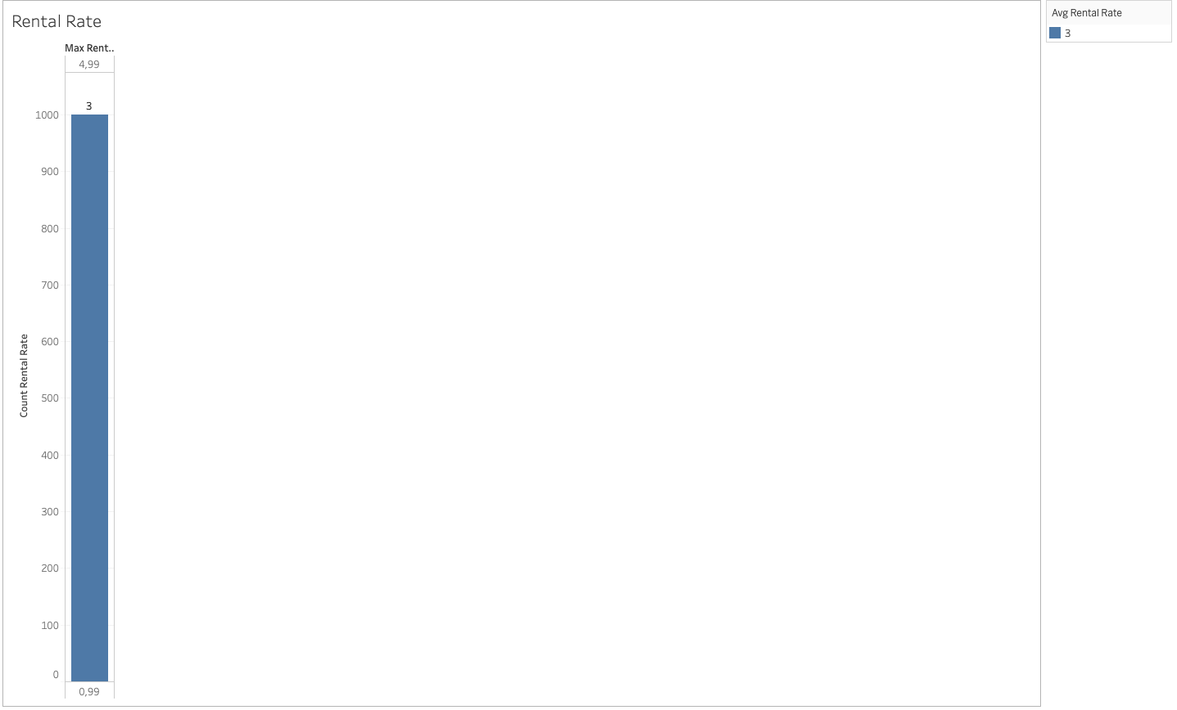
Descriptive statistics for film table
Tableau Link

Slide 5
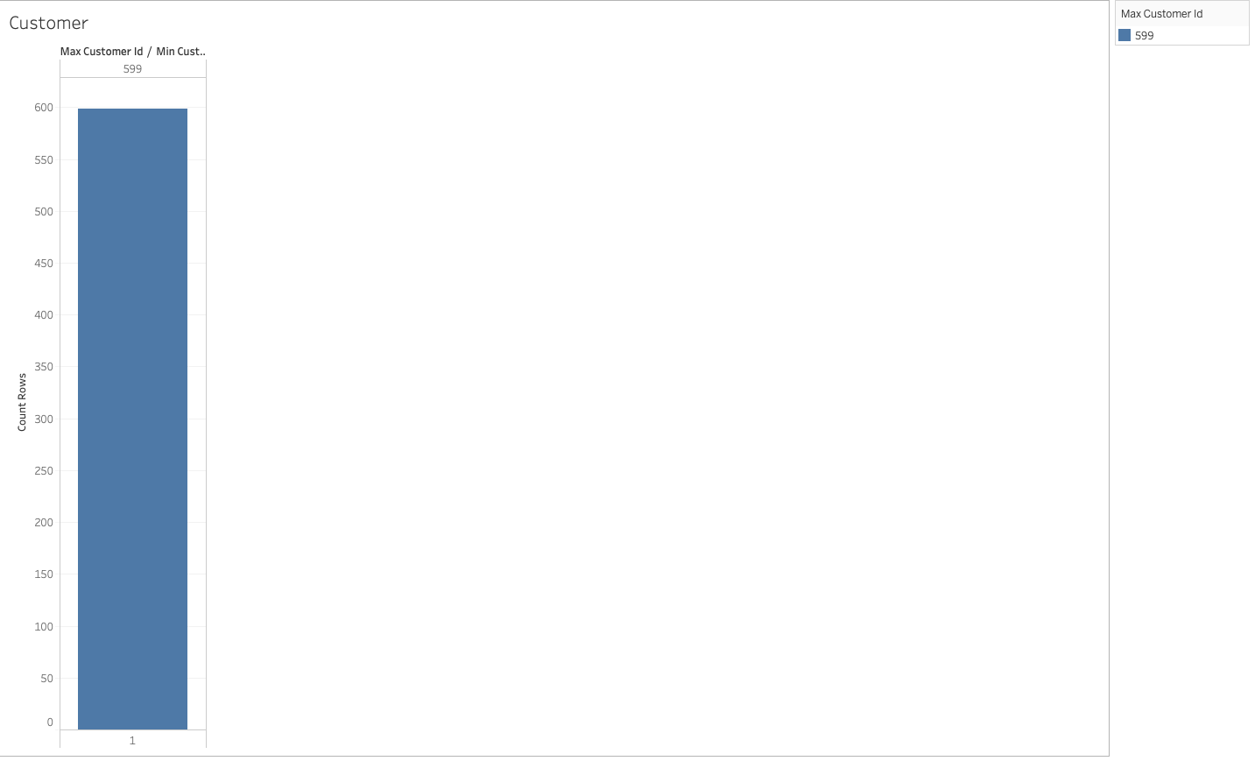
Descriptive statistics for customer table
Tableau Link

Slide 6
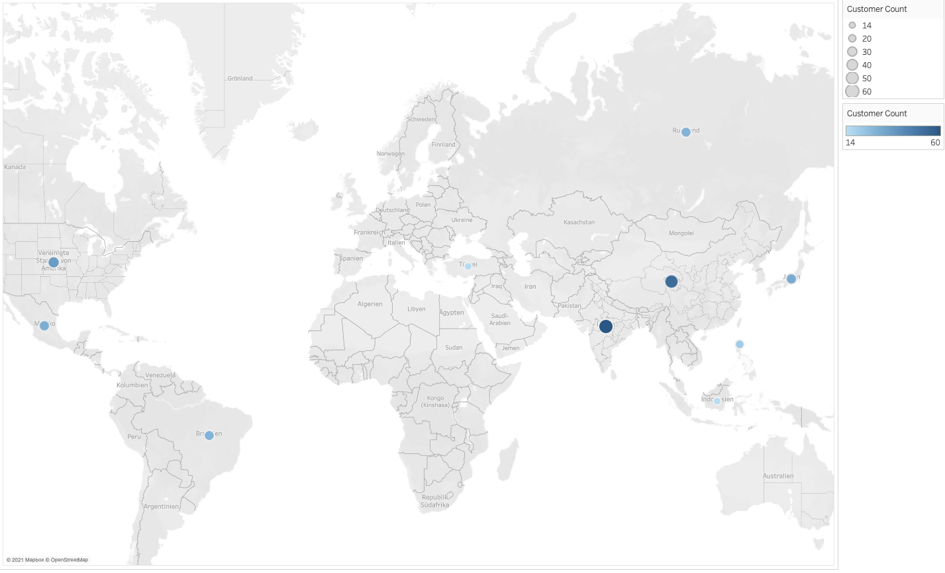
Top 10 countries in terms of customer numbers
Tableau Link

Slide 7
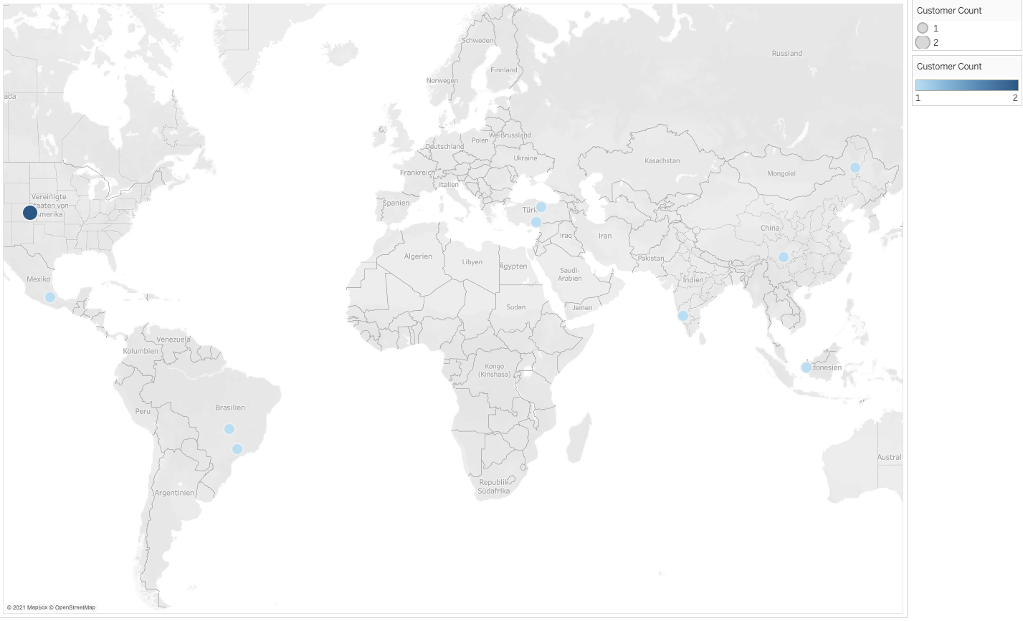
Top 10 cities within the top 10 countries
Tableau Link

Slide 8
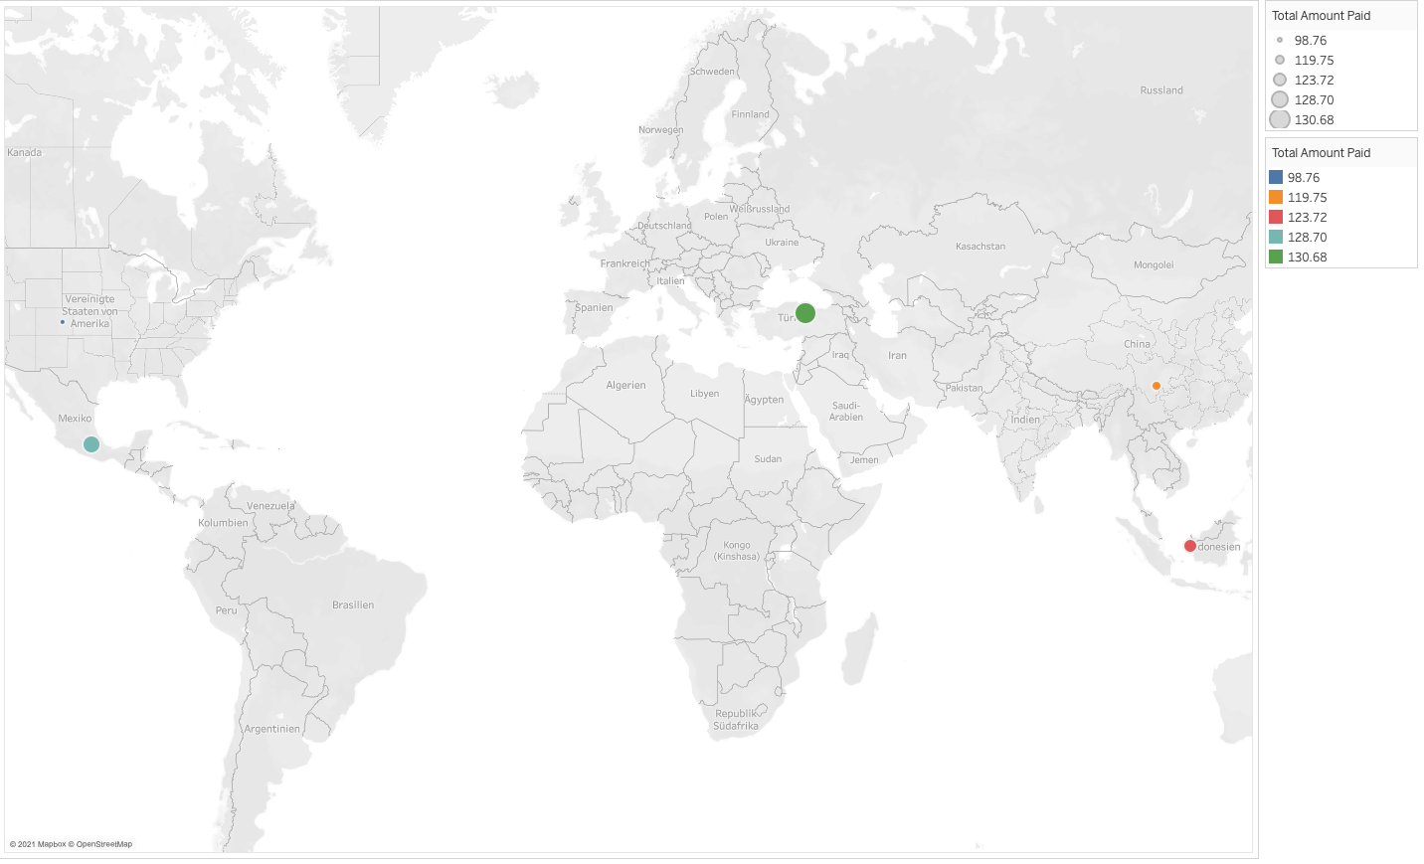
Top 5 customers in the top 10 cities
Tableau Link

Slide 9
Recommendations
To increase our profits, we should invest more in the following customers, cities, and countries:
top 10 countries for Rockbuster in terms of customer numbers
country | customer_count
India | 60
China | 53
United States | 36
Japan | 31
Mexico | 30
Brazil | 28
Russian Federation | 28
Philippines | 20
Turkey | 15
Indonesia | 14
top 10 cities within the top 10 countries
city | customer_count
Aurora | 2
Shimoga | 1
Aparecida de Goinia | 1
Emeishan | 1
Pontianak | 1
Tarsus | 1
Atlixco | 1
Zalantun | 1
Rio Claro | 1
Tokat | 1
top 10 cities within the top 10 countries
city | customer_count
Aurora | 2
Shimoga | 1
Aparecida de Goinia | 1
Emeishan | 1
Pontianak | 1
Tarsus | 1
Atlixco | 1
Zalantun | 1
Rio Claro | 1
Tokat | 1

