Slide 1
Machine Learning in Physics Ap40012
Using machine learning in detection of Pulsars

Slide 2
Outline
Dataset
Data preparation, clean, and visualization.
Feature correlation, selection, and scaling.
Apply machine learning algorithms for the topic.
Plot the results and calculate the prediction error.
Fine tune and optimize the hyperparameters.
Optimize the models and parameters for comparisons and optimizations.

Slide 3
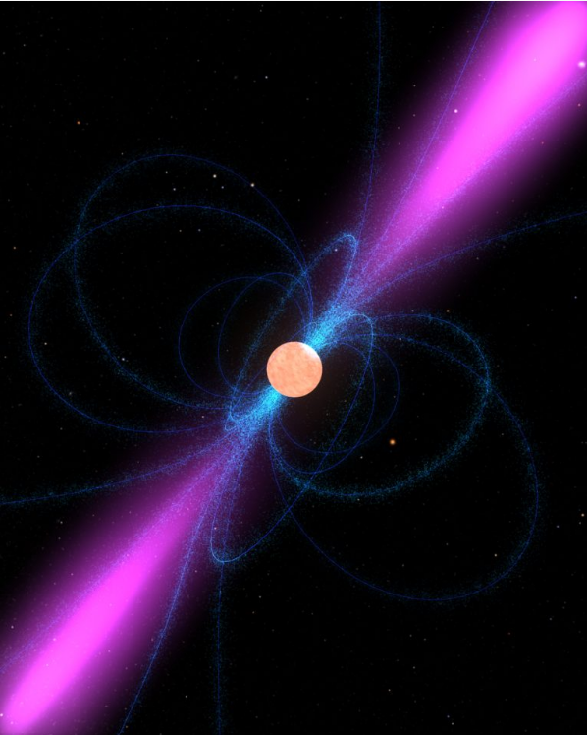
Pulsars
Rotating neutron star emitting radio signals
Due to rotation periodically recurring signal
Also background noise detected by telescops
Need to distinguish between Pulsar and non pulsar

Slide 4
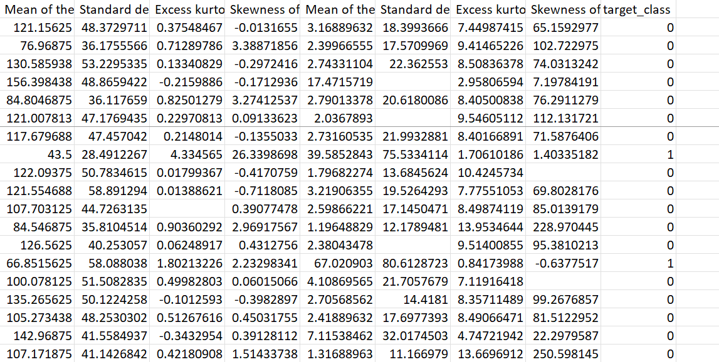
Dataset
Pulsar candidates collected during the High Time Resolution Universe Survey
17,898 total examples
Only 10% actual pulsars

Slide 5
Dataset preparation, cleaning and visualization
Dataset needs to be prepared first

Slide 6
Sources
Nieuwe methode om pulsars te ‘wegen’ (astroblogs.nl) (Pulsar)

