Slide 1
CSE 705 · Deep Learning
Architecture-dependent
deep GNN oversmoothing
A controlled analysis of depth, representation geometry, and mitigation on Cora
Kiarash Ara · Yiheng Wu · McMaster University
Notes:
Suggested timing: 0:45
Introduce the study as an empirical examination of architecture-dependent oversmoothing. The central claim is deliberately limited: increasing depth does not generate one universal failure mode. The observed accuracy, geometry, and training dynamics depend on the propagation architecture and on whether information-preserving pathways are present.

Slide 2
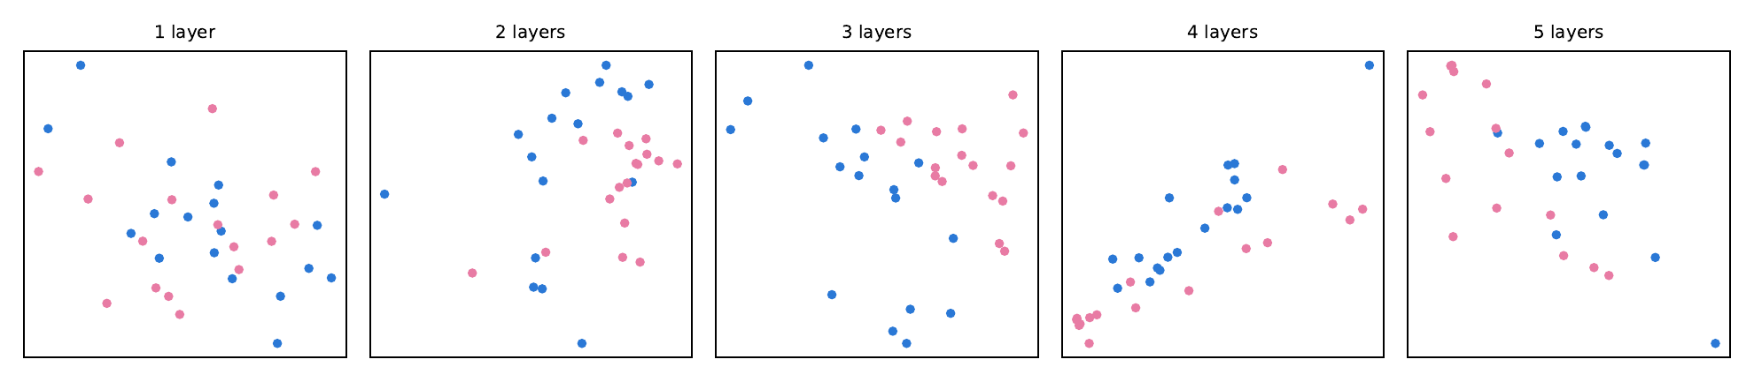
The depth–expressivity trade-off in message-passing GNNs
Message passing expands the receptive field by one hop per layer.
For a GCN, H⁽ˡ⁺¹⁾ = σ(ÃH⁽ˡ⁾W⁽ˡ⁾); repeated application of the normalized propagation operator can contract node-level variation.
The empirical question is whether this contraction produces the same failure signature across architectures.
Illustrative embedding trajectories. All substantive claims are evaluated on Cora across architectures, depths, and random seeds.
CSE 705 · CORA GNN STUDY
02
Notes:
Suggested timing: 1:20
Motivate the analysis through the depth–expressivity trade-off. Each layer increases graph context, but repeated aggregation can contract variation in the hidden state. The equation is shown for the GCN case as a representative operator, not as a universal description of GraphSAGE, GAT, or GCNII. The toy embedding panel is illustrative only; the subsequent Cora experiments provide the evidence.
[Sources]
- report/CSE705_GNN_ARAK_WU1261.ipynb — Sections 1.3 and 2.2
- figures/karate_club_collapse.pdf
[/Sources]

Slide 3
Research question and testable hypotheses
PRIMARY QUESTION
HYPOTHESES
How does depth alter predictive and geometric behavior?
Failure signatures should differ by architecture.
Across 2–32 layers, we compare accuracy, representation geometry, and layerwise dynamics under a fixed data and training protocol.
H1 Accuracy degrades non-uniformly.
H2 Geometric collapse is not equivalent across models.
H3 Effective mitigation depends on the failure mechanism.
CSE 705 · CORA GNN STUDY
03
Notes:
Suggested timing: 1:15
State the primary question and the three hypotheses before presenting results. H1 concerns predictive behavior, H2 concerns representation geometry, and H3 concerns intervention specificity. These hypotheses prevent the discussion from reducing oversmoothing to a single accuracy curve and make clear what evidence would distinguish architectures.

Slide 4
Benchmark and task specification
Cora · transductive, semi-supervised node classification
2,708
5,429
7
nodes
scientific publications
citation links
(edges)
target classes
research topics
Input dimension: 1,433 binary features · Fixed Planetoid split: 140 train / 500 validation / 1,000 test
CSE 705 · CORA GNN STUDY
04
Notes:
Suggested timing: 1:10
Define the task and the controlled benchmark. The graph, node features, labels, and Planetoid split remain fixed. Consequently, the principal experimental factors are architecture, depth, seed, and mitigation. The training set contains only 140 labeled nodes, which makes representation quality consequential without changing the evaluation protocol across runs.

Slide 5
Architectural controls isolate distinct propagation mechanisms
GCN
GraphSAGE
Symmetric normalized propagation; reference model for depth-induced contraction.
Mean aggregation with explicit self-features; separates self and neighborhood information.
GAT
GCNII
Learned attention weights; tests whether adaptive neighbor weighting delays collapse.
Initial residuals and identity mapping; purpose-built control for stable deep propagation.
CSE 705 · CORA GNN STUDY
05
Notes:
Suggested timing: 1:20
Treat the four models as controlled architectural contrasts. GCN supplies the canonical normalized propagation baseline. GraphSAGE changes the combination of self and neighborhood information. GAT introduces learned neighbor weights. GCNII is not merely another baseline; its initial residual and identity mapping explicitly address trainability and information preservation at depth.

Slide 6
Experimental protocol and reproducibility controls
01
02
03
Depth sweep
Diagnostics
Interventions
Architectures: 4
Depths: {2, 4, 8, 16, 32}
Independent seeds: 10
Test accuracy
MAD + Dirichlet energy
Epoch 0 · checkpoint · final
Residual · PairNorm
Jumping Knowledge
GCNII architectural control
CSE 705 · CORA GNN STUDY
06
Notes:
Suggested timing: 1:30
Describe the protocol as three linked analyses. The factorial sweep estimates depth trends across four architectures and five depths using ten independent seeds. Representation diagnostics are captured before learning, at the validation-selected checkpoint, and at the final epoch. The intervention analysis then tests whether common mitigation strategies recover the deep regime under the same evaluation contract.

Slide 7
Representation diagnostics: formal definitions
MAD(H)
E(H)
Cosine-distance geometry
Per-dimension variation on G̃
Dᵢⱼ = 1 − cos(hᵢ, hⱼ)
MAD(H) = mean₍Dᵢⱼ≠0₎ Dᵢⱼ
Scale-invariant; lower values indicate directional collapse.
E(H) = 1/(2p) Σ₍ᵢ,ⱼ₎∈Ẽ ‖hᵢ/√d̃ᵢ − hⱼ/√d̃ⱼ‖²
Fixed augmented graph; sensitive to representation magnitude.
The diagnostics are complementary by construction: MAD is scale-invariant, whereas energy is quadratic in magnitude.
CSE 705 · CORA GNN STUDY
07
Notes:
Suggested timing: 1:45
Define both instruments precisely. MAD is the mean non-zero cosine distance between node embeddings and is invariant to positive rescaling. Dirichlet energy is computed per feature dimension on one fixed augmented Cora graph, with degree-normalized endpoints; it changes quadratically with representation magnitude. Their disagreement is therefore interpretable rather than contradictory.

Slide 8
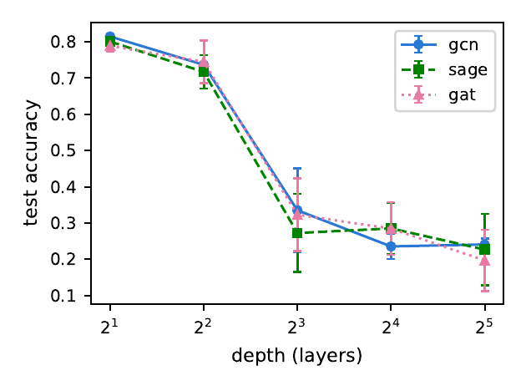
Result I — Depth degradation is architecture-dependent
Conventional architectures
GCN, GraphSAGE, and GAT attain their highest accuracy at 2–4 layers, followed by substantial degradation at greater depth.
83.26%
GCNII mean test accuracy · L = 32
CSE 705 · CORA GNN STUDY
08
Notes:
Suggested timing: 1:50
Report the first result at two levels. Conventional architectures peak in the shallow regime and deteriorate beyond four layers. In contrast, GCNII attains 83.26 percent mean test accuracy at 32 layers. The appropriate inference is not that depth is beneficial in general, but that the effect of depth is conditional on the architecture used to propagate and preserve information.

Slide 9
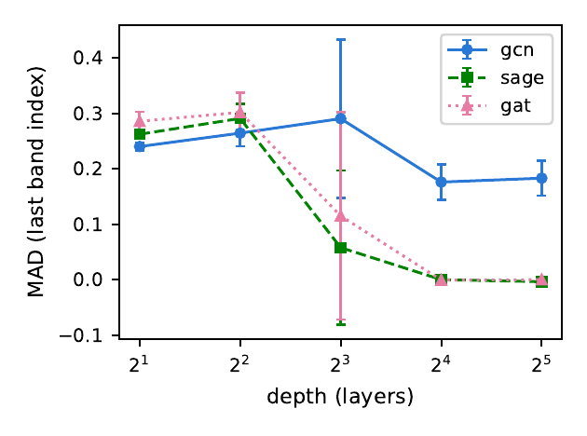
Result II — Accuracy loss and geometric collapse diverge
MAD separates two failure regimes
GraphSAGE and GAT converge toward MAD ≈ 0 at high depth, consistent with directional collapse.
GCN retains materially larger MAD despite comparable accuracy loss.
Predictive degradation is therefore not a sufficient proxy for representation collapse.
CSE 705 · CORA GNN STUDY
09
Notes:
Suggested timing: 1:40
Use MAD to reject a single-mechanism account of deep failure. GraphSAGE and GAT approach directional collapse at high depth, whereas GCN retains greater angular diversity despite losing predictive accuracy. Consequently, similar accuracy endpoints do not establish equivalent internal states, and accuracy alone cannot diagnose oversmoothing.

Slide 10
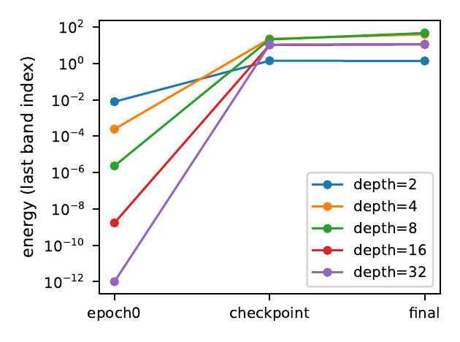
Result III — Collapse is present before optimization
Epoch 0: propagation effect
Before learning, GCN and GAT exhibit depth-dependent loss of both direction and magnitude.
GraphSAGE: metric disagreement
MAD collapses while energy remains non-vanishing, indicating directional rather than complete collapse.
Optimization changes the state
Checkpoint and final captures show recovery of variation or unstable late-layer amplification.
CSE 705 · CORA GNN STUDY
10
Notes:
Suggested timing: 1:40
The three capture points separate propagation from optimization. Epoch zero isolates architecture-dependent transformations before parameter learning. GCN and GAT already lose direction and magnitude with increasing depth, while GraphSAGE mainly loses direction. Checkpoint and final states then reveal what optimization restores, preserves, or destabilizes.

Slide 11
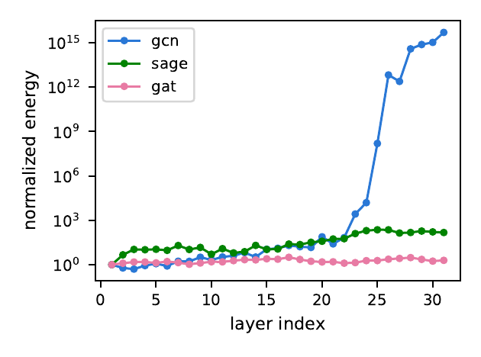
Result IV — Deep GCN contracts, then amplifies
9 / 10
seeds exhibit early-band energy collapse
at the selected checkpoint
For L = 32, normalized energy contracts across most hidden layers, then increases by many orders of magnitude near the output.
The pattern is reproducible; its parameter-level cause is not identified by this study.
CSE 705 · CORA GNN STUDY
11
Notes:
Suggested timing: 1:40
Characterize the GCN signature as a contraction–amplification transition. At 32 layers, the selected checkpoint exhibits very low energy through much of the hidden band, followed by a large increase near the output. Nine of ten seeds show the early-band collapse. The representation-level pattern is robust, but attributing it to a particular parameter or gradient mechanism would require additional causal analysis.

Slide 12
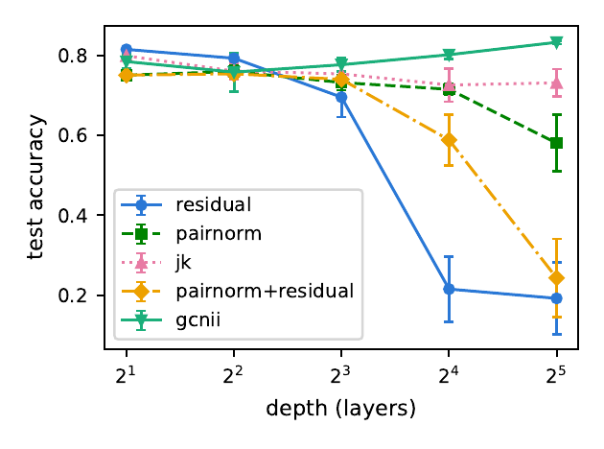
Intervention study — Jumping Knowledge gives the largest recovery
73.13%
Jumping Knowledge · L = 32
highest tested mean accuracy at L = 32
58.07%
PairNorm · L = 32
19.25%
Residual only · L = 32
CSE 705 · CORA GNN STUDY
12
Notes:
Suggested timing: 1:40
Compare interventions at 32 layers. Jumping Knowledge produces the largest tested recovery at 73.13 percent, followed by PairNorm at 58.07 percent. Residual connections alone reach 19.25 percent, and the PairNorm-plus-residual configuration reaches 24.36 percent, close to the 24.1 percent unmitigated baseline. These results support mechanism-specific rather than interchangeable mitigation.

Slide 13
Mechanistic interpretation — GCNII preserves the initial signal
Initial residuals and identity mapping alter information flow across layers
83.26%
↑
stable
mean test accuracy
at L = 32
accuracy trend
across tested depths
near-flat geometric
collapse slopes
The evidence is consistent with information-preserving paths as a prerequisite for effective depth; it does not establish a unique causal mechanism.
CSE 705 · CORA GNN STUDY
13
Notes:
Suggested timing: 1:20
Interpret GCNII as the constructive contrast. Initial residuals repeatedly reintroduce the projected input, while identity mapping limits destructive transformation across depth. GCNII reaches 83.26 percent mean test accuracy at 32 layers and maintains near-flat geometric trends. This is consistent with information preservation, although the experiment does not identify a unique causal mechanism.

Slide 14
CONCLUSIONS · SCOPE · NEXT STEPS
Conclusions and
research implications
01 Depth failure is architecture-specific, not universal.
02 Accuracy and representation geometry must be interpreted jointly.
03 Evidence is limited to Cora, one fixed split, and ten seeds.
.
Notes:
Suggested timing: 1:15
Close with three bounded conclusions. First, depth-related failure is architecture-specific. Second, accuracy must be interpreted with representation geometry. Third, the present evidence is restricted to Cora, a fixed split, and ten seeds, and it does not establish parameter-level causality. The next research step is transfer testing on larger and heterophilous graphs together with direct gradient and parameter diagnostics.

