Slide 1
Write a program using c# to print the
first n natural numbers using recursion
Respondent student: Shukirillaev Mukhammadsodik ID:202438379

Slide 2

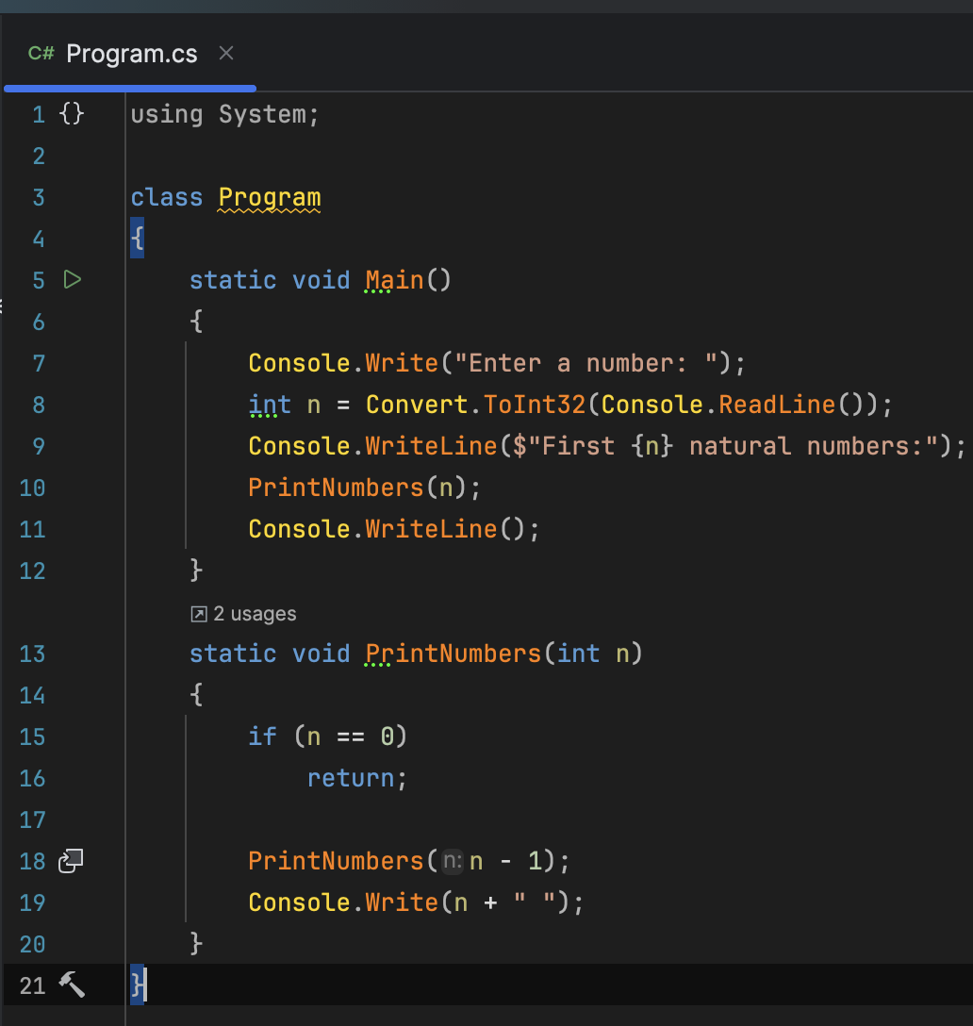
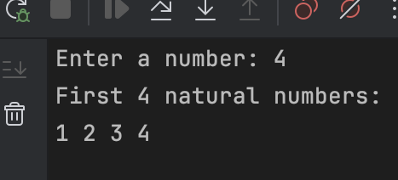
Recursion is a programming technique where a method calls itself to solve a smaller version of the same problem
It continues calling itself until it reaches a base case: a condition that stops the recursion
Notes:
condition

Slide 3
The function’s return type is
void, meaning it does not
return any value.

Slide 4
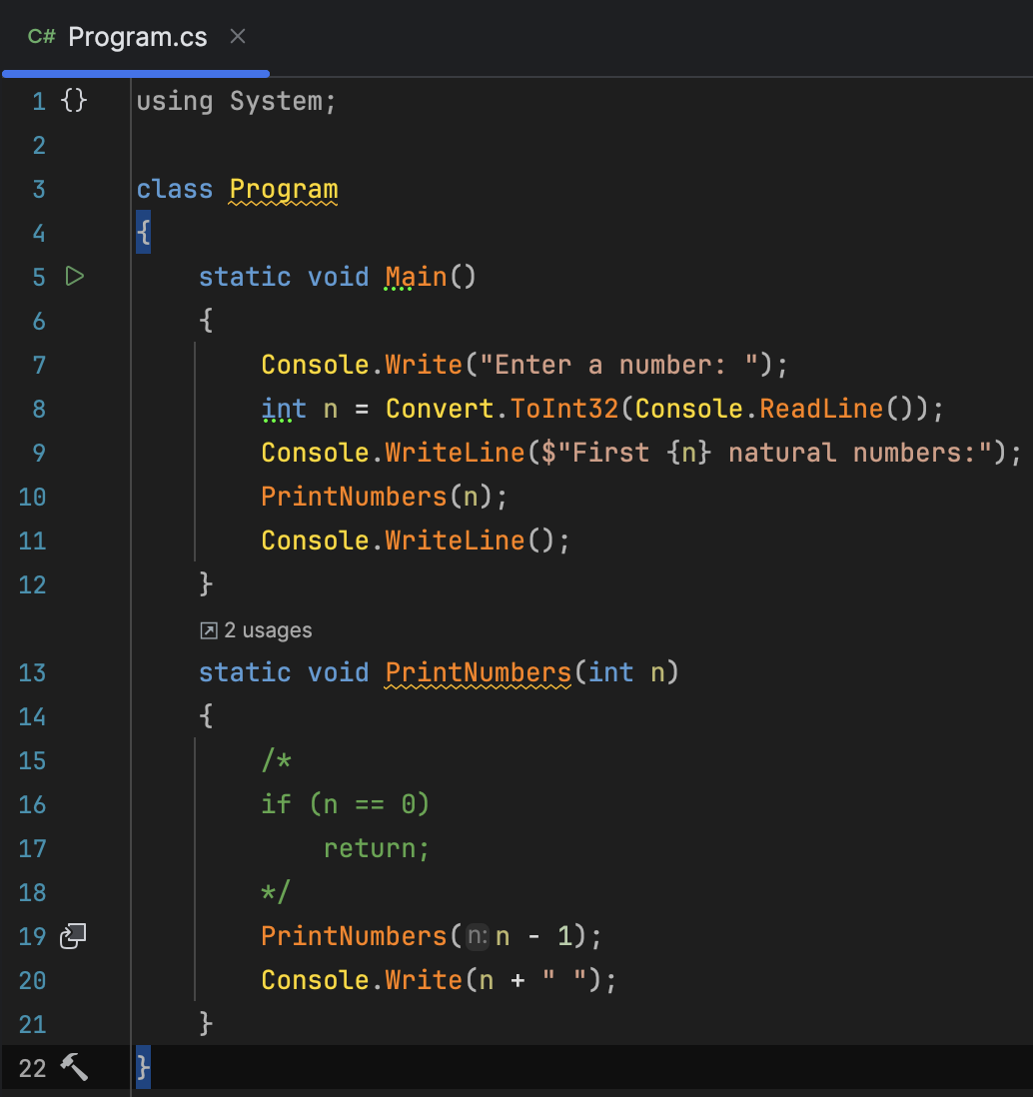
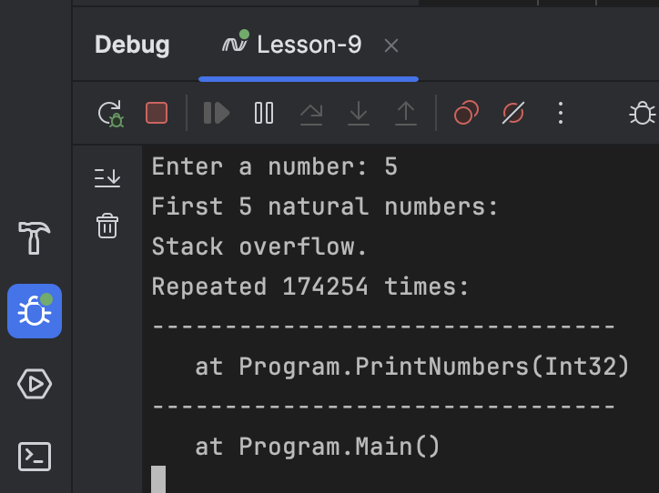
What if the condition is not deifined?

Slide 5
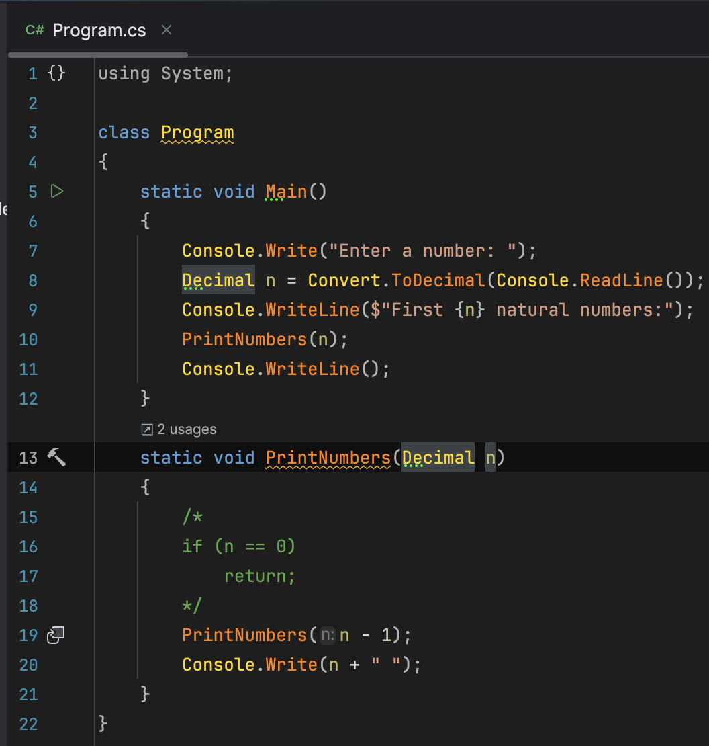
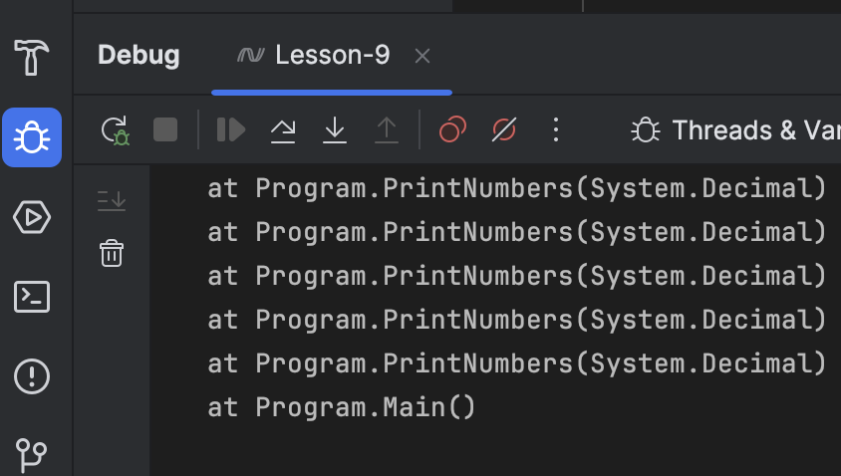
How about big numbers?

Slide 6
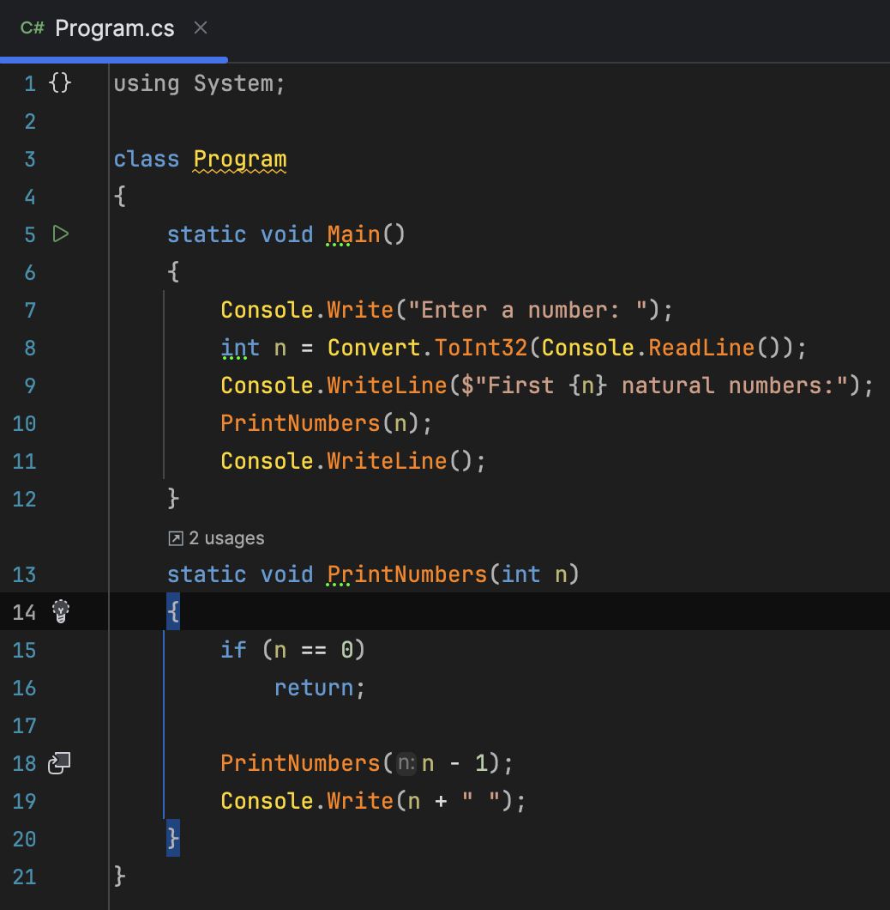
Question: What does the return
is returning in this case?

Slide 7
THANK YOU
Respondent student: Shukirillaev Mukhammadsodik ID:202438379

