Slide 1

C# Exersices
Shukirillaev Mukhammad
202438379

Slide 2

Printing two seperate lines
01
Question

Slide 3

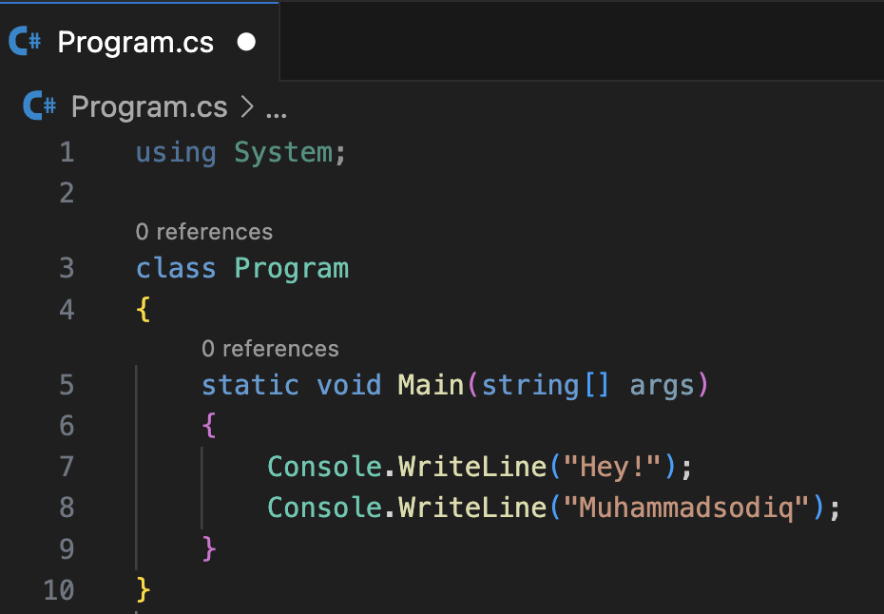


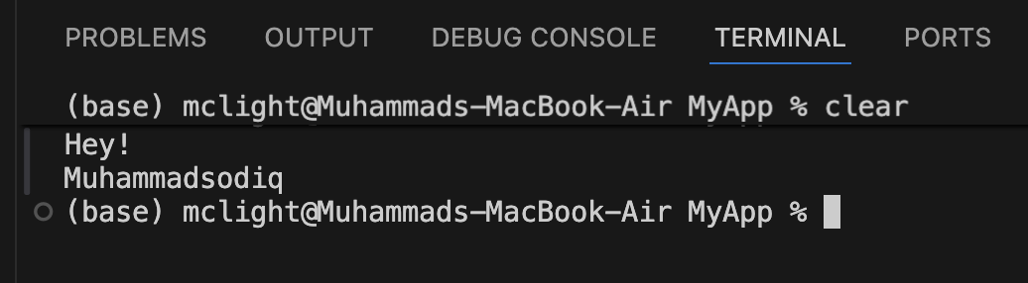
1 - question
Output:

Slide 4
Write a program to print the sum of two numbers.
02
Question

Slide 5
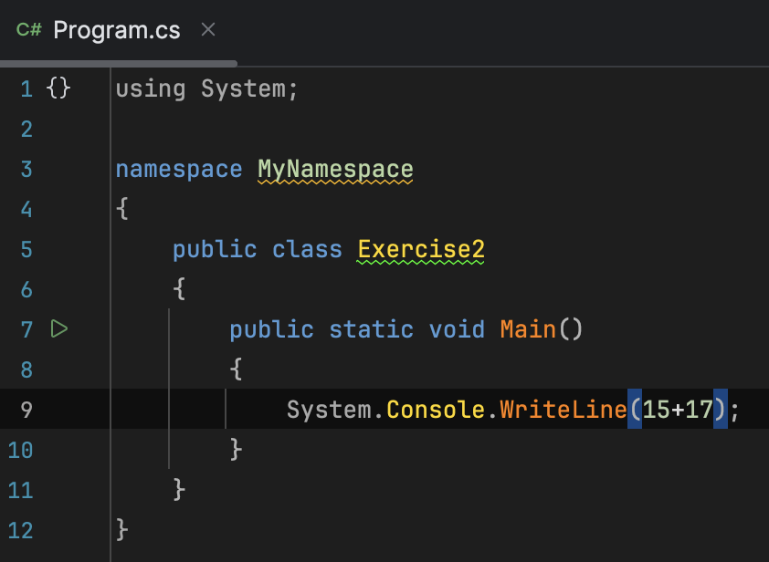
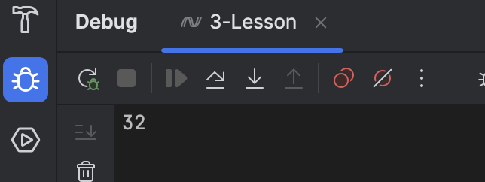
2 - question
Output:

Slide 6
Write a program to print the result of dividing two numbers.
03
Question

Slide 7
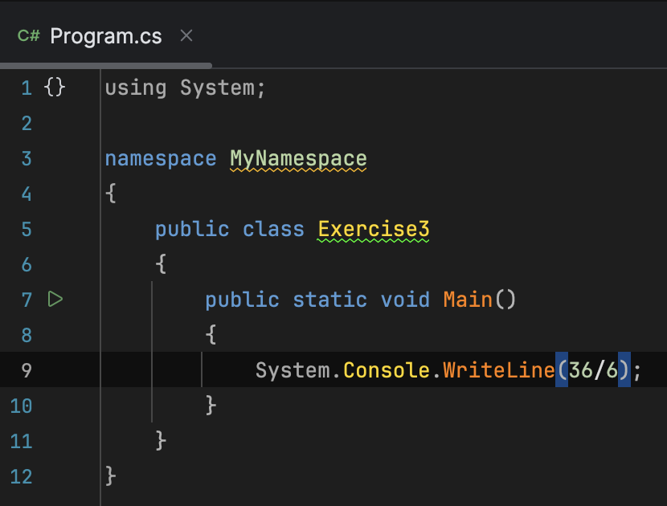
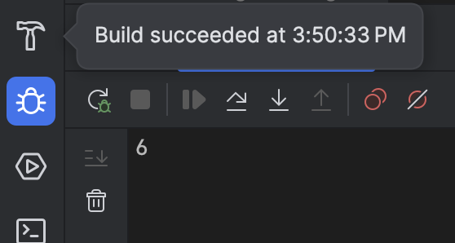
3 - question
Output:

Slide 8
Write a program to print the results of the specified operations.
04
Question

Slide 9
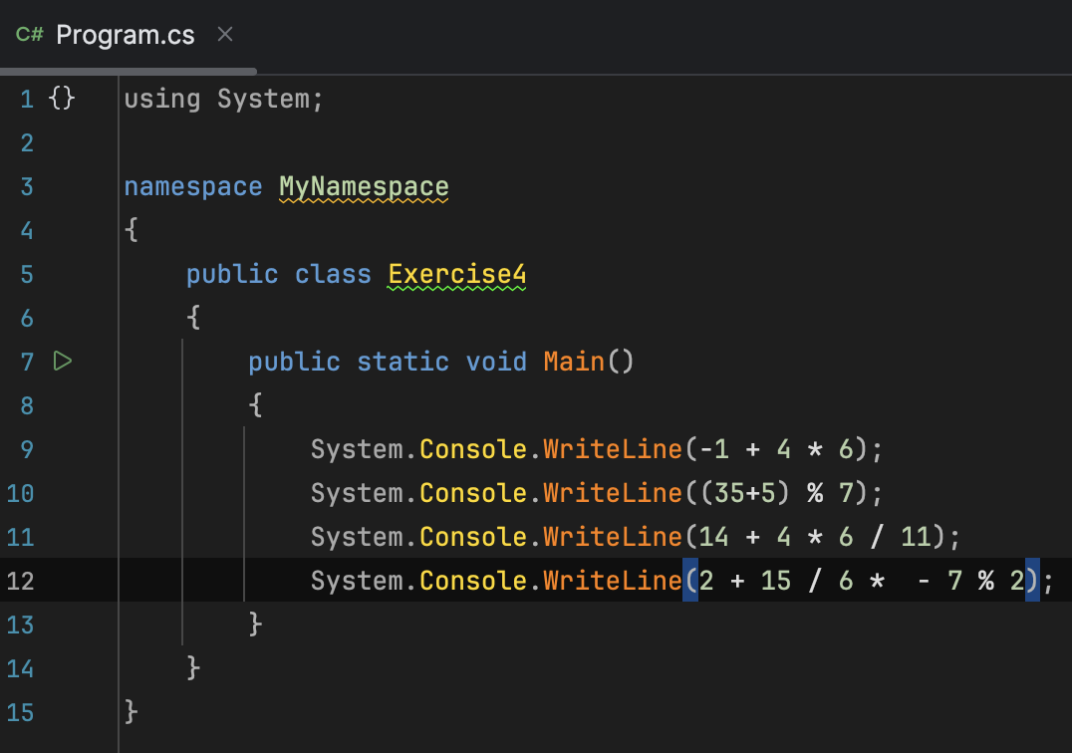
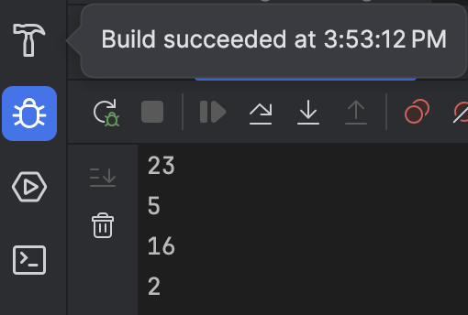
4 - question
Output:

Slide 10
Print your name (string), student number and age (int).
05
Question

Slide 11
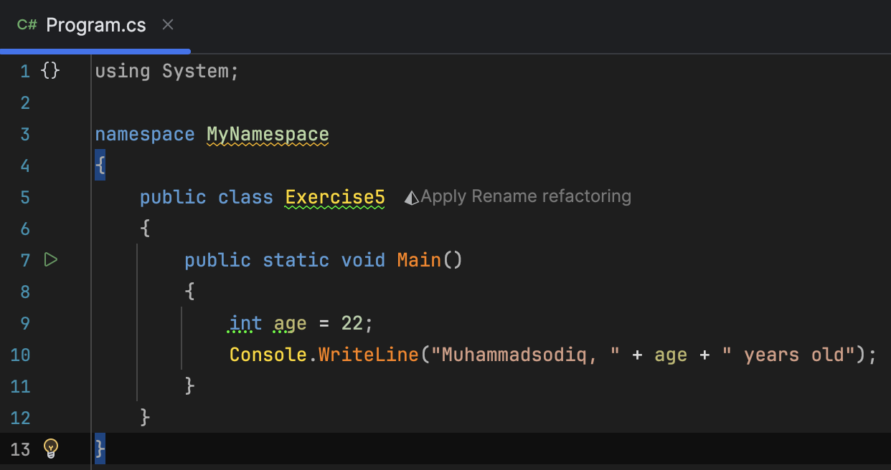
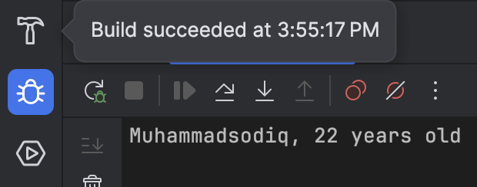
5 - question
Output:

Slide 12
Two string variables: firstName and lastName. Concatenate the strings to form the full name and print it
06
Question

Slide 13
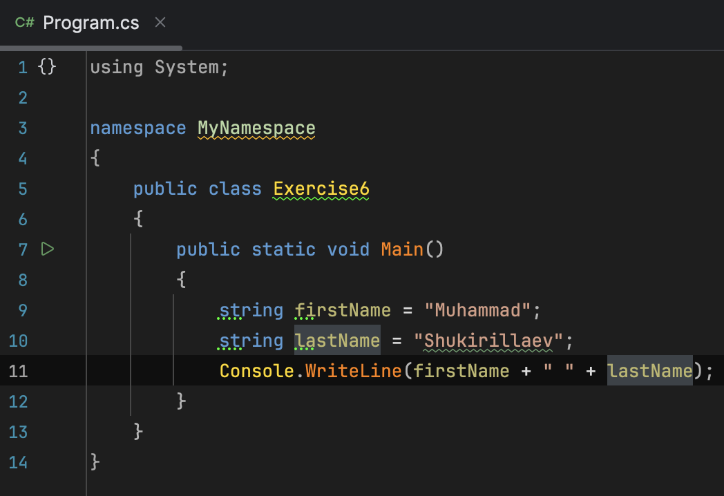
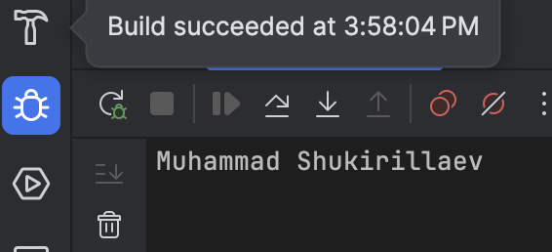
6 - question
Output:

Slide 14
THANK YOU
FOR YOUR ATTENTION TEACHER!

