Slide 1
More focus on
System.Console.WriteLine

Slide 2

Print Hello and Name. 5 minutes
Write a program to print Hello and your name in a separate line.
Output

Slide 3
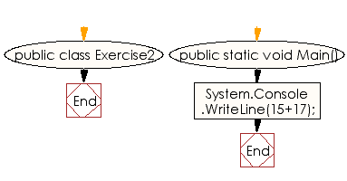
Sum of Two Numbers. 5 minutes
Write a program to print the sum of two numbers.

Slide 4
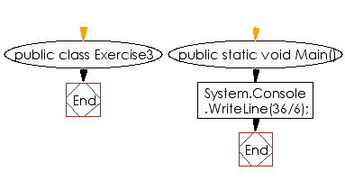
Divide Two Numbers. 5 minutes
Write a program to print the result of dividing two numbers.

Slide 5
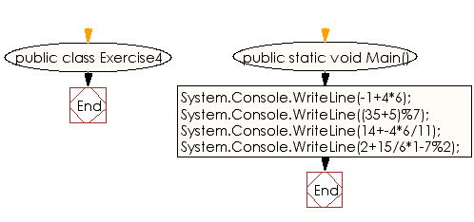
Specified Operations Results. 10 minutes
Write a program to print the results of the specified operations.
Test data:
-1 + 4 * 6
( 35+ 5 ) % 7
14 + -4 * 6 / 11
2 + 15 / 6 * 1 - 7 % 2
Expected Output:
23
5
12
3

Slide 6
Data types and variables. 5 minutes
Print your name (string), student number and age (int).

Slide 7
String Concatenation. 5 minutes
two string variables: firstName and lastName. Concatenate the strings to form the full name and print it using.
-> Sabina
-> Umirzakova
FullName: Sabina Umirzakova

