Slide 1
C#
Student: Shukirillaev Mukhammadsodik
ID: 202438379

Slide 2
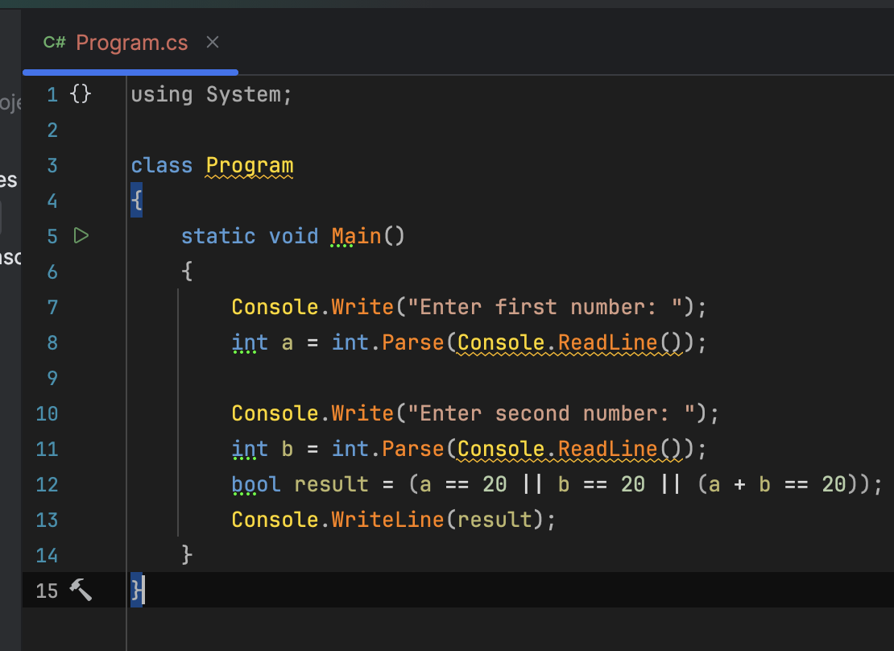
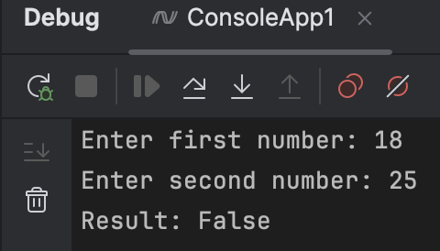
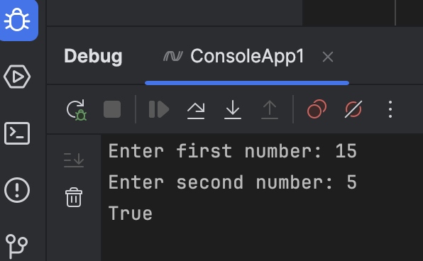
Write a c# program to check the sum of the two given integers.
Return true if one of the integers is 20 or if their sum is 20

Slide 3
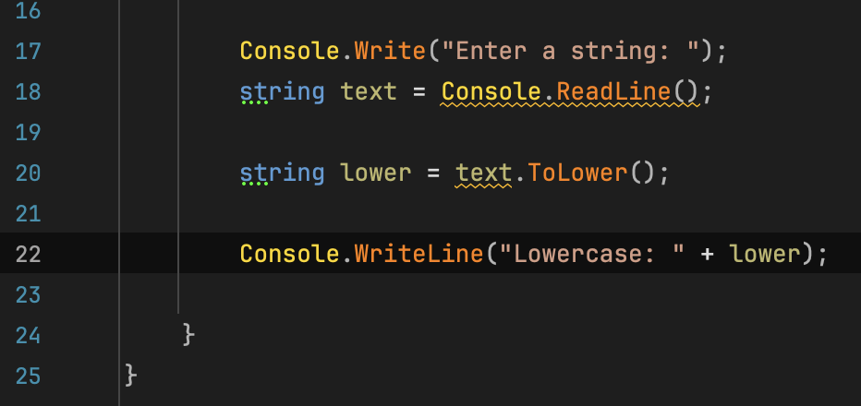
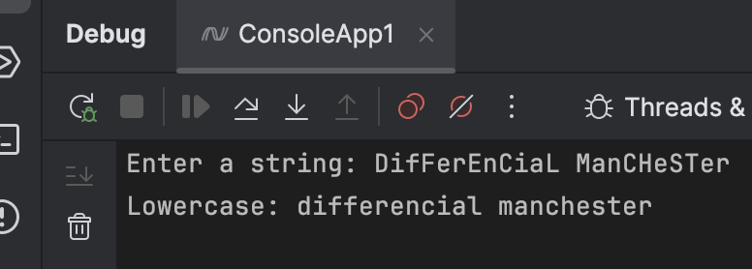
Converting given string into a lower case

Slide 4
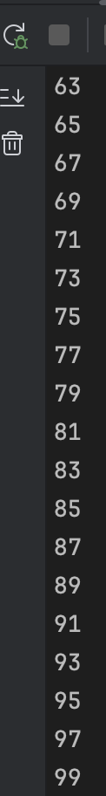
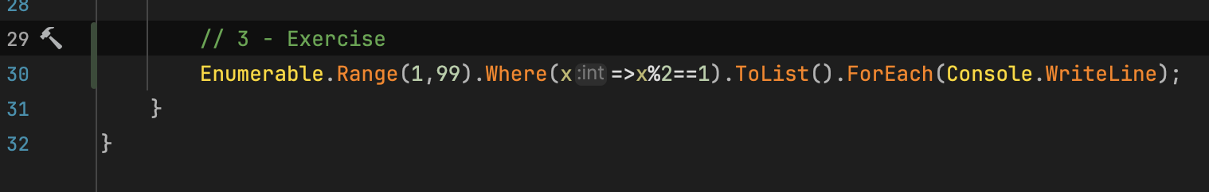
Print odd number from 1 to 99

Slide 5
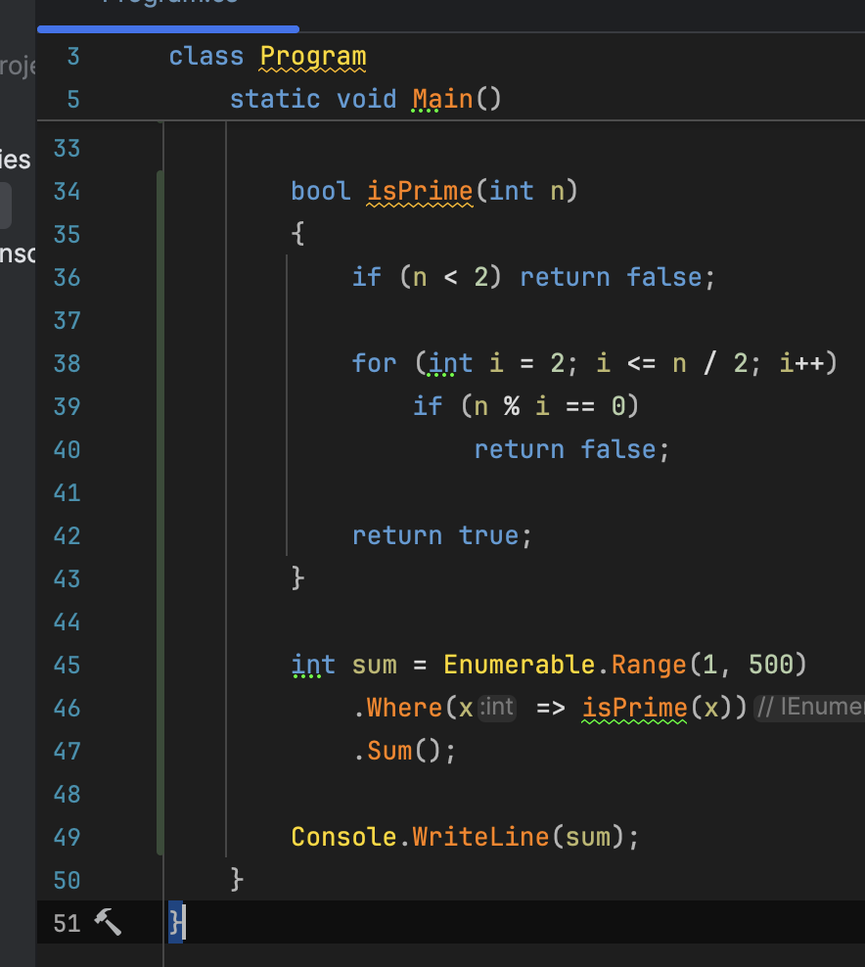
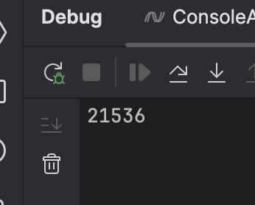

Slide 6
Thank you!

