Slide 1

Input & Output
in C#
Console.WriteLine()
&
Console.ReadLine()
Reporter: Shukirillaev Mukhammad ID: 202438379

Slide 2
CONTENTS
What is Input and Output?
Console Class Overview
Console.WriteLine() (with some examples)
Console.Readline() (with some examples)
Combination of Console.WriteLine() and Console.ReadLine()
Fun little Q&A

Slide 3




What is Input and Output?
Input
Output
Data / information received by a program from the user
Data sent by a program to the user

Slide 4

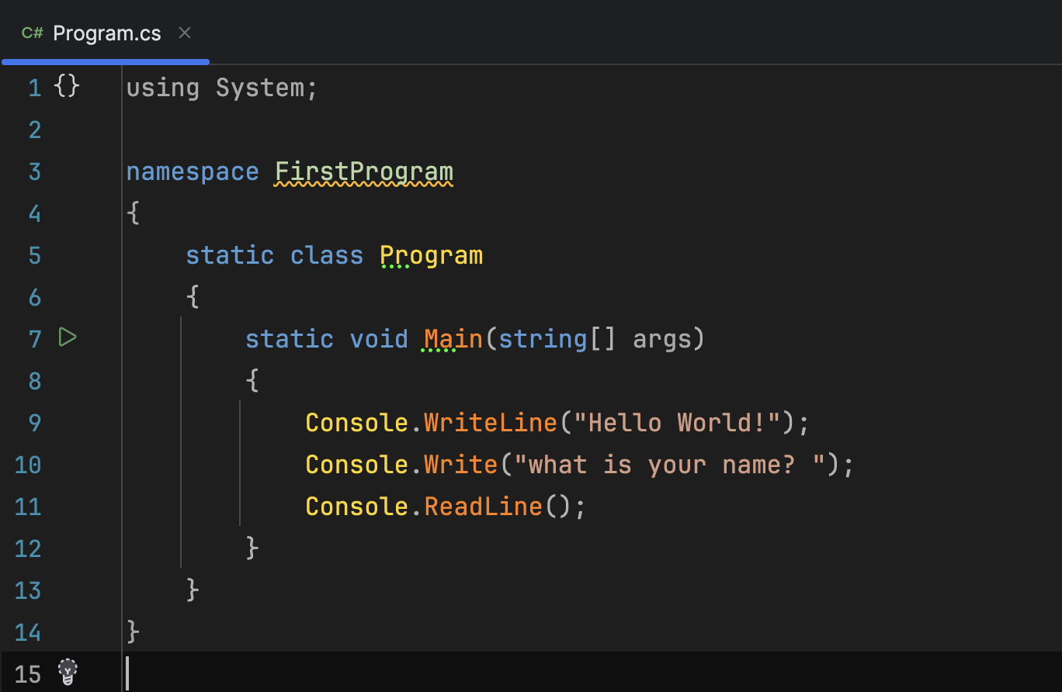
Console Class Overview
It is part of System namespace
It`s purpose is to provide the input and output in C# programs
Commonly used methods

Slide 5
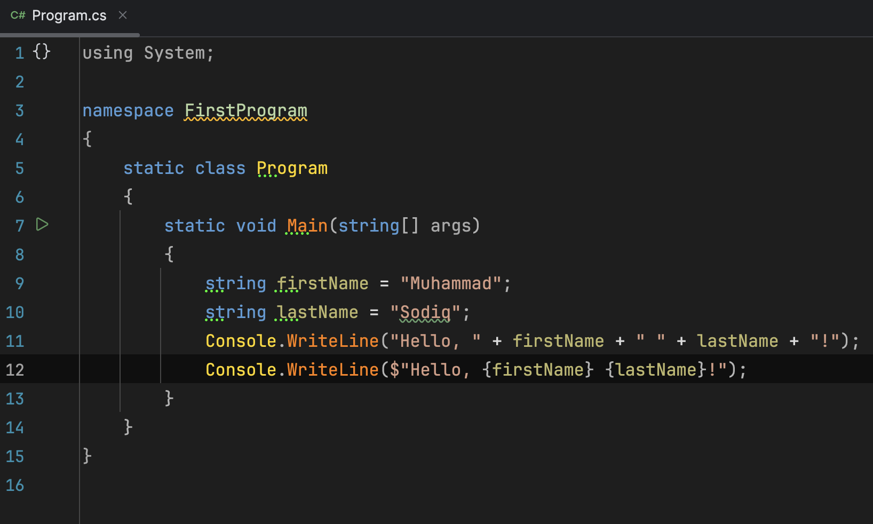
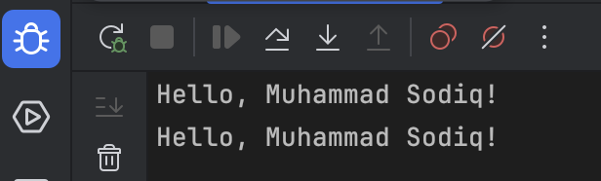
Console.WriteLine()
- Writes text followed by a newline character (automatic cursor movement to the next line)
- Supports string interpolation & concatenation
- Concatenation;
- Interpolation;

Slide 6
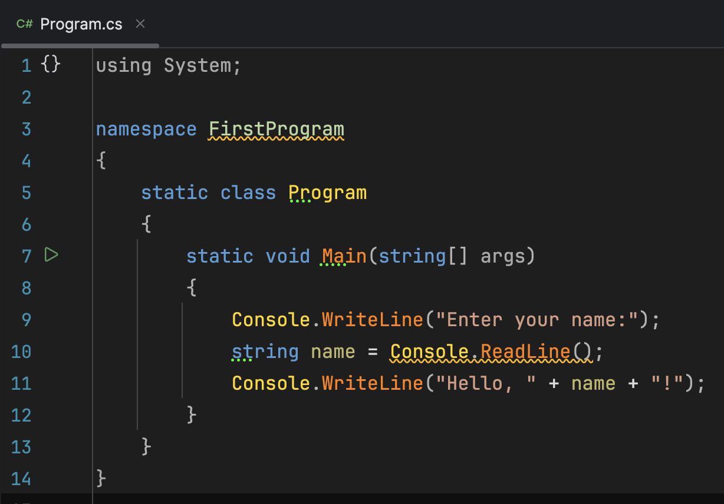
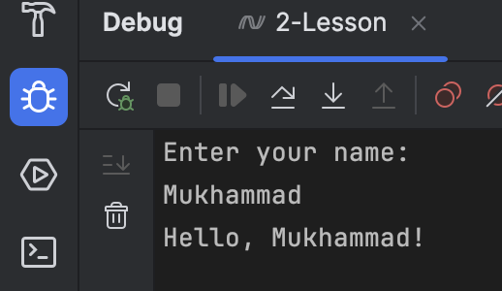
Console.ReadLine()
- Reads input from the user as a string.
(it is a method that reads a line of text input from the user)
- Mostly used to capture user information or data in console applications

Slide 7
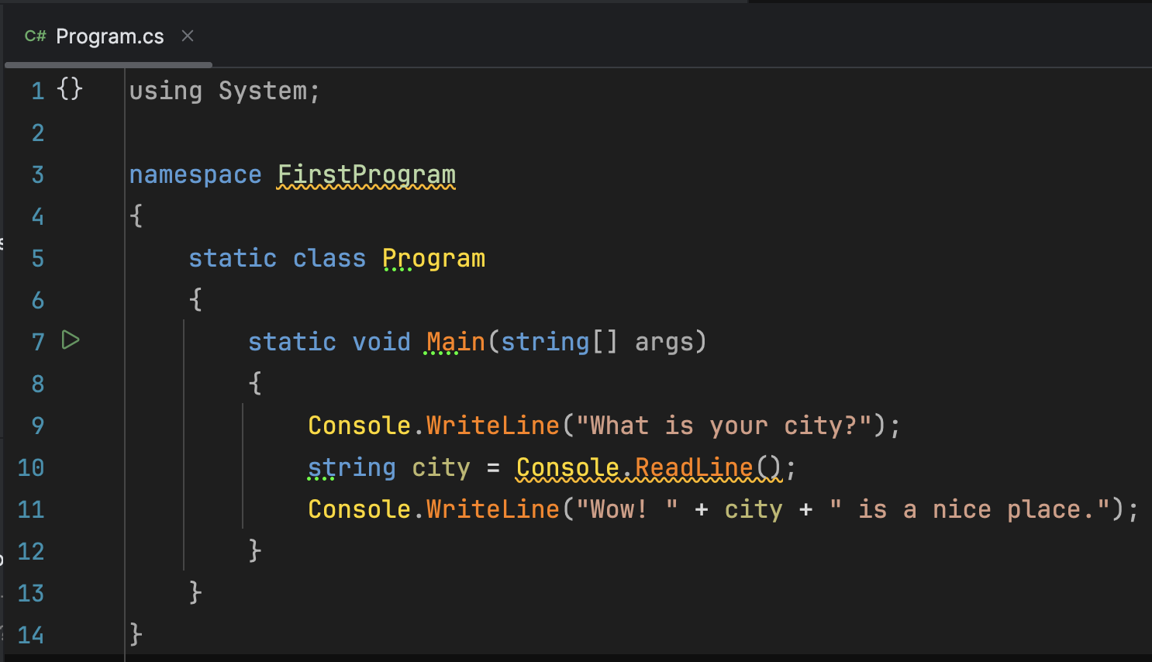
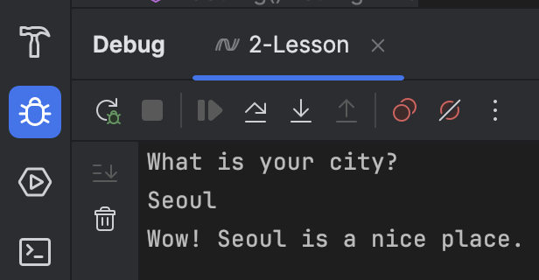
Combination of them
You can combine them and make some nice applications

Slide 8
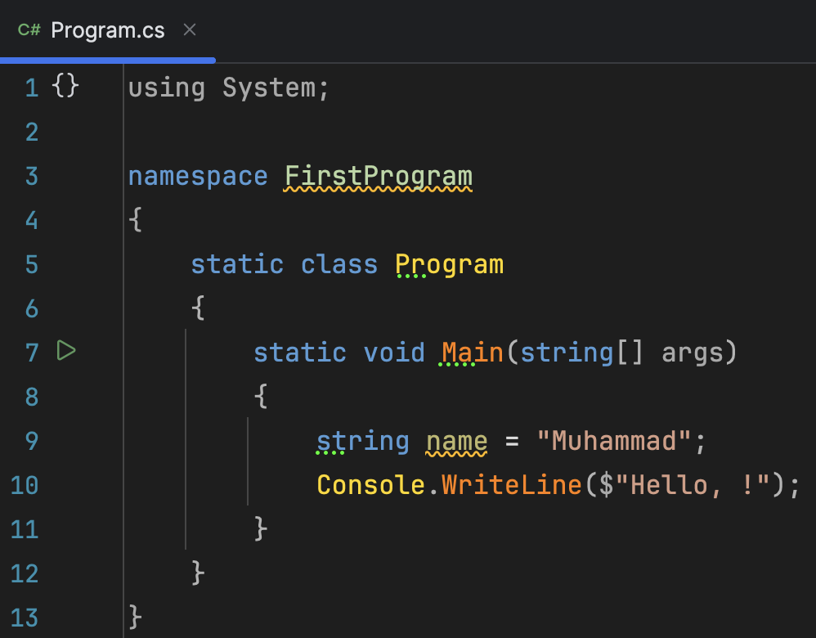

Fun Q&A
Question
What is missing?
Output:

Slide 9
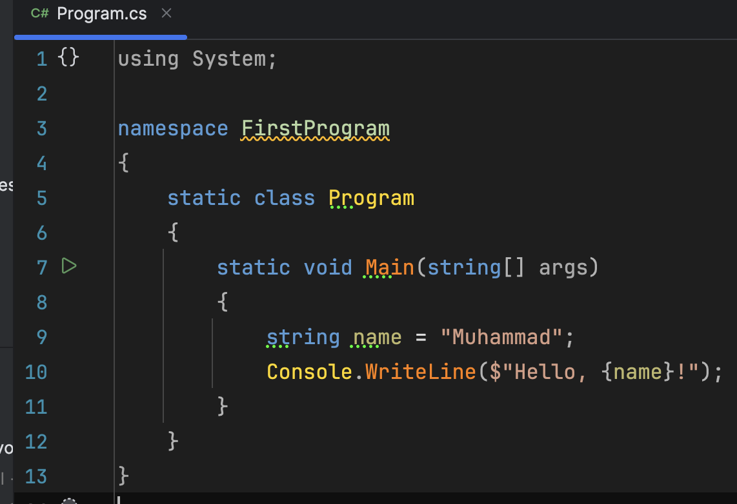
Fun Q&A
Answer
{name} variable

Slide 10
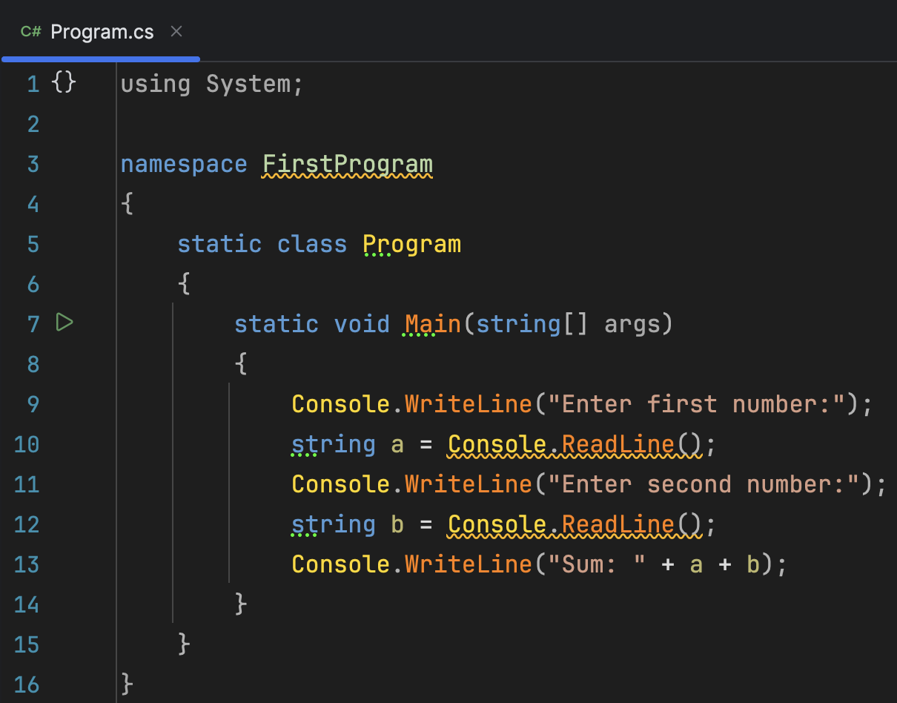
Fun Q&A
Question
What is the output if we input:
a=5 and b=10 ?

Slide 11
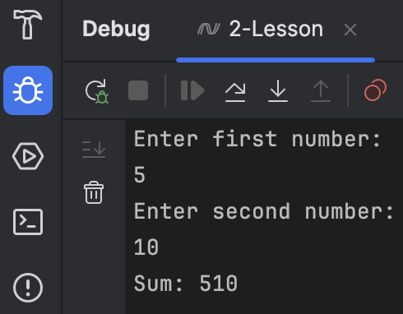
Fun Q&A
Answer
Because they are strings

Slide 12
Thank You
Everyone :)

